Slide 1
LOGO REDESIGNS
LOGO REDESIGNS
Which is better and why?
For each Logo below, look at the OLD and the NEW and decide if the new was a good redesign or a bad redesign, and then explain why you think they made these changes. All these logos were changed for a reason!

Slide 2
Which is better and why?
Old:
New:

Slide 3
Which is better and why?
Old:
New:

Slide 4
Which is better and why?
Old:
New:

Slide 5
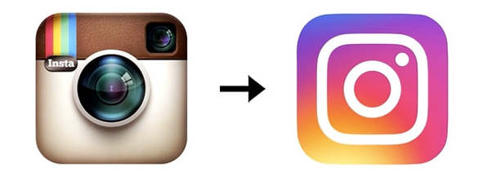
Which is better and why?
Old:
New:

Slide 6
Which is better and why?
Old:
New:

Slide 7
Which is better and why?
Old:
New:

Slide 8
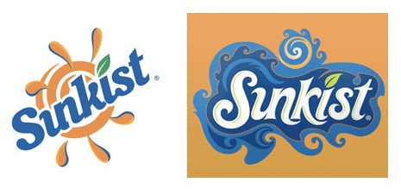
Which is better and why?
Old:
New:

Slide 9
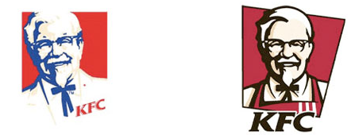
Which is better and why?
Old:
New:

Slide 10
Which is better and why?
Old:
New:

Slide 11
Which is better and why?
Old:
New:

Slide 12
Which is better and why?
Old:
New:

Slide 13
Which is better and why?
Old:
New:

Slide 14
Which is better and why?
Old:
New:

Slide 15
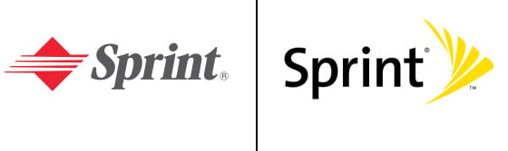
Which is better and why?
Old:
New:

Slide 16
Which is better and why?
Old:
New:

