Slide 1
Introduction to Photoshop
CTE Summer Conference
Michael Poller and Emily Scales

Slide 2
Understanding
Raster images
Adobe Photoshop

Slide 3
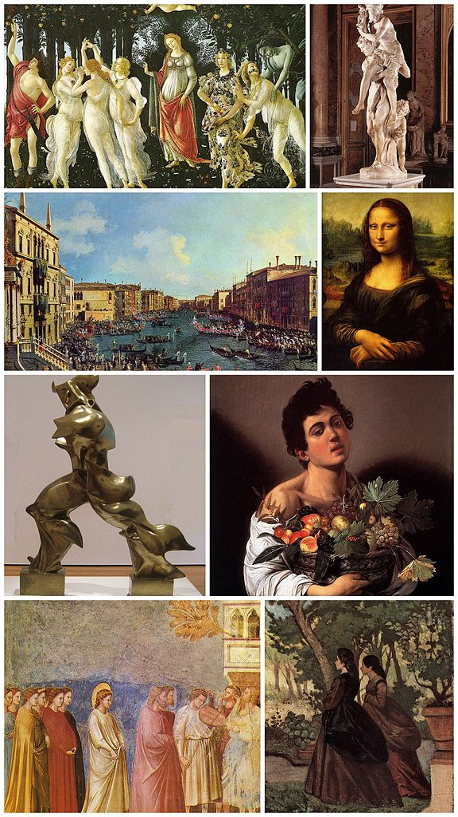
Raster Graphics
Before we dive into Photoshop it’s important to understand some basics about raster images (photographs).

Slide 4
2 Types of Graphics
Vector
Raster

Slide 5
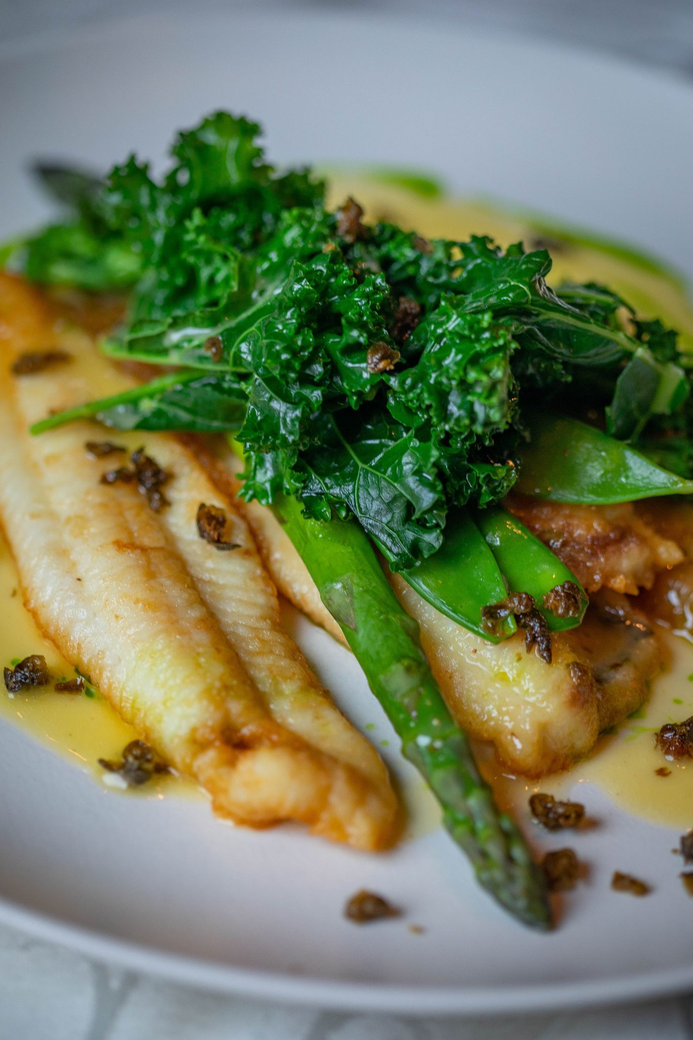
What is a raster image?
Original Image Close up of Veggies
Raster images are digital images made up of tiny individual squares of color called PIXELS.
The number of pixels in a specific space is called RESOLUTION.
The more pixels an image has, the larger the resolution, the larger an image can become before it gets blurry.
Higher resolution images have larger file sizes.

Slide 6
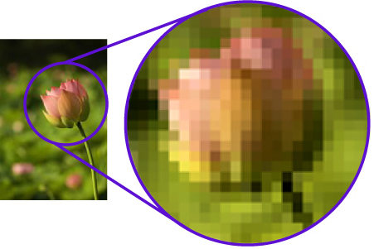
Raster Graphics
Also called Bitmap Graphic
Raster graphics are from small squares of specified color called Pixels on a grid to create a graphic image
Best for Photography
Loses clarity when zoomed in
Edited in Painting programs

Slide 7
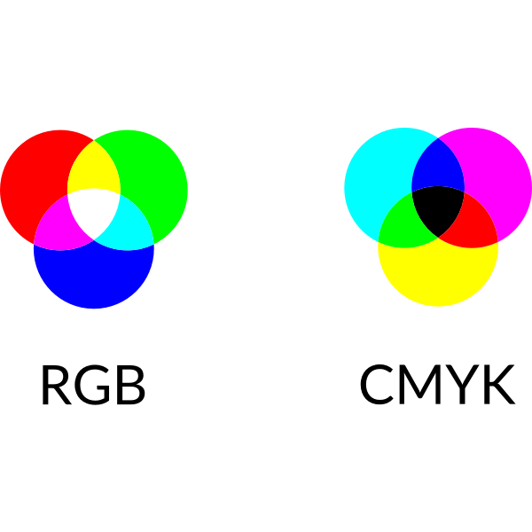
Understanding pixels
Each pixel is a square of color.
Digital images use different colors and color modes to correctly display the intended color.
RGB - Red / Green / Blue is the color mode used by screens. If you magnify a screen you can see little Red, Green, and Blue squares.
CMYK - Cyan / Magenta / Yellow / Black is the color mode traditionally used for printing purposes.
Hexcode - A six digit alphanumeric combination that is used to identify colors. For example #FFFFFF is white and #000000 is black.

Slide 8
Color Examples
Blue
Red
Green
#0000ff
RGB (0,0,255)
C: 100%
M: 100%
Y: 0%
K: 0%
#fe0200
RGB (255,0,0)
C: 0%
M: 100%
Y: 100%
K: 0%
#28ff00
RGB (0,255,0)
C: 100%
M: 0%
Y: 100%
K: 0%

Slide 9
Why does this matter?
95% of work in Photoshop is deleting, hiding, or changing pixels. If you make an image brighter, you change the color of the pixels. If you make an image darker, you change the color of the pixels. If you remove a background you erase or hide pixels. If you crop an image you delete pixels. If you remove skin blemishes…you guessed it, you change the color of the pixels to match surrounding pixels.
A lot of the magic of Photoshop is the program knowing what pixels have what colors and using that information to make changes for the user. Since colors are just numbers, Photoshop can identify those numbers (and similar numbers) and use that information to make changes.

Slide 10
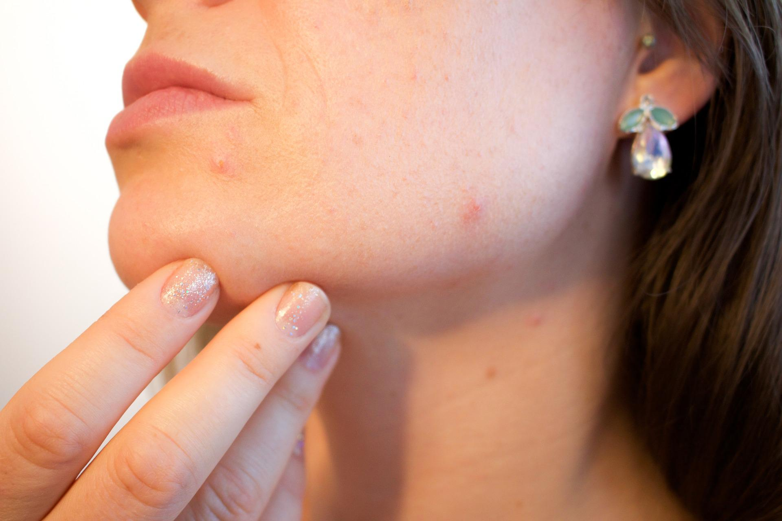
Photoshop in Action
These two images demonstrate the magic of Photoshop. Using the “Healing Brush Tool” allows the user to remove skin blemishes. All that’s changed are the color of the pixels. Photoshop knows what colors to remove and what colors to replace them with.
Some user input is still required!

Slide 11
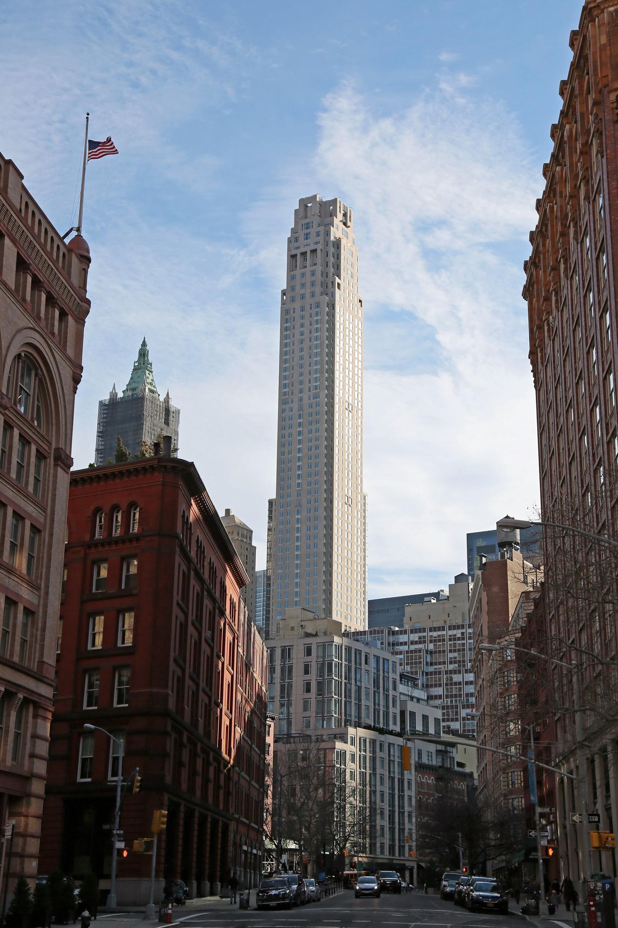
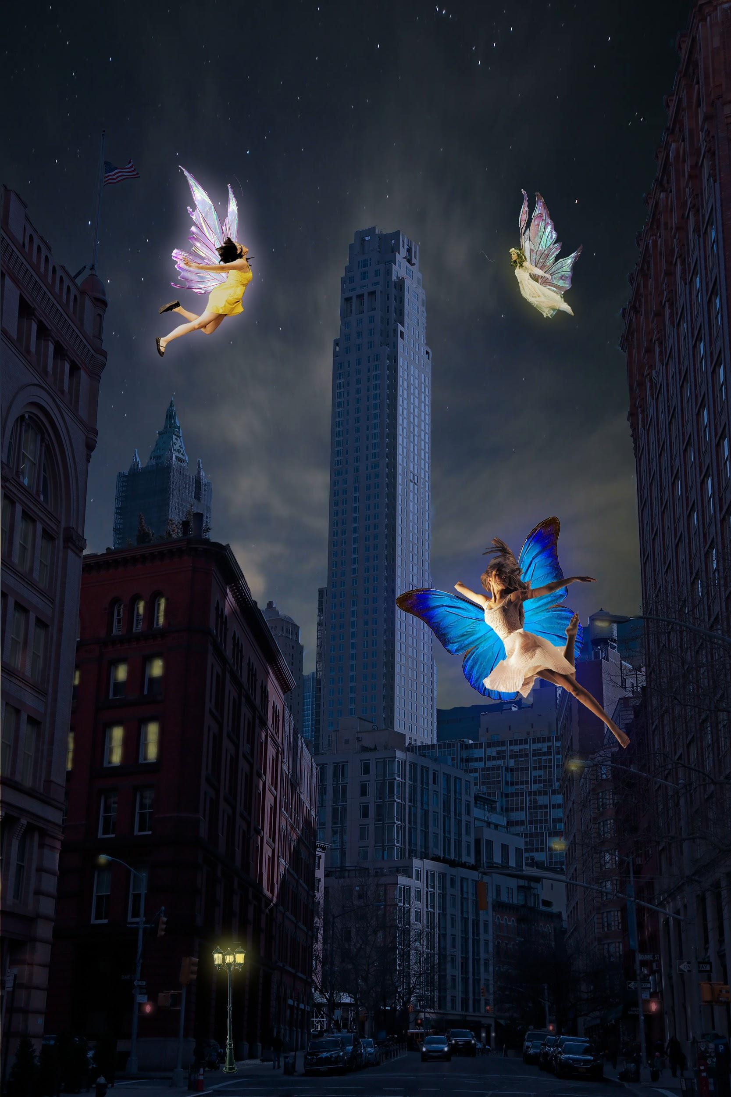
Photoshop Basics
AFTER
BEFORE
After

Slide 12
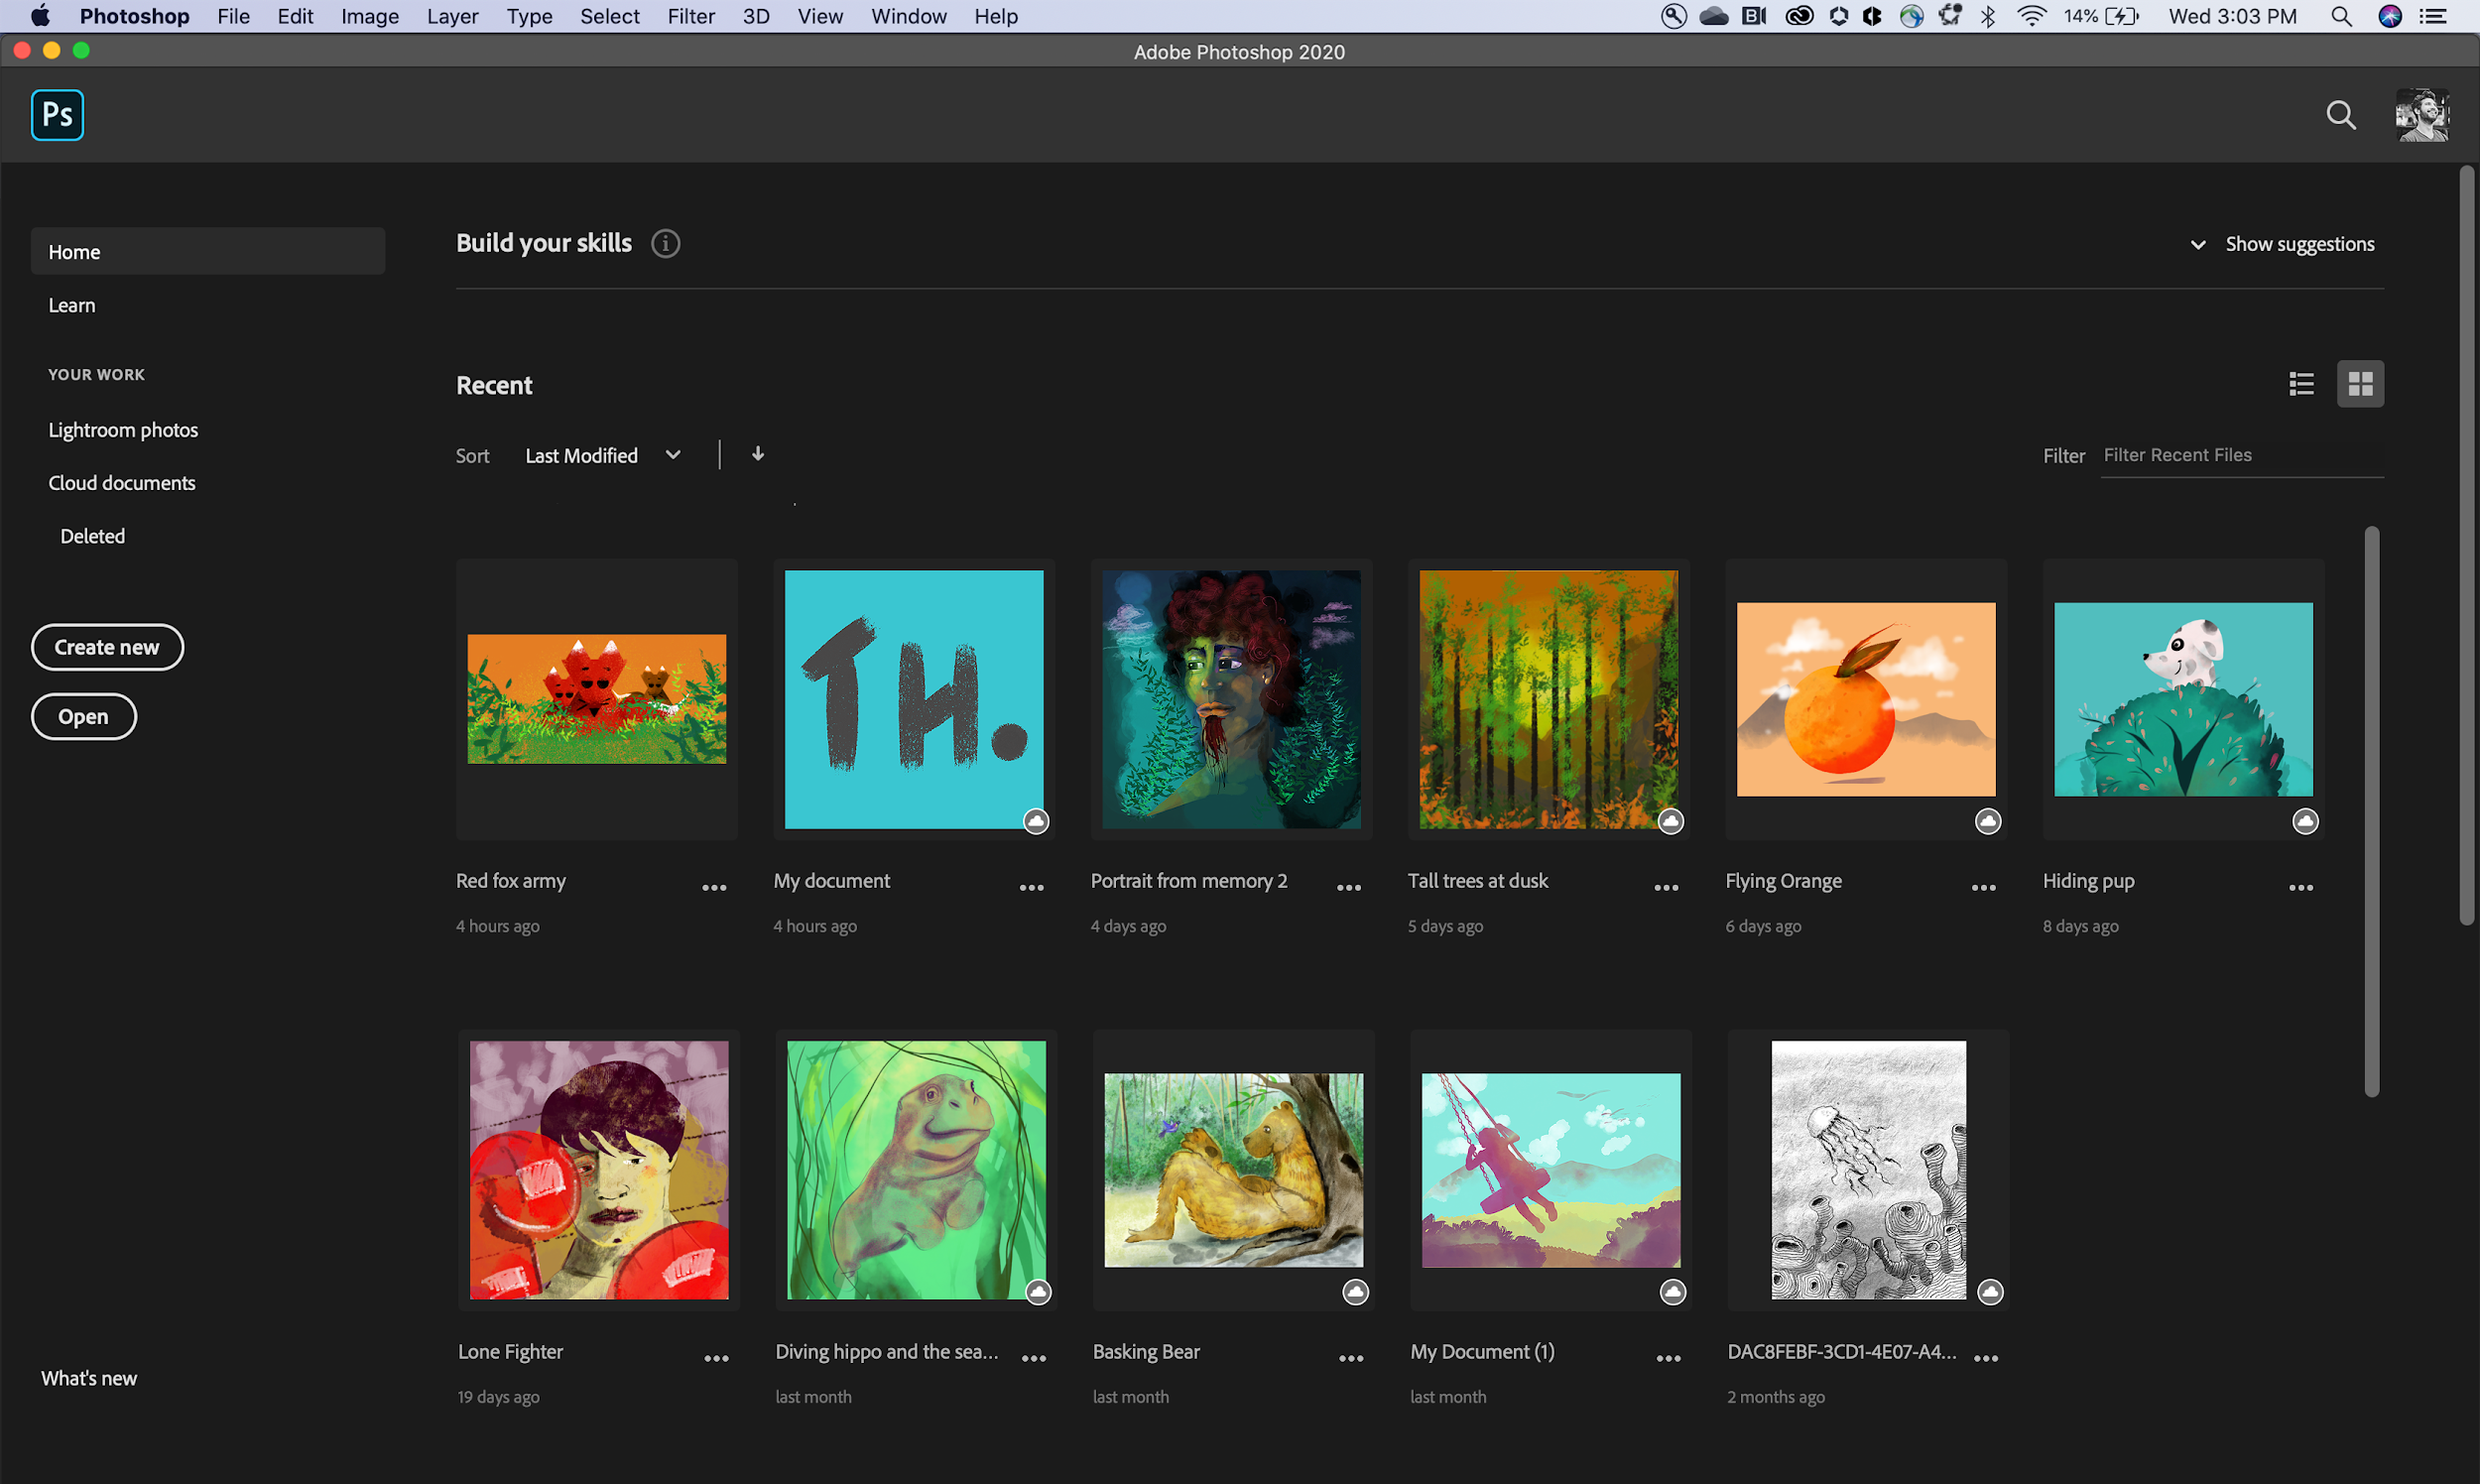
The Home Screen:
Create a New Document
There are two ways to create a new document. 1.) Click “Create New” after the program loads. 2.) File > New (using the menu bar at the top of your screen)
Open a File
There are two ways to open a file. 1.) Click “Open…” after the program loads. 2.) File > Open (using the menu bar at the top of your screen)
Recent
Displays your recent images and projects as tiles in a grid format. The tiles show a preview of what the project looks like.

Slide 13
Questions to ask before you begin:
Is this meant for the screen or print?
How large should my image be?
What resolution should it be?
What file naming structure can I use to easily locate my files?

Slide 14
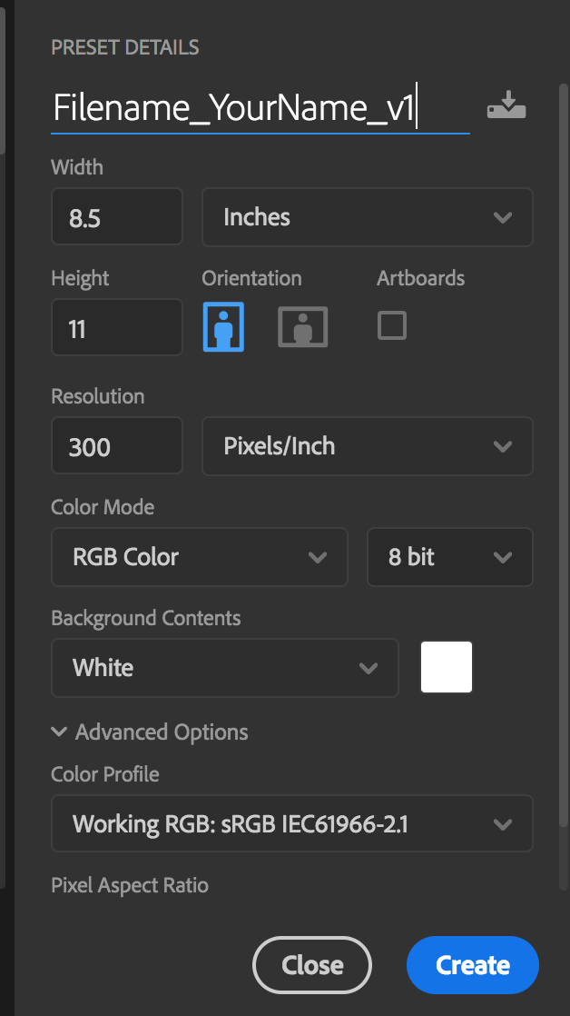
Creating a New Document
Project Name
The title of your project. When you save, it will default to the Project name and add the proper file extension to it.
Image Size
Determines the size and resolution of your canvas. You can change units of measure (i.e. pixels, inches, picas, etc.) in the drop down to the right.
Orientation
Portrait is when the image is taller than it is wide. Landscape is when the image is wider than it is tall.
Color Mode
Limits the amount of colors available to match the output settings of your project. For instance, RGB color is meant for screens; whereas CMYK is meant for printers.
Background Contents
The bottommost layer in the Layers palette, the background layer is always locked (protected), meaning you cannot change its stacking order, blending mode, or opacity (unless you convert it into a regular layer).

Slide 15
Photoshop Layout:
Options Bar: displays options for the currently selected tool.
History Panel: jump to any recent state of the image created during the current working session. Each time you apply a change to an image, the new state of that image is added to the panel.
Color/Swatches/Properties Panel: Choose your color, select one from one of your swatches or view and adjust any of your properties depending on the tool you use.
Tools Panel: contains tools for creating and editing images, artwork, page elements, and so on. Related tools are grouped.
Document Window: displays the file you’re working on. Document windows can be tabbed and, in certain cases, grouped and docked.
Layers Panel: lists all layers, layer groups, and layer effects in an image. You can use the Layers panel to show and hide layers, create new layers, and work with groups of layers.
Adjustments Panel: tools for making color and tonal adjustments The adjustments you make using the controls and options create non-destructive adjustment layer.
A
B
c
D
E
F
G

Slide 16
The Toolbar
Photoshop has a lot of tools that you can use. These tools can be accessed through the “Tool Bar” [usually found on the left]. If you do not see the toolbar, you can load it by going to Window > Tools at the menu bar on the top of your screen.
Tools are grouped together with similar function. If you click and hold the icon on the toolbar, a dropdown will appear with other possible tools. You can also access these tools using keyboard commands (by holding “Shift” + [the proper keyboard letter]. By doing so it will toggle between all of the tools in that category. The default tools are defined in the next page.
Each tool changes the “Control” panel options (located above your “Document Window”). You can also see a change in the cursor icon to let you know what tool is being used [as well as the cursors size & shape}.
Cursor examples:
Move Cursor
Magic Wand Cursor

Slide 17
Move (V)
Marquee (M)
Lasso (L)
Quick select (W)
Crop (C)
Eyedropper (I)
Spot heal (J)
Brush (B)
Stamp (S)
History brush (Y)
Eraser (E)
Gradient (G)
Blur
Dodge (O)
Pen (P)
Text (T)
Path Selection (A)
Rectangle (U)
Hand (H)
Zoom (Z)
Quick mask (Q)
Tools:
Move a selection or an entire layer
Select rectangles, ellipses, and 1‑pixel rows and columns.
Draw freeform segments of a selection border.
"Paint" a selection using a brush tip. The selection jumps to edges of shapes.
Crop or straighten photos.
Select a color from an area within your image.
Correct imperfections, causing them to disappear into the image
Applies color with brushstrokes in a variable tip.
Copies pixels to a new location in the image.
Paints a copy of the selected state into the current image window.
Changes pixels to the background color or to transparent
Creates a gradual blend between multiple colors
Blurs hard edges in an image.
Lightens areas in an image.
Lets you draw smooth lined paths.
Create type on an image.
Make shape or segment selections showing anchor points, direction lines, and direction points.
Draw shapes and lines in a normal layer or shape layer.
Moves an image within its window.
Magnifies and reduces the view of the image.
A red overlay appears as you make a selection. You can paint and refine your selection.

Slide 18
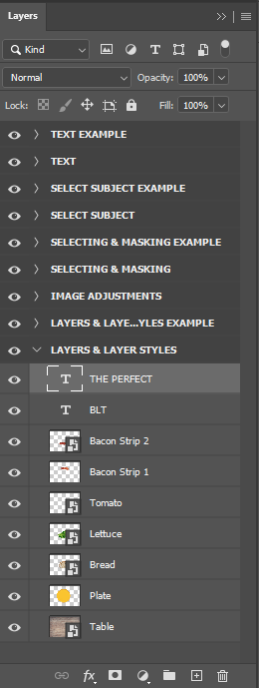
Layer & Layer Styles
Layer Opacity & Blend Modes
Layers
Layers are one of the core features of Photoshop. Every image, graphic, article of text, etc. can be placed on its own so it can be moved, edited, and adjusted individually. Layers can be renamed, grouped, or locked to assist according to the users discretion.
Stacking order
The stacking order is the order the layers appear in. Layers at the top of the layers panel appear above other layers in your image
Opacity and Blending Modes
Opacity is how transparent a layer is. At 100% opacity the layer isn’t transparent at all. At 0% opacity the layer is invisible. Blend modes adjust how layers interact with each other.
Layer Styles
Layer styles are effects and styles that can be applied to layers to alter their appearance. Styles include Stroke, Drop Shadow, Outer Glow, Bevel & Emboss, & Color Overlay. Layer styles help add depth, dimension, and interest in a design. Layer Styles can be edited after they are applied to an image.
Layer Name
Layer Visibility
Layer Styles

Slide 19
Layer & Layer Styles
Layers Types
Different types of layers are identifiable by the thumbnail image in the layers panel. An editable text layer thumbnail is a capital T. An image layer shows the actual image in the thumbnail.
Smart Objects
Smart objects are layers where certain edits are toggleable. With smart objects, you can hide and rework edits that would be permanent on non smart objects. Smart objects are identified by the little icon at the bottom right of the thumbnail.
TEXT layer
IMAGE LAYER
SMART OBJECT

Slide 20
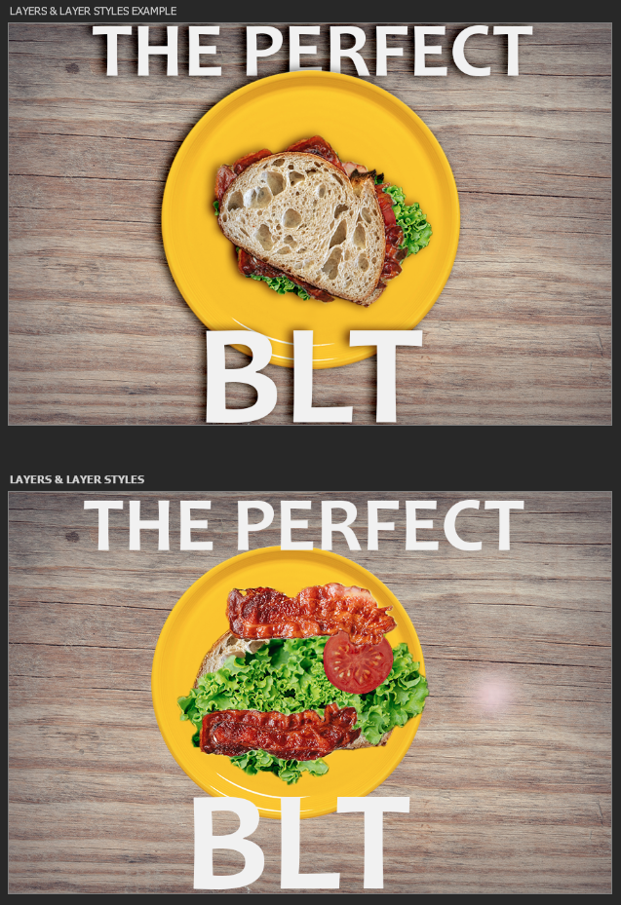
Layer & Layer Styles
Goals
Your goal for the layering activity is to try to make the lower artboard match the upper artboard. Use the layers panel to move, rename, & duplicate the sandwich ingredients to best create “The Perfect BLT”. You will need to adjust the stacking order of the layers by dragging layers above and below each other.
Tools
You will need to use the MOVE (V) tool to help move images.
To adjust the scale and rotation of images you need to use the TRANSFORM TOOL (CTRL+T) / EDIT > FREE TRANSFORM. In the free transform tool you can scale, rotate, skew, and adjust your images as you see fit.
Layer Styles
After you organize your sandwich as best as possible, select the plate layer, navigate to the layer styles options, and add a drop shadow. Then add that drop shadow to each layer that needs a drop shadow.
Move Tools
The MOVE TOOL (V) is located at the top of your tools panel.

Slide 21
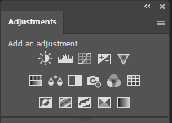
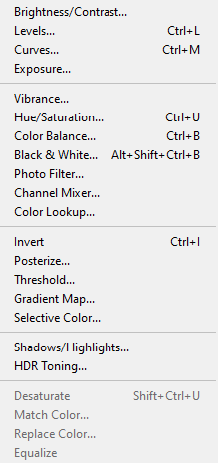
Image Adjustment
Adjustments MENU
Adjustments Panel
Image Adjustments
Photoshop is able to “adjust” image in a variety of different ways. It can adjust brightness, contrast, and colors very easily. These adjustments can be done via the Adjustments panel or adjustment layers. Multiple adjustments can be applied to a single image. The adjustments panel creates adjustment layers (applies adjustment to all layers beneath it) and the adjustment menu applies the adjustment directly to a single image.
Brightness & Contrast Adjustments
Brightness and Contrast adjustments all the user to adjust how bright and how contrasted an image is. In Photoshop terms, contrast is the separation between light and dark parts of an image. A low contrast photo will appear flat with light and dark not all that different. A high contrast photo will be really bright and really dark but the middle parts (midtones) will be lost. Increasing contrast can lose details in an image but make it look more interesting and eye catching. Adjustments include Brightness / Contrast, Levels, Curves, & Exposure.
Color adjustments
Color adjustments allow the user to adjust colors in an image. The user can add color, subtract color, and shift colors. Adjustments include Hue & Saturation, Vibrance, Color Balance, Black & White, and Photo Filter.
Goal
Your goal for image adjustments is to select each image in the layers panel and apply the adjustment that the layer is named. Experiment with the adjustments! Maybe apply additional adjustments. Navigate to IMAGE > ADJUSTMENTS to adjust each image.

Slide 22
Selection Parts of an Image
Marquee selection tools
Selections
Many of the functions and tools within Photoshop work with selections. There are multiple tools in Photoshop that allow the user to select different parts of an image. When part of an image is selected, any work done only affects the selected part. Selections are denoted by the “Dancing Ants”.
Selection Tools
There are multiple tools in Photoshop that allow the user or the program to select parts of an image. The Marquee selection tools allow the user to select specific shapes. The Lasso selection tools allow the user to trace around something to select it. The Content Aware selections have Photoshop use it’s magic to assist the user in selecting based on color (pixels and numbers).
Editing Selections
Once you have part of an image selected, you can edit that select by going to the SELECT menu. You can invert a select, expand a selection, modify a selection, and feather a selection.
LASSO SELECTION TOOLS
CONTENT AWARE SELECTION TOOLS

Slide 23
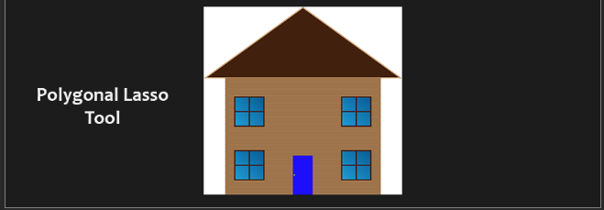
Removing Parts of an Image Masking vs. Erasing
Removing parts of an Image
Photoshop can remove parts of an image. When we CROP an image we permanently alter the size of the image. We might crop an image to remove a whole side of a picture or center someone in a picture. ERASING part of an image permanently erases part of an image. When you erase part of an image you do not alter the size of an image. MASKING is like erasing but instead of erasing and permanently altering an image, we hide unwanted parts of an image. Erasing and cropping are called DESTRUCTIVE EDITING. Masking is called NON-DESTRUCTIVE EDITING. Both are useful and have their places.
Layer & Image without masks

Slide 24
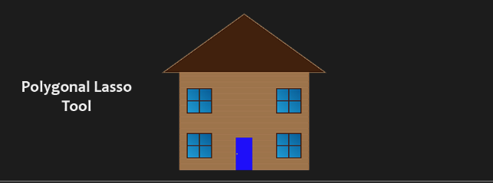
Removing Parts of an Image Masking vs. Erasing
Masking an Image
When we mask an image we hide unwanted parts of an image. For example, if we wanted to take a picture of someone and put them in a different location, we would “Mask them out” of the background and put them in a different background. Masking works based on the selections from the previous slide. First you select what you want to keep (or hide) and then tell Photoshop to remove the rest.
Understanding Masks
Masks appear in the layers panel and are black and white. What’s black is what is hidden and what’s white is what is still revealed. Masking is valuable because we can always fix a mask and edit it later if we want to bring something back.
Layer & Image WITH masks

Slide 25
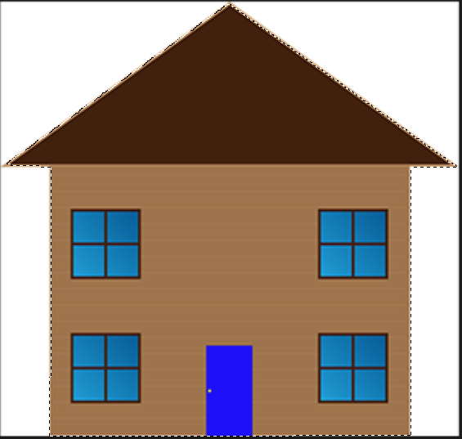
Selecting & Masking
LAYER MASK BUTTON
Masking out the Orange Square
Select the Rectangular Marquee Tool in the tools panel.
Select the Orange Square layer in the layers panel/
Use the Rectangular Marquee Tool to select the square. To use the tool hold left click and drag a box. If you don’t like your selection, start over by clicking on CTRL+D.
Once you have the square selected, click on the Add Layer Mask button at the bottom of the layers panel to add the mask and remove the white.
Mask out the house
We can’t just select a shape here since the house is multiple shapes!
Right click on the Lasso Tool and select the Polygonal Lasso Tool.
Select the House layer from the layers panel.
To use the Polygonal Lasso Tool you need to click on the corners of the shape to create one selection.
Click at each corner of the house and roof. When you are finished click back on the first corner you clicked on (or hit enter).
Add the Layer Mask by clicking on the Layer Mask Button at the bottom of the layers panel.

Slide 26
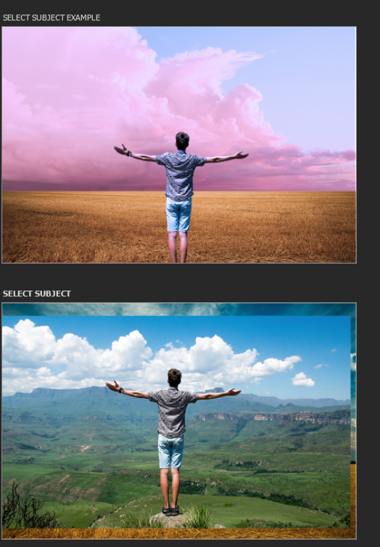
Selecting & Masking Ctd
Goals
Now that we understand masking we will create a little image composite out of masks using the marquee tools and the “SELECT SUBJECT” function.
Steps
First hide the person layer by click on the eye icon.
Select the Land layer.
Activate the Rectangular Marquee Tool in the tools panel.
Use the Rectangular Marquee Tool to select only the land in the land layer.
Add a mask to the land layer to hide the sky. Now you should have two layers blended together to create a land and sky composite.
Turn on the Person layer by clicking on the eyeball icon again and select the person layer..
Grab the “Object Selection Tool” in the content aware selection tools.
With the Person layer highlighted and the Object Selection Tool activated, click on Select Subject at the top of your screen. Photoshop will do some magic and select the person for us!
Notice that the selection might not be perfect. Photoshop is still a program and isn’t always 100% accurate.
Now add the mask to the Person layer! You’ve just created an image composite!

Slide 27
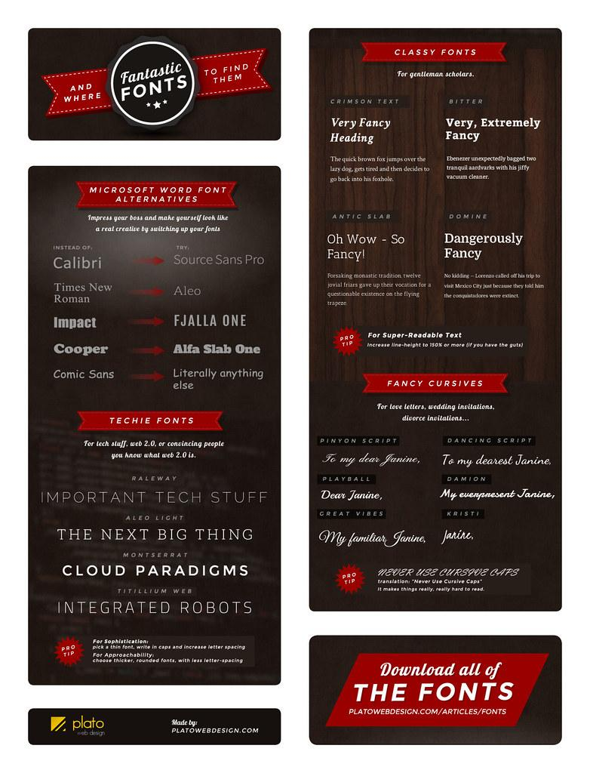
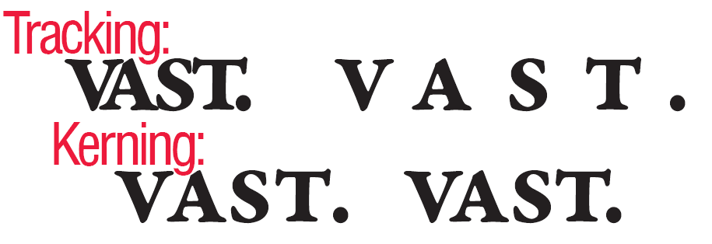
Typography & Text in PS
Typography
One of the most important parts of graphic design is Typography. Typography is the study of why and how we communicate messages with text and words on a page. To best understand typography principles it is important to know how to use the Type tool and functions in Photoshop.
Font: What font you are using.
Font Size: How large the font is.
Tracking: Horizontal space between all of the letters in a layer.
Kerning: Horizontal space between two individual letters.
Leaning: Line spacing

Slide 28
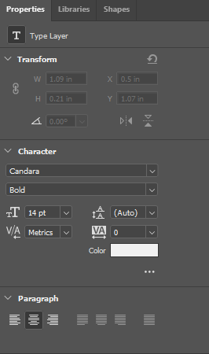
Working with Text in PS
TEXT PROPERTIES
Goal
Our goal is to make the “Text” artboard look like the “Text Example” artboard.
Steps
Select the “Background” layer in the Text artboard.
Select the HORIZONTAL TYPE TOOL from the tools panel.
Before using the text tool we want to set some default options.
At the top of the screen select the proper font and font size.
With the HORIZONTAL TYPE TOOL selected click once (do not drag and click) to start writing.
Write out the quote.
When you are finished writing either go back to the MOVE TOOL or hit CTRL+ENTER to finalize your text.
Navigate to the Properties Panel and adjust the Tracking, Leading, and Color of the text.
With the text layer selected, add a Drop Shadow to the text by going into your Layer Styles menu.
Grab the Type Tool again, change the font to whatever you like, click once, and attribute the quote!
TYPE
TOOLS

Slide 29
Want to Learn More?
Scales’ Class Website
https://whsdigitalmedia.weebly.com/photoshop-projects.html
Adobe HelpX
https://helpx.adobe.com/photoshop/get-started.html?promoid=VPM4KCNL&mv=other
Photoshop Essentials
https://www.photoshopessentials.com/
Photoshop for Beginners (YouTube)
https://www.youtube.com/watch?v=IyR_uYsRdPs
Every tool is explained (YouTube)
https://www.youtube.com/watch?v=2cQT1ZgvgGI

