Slide 1
Elements & Principles of design
Adobe visual design
Objectives: 1.02, 2.02, 3.02

Slide 3
PART 1: ELEMENTS OF DESIGN
Color
Line
Shape
Texture
Watch this video on Fundamentals of Design.

Slide 4
COLOR
Helps identify objects in a design.
Creates visual flow in a design.
Communicates feelings and moods to the audience or viewer.
Consists of hue, saturation, and brightness.
Watch this video on Color Basics.

Slide 5
COLOR THEORY
Particular colors in a design can communicate certain moods and feelings to the audience.
Watch this video on Color Theory.
RED - excitement, anger,
danger, love
ORANGE - liveliness, energy
warmth
BLUE - calm, sadness,
serenity
PURPLE - royalty, dignity
mystery
GREEN - envy, luck,
peacefulness
BLACK - mourning, despair
sophistication
YELLOW - cowardice, sympathy
cheerfulness
WHITE - innocence, purity,
faith

Slide 6
COLOR SCHEME
The purposeful selection of colors for use in design.
Sets a mood, attracts attention, or makes a statement.
Color can be your most powerful design element if you learn to use it effectively.
Color schemes usually are only 2 or 3 colors.

Slide 7
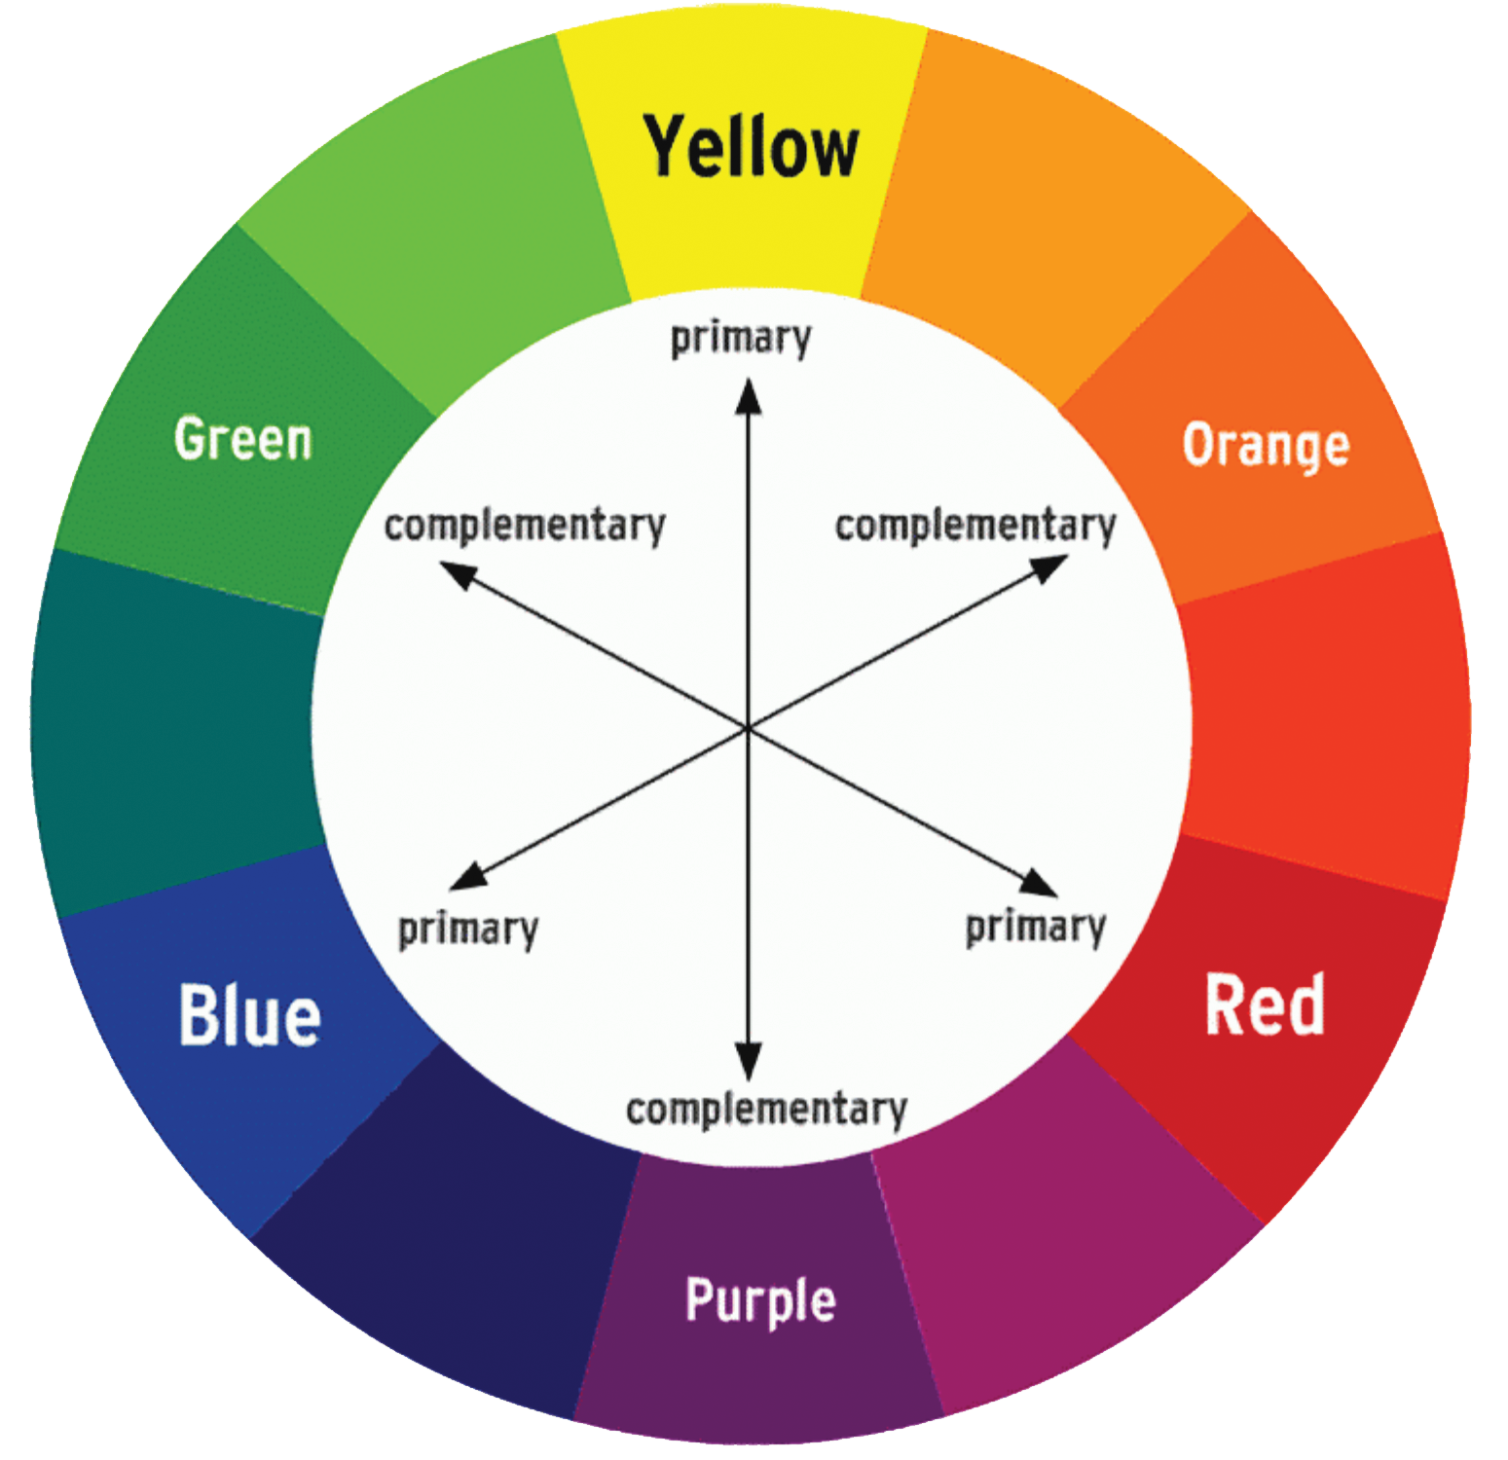
COMPLEMENTARY COLORS
Colors across from each other on the color wheel work well together when used in a design.
Examples:
Orange and Blue
Red and Green
Yellow and Purple

Slide 8
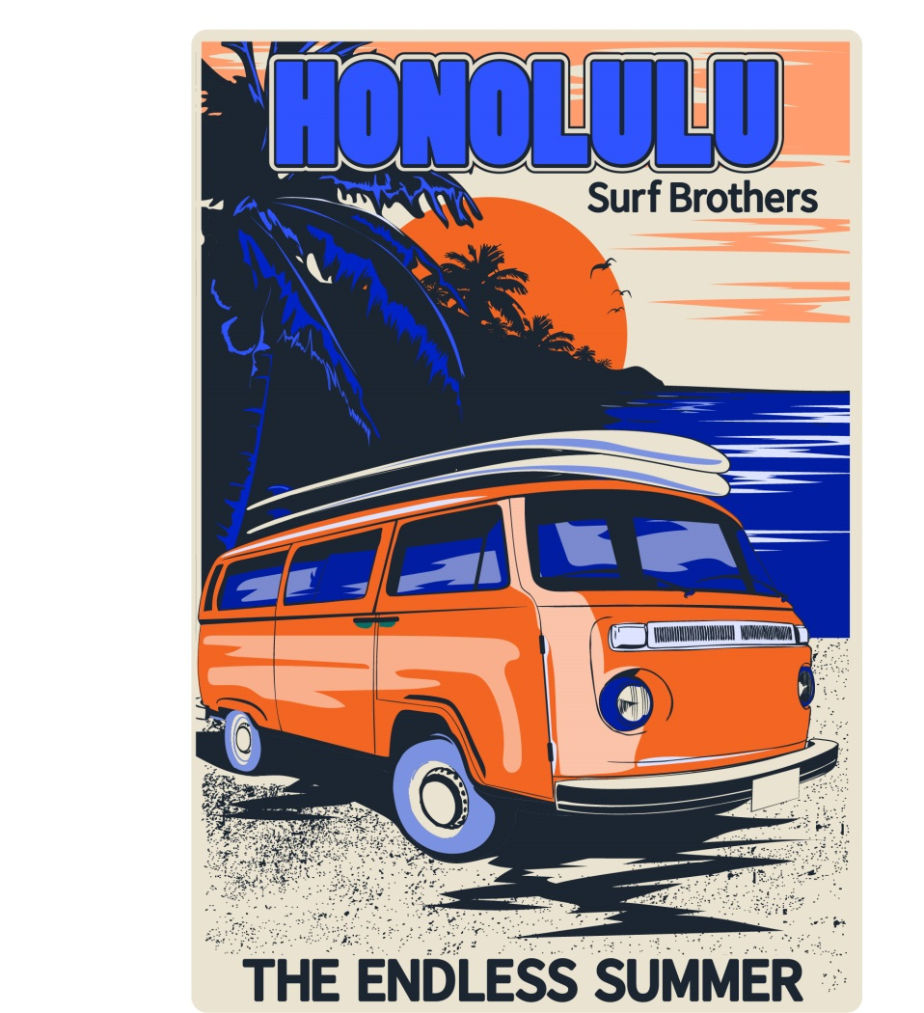
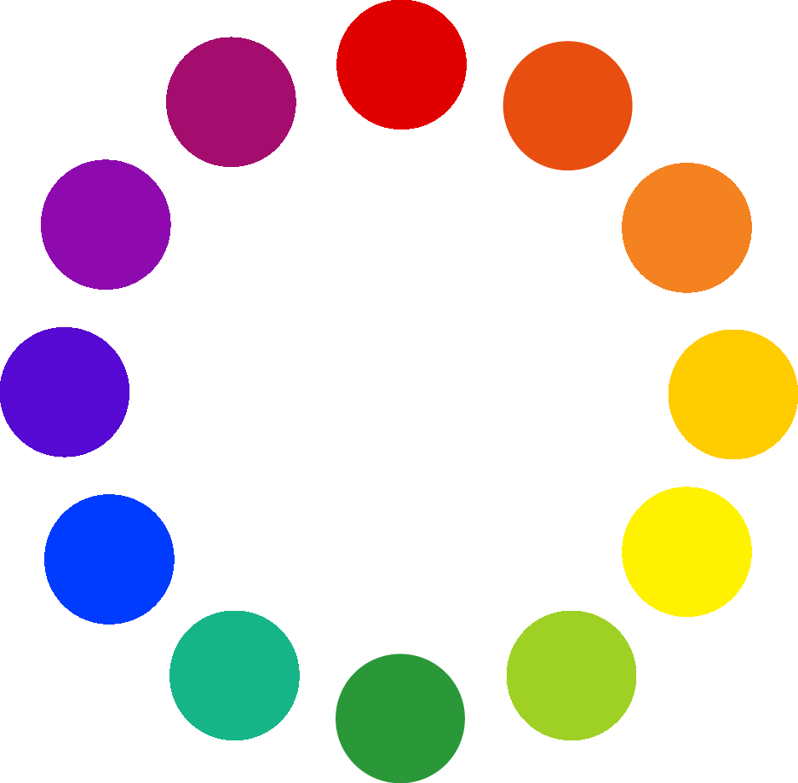
COMPLEMENTARY COLORS

Slide 9
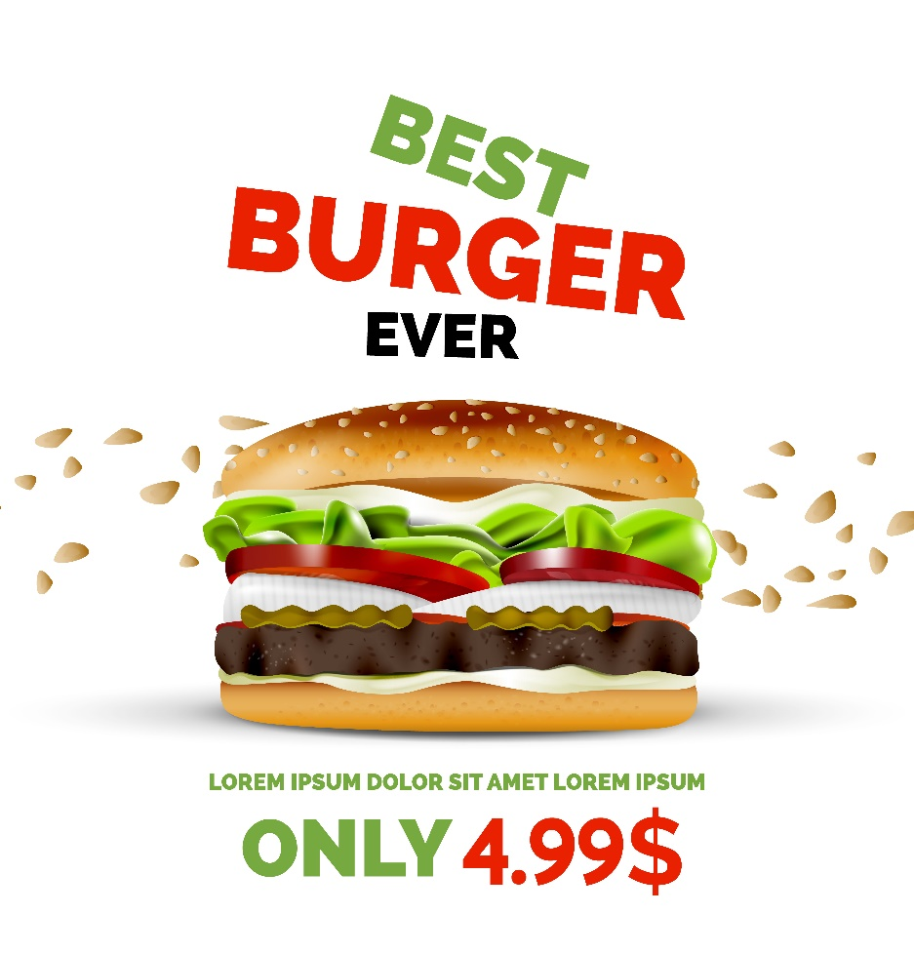
COMPLEMENTARY COLORS

Slide 10
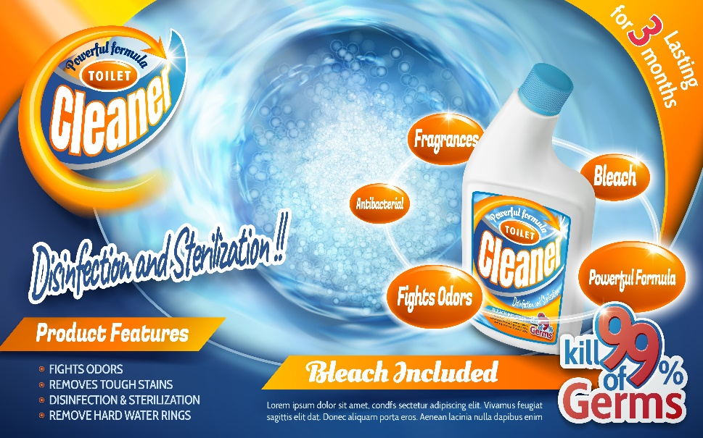
COMPLEMENTARY COLORS

Slide 11
SPLIT COMPLEMENTARY COLORS

Slide 12
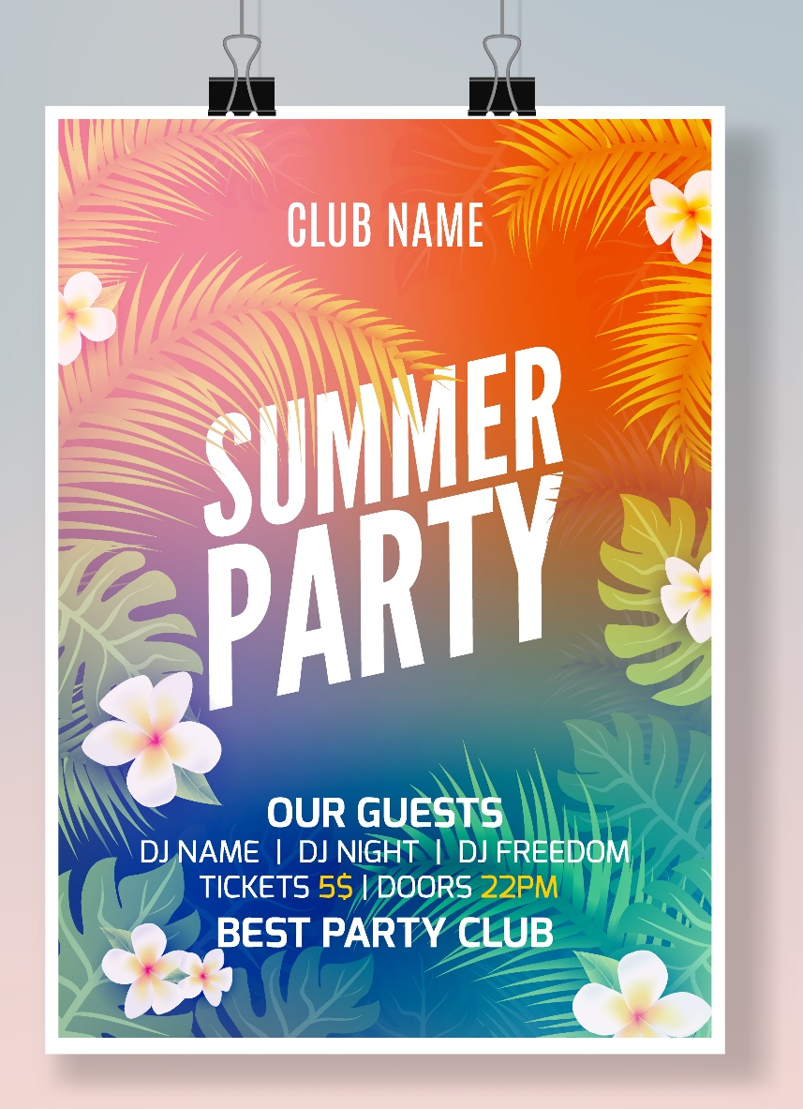
SPLIT COMPLEMENTARY COLORS

Slide 13
SPLIT COMPLEMENTARY COLORS

Slide 14
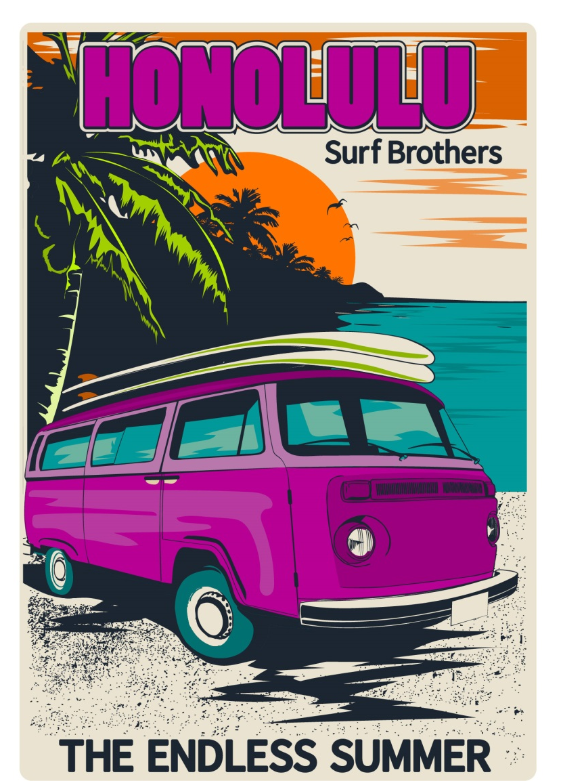
DOUBLE COMPLEMENTARY COLORS

Slide 15
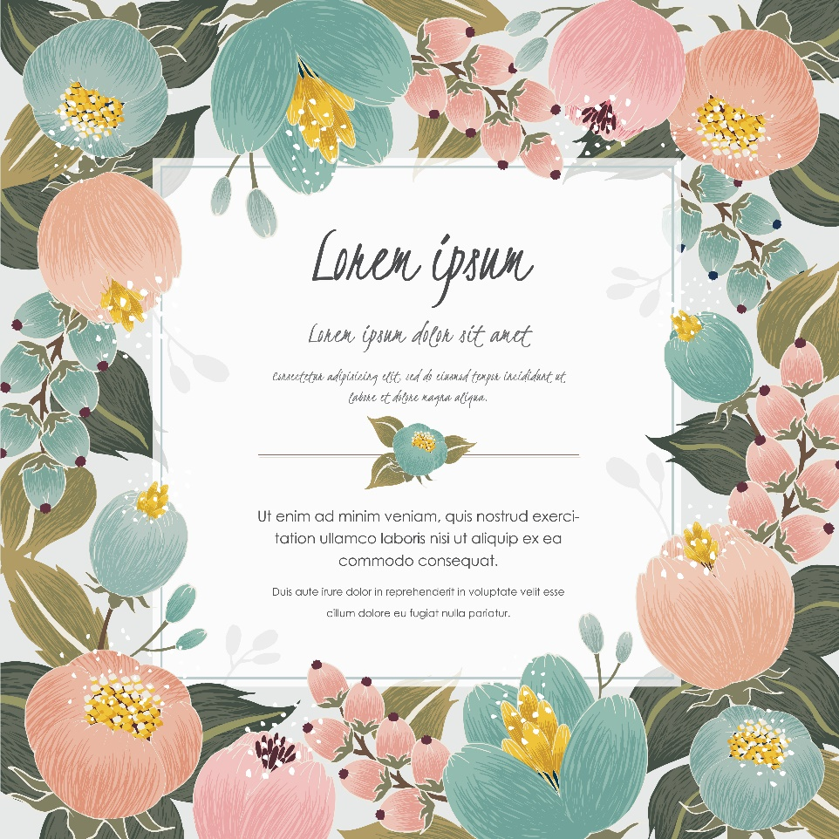
DOUBLE COMPLEMENTARY COLORS

Slide 16
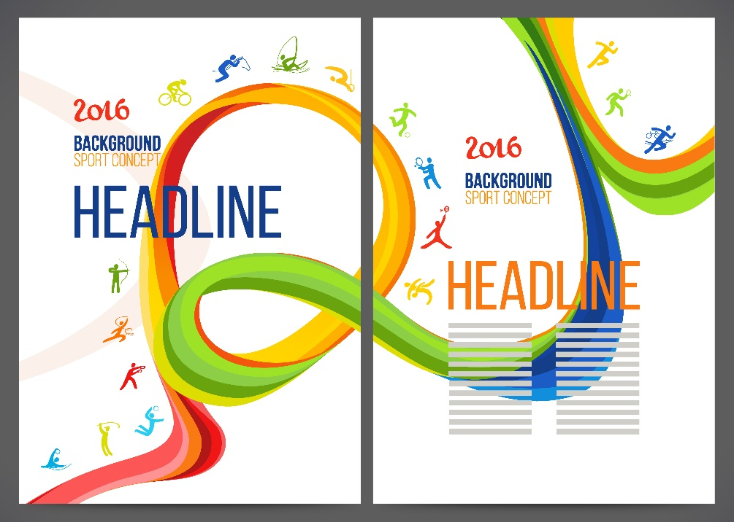
DOUBLE COMPLEMENTARY COLORS

Slide 17
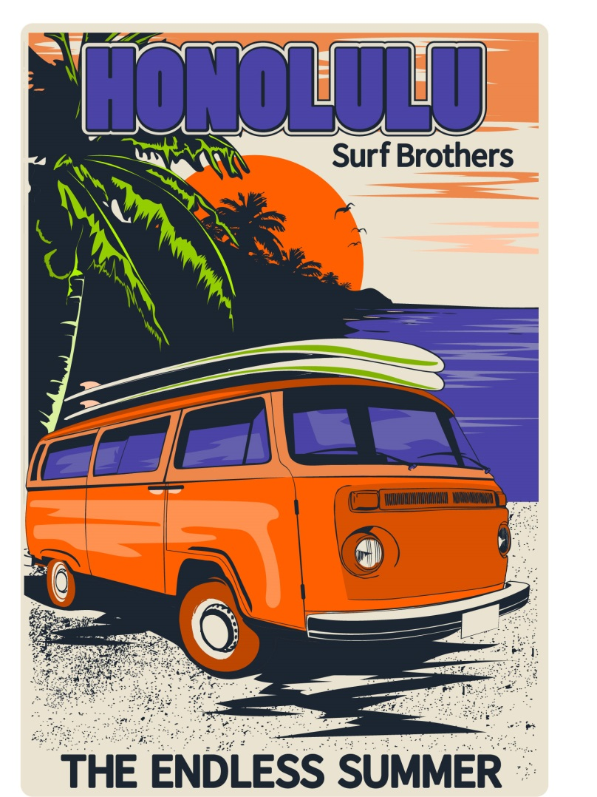
TRIADIC COLORS

Slide 18
TRIADIC COLORS

Slide 19
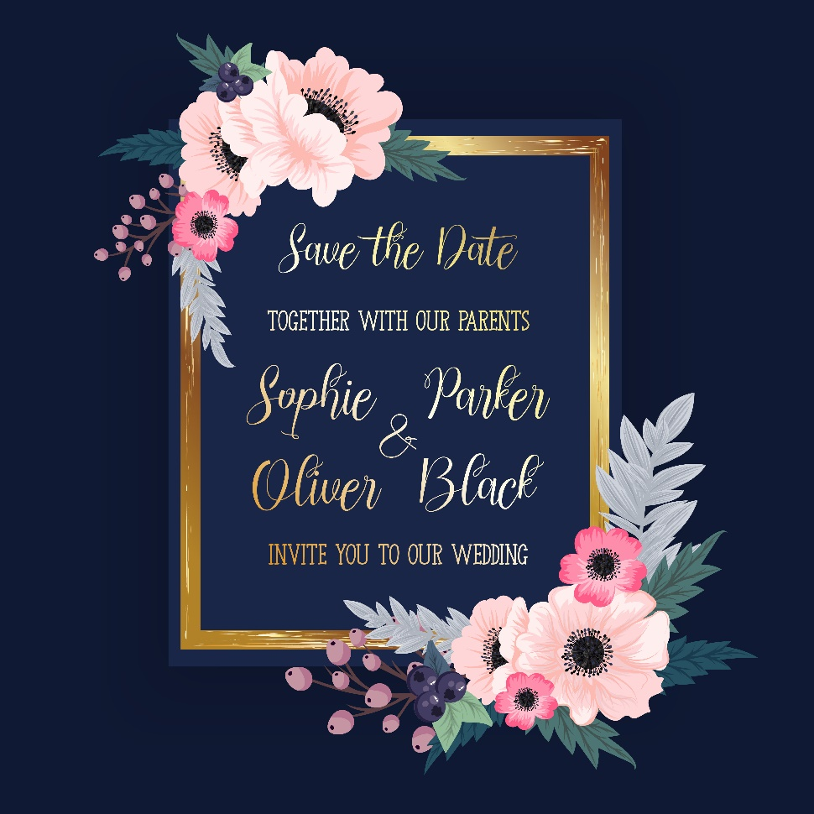
TRIADIC COLORS

Slide 20
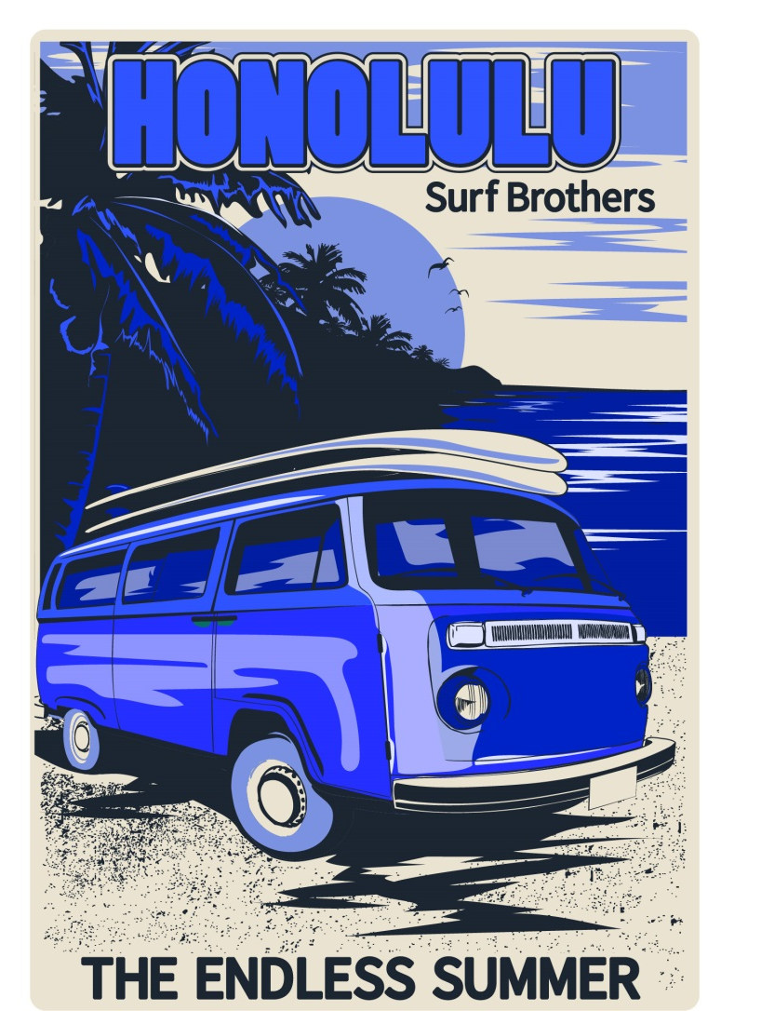
MONOCHROMATIC COLORS

Slide 21
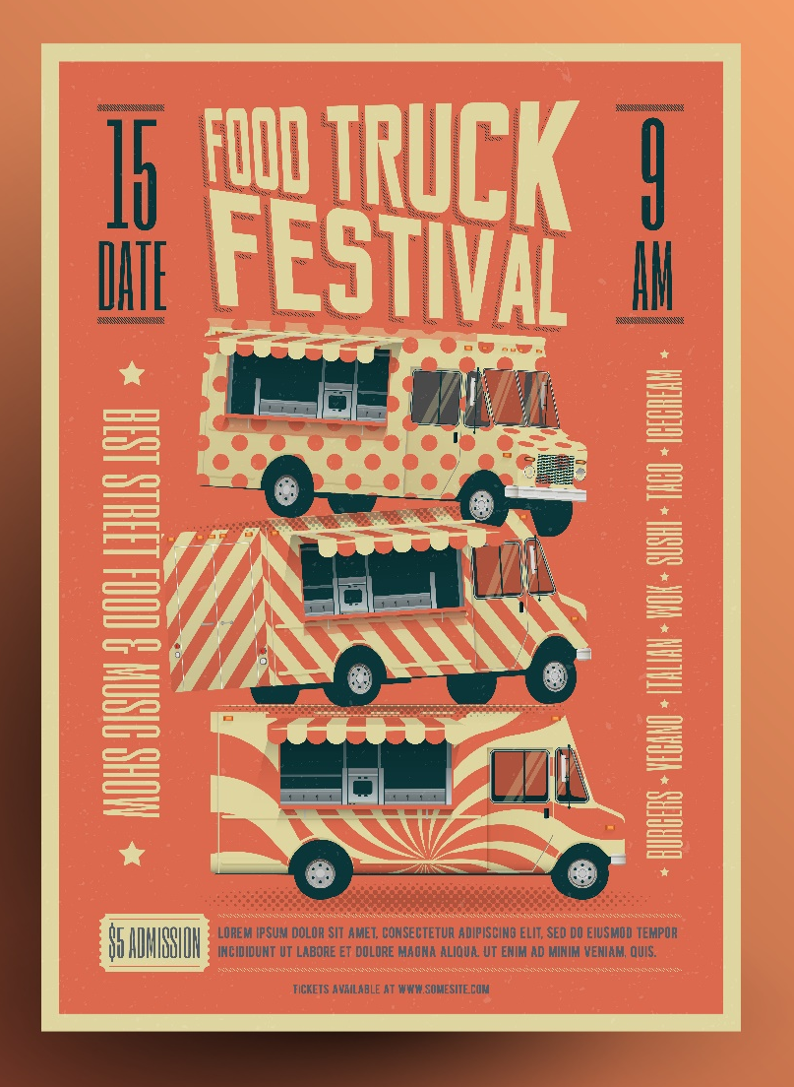
MONOCHROMATIC COLORS

Slide 22
MONOCHROMATIC COLORS

Slide 23
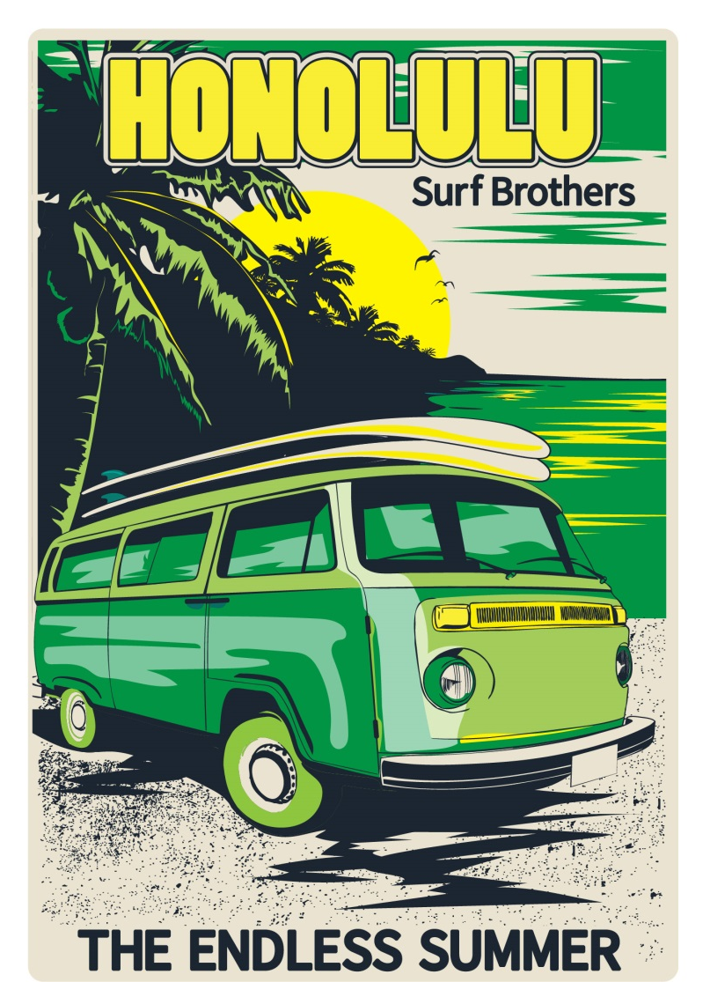
ANALAGOUS COLORS

Slide 24
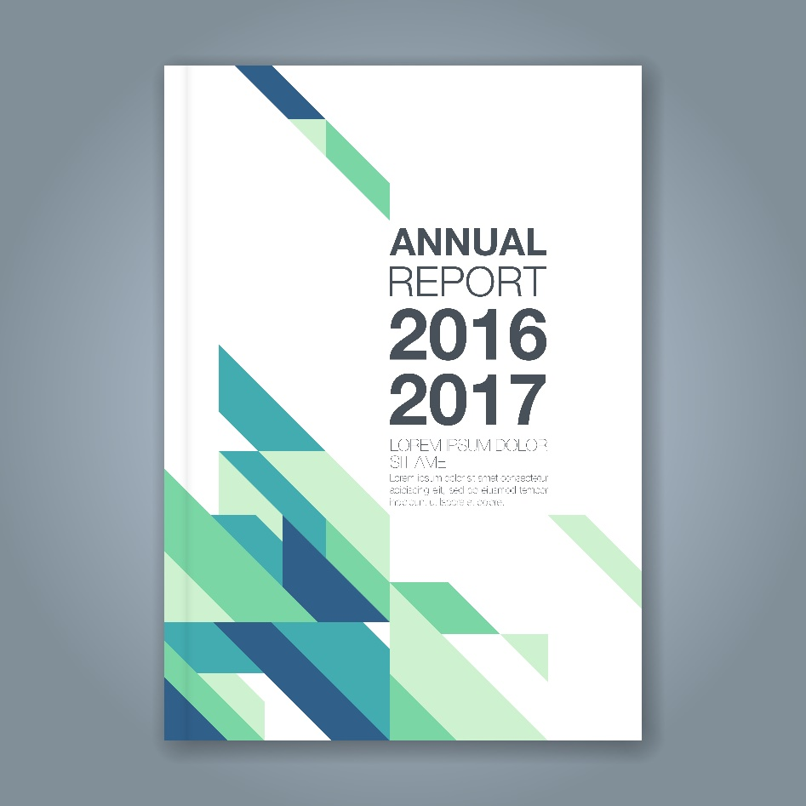
ANALAGOUS COLORS

Slide 25
HUE
The name given to a color.
Within a particular hue, a variety of individual colors can be created by changing saturation and brightness.
Select Hue on color bar using sliders.

Slide 26
SATURATION
The amount of hue used in a particular color.
Example: PURPLE
Less saturated with the purple hue.
More saturated with the purple hue.

Slide 27
BRIGHTNESS
How light or dark a color appears; adding black or white changes a color’s brightness.
Example: GREEN
Bright Green (white added to a green hue).
Dark Green (black added to green hue).

Slide 28
QUESTIONS TO CONSIDER
Why would a designer want to use complimentary colors when creating a logo?
Summarize the benefits of using color as a design element.
Identify several ways a color scheme can impact a graphic.
Contrast the color psychology of black and white and how this affects advertising choices.

Slide 29
LINES
Give direction to a design.
Create movement in a design.
Thick lines show importance, thin lines demonstrate quick movement.

Slide 30
TYPES OF LINES
VERTICAL LINES
-carry eye up and down
-convey a feeling of awe
or challenge
DIAGONAL LINES
-slanted
-add interest to a design
HORIZONTAL LINES
-carry eye left and right
-convey a feeling of calm or peacefulness
CURVED LINES
-gently bent
-give a soft, relaxed
feel to a design

Slide 31
Design using LINES

Slide 32
Design using LINES

Slide 33
Design using LINES

Slide 34
SHAPES
The form of an object.
When lines enclose a space.
Can be used to help identify objects:
Example : circle = sun, oval = egg
Three basic shape types:
Circle
Square
Triangle

Slide 35
Design using SHAPES
This one uses Lines too!

Slide 36
Design using SHAPES

Slide 37
Design using SHAPES

Slide 38
Design using SHAPES

Slide 39
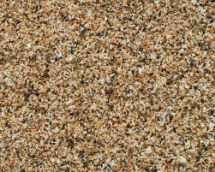
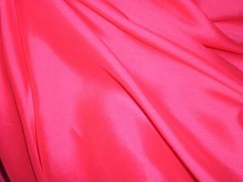
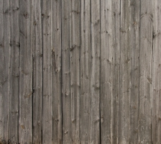
TEXTURE
Combination of dots, lines, and colors used create the illusion of a surface appearance.
Adds depth and dimension to a design.
Look and “feel” of a surface.

Slide 40
Design using TEXTURE

Slide 41
Design using TEXTURE

Slide 42
QUESTIONS TO CONSIDER
Give 4 or 5 examples of textures found in nature a designer could use.
When would a circle be a preferred shape to a square or triangle?
How do lines differ from shapes in graphic design?

Slide 43
PART 2: PRINCIPLES OF DESIGN
Proportion
Balance
Rhythm
Emphasis
Unity/Harmony

Slide 44
PROPORTION
A size relationship between components of a design.
Proportion can be:
Between one component of a design and another component .
OR
Between a component and the design as a whole.
Good proportion adds harmony, symmetry, or balance among the parts of a design.

Slide 45
BALANCE
How design elements are arranged either horizontally or vertically on the canvas.
INFORMAL BALANCE
Also known as asymmetrical balance.
Both sides of the design are not equal, but are still balanced.
FORMAL BALANCE
Also known as symmetrical balance.
Design is exactly equal on both sides.

Slide 46
SYMMETRICAL BALANCE

Slide 47
ASYMMETRICAL BALANCE

Slide 48
Design using Formal BALANCE

Slide 49
Design using Formal BALANCE

Slide 50
Design using Formal BALANCE

Slide 51
Design using Informal BALANCE

Slide 52
Design using Informal BALANCE

Slide 53
RHYTHM
Creating the feeling of movement in a design.
Generated through the repetition of lines, colors, shapes, and textures.
Tyndale
Forestry

Slide 54
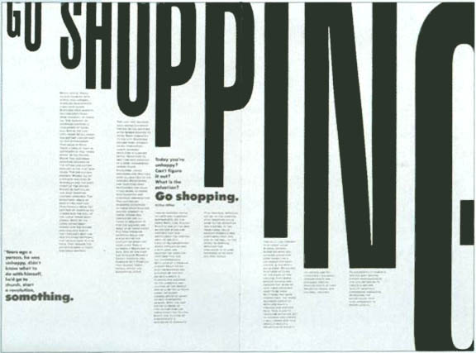
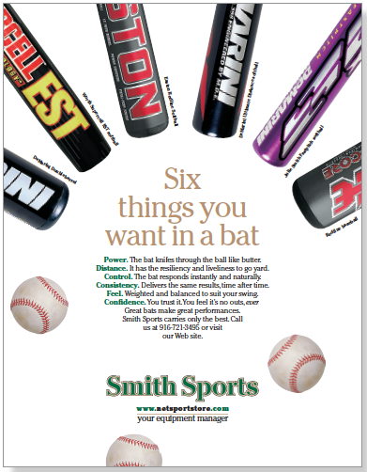
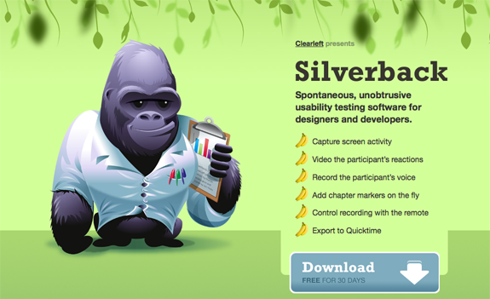
Design using RHYTHM

Slide 55
Design using RHYTHM

Slide 56
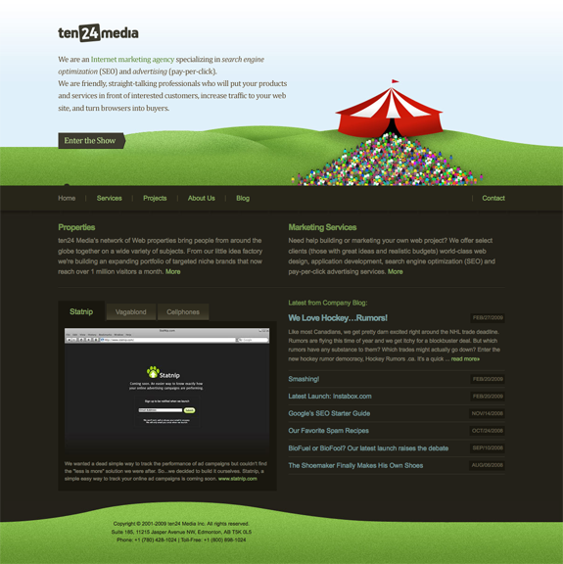
Design using RHYTHM

Slide 57
EMPHASIS
Center of interest in a design.
Noticed first by the audience.
Creates visual flow or hierarchy which carries the viewer’s eye through the design.
Use differences in size, color, and type.

Slide 58
Design using EMPHASIS

Slide 59
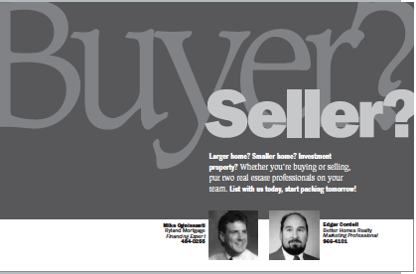
Design using EMPHASIS

Slide 60
Design using EMPHASIS

Slide 61
UNITY/HARMONY
When all components of a design look as if they belong together. Achieved when the Elements and Principles of Design are used effectively.
Alignment often impacts unity/harmony.
Arranging design components in an organized and visually appealing manner.
White Space--The absence of text or graphics in a design; visual breathing room for the eye; helps avoid over-crowding and creates natural flow.

Slide 62
Design using UNITY/HARMONY

Slide 63
Design using UNITY/HARMONY

Slide 64
Design using UNITY/HARMONY

Slide 65
QUESTIONS TO CONSIDER
Identify ways to achieve harmony in designing a layout.
How can placement, alignment, size, and white space of text and graphic elements impact readability?
How does balance change depending on the number and placement of graphics?

Slide 66
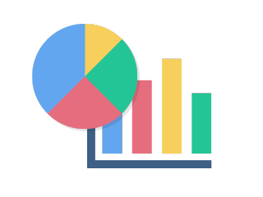
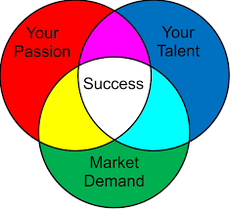
PART 3: DIGITAL GRAPHICS
Any image or design created or edited by a computer.
Drawings
Logos
Photos
Buttons & Icons
Diagrams
Charts

Slide 67
BITMAP VS. VECTOR GRAPHICS
Bitmap
Vector
Use square pixels arranged in a grid that have assigned colors.
Usually larger file size.
Lose clarity when viewed up close or zoomed in.
Also referred to as Raster Graphics.
Use mathematical formulas to define lines, points, curves, and other attributes.
Small file size.
Do not lose clarity when viewed up close or zoomed in.
Best type of graphic for printing in large scale.

Slide 68
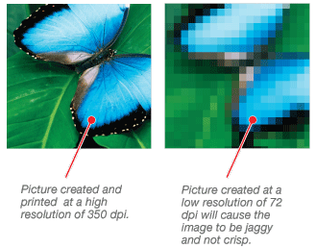
RESOLUTION
Describes the clarity of Bitmap Graphics.
Determined and defined by the number of Pixels Per Inch (PPI).
Low Resolution
Blurry in appearance.
Relatively small file size.
High Resolution
Very clear in appearance.
Relatively large file size.

Slide 69
QUESTIONS TO CONSIDER
Predict the quality of the same graphic with a small file size versus a large file size.
Why are logos best created in a vector graphic software program?

Slide 70
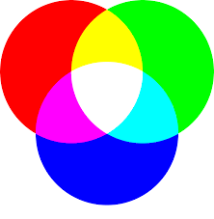
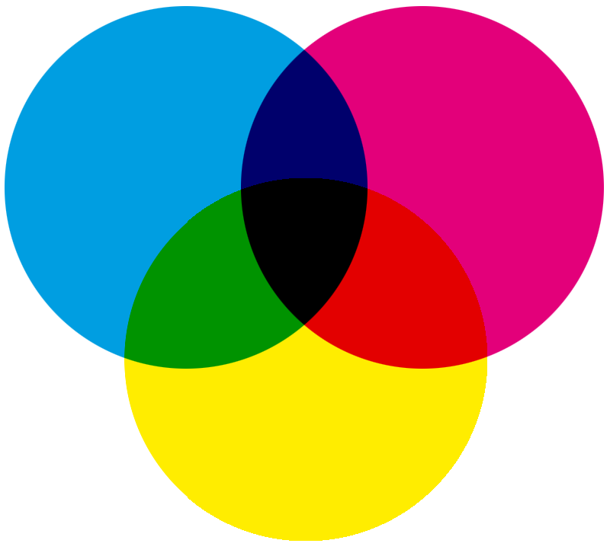
COLOR MODES
Black & White - uses only true black and true white.
Grayscale - uses true black, true white, and all shades of gray in between.
True Color - all possible color combinations.
RGB (Red, Green, Blue) - optimized for viewing on a screen.
CMYK (Cyan, Yellow, Magenta, Black) - optimized for printing purposes.

Slide 71
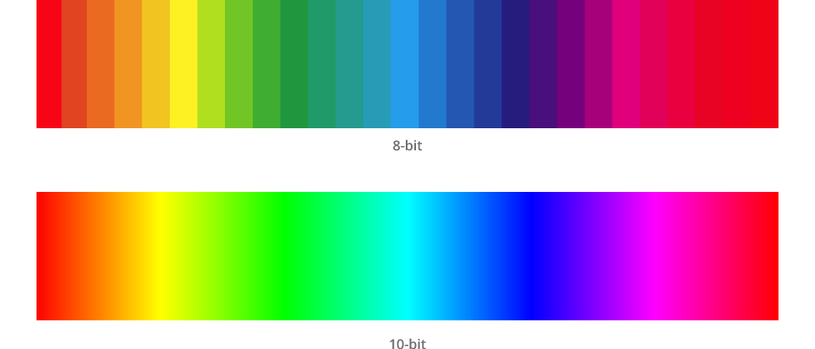
COLOR DEPTH
The number of distinct colors a graphic is capable of displaying.
Related to color mode:
Black & White
Indexed Color (256 colors)
True Color (16.7 million colors)

Slide 72
QUESTIONS TO CONSIDER
What factors can affect the decision to use RGB or CMYK when creating a graphic?
Why would designers prefer to use true color for high resolution photos?

Slide 73
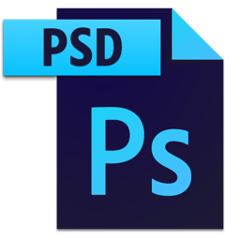
ADOBE NATIVE GRAPHIC FORMATS
.PSD
.AI
Native file type used by Adobe Photoshop.
Does not compress layers of a design, allowing for future editing.
May not be recognized by all programs.
Native file type used by Adobe Illustrator.
Does not compress layers of a design, allowing for future editing.
May not be recognized by all programs.

Slide 74
BITMAP (RASTER) GRAPHIC FORMATS
.JPEG (JPG)
.GIF
Most common graphic file format.
Full color graphic format (16.7 million colors).
Relatively small file size.
Indexed color format (256 colors).
Supports simple transparency layer.

Slide 75
BITMAP (RASTER) GRAPHIC FORMATS
.TIFF (TIF)
.PNG
Versatile graphic type that can use a variety of color formats.
Format works best for desktop publishing or print work.
Supports advanced transparency.
Relatively average file size.
Can be interlaced, optimizing for internet use.

Slide 76
VECTOR (LINE DRAW) FORMATS
.SVG
Supports interactivity and 2-D animation.
XML-based vector format.
Can be opened in any Vector Drawing Program
Open standard.

Slide 77
QUESTIONS TO CONSIDER
If the client does not have a current license for Photoshop, should you send the proofs as a .JPEG or .PSD file type? Why?
How does a client’s use of a graphic (on printed material or on the Internet) change its file type?

Slide 78
TYPOGRAPHY
Typography
The design and use of fonts and typefaces as a means of visual communication in a design.
Readability
A characteristic of fonts that make them easy to identify and read; all fonts in a graphic design should be legible unless desired effect is otherwise.
Font Families
Collection of fonts that fall within a group or subset that are visually similar, but with minor variations (ex. Arial, Courier, Times, etc.)

Slide 79
SERIF VS. SANS SERIF
Serif
Sans Serif
A slight projection finishing off a stroke of a letter. Fonts with the serif are called serif fonts.
Fonts without the serif on the letters.

Slide 80
FONT FAMILIES

Slide 81
TEXT SPACING TERMS
Leading
Leading
The amount of vertical space between lines of text in a paragraph.
Tracking
The amount of horizontal space between characters within a word or sentence.
Kerning
The amount of horizontal space between pairs of individual characters.

Slide 82
TEXT SPACING TERMS
Leading is the space between lines of text, what we often call line spacing.
Tracking is the space between letters in a line which is sometimes called character spacing.
Kerning is the space between a pair of letters.
Leading
Tracking
Kerning of
i and r

Slide 83
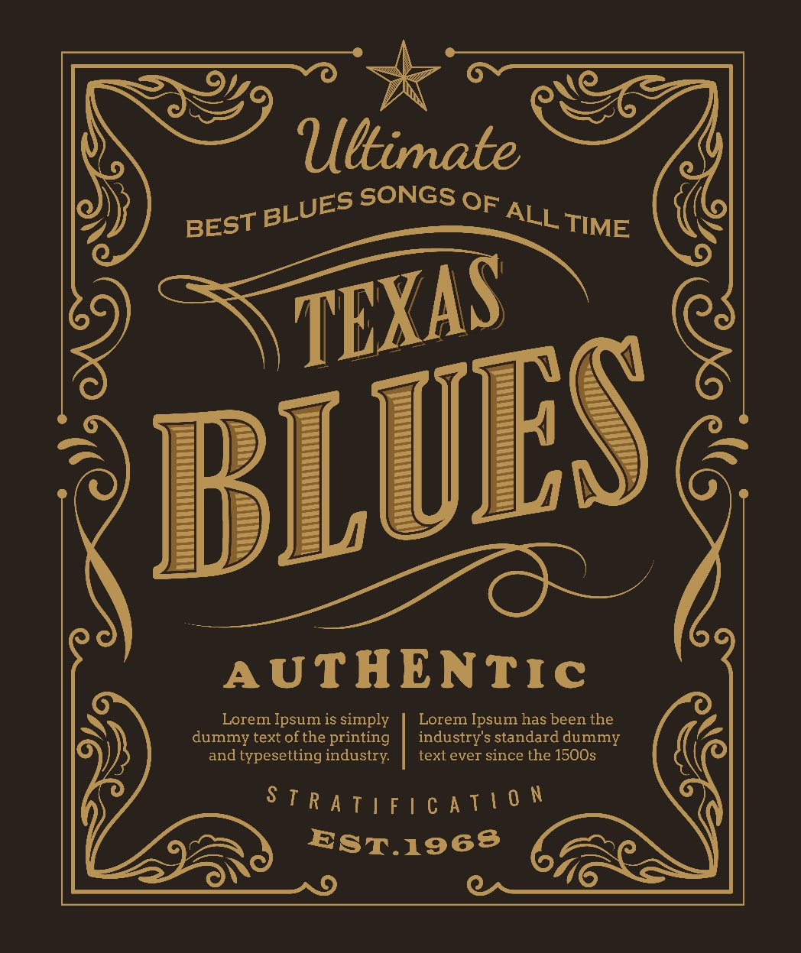
Design using TYPE

Slide 84
Design using TYPE

Slide 85
Design using TYPE

Slide 86
QUESTIONS TO CONSIDER
How does adjusting the spacing of two adjacent letters differ than adjusting the spacing horizontal (side to side) between the characters?
Why would designers prefer to use fonts with serifs on printed material?

Slide 87
PASS THE TEST!
Graphic Design and Illustration Using Adobe Illustrator CC 2018
1.4 Demonstrate an understanding of key terminology related to digital images.
1.5 Demonstrate knowledge of basic design principles and best practices employed in the design industry.

