Slide 1
Vocabulary
Term | Definition
Target Audience
Message
Celebrity Endorsement
Customer Testimonial
Jingle

Slide 2
Target Audience - You
How do you define yourself (or make up a character)? Provide the appropriate description in each box below. Examples of “other” categories include social group, economic status, religion, level of education, region of the country, and so forth.
Define the demographics
Gender
Age Group
Race
Other
Other

Slide 3
With these demographics in mind, list of specific types of media that people expect to appeal to someone like the person you described above:
TV Programs | Music | Movies
2) | 2) | 2)
3) | 3) | 3)

Slide 4
What kind of ad’s would you or your described person see?
List a few examples:

Slide 5
What are “persuasive techniques” used in advertising?
Term | Define
Pathos
Logos
Ethos

Slide 6
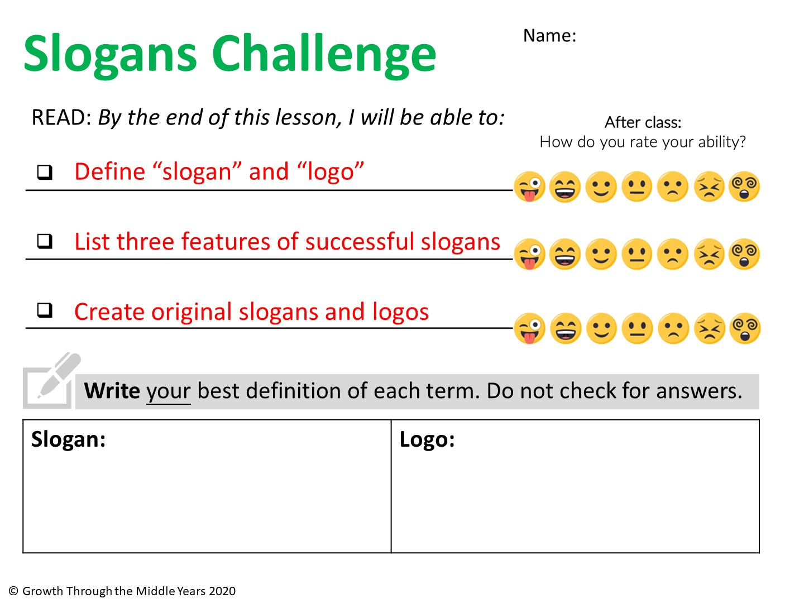
Write your definition here
Write your definition here

Slide 7
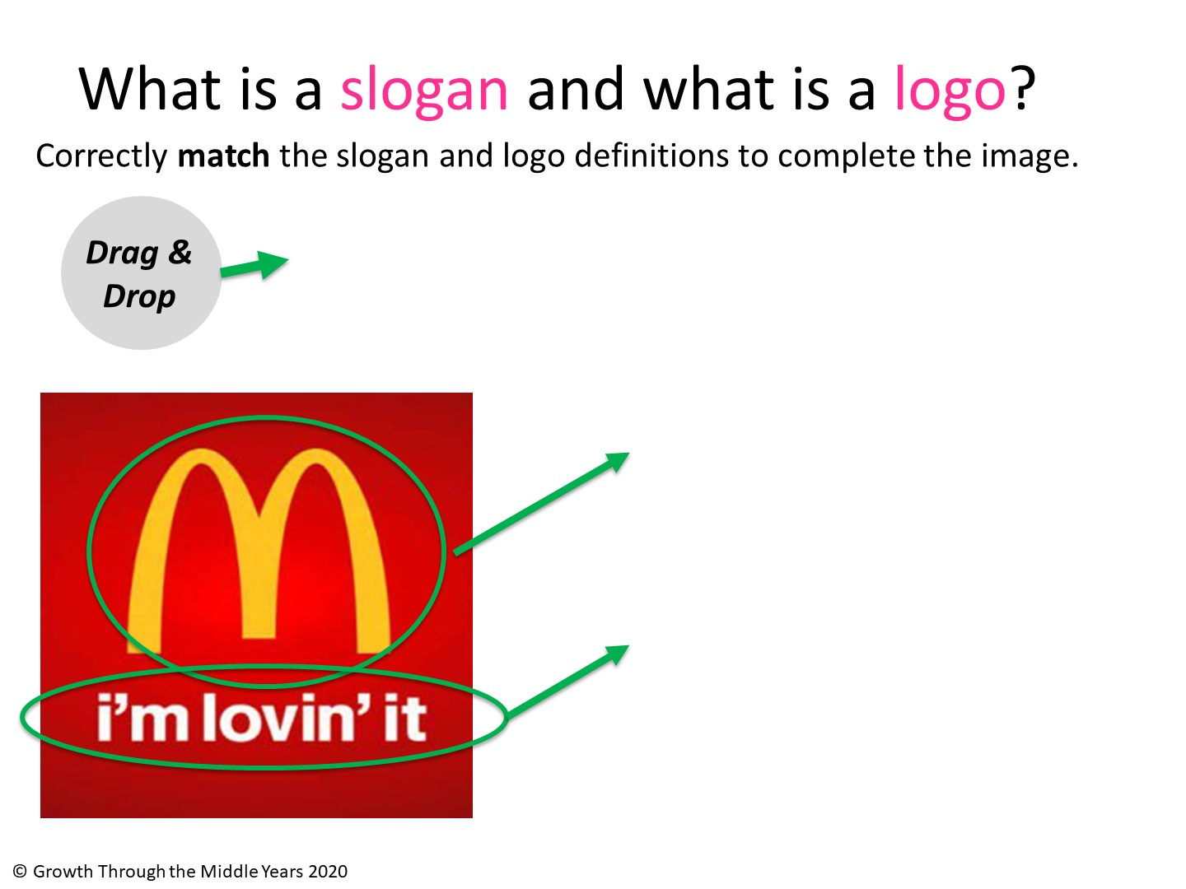
A symbol (can be a letter or image) visually representing a company.
A short, catchy phrase, usually between 2 – 4 words, orally representing a company.

Slide 8
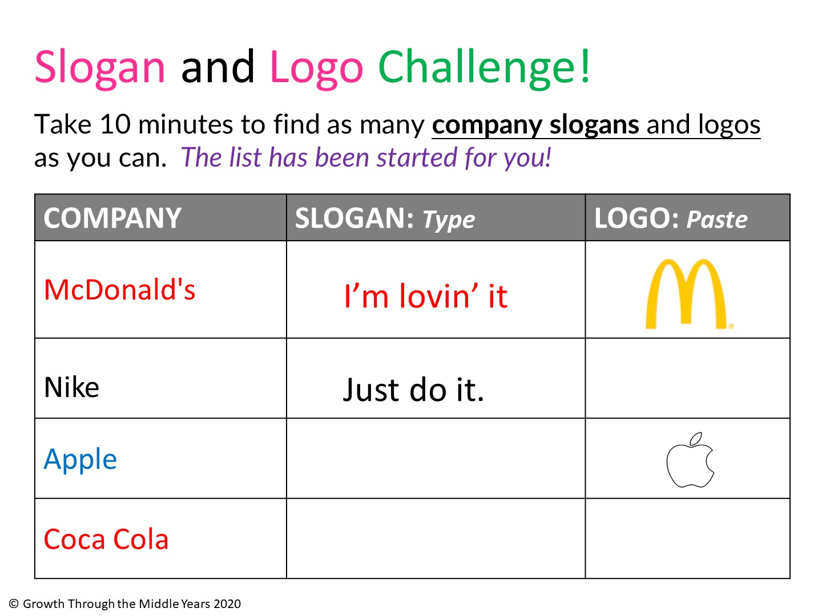
Find an image and paste logo here…
…
…
Find an image and paste logo here…

Slide 9
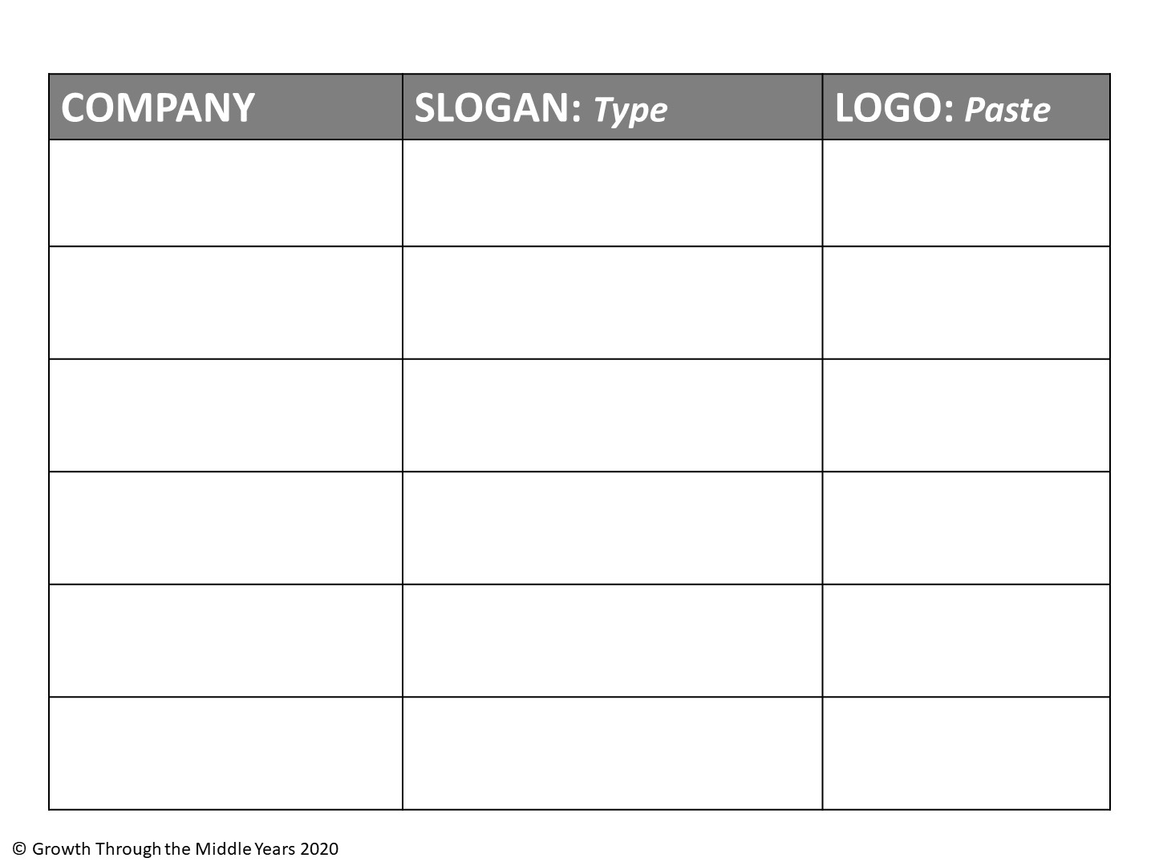
Find an image and paste logo here…
…
…
…
…
…
…
…
…
…
…
…
…

Slide 10
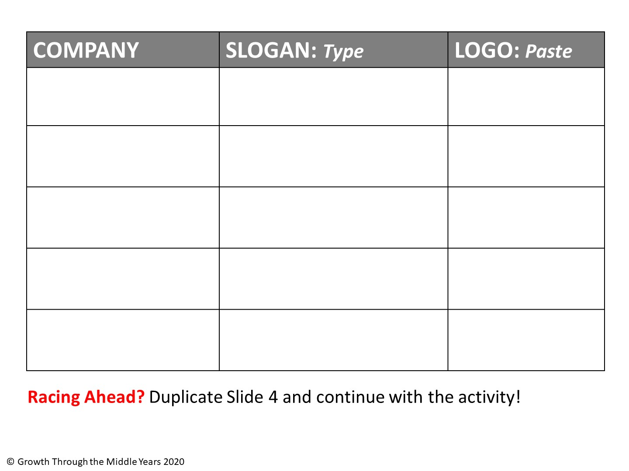
…
…
Find an image and paste logo here…
…
…
…
…
…
…
…
…

Slide 11
Find an image and paste logo here…
…
…
…
…
…
…
…
…
…
…
…
…

Slide 12
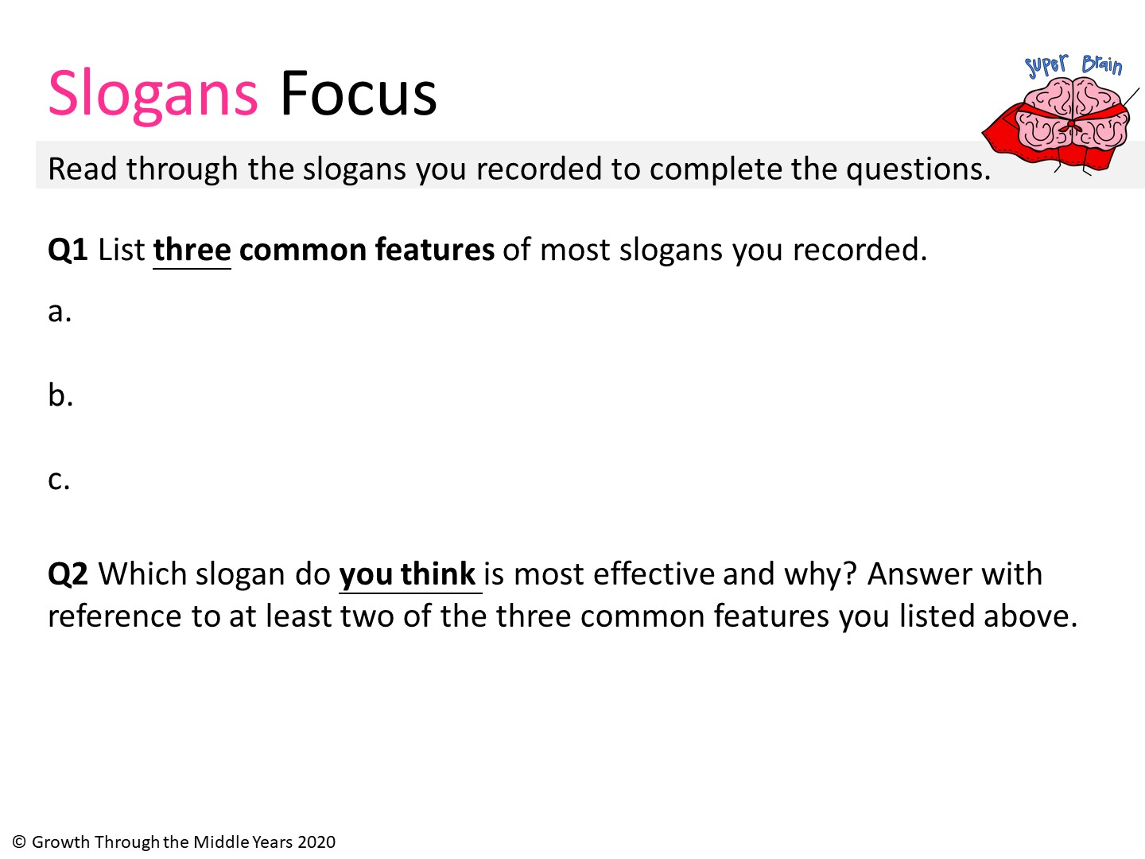
Write feature 1 here
Write feature 2 here
Write feature 3 here
Explain your answer here…

Slide 13
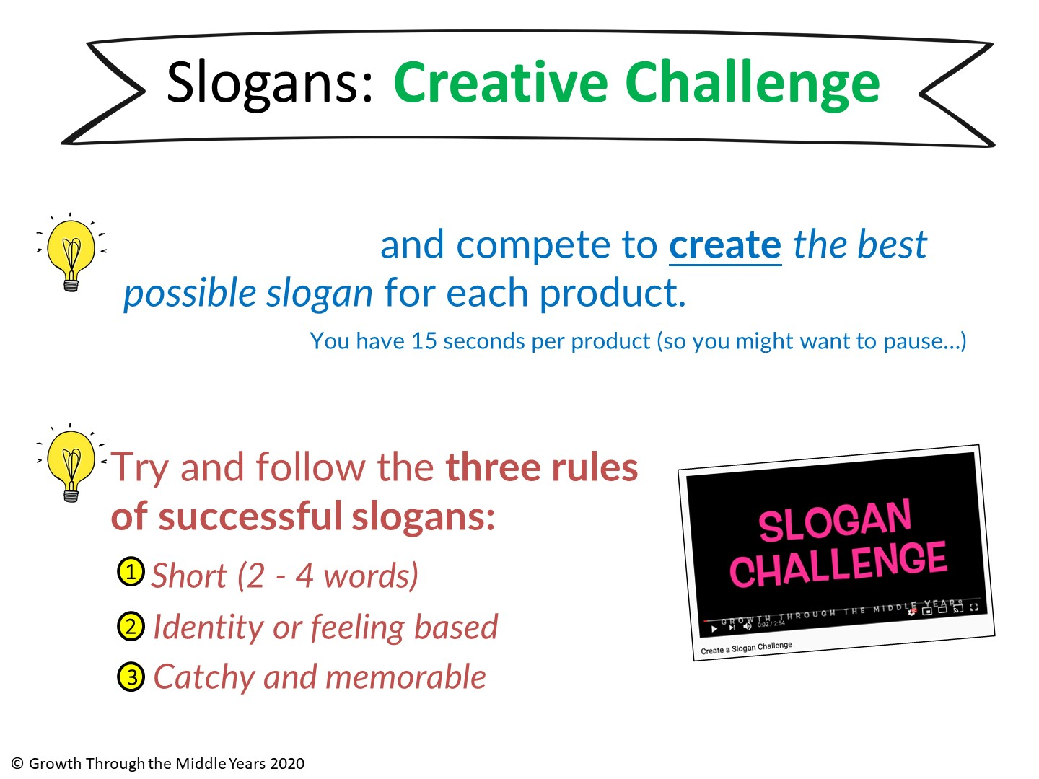
Watch the clip
https://www.youtube.com/watch?v=6SAtTx_WfKE&feature=youtu.be

Slide 14
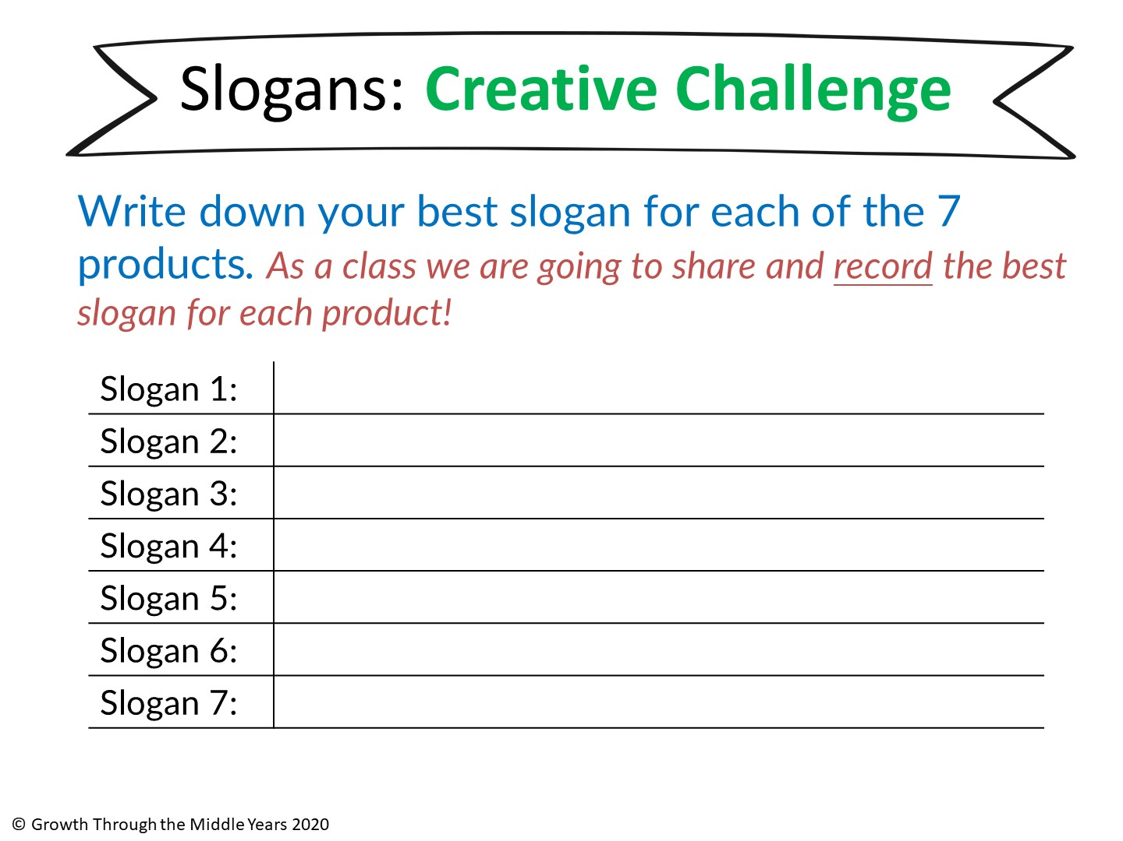
Type here
Type here
Type here
Type here
Type here
Type here
Type here
Add your best slogans to the YouTube comments! Compare with other students and schools ☺

Slide 15
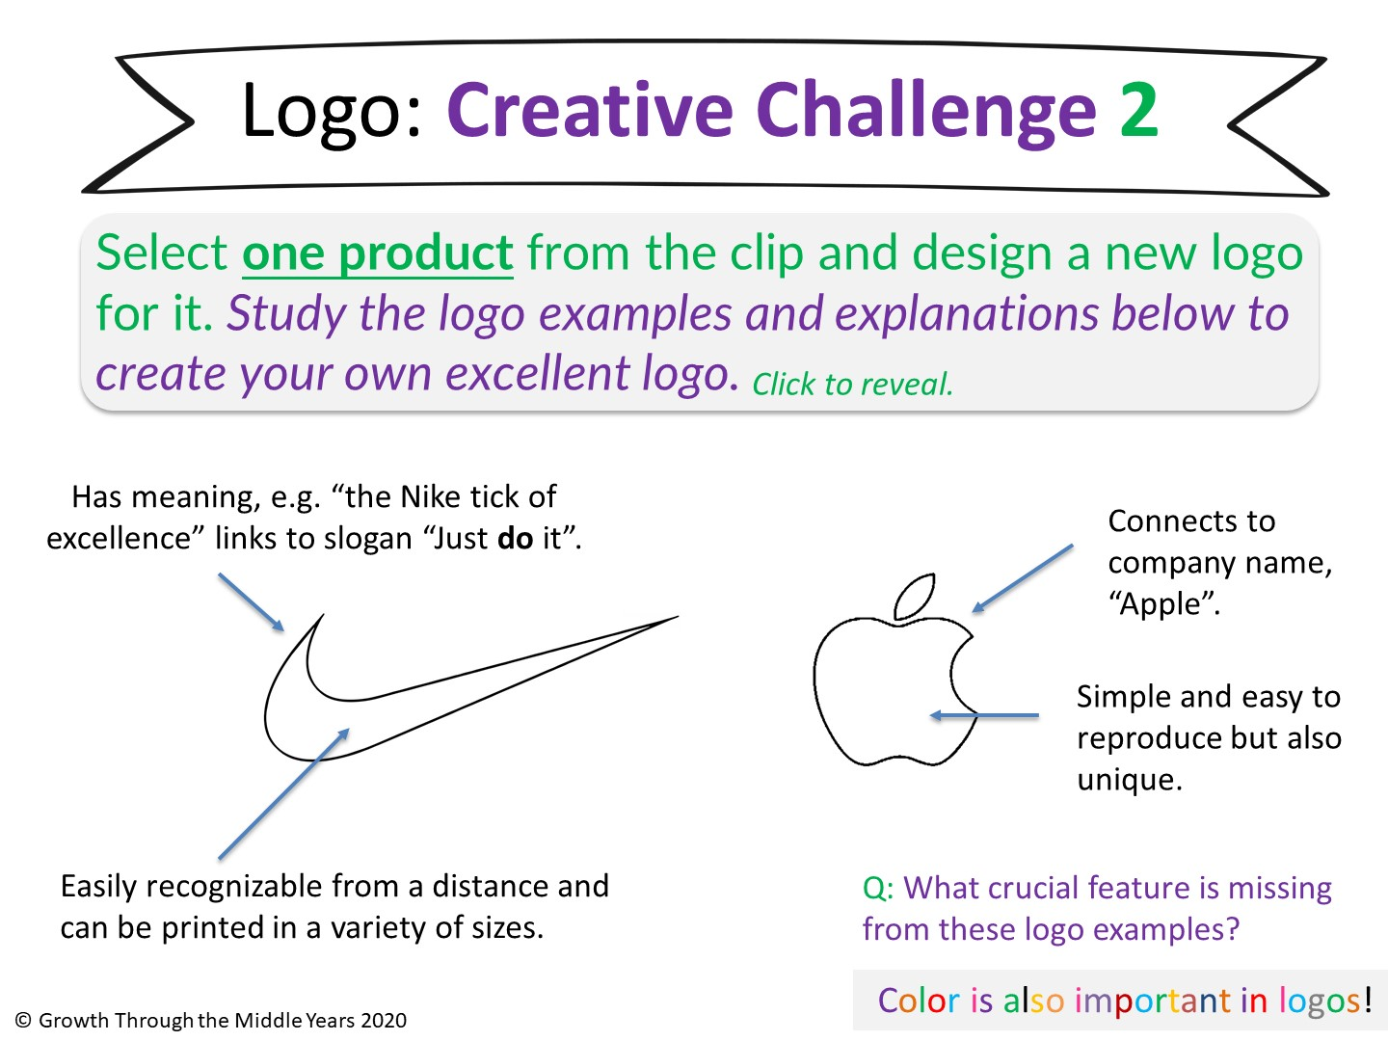

Slide 16
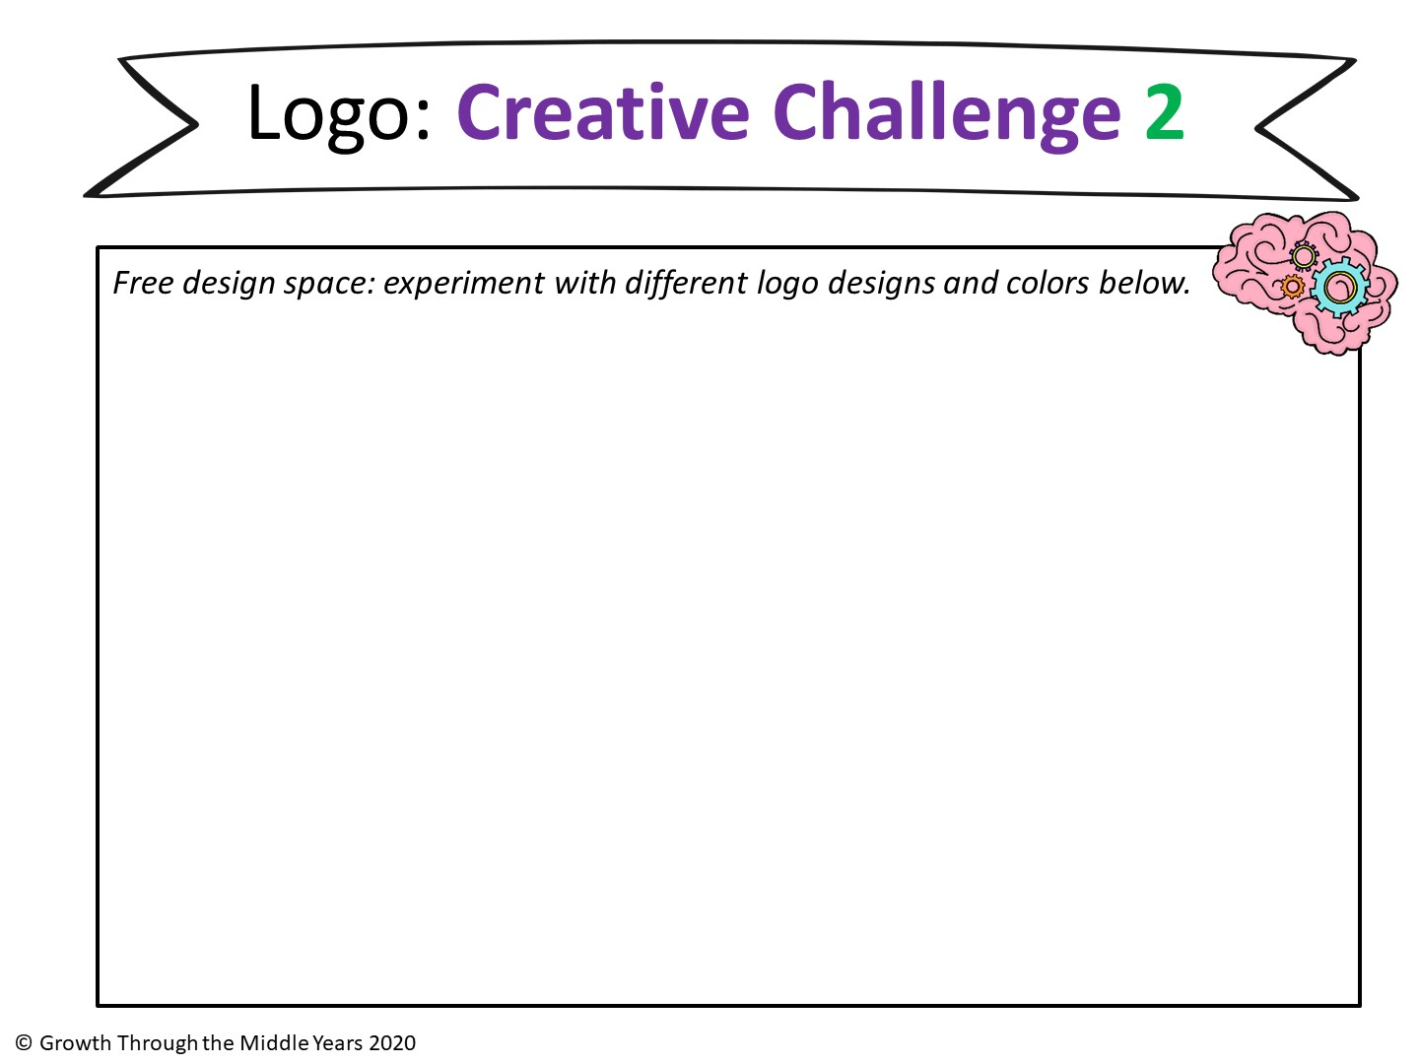
ONLINE LOGO CREATION TOOLS:
https://www.canva.com/
https://www.wix.com/logo/maker
https://www.brandcrowd.com/maker

Slide 17
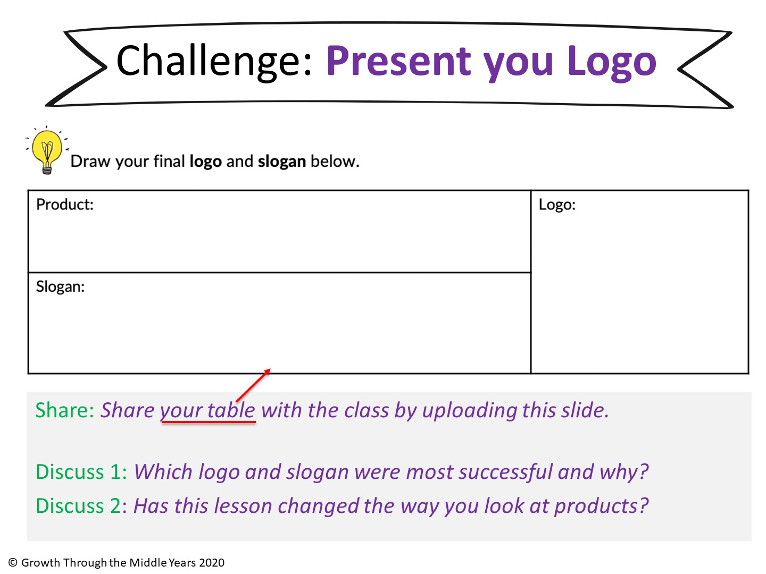
Type here
Paste final logo here (and delete this box)
Type here

Slide 18
