Slide 1
Color

Slide 2
Color as a Design Element
Color is one of the most important elements of design.
It can evoke action and emotion.
It can attract or detract attention.
Notes:
Click on the link to a website about color. This interactive website allows students to explore information about color and its symbolism. Students can view animations describing the colors. They can also draw illustrations with color and take a quiz about color symbolism.

Slide 3
I. Color Sets

Slide 4
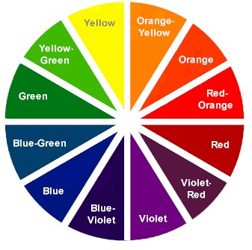
Color Harmony
Color Harmony occurs when a designer achieves a visually pleasing arrangement of colors.
A Color Wheel is an arrangement of hues around a circle to show the relationships between colors.
A Color Palette is a selection of available colors based on a color model. They are used to select colors for use in projects.

Slide 5
Color Themes
Color Themes are sets of colors (swatches, palettes) that are intended to be used together in a publication.
When you choose a color theme you are also setting the mood. Examples:
Warm Colors | red, orange, yellow |  | Exciting
Cool Colors | green, blue, violet |  | Calming
Neutral Colors | beige, ivory, taupe, black, gray, white |  | little to no emotion

Slide 6
Color Schemes
Selecting color combinations may be based on several traditional color schemes. These are:
Complimentary
Monochromatic
Neutral
Analogous
Low Intensity
Split Compliments
Double Compliments

Slide 7
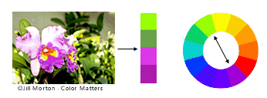
Complementary Colors
Complementary Color Schemes – any 2 colors directly opposite each other on a 12-part color wheel.
Examples: Red/Green, Orange/Blue, Yellow/Violet

Slide 8
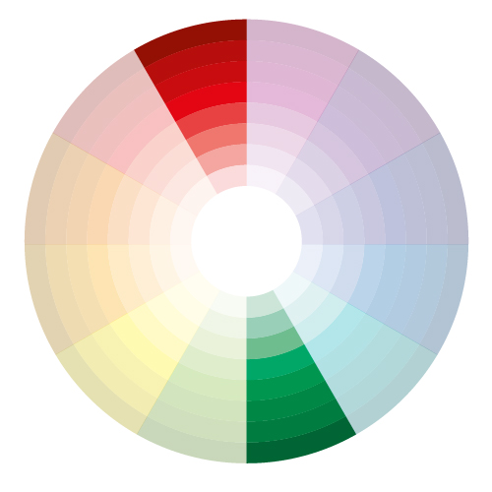
Complementary Colors
Any two colors whose light together produces white are called complementary colors.
Complementary colors in an image are pleasing to the eye. The colors seem to belong together.
The most effective use of complements is to let one of them dominate by giving it a bigger area or a fuller saturation, while using the other as an accent.

Slide 9
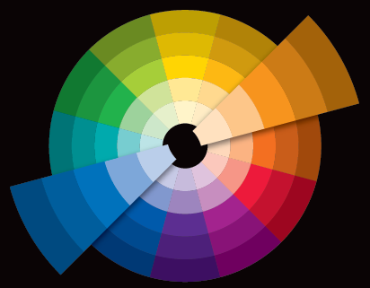
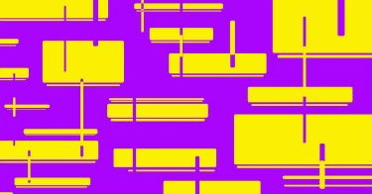
Complementary Colors
Complementary colors lie opposite each other on the color wheel. They complete or enhance each other.
When a pair of high intensity complements are placed side by side, they seem to vibrate and draw attention to the element.
If the hues are of low-intensity, the contrast is not too harsh.

Slide 10
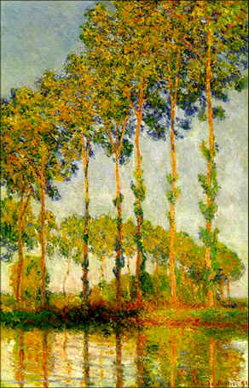
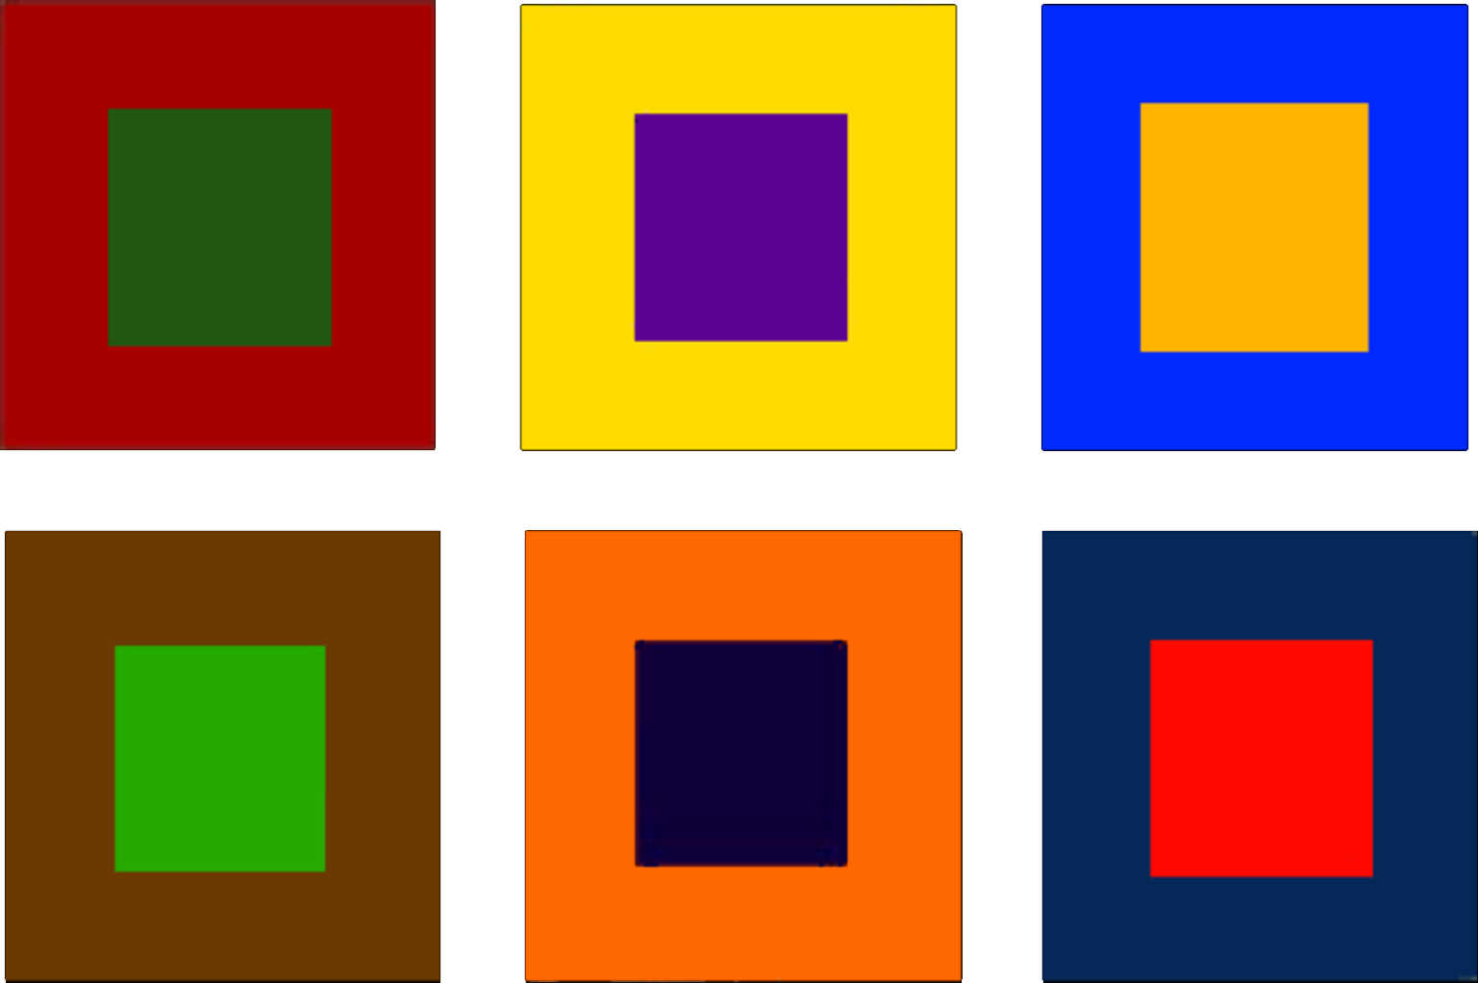
Complementary Colors
Intensity can only be altered by mixing a color with its complement, which has the effect of visually neutralizing the color.
Changing the values of the hues, adding black or white, will soften the effect.

Slide 11
Monochromatic Colors
Monochromatic Color Schemes - variations in lightness and saturation of a single color. Easy on the eyes but designers may find it difficult to emphasize important elements.

Slide 12
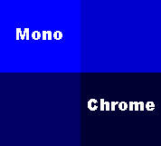
Monochromatic Schemes
A monochromatic color scheme uses only one hue (color) and all values (shades or tints) of it for a unifying and harmonious effect.
You can change the value of a color by adding black (shade), or white (tint), or gray (tone).
As white is added to a color it becomes “higher” in value (lighter).
As black is added it becomes “lower” in value (darker).

Slide 13
Monochromatic Schemes
Value is the relationship of light to dark.
Values that are close together give the design a calm appearance.
Values of pure hues as well as those of tints and shades create movement.
Value contrasts show texture and provide an effective means of directing viewer attention in a composition.

Slide 14
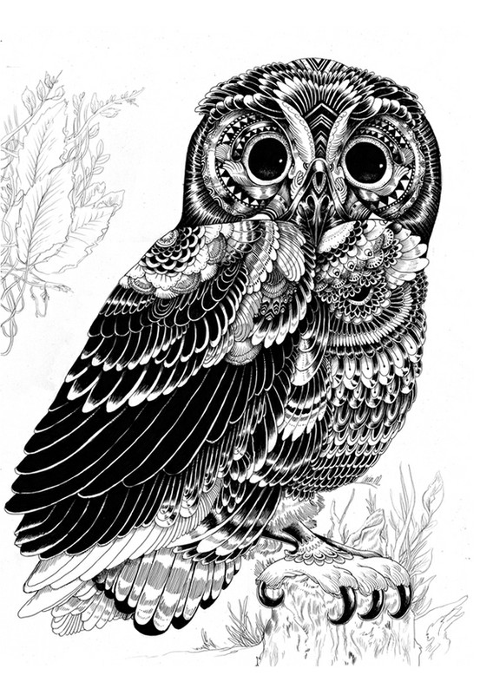
Neutral colors
Contains equal parts of three primary colors - black, white, gray, and sometimes brown.
When neutrals are added to a color, only the value changes.
If you try to make a color darker by adding a darker color to it, the color (hue) changes.
Black and white are thought of as neutrals because they do not change color.

Slide 15
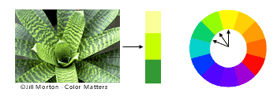
Analogous Colors
Analogous Color Schemes - any three colors which are side by side on a 12-part color wheel. Usually one of the three colors is dominant.
Example: yellow-green, yellow, and yellow-orange.

Slide 16
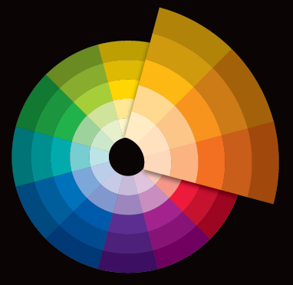
Analogous Colors
Colors that contain a common hue and are found next to each other on the color wheel.
Adjoining colors on the wheel are similar and tend to blend together.
They are effective at showing depth.

Slide 17
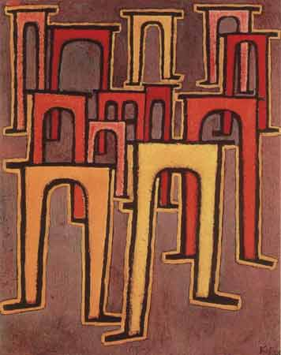
Analogous Colors
Analogous color can be used to create subtle differences in an image or design by creating a peaceful and more harmonious feeling.

Slide 18
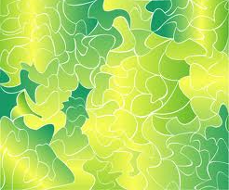
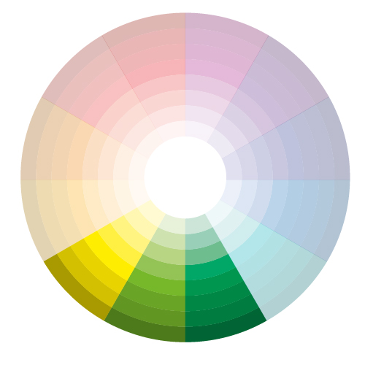
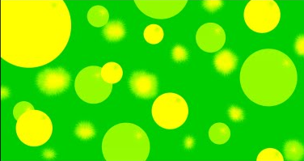
Analogous Colors

Slide 19
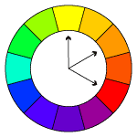
Split-Analogous
A color scheme that includes a main color and the two colors one space away from it on each side of the color wheel.
An example is red, blue, and violet or red, yellow and violet.

Slide 20
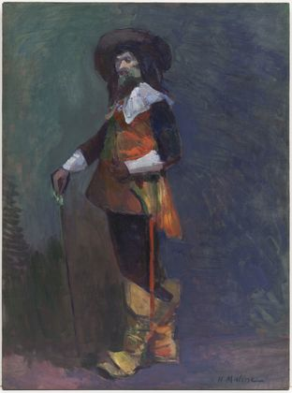
Intensity
Intensity is the Brightness or dullness of a color.
A pure hue is a high-intensity color.
A dulled hue, a color mixed with its complement, is called a low-intensity color.

Slide 21
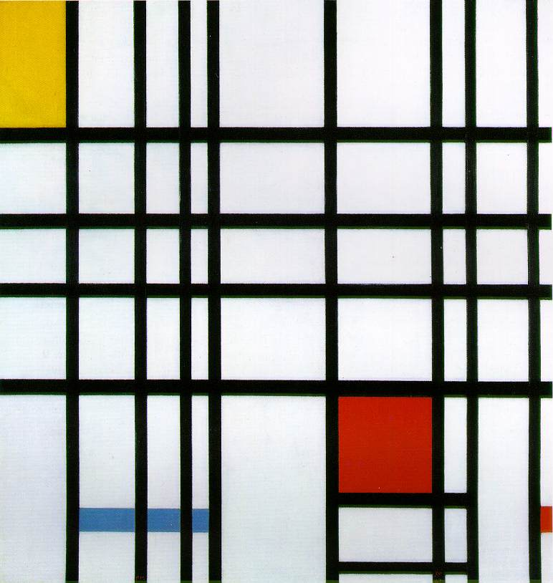
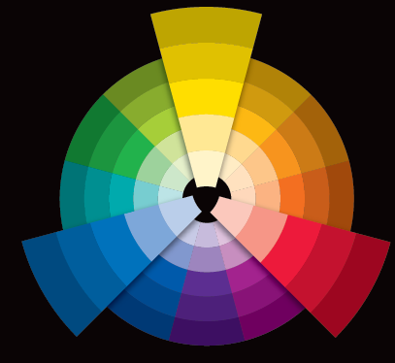
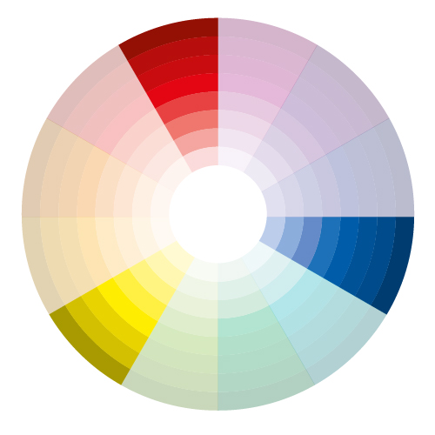
Triads
A color triad is composed of three colors spaced an equal distance apart on the color wheel.
The contrast between triad colors is not as strong as that between complements.

Slide 22
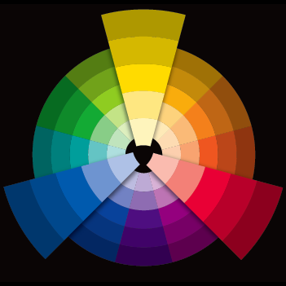
Triad - Primary Colors
Primary Color are rarely seen as a trio except in children’s products.
Red and yellow, are popular in the USA for everything from fast food to gas stations.
Blue and red are also common, but are attractive only when separated by space.

Slide 23
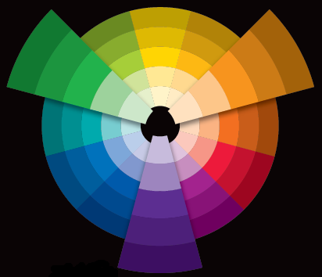
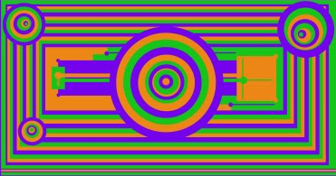
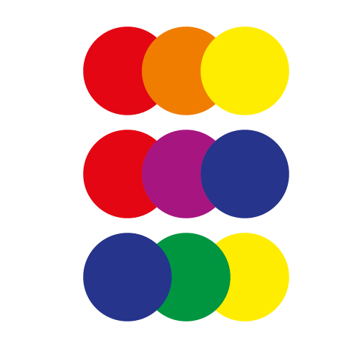
Triad - Secondary
Colors created by mixing two primary colors to create a secondary color.
Red + yellow =orange
Yellow + blue = green
Blue + red = purple (violet)

Slide 24
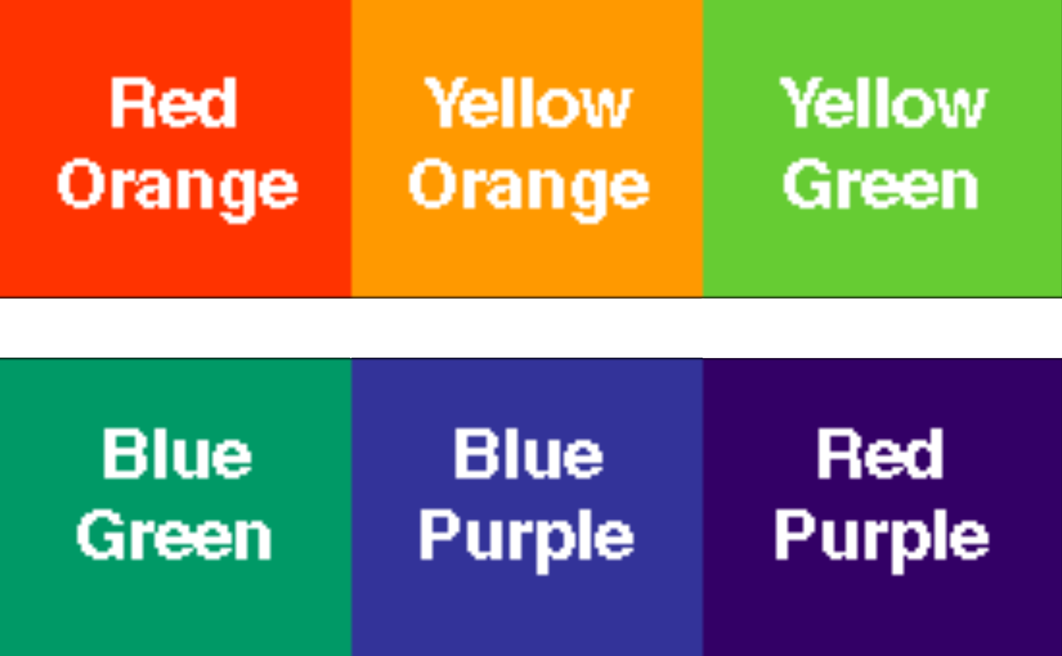
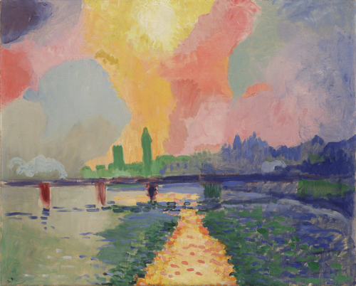
Intermediate Triads
Colors are created by mixing a primary and a secondary
Examples:
red-orange yellow-orange yellow-green blue-green blue-purple red-purple

Slide 25
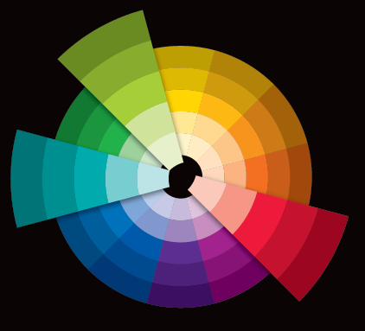
Split Complements
The combination of one hue, plus the hues on each side of its complement.
Easier to work with than a straight complementary scheme because it offers more variety.
Example: red-orange,
blue, and green.

Slide 26
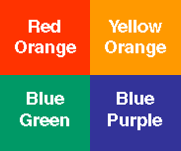
Double Complements
Two hues and their opposites.
Four colors arranged into two complementary color pairs.
Scheme is hard to harmonize.
If all four colors are used in equal amounts, the scheme may look unbalanced.
Choose a color to be dominant or subdue the colors.

Slide 27
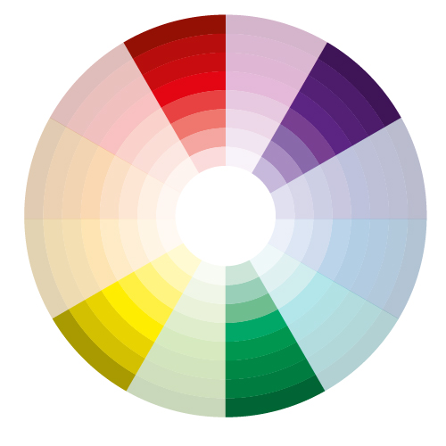
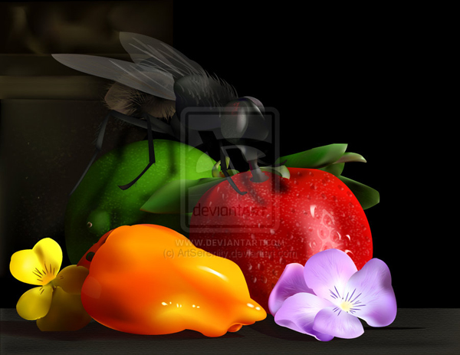
Double Compliments

Slide 28
II. Color Theory

Slide 29
Color Theory
Color Theory refers to knowledge of color mixing and the visual impact of color choices on design.
Colors are defined by three primary characteristics:
Hue
Luminosity
Saturation

Slide 30
The Three Properties of Color
Hue
The primary property of colors by which they are named and that distinguishes one color from another.
Examples: Red, Blue, Yellow, Green, etc.
Luminosity
A subjective property of colors that describes its perceived brightness along a lightness–darkness axis.
Same as Brightness, Lightness, and Value.
Produces Tints and Shades.
Saturation
A subjective property of colors that describes its perceived concentration along an intense–dull axis.
Same as Colorfulness or Purity.
Produces Tones.

Slide 31
Tints and Shades
Tints - Lighter versions of the same color made by mixing with white.
Shades - Darker versions of the same color made by mixing with black.
When creating Tints and Shades, the color’s Luminosity will change but Hue and Saturation will remain constant.
Pink: A tint of red
Red is the hue
Burgundy: A shade of red

Slide 32
Tones
Tones - More colorful or dull versions of the same color made by mixing with gray.
When creating Tones, the color’s Saturation will change but Hue and Luminosity will remain constant.
Hue
Tints
Tones Shades
Blue mixed with White
Blue mixed with Gray
Blue mixed with Black

Slide 33
III. Color Models

Slide 34
What is a Color Model?
A Color Model is a system for mixing a set of base colors to create a full spectrum of all possible colors.
There are two basic types of color models :
Additive
Subtractive

Slide 35
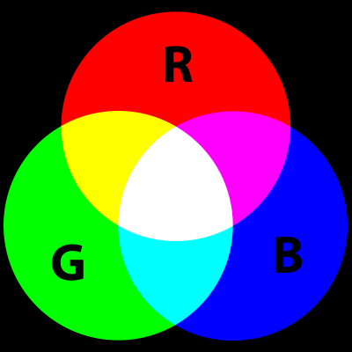
Additive Color Models
In Additive Color Models, new colors are created by combining colors of light on a black background.
All electronic displays use an additive color model. As light gets added the resulting color gets lighter.

Slide 36
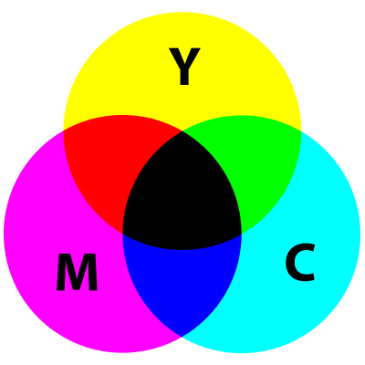
Subtractive Color Models
In Subtractive Color Models, new colors are created by combining dyes, inks, or paints on a white background that absorbs (subtracts) different wavelengths of light.
All real-world objects follow a subtractive color model. As pigment gets added the resulting color gets darker.

Slide 37
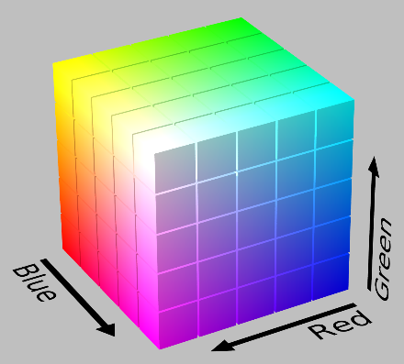
RGB
RGB (short for Red-Green-Blue) is an additive color model used with electronic displays by mixing Red, Green, and Blue light values.

Slide 38
CMYK
CMYK (short for Cyan-Magenta-Yellow-Black) is a subtractive color model used in color printing by adding Cyan, Magenta, Yellow, and Black pigment to a background, usually white paper.

Slide 39
Color on Monitors
Electronic displays use the additive RGB model to display color.
The amount of red, green, and blue are shown in different amounts in different “spots” on the monitor to produce an image.
All colors can be formed from these three base colors (red, green, and blue).
Notes:
Look at color palette and then experiment with the different combinations of red, green and blue.
Wikipedia RGB link url = http://upload.wikimedia.org/wikipedia/commons/2/28/RGB_illumination.jpg

Slide 40
Color in Printing
Printers use the CMYK model to create color. This process is also called four-color printing.
Q: All colors can be formed from the three base colors (cyan, magenta, and yellow) so why include black?
A: Mixing all three colors does not produce a true black. (It’s more of a dark muddy brown.) The industry’s solution was to include black ink separately.
Notes:
For more information, visit http://www.worqx.com/color/color_systems.htm

Slide 41
Color Matching
Since color is displayed differently on monitors than it is printed with printers, color matching must be used.
Color Matching is the process of matching the printed ink color as closely as possible to the color displayed on the monitor.
The goal is to make the printed publication look as close to the version on the monitor as possible.

Slide 42
IV. Color Representation Systems

Slide 43
Color Representation Systems
RGB is the internal color model used with all digital displays. However as a designer, you have many options when choosing colors and color sets. You can set colors “in the raw” by using an implementation of the RGB model directly or by using one of several standardized notation systems.
Since working directly with RGB can feel too technical, other color representation systems have been developed specifically to make the designer’s job easier by making the task of color picking more intuitive.
The primary alternative to raw RGB manipulation is HSL.

Slide 44
HSL vs RGB
HSL (short for Hue-Saturation-Luminosity) is a cylindrical-coordinate representation of points in an RGB color model.
By contrast, RGB uses a cube representation based on the relative amounts of Red, Green, and Blue in a given color.
While RGB is simpler to conceptualize, it is also less intuitive to use for professionals. Thus the usefulness and popularity of alternative systems like HSL.

Slide 45
Color Notation Systems
Decimal Notation
Represents colors using values for red, green, and blue that range from 0 to 255.
CSS Example: p { color: rgb(255,0,0); }
Hexadecimal (Base 16) Notation
Represents colors using the numbers 0–9 and the letters A-F to represent values of red, green, and blue.
CSS Example: p { color: #FF0000; }
Percentage Notation
Represents colors as percentages of red, green, and blue light values.
CSS Example: p { color: rgb(100%,0%,0%); }
HSL Notation
Represents colors using values for hue, saturation, and luminosity.
CSS Example: p { color: hsl(0, 100%, 40%); }
Note: All examples here produce Red.

Slide 46
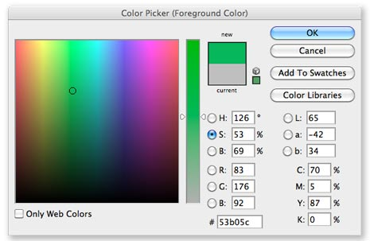
A Color Picker that supports Many Color notation Systems

Slide 47
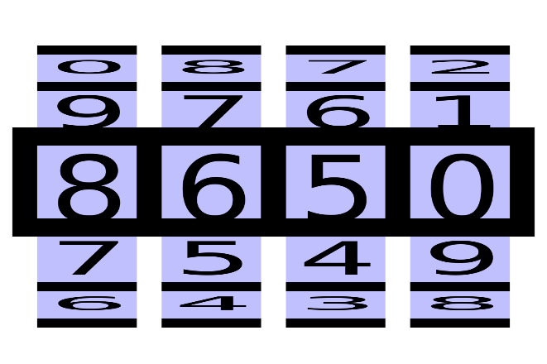
How to Count in Hex
Counting in Hexadecimal (Hex for short) is really quite easy once you get the hang of it.
In normal counting there are 10 digits (the numbers 0 through 9) and when you count up from 0 and reach 10 you “roll over” the number in the ones position back to 0 and increment the number in the tens position to 1.
It is the same in Hex. However, you have 16 digits rather than 10. Since English only has 10 digits we use the first six letters of the alphabet to represents the missing digits for 11 through 16.
So in Hex we count up from 0 like normal but what comes after 9 is A then B, C, D, E, and F. After F is when we “roll over” to 10. Now hold on! This number may look like a normal “ten” but in Hex it’s the number “seventeen”. To prevent confusion we don’t pronounce it like “ten”. Instead, say “one zero”. (And what comes after “one zero” in Hex? Why “one one” of course!)

Slide 48
How RGB Notation Works
In the RGB model, colors are represented by values of Red, Green, and Blue from 0 to 255.
These values can be written using normal decimal numbers like “127, 0, 255” or converted to hexadecimal numbers like “7F 00 FF”.
In both cases, the first value (127 or 7F) is the amount of Red, the second the Green, and the third the Blue.
This example produces a nice purple with half Red, no Green, and full Blue values.
 | Red | Green | Blue
DEC | 127 | 0 | 255
HEX | 7F | 00 | FF

Slide 49
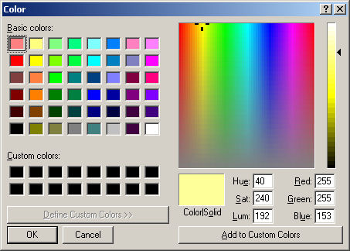
Which Color Representation System Should I use?
Modern software and operating systems usually support multiple color representation systems. So designers can use whichever they prefer among the options available.
There are also web apps that can perform any conversions you might need:
Adobe Color CC
HSL Color Picker
HSL Color Schemer
Paletton

