Slide 1
PREMIERE PRO BOOTCAMP PART 2 UNDERSTAND THE ADOBE PREMIERE PRO CC INTERFACE.
Objective 3.00

Slide 2
PREMIERE PRO PANEL SHORTCUTS
Project Panel
Shift + 1
Source Monitor
Shift + 2
Timeline Panel
Shift + 3
Program Monitor
Shift + 4
Effect Controls
Shift + 5
Audio Track Mixer
Shift + 6
Effects
Shift + 7
Audio Clip Mixer
Shift + 9

Slide 3
Clip vs Shot
Video Shots are what you record on your device.
A clip is a section or portion of your shot that you use in editing

Slide 4
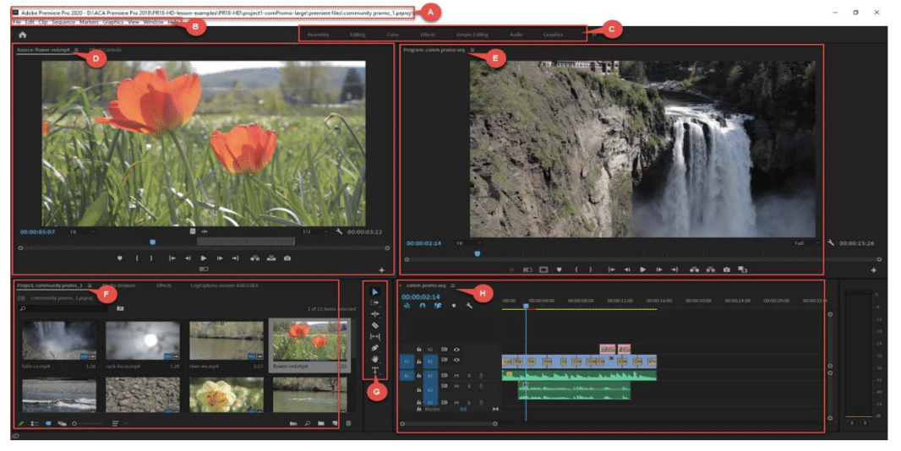
A. Project File Address
B. Menu Bar
C. Workspaces
D. Source Monitor
E. Program monitor
F. Project Panel
G. Toolbar
H. Timeline panel

Slide 5
This is the Project Panel. This holds your media browser, also holds your project, any footage and assets you bring into each project. You can have multiple projects open and see all the projects as tabs like in your internet browser. You can also find other tabs listed that can take you to Effects Panel, Media Browser, and libraries.

Slide 6
PROJECT PANEL (SHIFT +1)
Where assets are stored. Clips, bins, titles, sequences, etc.
Importing methods:
Project Panel - Double Click
File -> menu – import
Shortcut – Ctrl+ I
Importing a Folder: Select the ‘Import Folder’ button in the dialogue box
Bins: are similar to Folders in Windows. Click New Bin Icon
Views:
List – File Name
Icon – Thumbnail Images, Hover over and scrub

Slide 7
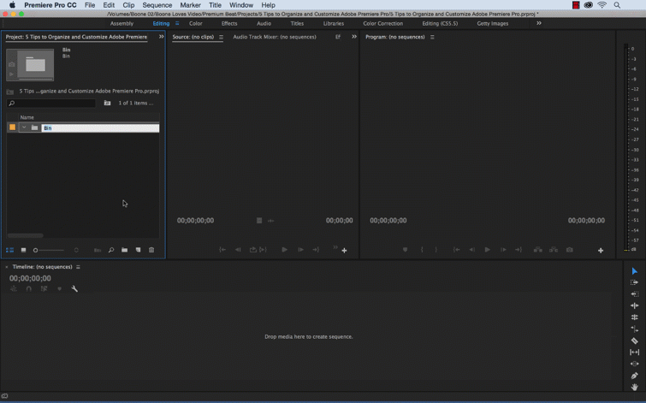

Slide 8
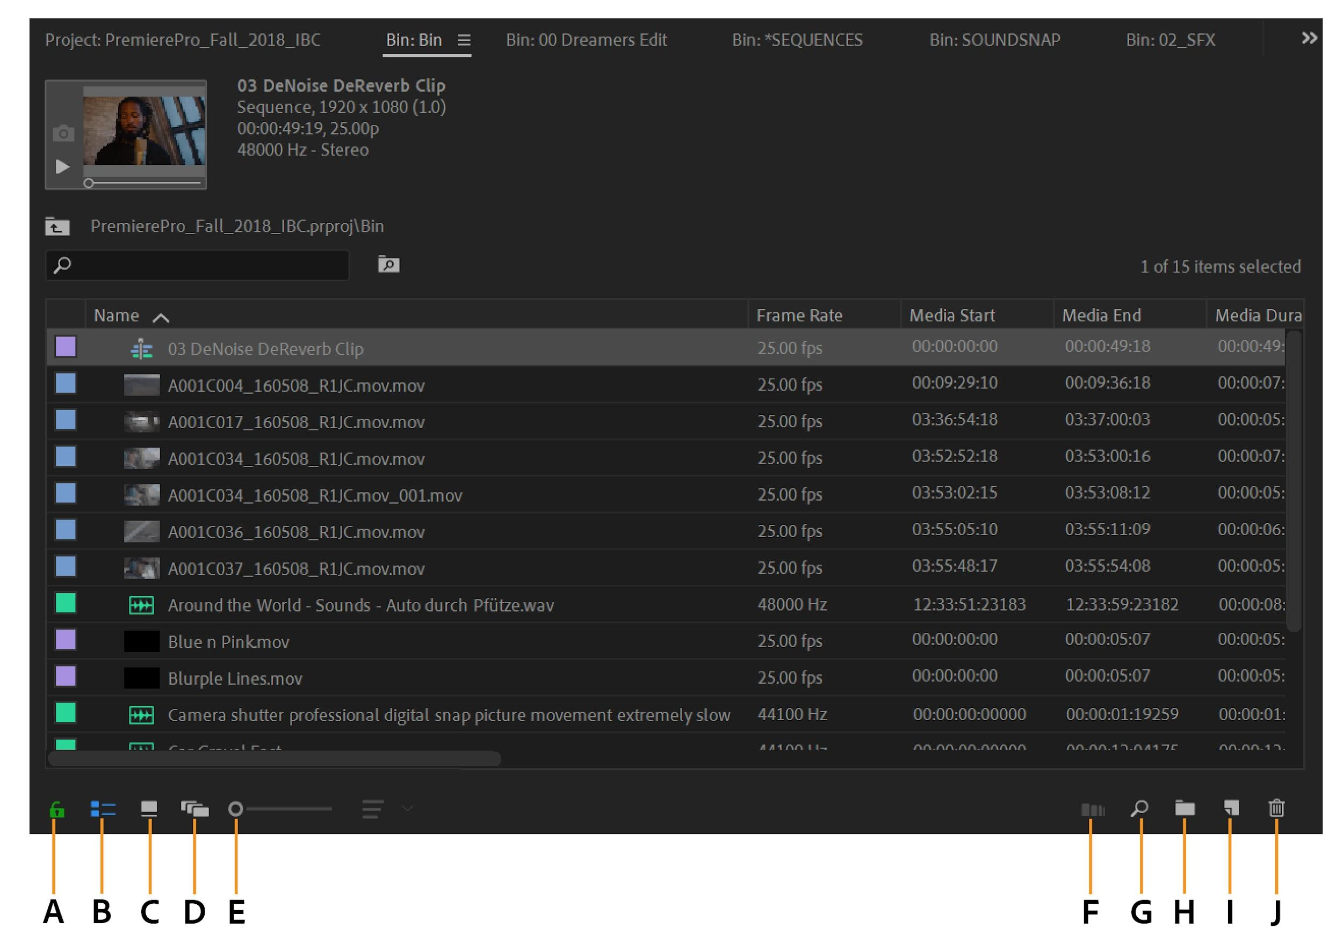
A. Lock
B. List view
C. Icon view
D. Freeform view
E. Zoom slider F. Automate to sequence
G. Find
H. New Bin
I. New item
J. Clear

Slide 9
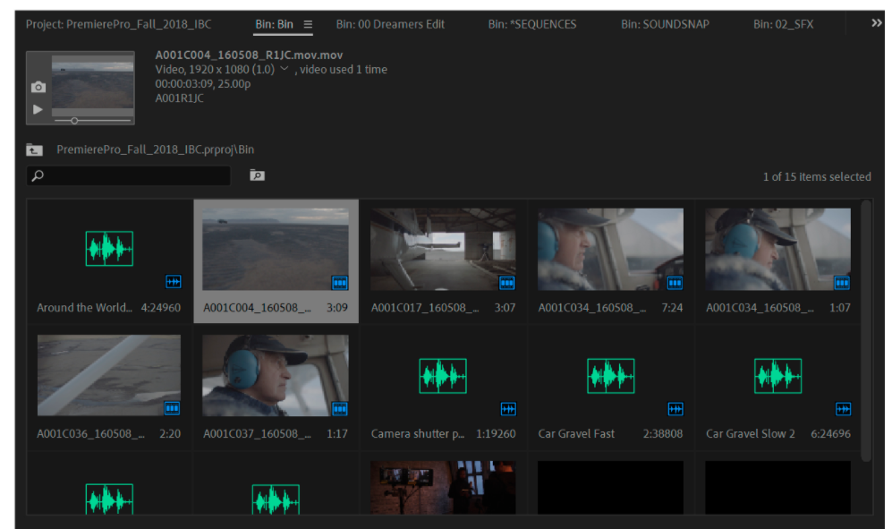
Previous Slide was list view. This is icon view.
You can also see there are different tabs at the top of the panel, can open bins and other projects

Slide 10
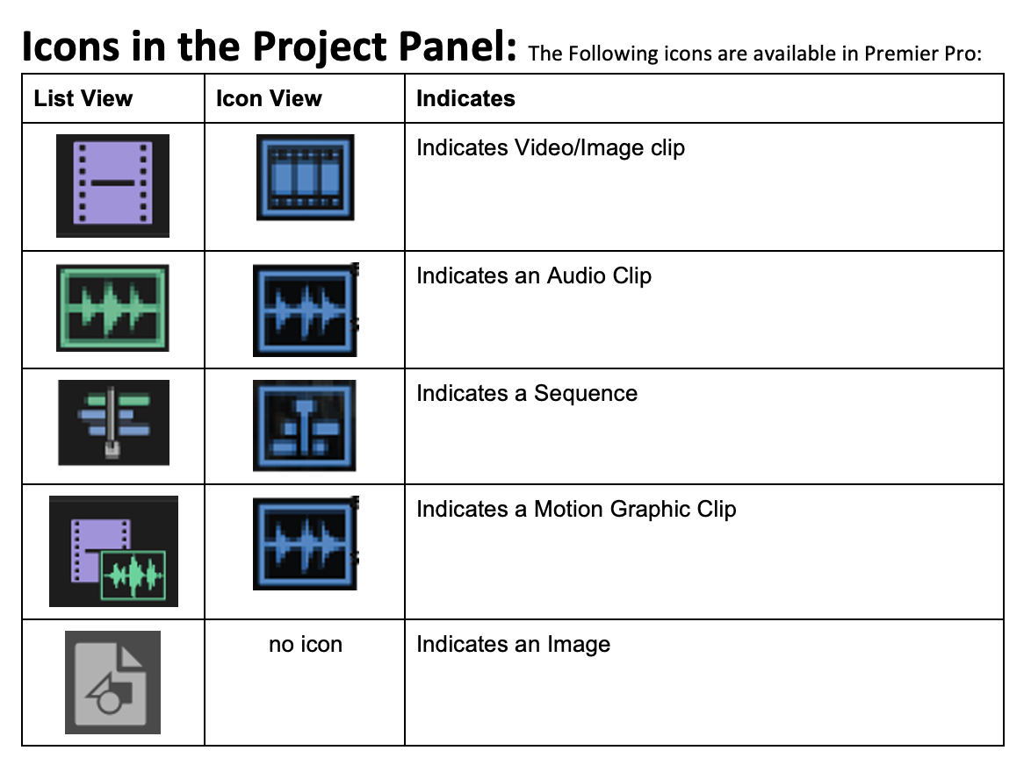

Slide 11
TIMELINE
Used to place and edit all media elements.

Slide 12
TIMELINE PANEL (SHIFT + 3)
Allows you to assemble, edit, and modify clips, add effects, titles, etc.
CTI: Current Time Indicator – AKA your playhead
Sequence: series of clips, titles, effects, etc.
Shortcut to Fit All Clips: \
Tracks: Default is 3 video and 3 audio
Expanding Track: Double-click track header
Audio: Rubberband to adjust volume. Shift+Click with selection Tool or Pen for Keyframes
Unlinking/Linking Audio Video: Right-Click and press Unlink/Link
Clip Speed/Duration: Right-Click, Speed Duration
Dynamic Trimming: JKL keyboard shortcuts - (They mean Dynamic Playback)
Ripple Delete – Shift+Delete

Slide 13
Every video you edit, you will create a sequence. Your sequence lives in the project panel but is edited in the timeline panel
You can create a new sequence 2 ways.
1) drag your media asset over to the timeline panel from the project panel and it will create a sequence for you
2) go to the bottom right of the project panel and click new item and select sequence
(There is a third way but not used often. Going into the menu up at the top and selecting new and create new sequence from clip.)
You can open more than one Timeline panel if you have more than one sequence in a project. When you open a sequence, it opens in a new tab. Drag the tab into another docking area. The sequence appears in a new timeline.

Slide 14
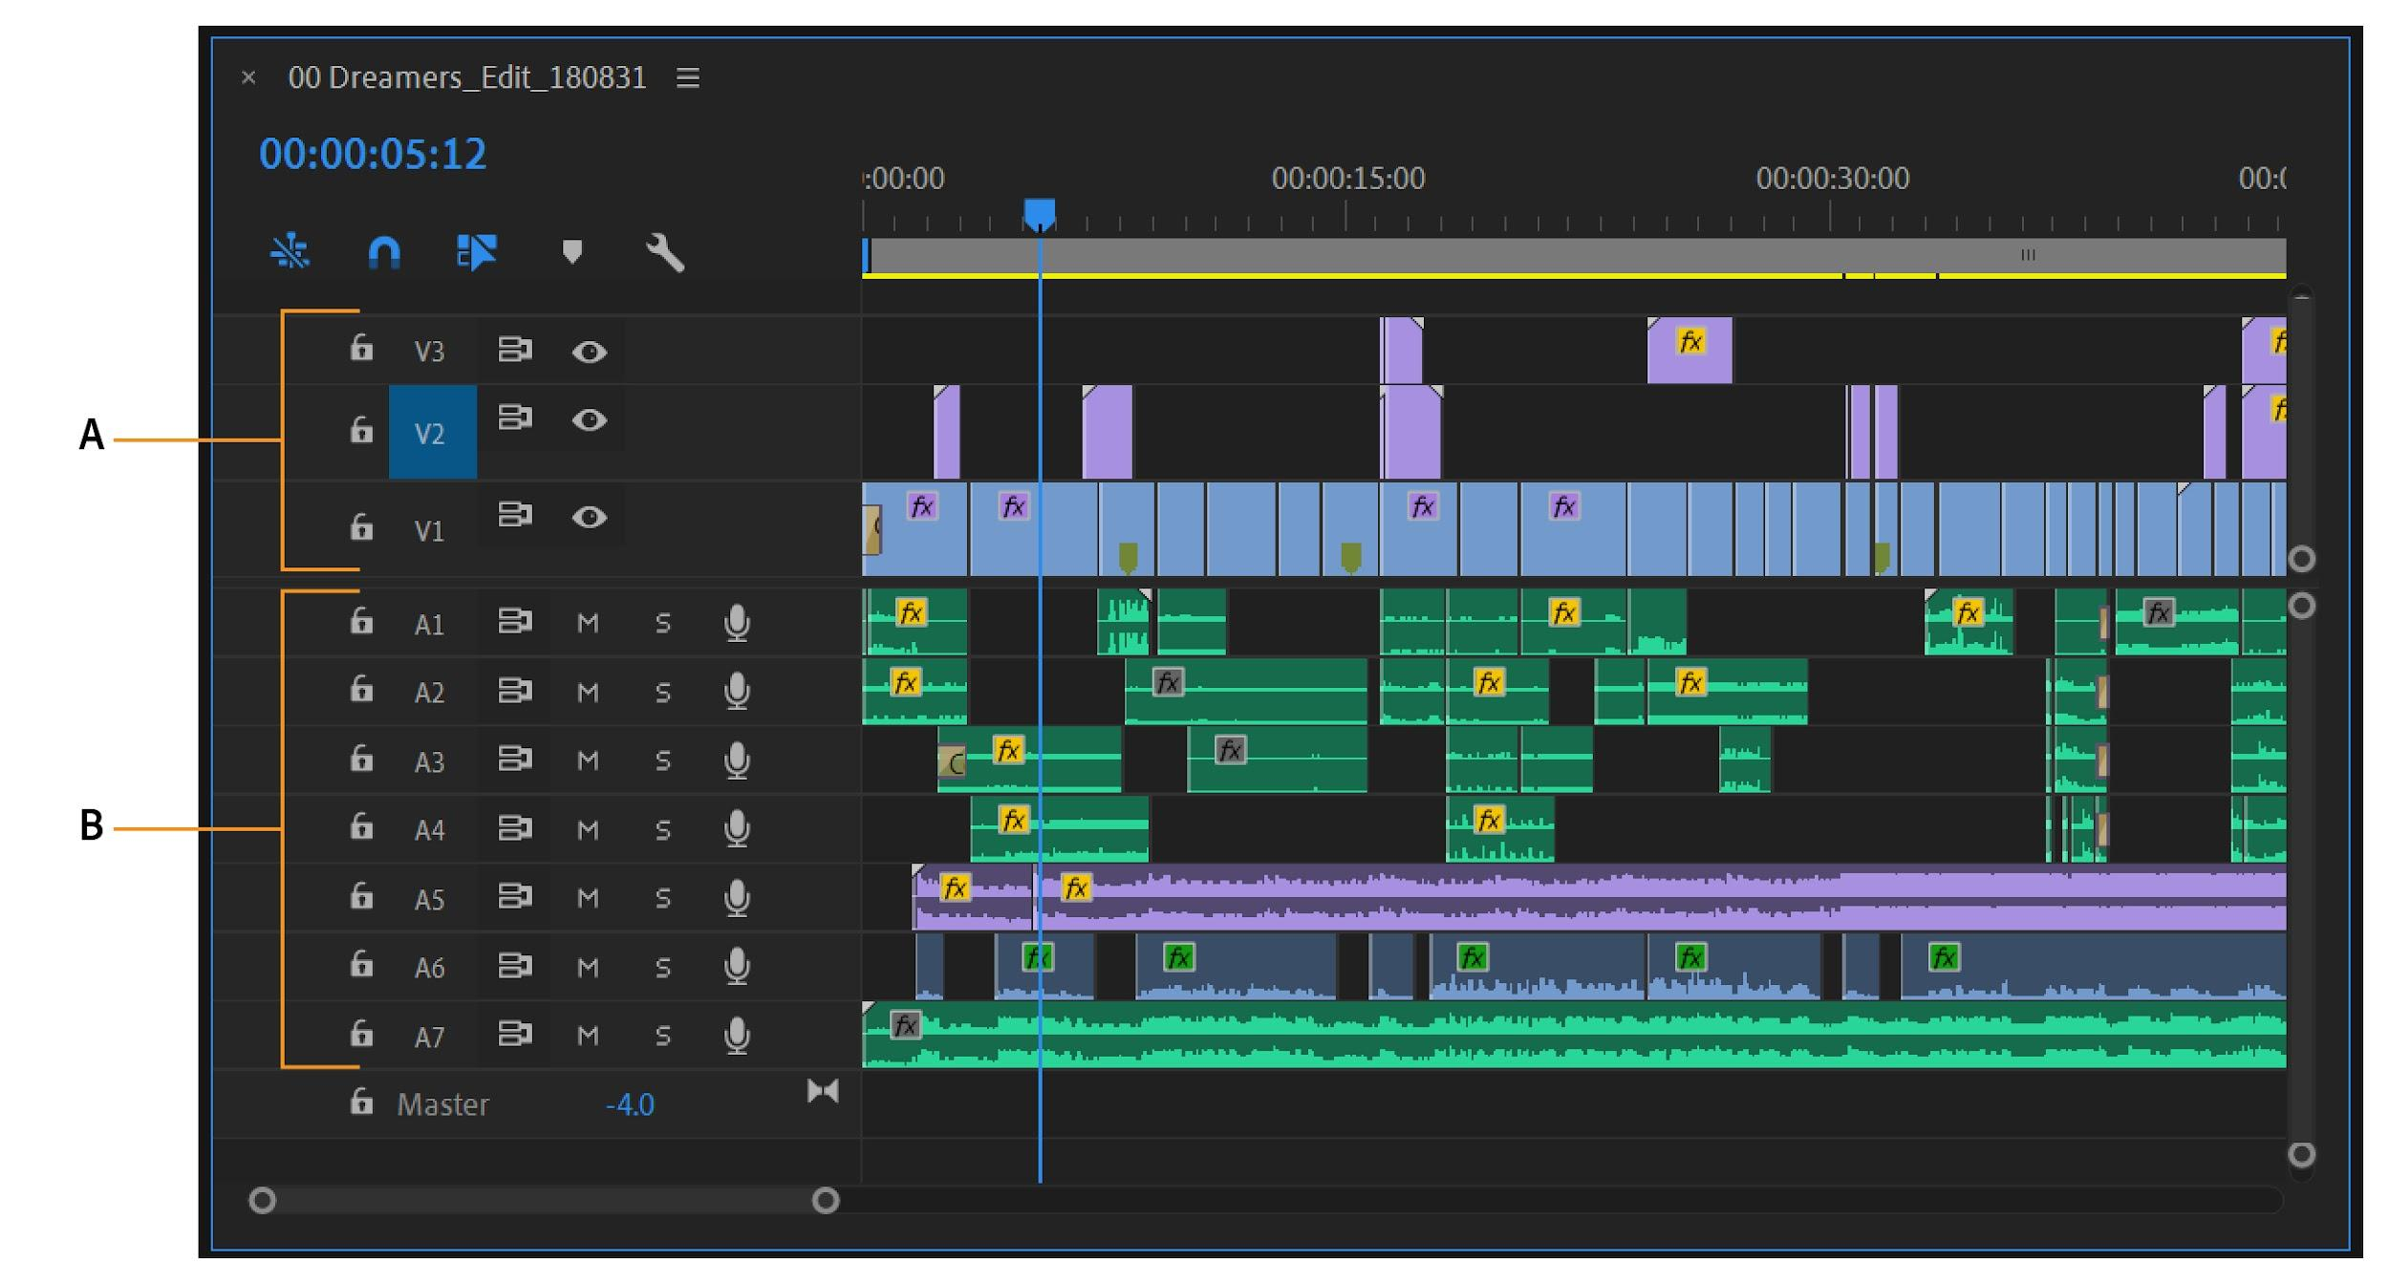
A. Video tracks B. Audio tracks

Slide 15
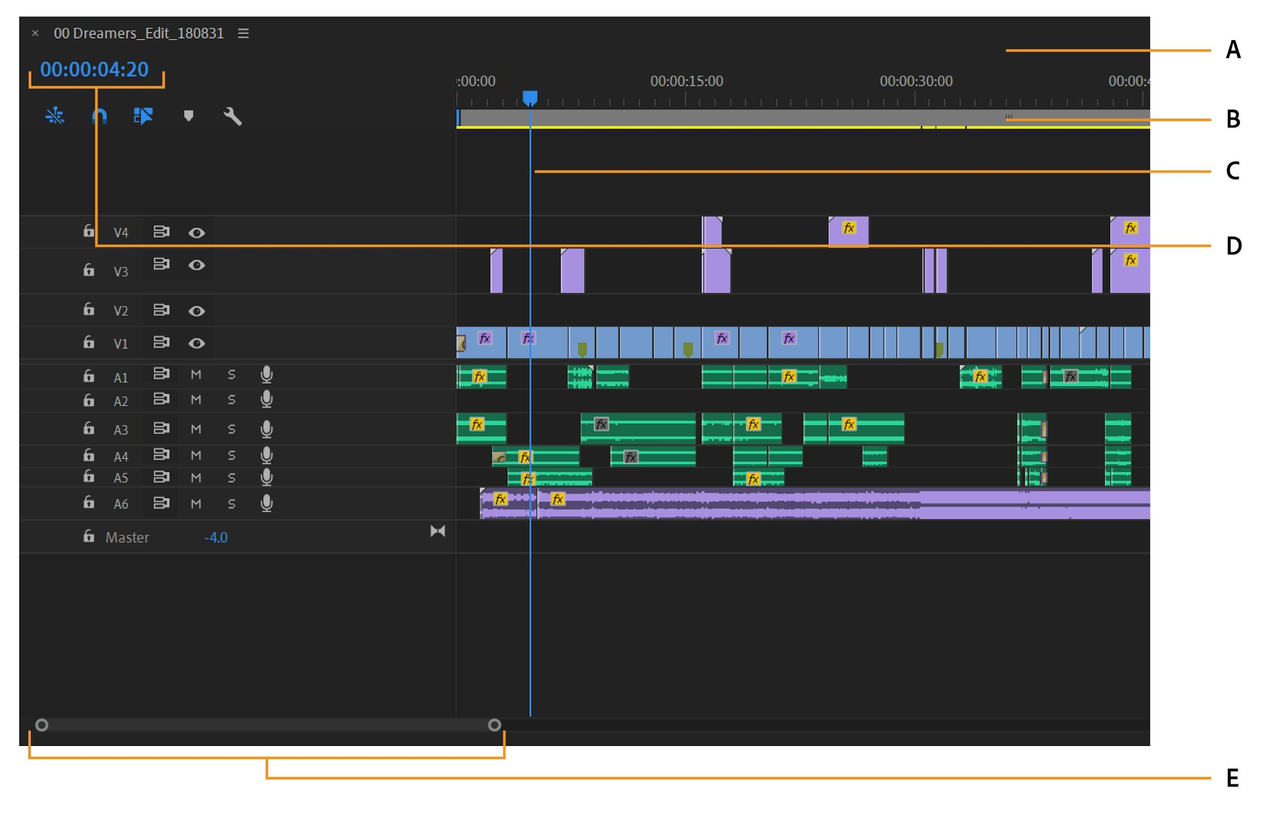
A. Time ruler
B. Work area bar
C. Playhead
D. Playhead position
E. Zoom scroll bar

Slide 16
A. Toggle Track Output
B. Mute Track
C. CTI (aka Playhead)
D. FX Button

Slide 17
SOURCE MONITOR VS. PROGRAM MONITOR
Source Monitor - Used to edit clips before putting on timeline.
Program Monitor - Used to view clip sequences in timeline.
Source Monitor
Program Monitor

Slide 18
SOURCE MONITOR PANEL (SHIFT +2)
Preview clips from Project Panel
Transport Controls:
Mark In/Out
Play
Add Marker
Insert
Overwrite
Export a still
Insert – Ripples Overwrite – Replaces
Button Editor: + Sign. Add/Remove on Transport Controls
Drag Options: Audio and Video, Audio Only, Video Only (Crtl to Ripple)
Timecode Format: H:M:S:F
Safe Margins: Action Safe 90%, Title Safe 80%

Slide 19
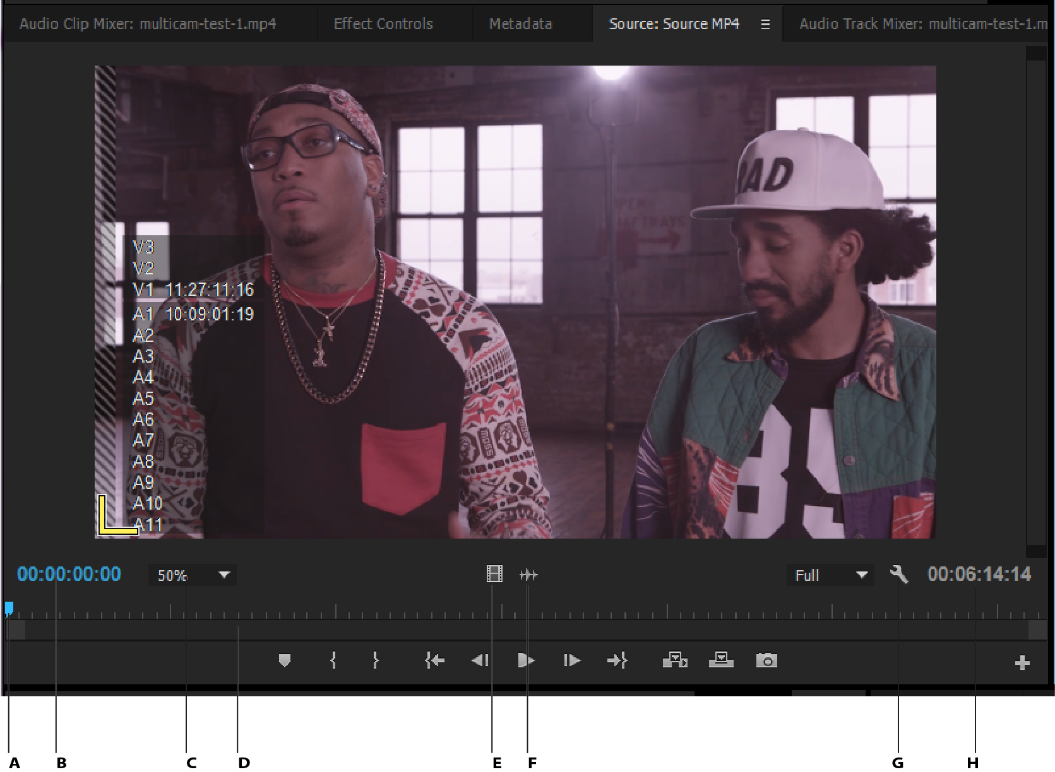
A. Playhead
B. TimeCode
C. Scaling options
D. Zoom scroll bar
E. Drag video (for timeline)
F. Drag audio
(for timeline)
G. Settings button
H. In/Out Duration

Slide 20
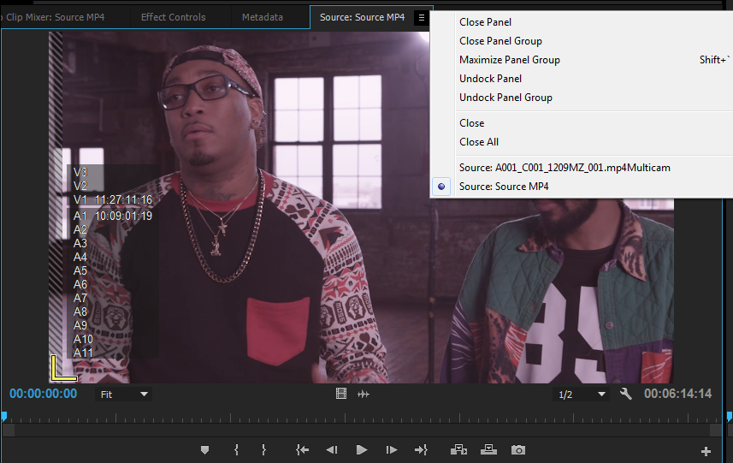
When you are done with a clip in the source monitor, you can clear it out

Slide 21
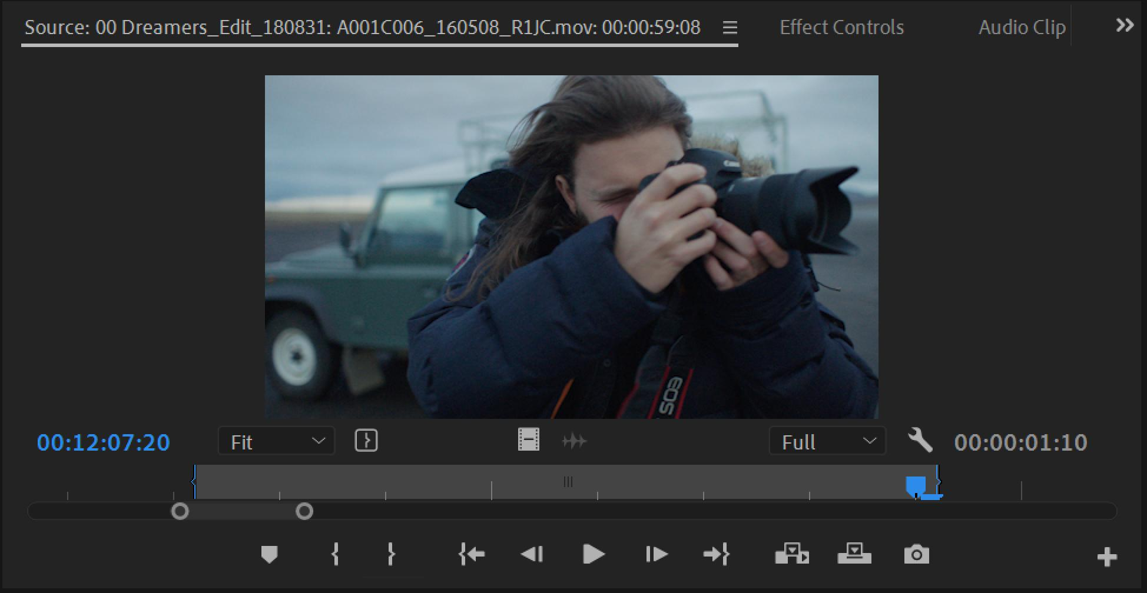
We use the source monitor to select portions of our clip to move into the timeline panel for editing
To select only a portion of your clip, you would set an in point and an out point
This is what selecting a portion of the clip looks like in the source monitor
How to set in and out
You can also select I and O on your computer
I= in
O= out

Slide 22
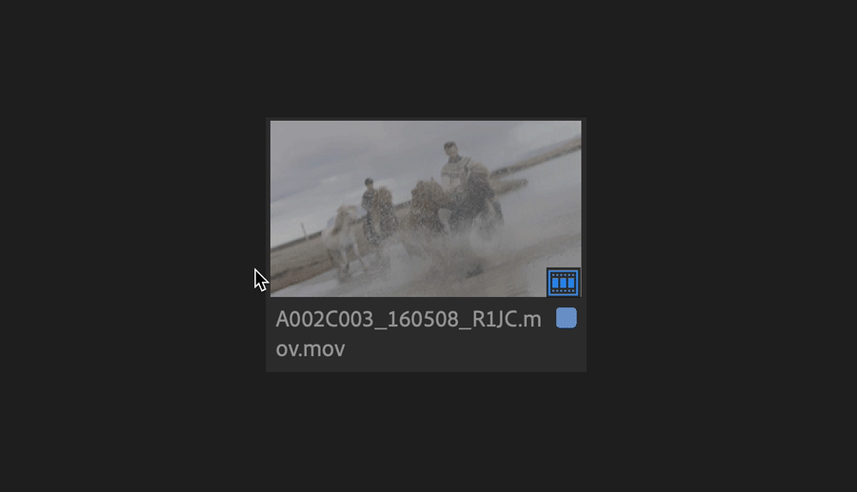
You can hover over the clip and view what is happening in icon view in the project panel and set in’s and out’s as well.

Slide 23
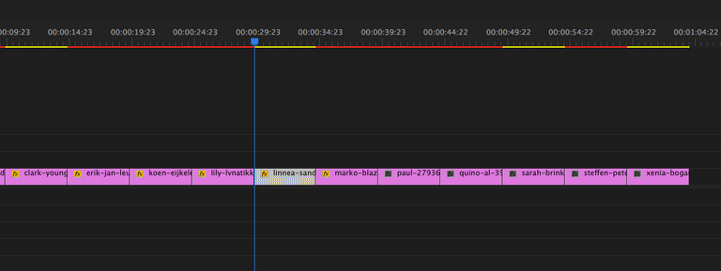
PROGRAM MONITOR (SHIFT + 4)
Preview video being created. Play back sequences.
Displays frame based on CTI in Timeline.
CTI/the playhead (this is located on the timeline)
This monitor shows us exactly where our line is placed and what frame of video shows at that moment

Slide 24
Transport Controls: Similar to Source Monitor, except:
*Lift – Leaves a Gap *Extract – Ripples, no gap
*Safe Margins – Similar to Source Monitor
Source Monitor vs. Program Monitor
Source – previews clips in project panel
Program – previews clips assembled in timeline
Markers – mark a location in a clip for future use, can add comments.

Slide 25
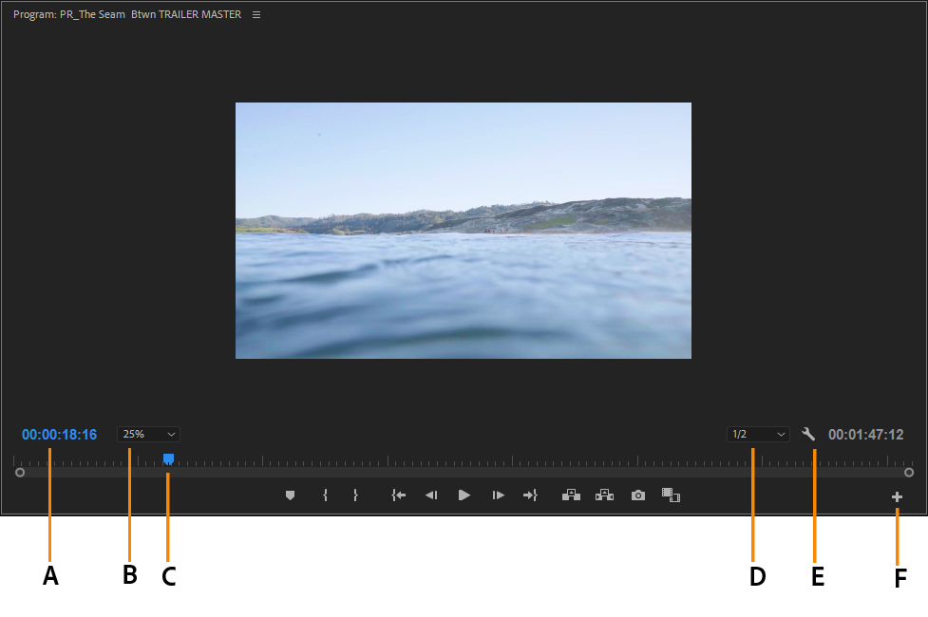
A. Timecode
B. Scaling options
C. Playhead
D. Resolution
E. Settings button
F. Button editor

Slide 26
A B C D E F G H I J K
A - Marker (this allows you to mark something to go back and look at it *you can also name each marker*)
B & C - You can set In & Out points of a portion of the timeline
D & H - Allows you to go directly to the In & Out points
E & G - Allows you to go forward or backwards
F - This is your play Button
I - Lifts (this means you can lift a clip *like deleting* and it will leave a space on your timeline
J - Extracts (deleting a clip and it combines the surrounding clips *so no space*)
K- Export Frame (allows you to take a single frame and save it as an image)

Slide 27
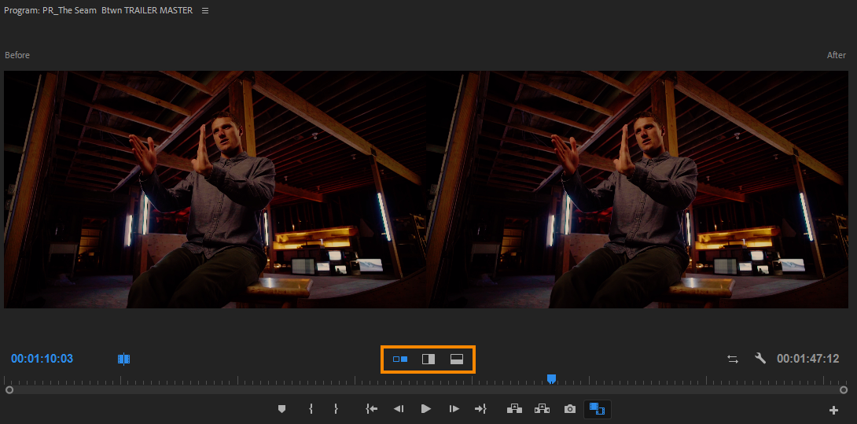
You can also compare two clips in the program monitor to help editing - we will take a look at this when we get into multi-cam editing

Slide 28
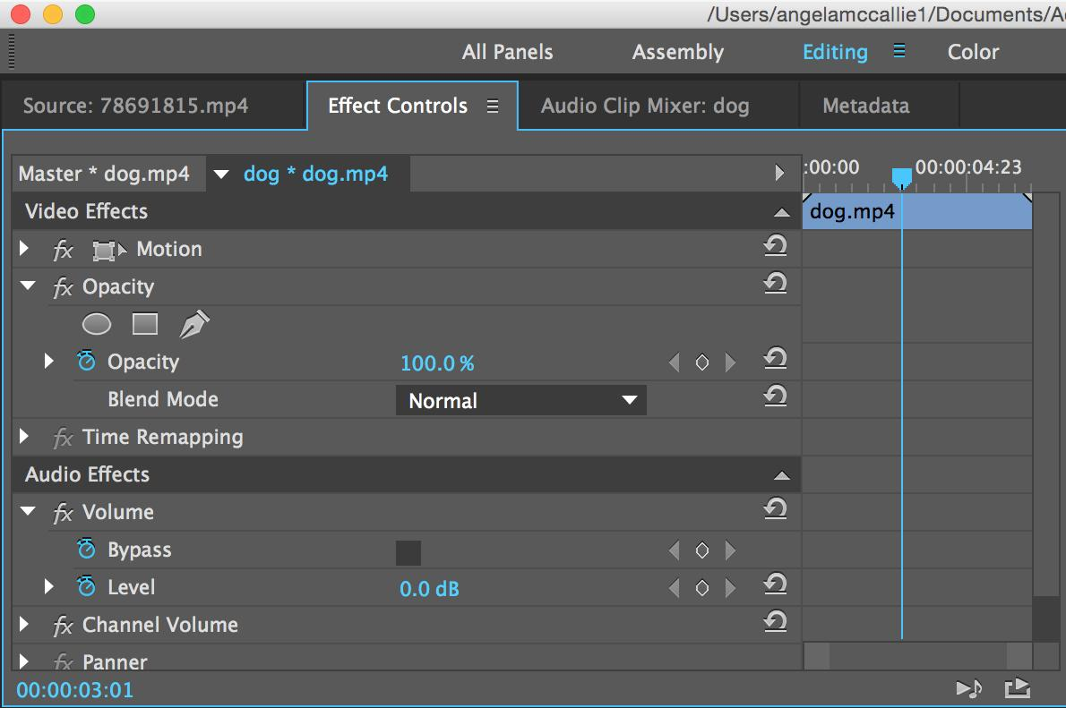
EFFECT CONTROLS
Lists all the effects that are applied to the currently selected clip.
Fixed effects are included with every clip:
Motion, Opacity, and Time Remapping for Video Effects.
Volume effect is listed in the Audio Effects section.

Slide 29
EFFECTS CONTROLS PANEL (SHIFT + 5)
Allows you to edit any effects applied to an audio/video clip
By default –
Video: Motion (Position, Scale), Opacity
Audio: Volume
Keyframes: Marks a point in time with a specific value

Slide 30
EFFECTS PANEL
Contains bins with a variety of audio and video effects, as well as transitions which can be applied to clips.

Slide 31
EFFECTS PANEL (SHIFT + 7)
Provides Video and Audio effects and transitions
How to apply:
1) Select clip, double click effect
2) Drag onto clip
Default Video Transition – Cross Dissolve
Default Audio Transition – Cross Fade (Constant Power)
Shortcut to apply Default Transition: Ctrl+D
Dip to Black – Change in time or location

Slide 32
AUDIO LEVELS
Can view the audio level while playing clip sequence.

Slide 33
AUDIO TRACK MIXER (SHIFT + 6)
Allows you to adjust audio for entire tracks
Sliders – One for each track, plus a Master Slider

Slide 34
AUDIO CLIP MIXER (SHIFT + 9)
Allows you to adjust audio for each clip
Sliders – One for each track

Slide 35
CUSTOMIZE WORKSPACE
Your Premiere workspace can be changed to best meet your needs as a video editor.
Change document views
Rearrange/resize windows and panels
Add or remove tools on toolbar
Create and save custom workspace
These same techniques can be used to customize other Adobe software.

Slide 36
OBJECTIVE 5.00
Apply procedures for exporting video with Adobe Premiere Pro CC.

Slide 37
EXPORT VIDEO - we will walk through this together friday
To export a video in Premiere Pro go to File>Export>Media. This will bring up your export settings window,
Choose format, file name and other settings.
May export entire or selected sequence, audio or video.
Make sure your sequence that you want to export is selected when you do this.

Slide 38
EXPORTING
Converting a project to a standard file format
Shortcut = Ctrl + M
You can export: Audio and Video, Audio Only and Video Only
Source Range: Entire Sequence, In/Out, Work Area, Custom.

Slide 39
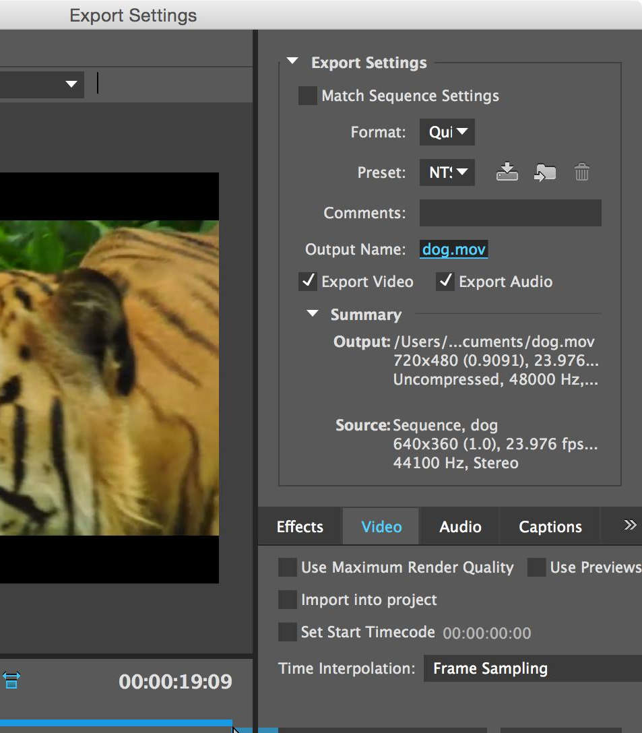
EXPORT SETTINGS
Format Options
File Save As Options
Other Options

Slide 40
OUTPUT NAME
Name and Location (Important)

Slide 41
Formats
Still File Formats: .Jpg, .bmp, .tif, .gif, .png
Video File Formats: .avi, .mpeg, .mov, .wmv, H.264/.mp4
Audio File Formats: .aiff, .mp3, .wav
CODEC: Encoding, Decoding
Notes:
CODEC - a device or program that compresses data to enable faster transmission and decompresses received data.

Slide 42
H.264 VS. MP4
H.264 – Video Codec
Most frequently-used video codec
requires a video container to host the encoded video
Could also be contained in an AVI file
MP4 – a container format
most popular video format at present
it allows a combination of audio, video, subtitles and images to be held in the one single file

Slide 43
OTHER VIDEO FILE FORMATS
.MOV – QuickTime Movie, standard for Apple Computers
.AVI – Standard video format for Microsoft PCs
.WMV - uses Windows Media Player. It is a Microsoft file format used for streaming on the Internet
Codecs -
.MPEG-2 - used for DVDs - Format Files: .m2v, .mpg
.MPEG-4 - used for Blu-Ray Discs - Format Files: .m4v

Slide 44
Why do you think export settings are important?
Why can’t we just choose a file type, set it, and forget it?

Slide 45
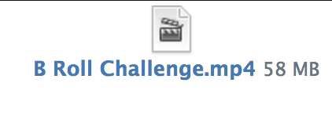
WHEN YOU UPLOAD YOUR ASSIGNMENTS
Upload your .Mp4 files
Do NOT
upload your project files

