Slide 1
Titles & Essential Graphics in Premiere
Objective 4.00
Apply procedures for editing Digital Video using Adobe Premiere Pro CC.

Slide 2
Good Video Titles can be used for promo posters, DVD covers, etc.
Titles are used to set the date, location, or time of the movie/film
They identify main characters
Defined As: block of text with or without an accompanying graphic

Slide 3
Question to Consider
Can you think of examples in movies and TV shows when different titles are used?

Slide 4
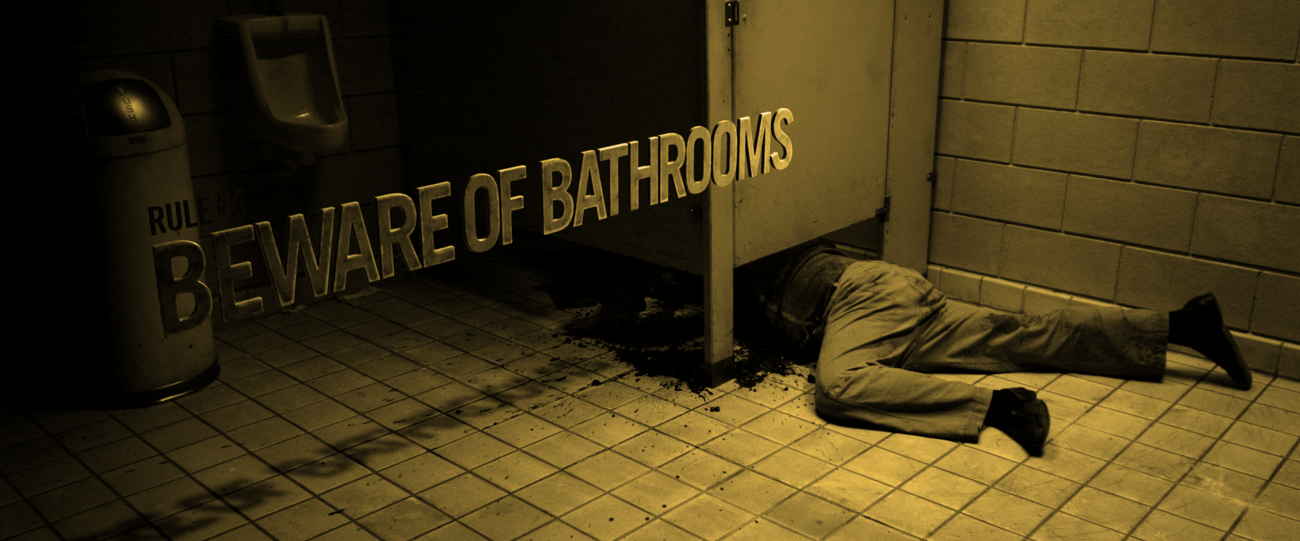
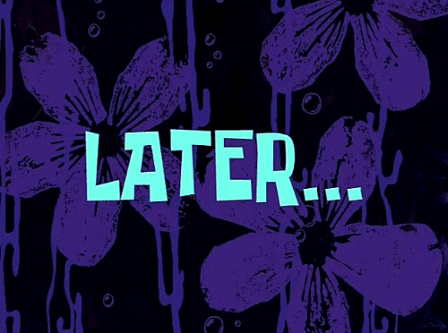
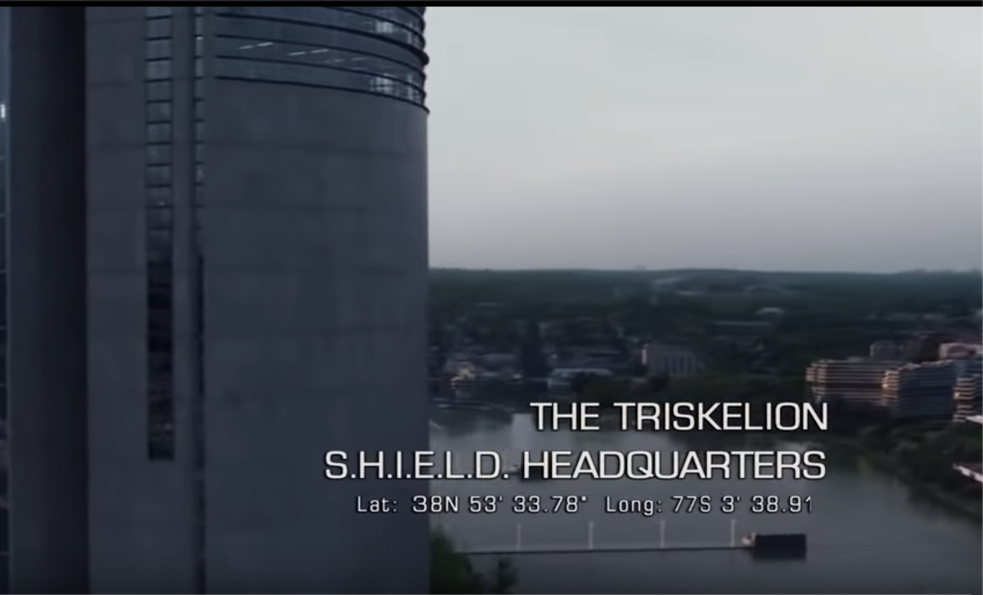
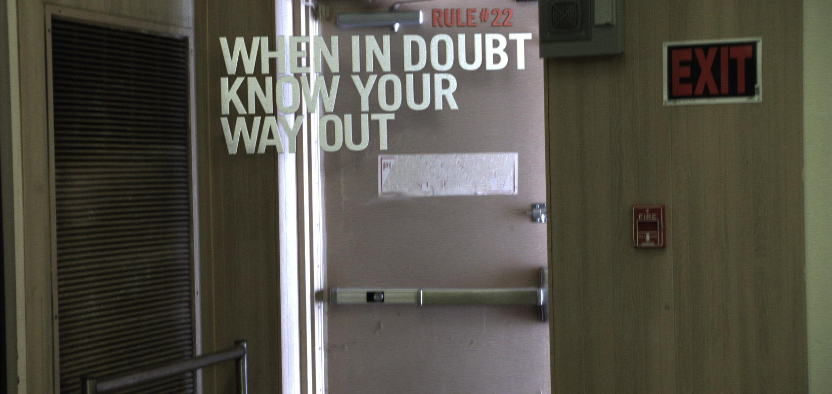

Slide 5
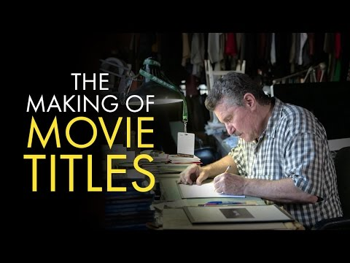

Slide 6
Alright!
Well we won’t be making titles by hand but we can make amazing titles in Premiere Pro or any video editor

Slide 7
Question to Consider
What are some famous titles you have seen?

Slide 10
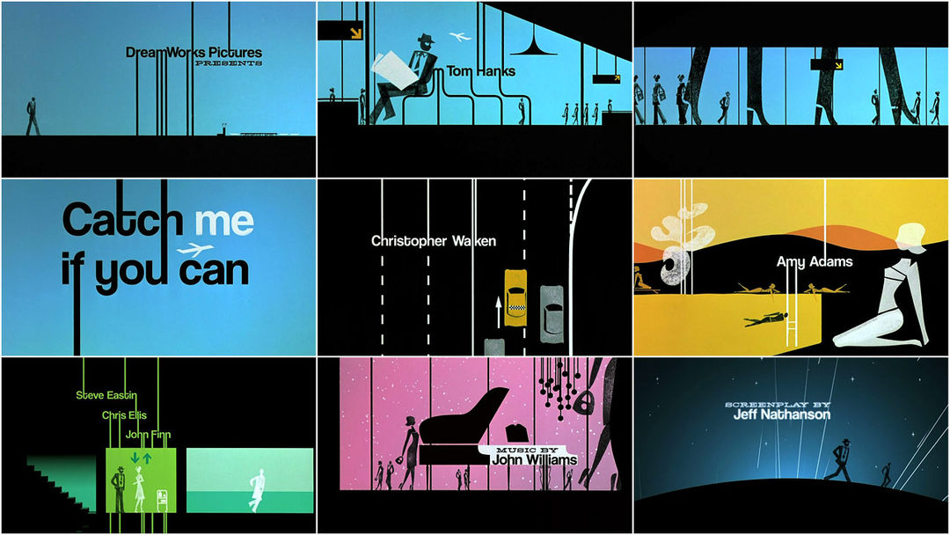
Can you guess what movie this title sequence is from?

Slide 12
4 Title Types
Still Title
Roll Title
Crawl Title
Superimposition Title

Slide 13
Still Titles
A block of text with or without an accompanying graphic.
It appears on the screen, remains motionless, and then disappears.

Slide 14
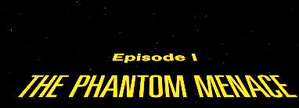
ROLL TITLE
Can appear from top or bottom.
Moves vertically through the screen

Slide 15
Crawl Title
Appears from left or right
Moves horizontally across the screen

Slide 16
Superimposition Title
This title relays information
Name, position, title, stats, etc.
Usually appears on the lower third of the screen
Used in documentaries and news often
Also known as Super, Lower Third, Chyron

Slide 17
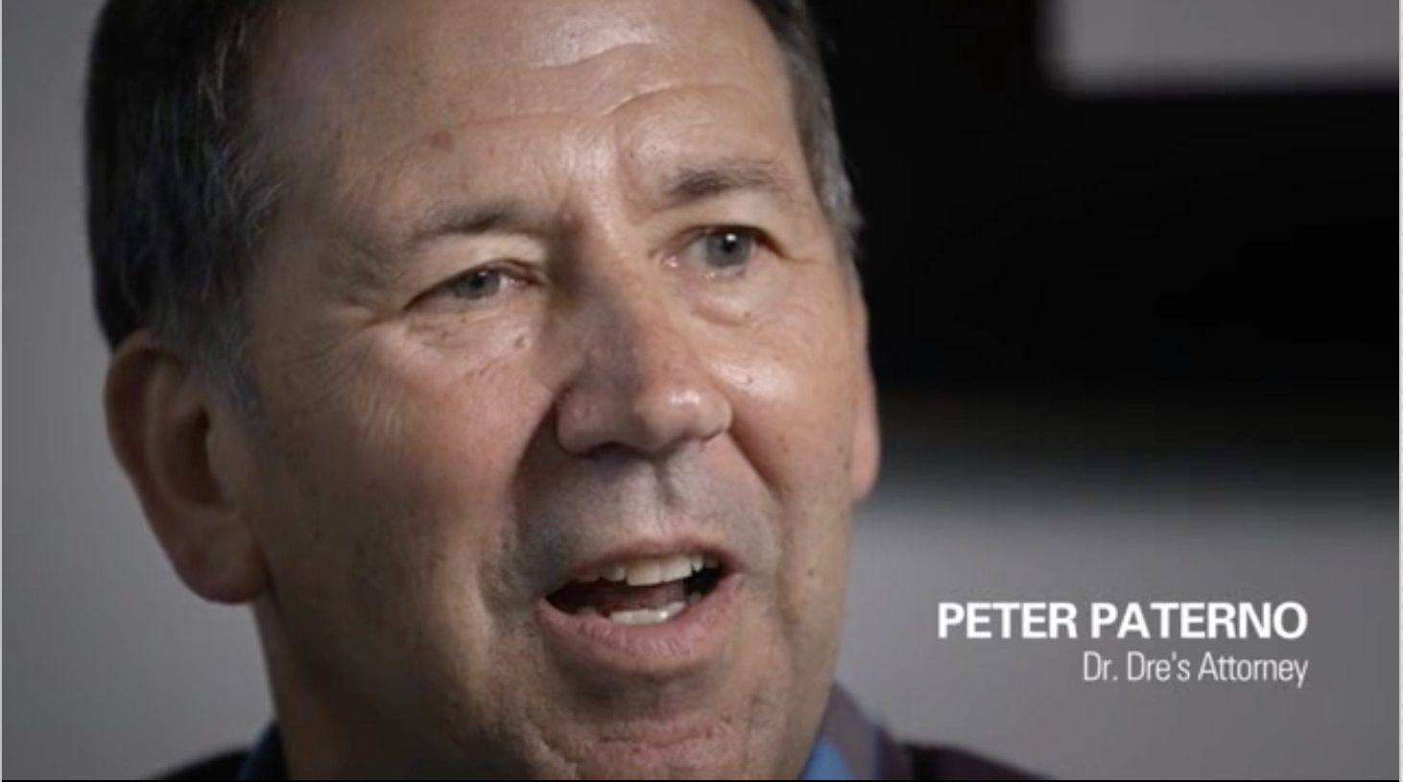
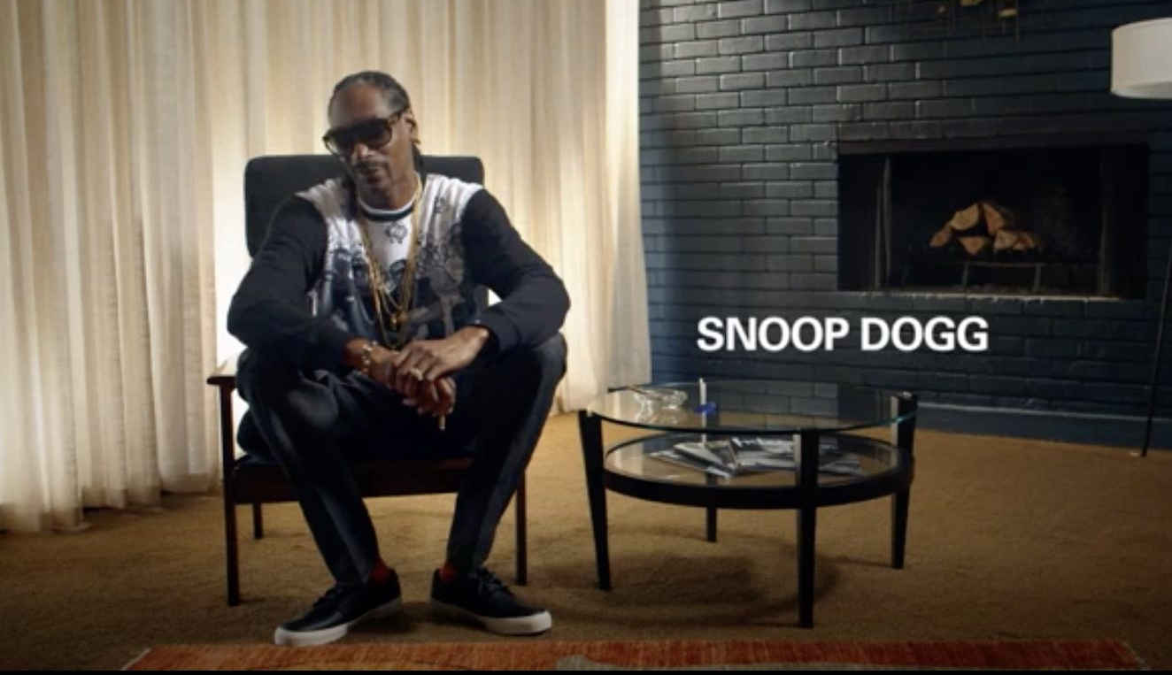
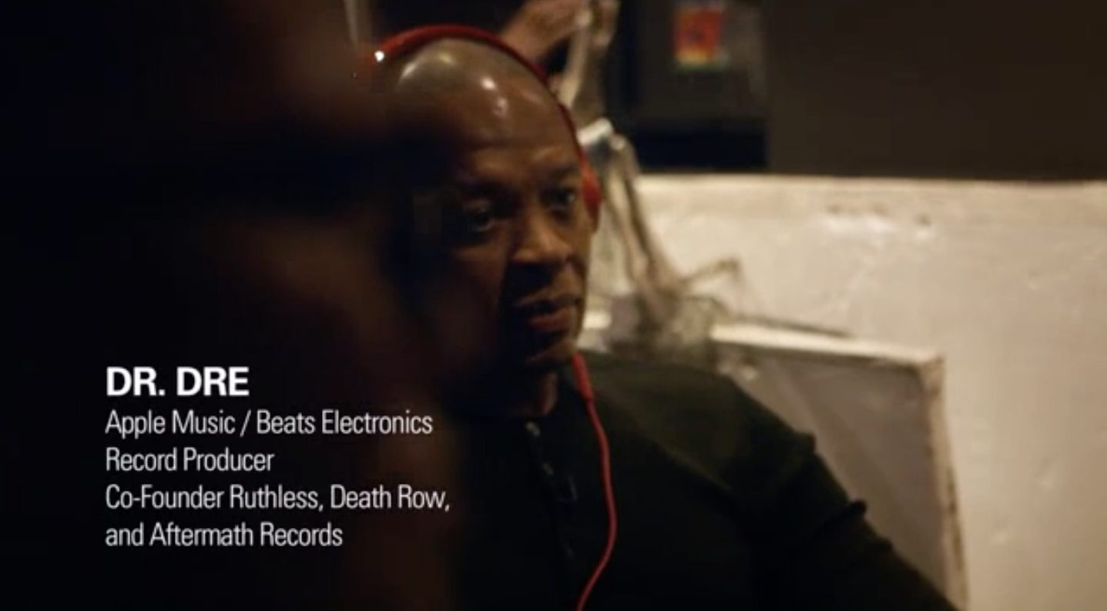

Slide 18
Question to Consider
Why is it important to use Lower Thirds to introduce people in interviews?

Slide 19
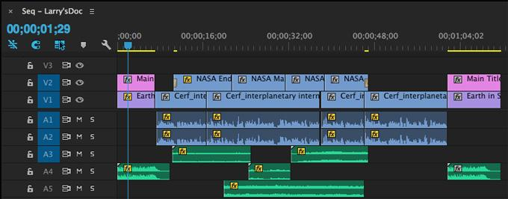
We read video from top to bottom. The item on the top layer is what is seen first in the Program Monitor

Slide 20
Creating:
Type Tool
01
Using the Type Tool to create Graphics

Slide 21
Another tool in our toolbar is the Type tool.
This tool was not listed in Bootcamp.
Shortcut on keyboard is the letter T

Slide 22
Notes:
gif

Slide 23
Select the Type Tool
Draw a box on your Program Monitor.
Then start typing

Slide 24
Once you start typing, it will change the name of the graphic clip to what you wrote.

Slide 25
Editing Text
02
Using Essential Graphics Panel or Effect Controls Panel

Slide 26
Editing your title
Graphics Workspace
Essential Graphics
Browse & Edit
Window> Workspaces> Graphics
Panel - Pulls up with title options
Must highlight title on timeline to edit

Slide 27
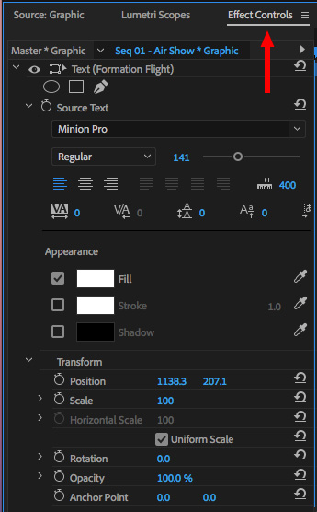
Editing Titles
Essential
Graphics
Panel
Effects
Controls
Panel
Need to select the edit button and the specific title
You can align the placement of the graphic using the icons (not found in the Effect Controls)
Can edit text and color
Can edit text and color
Keyframes mark a point in time with a specific value
Can also create masks to cover your text

Slide 28
Notes:
gif

Slide 29
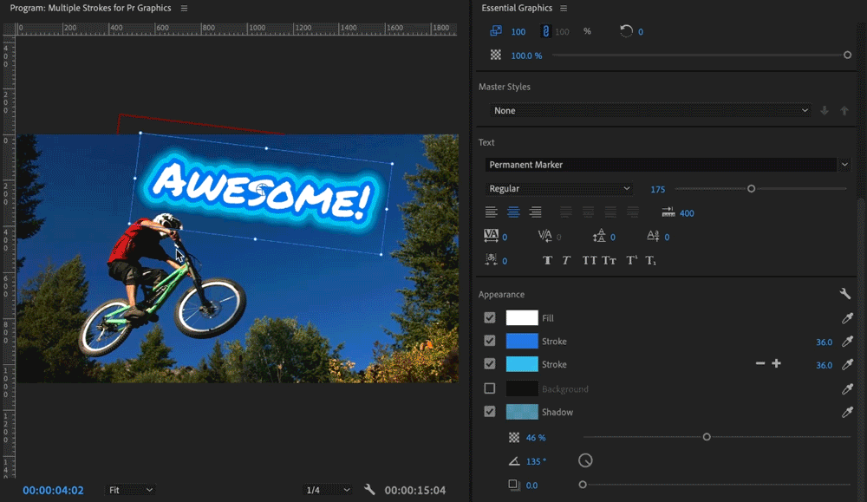
You can customize your text:
changing the color (Fill)
outside color (Stroke)
font type/size (under Text)
alignment.

Slide 30
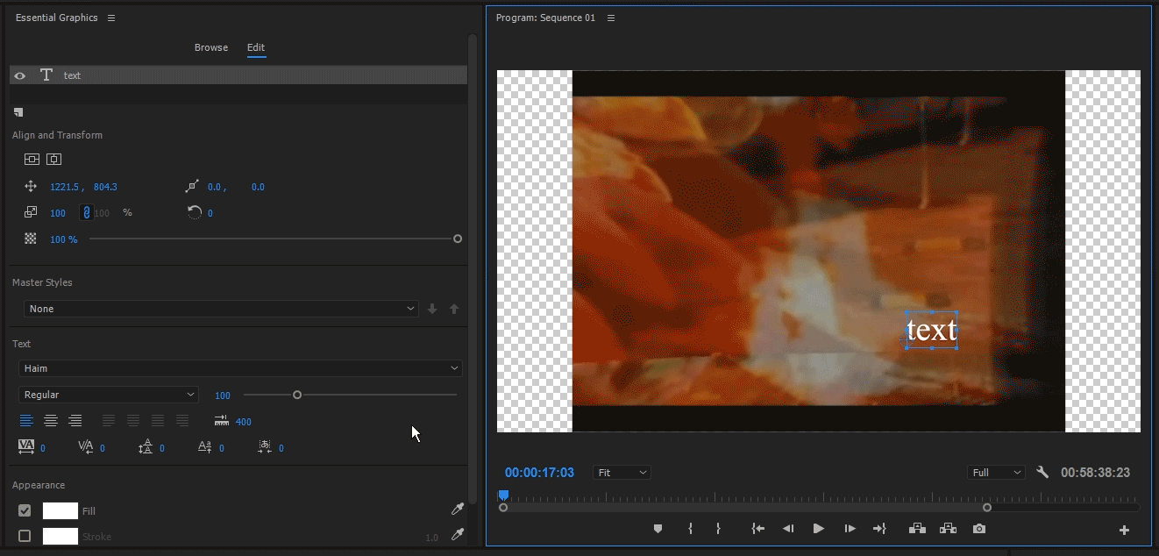
Align & Transform buttons
Essential Graphics panel
Allows you to quickly move the location of text
NEEDED FOR CERT EXAM

Slide 31
Creating Shapes
Can be created with the new items button.
Looks like the page icon.
Video reads top down, so make sure the layers are in the correct order

Slide 32
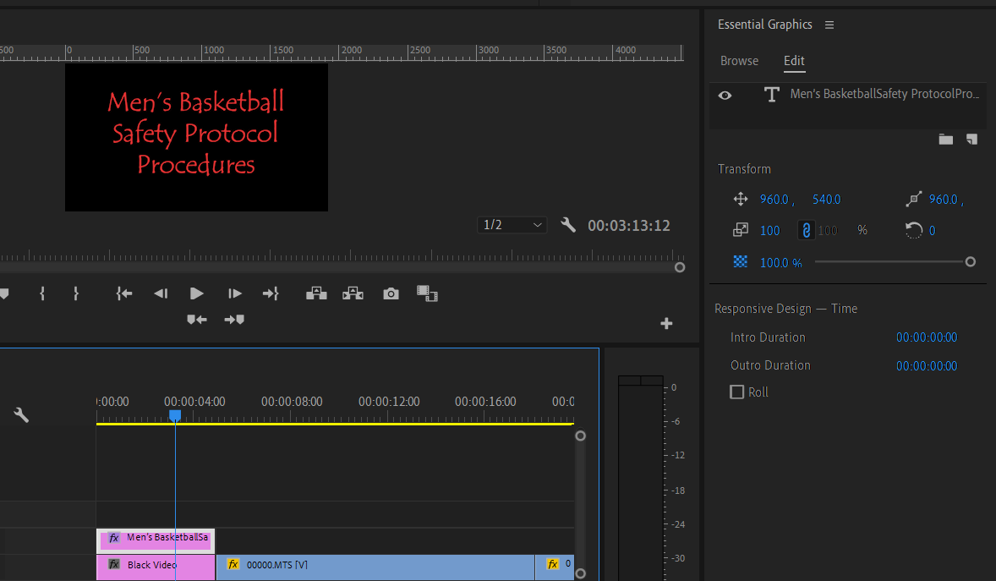
Credit Roll
3
2
1
Do not select the title in the Essential Graphics Panel, that will hide the checkbox
Inside the Essential Graphics panel, click the box that says Roll
Select the graphic on the timeline

Slide 33
03
Creative:
Effect Controls Panel & Animating with Keyframes

Slide 34
Keyframes allow us to animate our graphic/clip
This is achieved in the Effect Controls Panel

Slide 35
This shows you how to change the position of your graphic and allows you to ‘animate’ your graphic, using Keyframes inside Effect Controls panel.

Slide 36
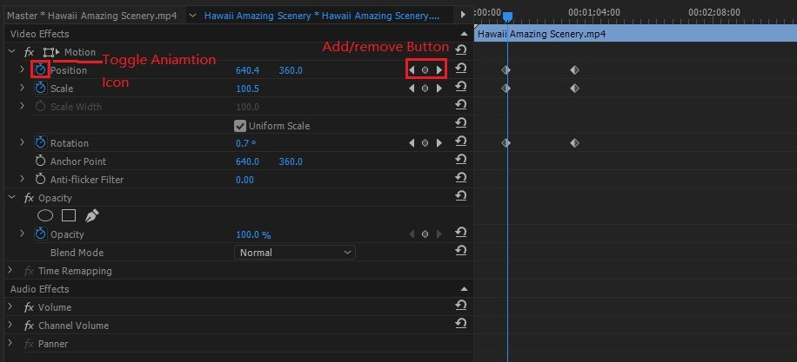
Change the position of video or graphic
(Position)
These are your data points, they tell you what is happening at the specific timecode
Change the size of video or graphic (Scale)
To make any movement, you must turn on Animation first!

Slide 37
Set Keyframes
Setting keyframes is easy. Simply hit the stopwatch icon to the left of your desired parameter. By default, Premiere will set a single keyframe as soon as you hit the stopwatch button.
To set another keyframe, move your playhead to your desired time and hit the small diamond between the left and right arrows to the right of your parameter’s values (see example).

Slide 38
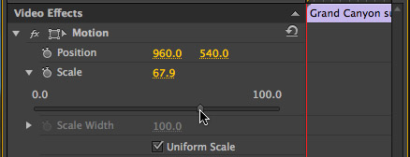
Position
There are two numbers under Position.
The 1st number is X-Axis and the 2nd number is Y-Axis

Slide 39
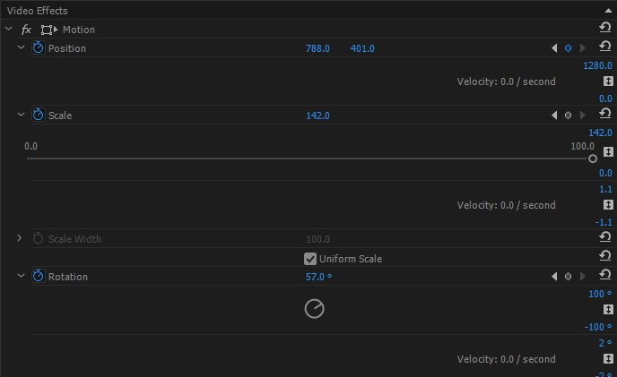
Changing Keyframe Values
Hovering over the blue numbers and dragging your mouse left or right changes the values of the keyframes. You can select them and type right in the number.

Slide 40
Removing Keyframes
Select your keyframe and hit delete or right click and select clear

Slide 41
04
Creative:
Text Behind
Moving Object
See Full Tutorial Attached

Slide 42
See walkthrough attached in G.C.
Step by step instructions in GC on how to complete

Slide 43
Title Practice Edit
Format: H.264
Preset: Youtube 720p
Turn in mp4 file
7
Graphics
You Need:
Assets Provided
1 - Title Graphic
5 - Fact graphics about doughnuts
1 - Credit graphic with your name (rolling credits)
No less than 3 video clips used
Add audio
CONCLUSION
Find location of assets in instructions in GC. Task List, Walkthrough & Example attached in GC.
You will create a video about Donut Facts using your knowledge of titles. You will create a total of 7 titles.

