Slide 1
Pre-Production: Shots & Angles
Objective: 2.01
Understand key terminology related to digital video.

Slide 2
Production Phase
The actual shooting of the video
What are Shot Types?

Slide 3
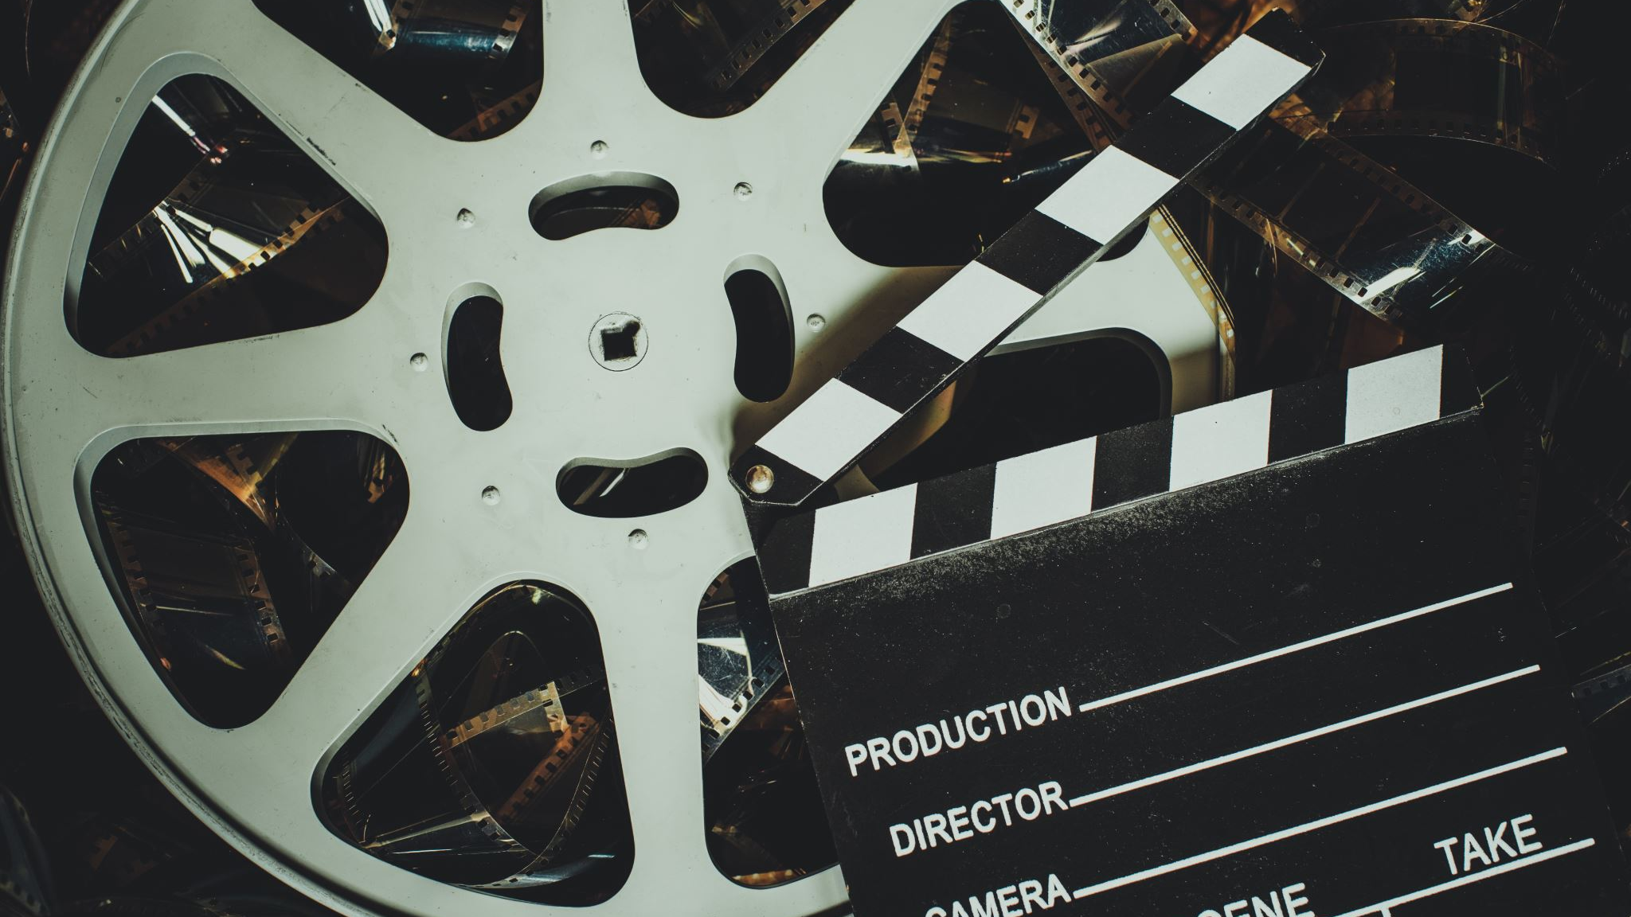
Shot Types, Sizes & Angles

Slide 4
What does getting
coverage mean?

Slide 5
Distance Shots aka Shot Sizes
are used to show distance between the camera and the subject.

Slide 6
place video here

Slide 7
AKA MLS
AKA Long Shot

Slide 8
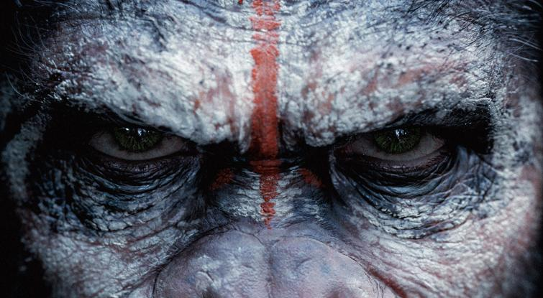
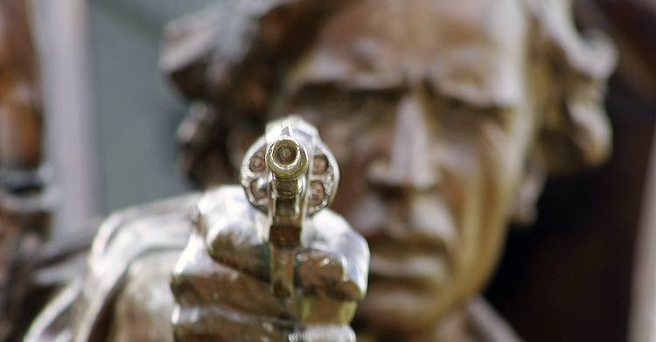
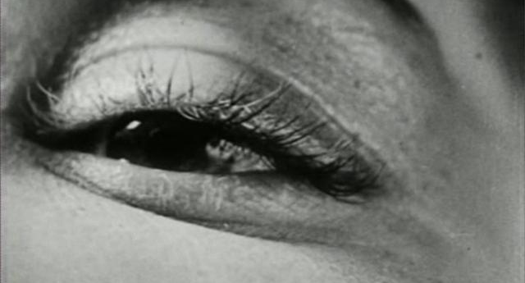
ECU: Extreme Close Up
Frames a small part of the body or object.
Makes the audience focus on one thing and emphasizes its significance.
It can make a small object seem larger and more significant.

Slide 9
Close Up
This shot shows the subject up close.
It focuses on the detail of an object or expression/reaction of a person.
It shows either head or head and shoulders.

Slide 10
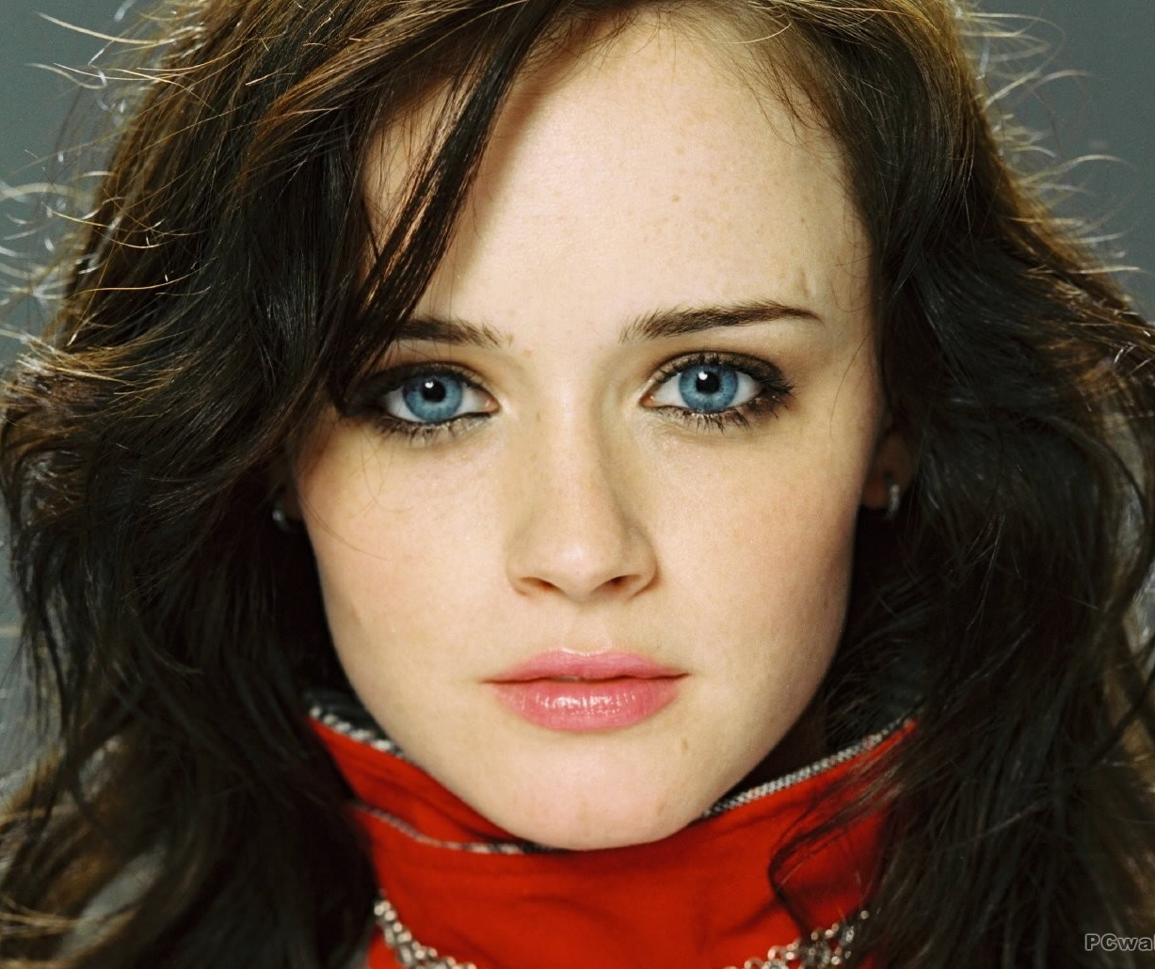
Close Up’s effect
The close up is used to imply intimacy between the characters or between the character and the audience. It is used to reveal the character’s thoughts and feelings.
Close-ups get closer as the ‘truth’ about a character is revealed.

Slide 11
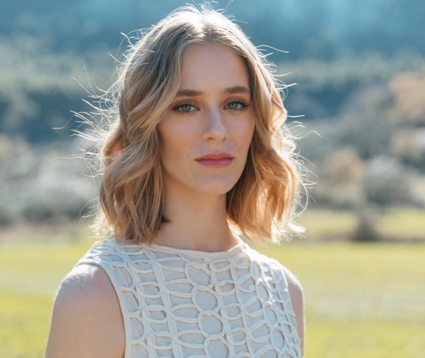
Medium Close Up
Finds the middle between the Close Up and the Medium Shot.
This shot is from the shoulders and up

Slide 12
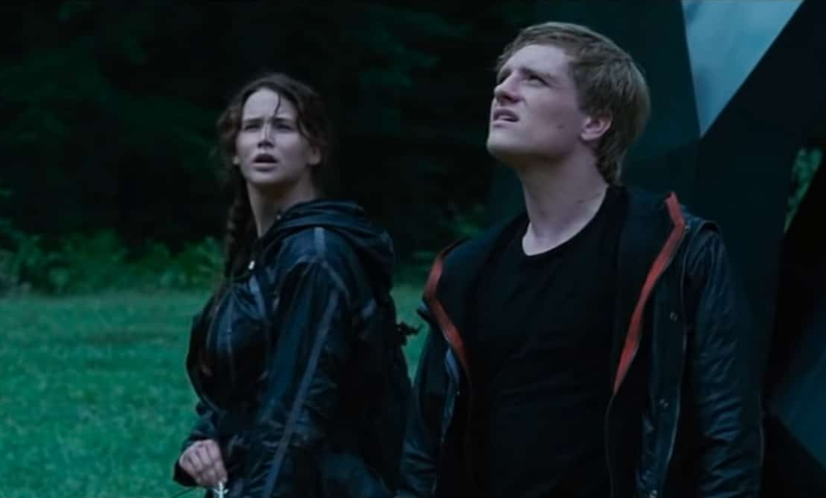
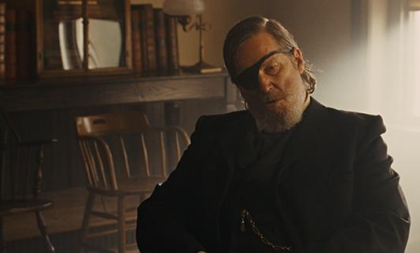
Medium Shot
The most common shot is the medium, or mid shot.
AKA the waist shot: shot from the waist up to the top of the head
Captures both the details of an actors’ performance and their surroundings.
Notes:
https://www.studiobinder.com/blog/medium-shot-examples/
https://www.youtube.com/watch?v=eKz5Hida8n4

Slide 13
Cowboy Shot
Frames the subject from roughly mid-thighs up.
It’s called a “cowboy shot” because it is used in Westerns to frame a gunslinger’s gun or holster on his hip.

Slide 14
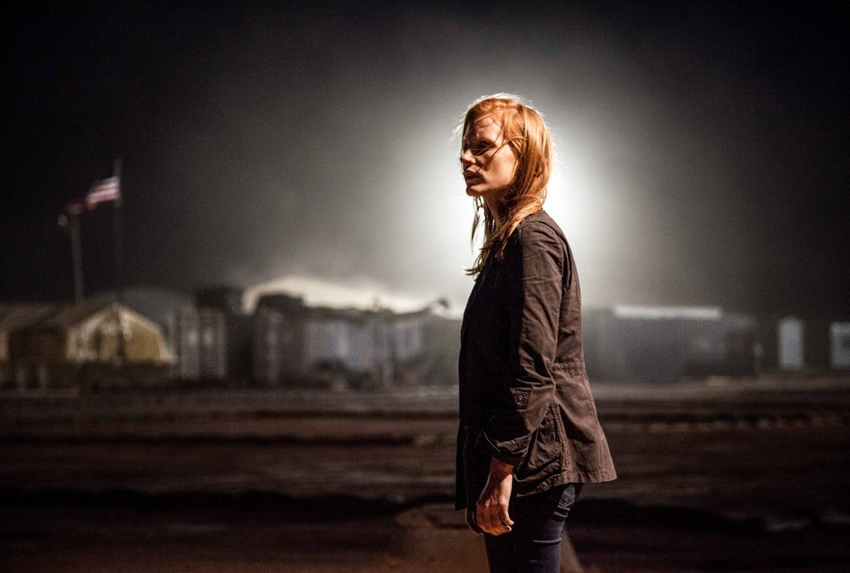
Medium Long Shot
AKA "three quarters shot"
A lot like the medium shot, just a tad wider. But not a full-on long shot

Slide 15
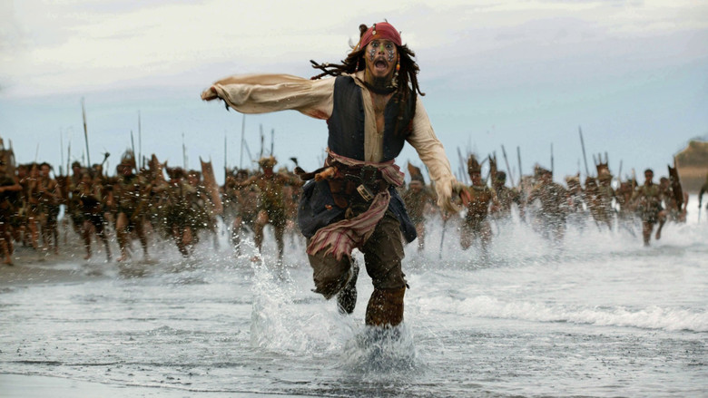
Long Shot
Shot which shows all or most of a subject
Usually from the feet up to the head

Slide 16
Long Shot
Shot which shows all or most of a subject
Usually from the feet up to the head

Slide 17
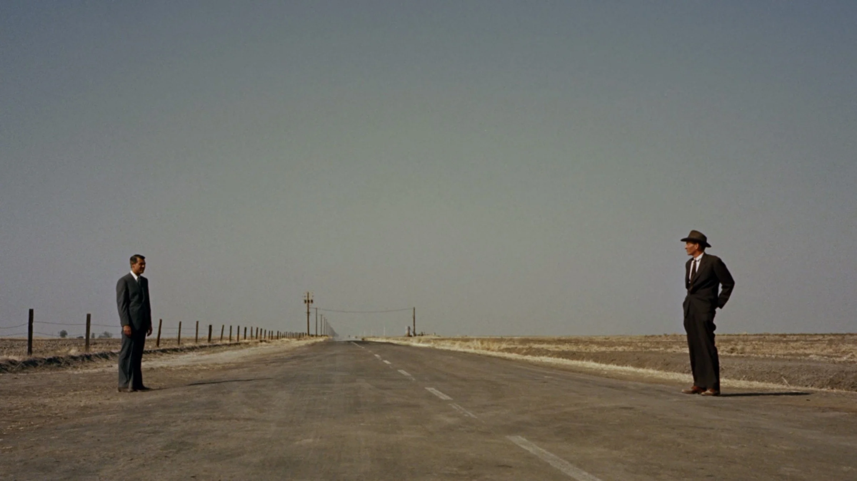
Wide Shot
Usually shot with a wide-angle lens. This includes a lot of visual information for the audience to ‘set the scene’.
Another type of Long Shot but with more information

Slide 18
Extreme Long Shot
aka Extreme Wide Shot- Used to show the subject from a distance, or the area in which the scene is taking place.
The character doesn’t necessarily have to be viewable in this shot.
Can also be used as an Establishing Shot

Slide 19
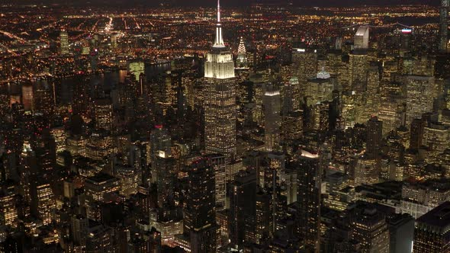
ESTABLISHING SHOT
Usually the first shot of a new scene, designed to show the audience where the action is taking place.

Slide 20
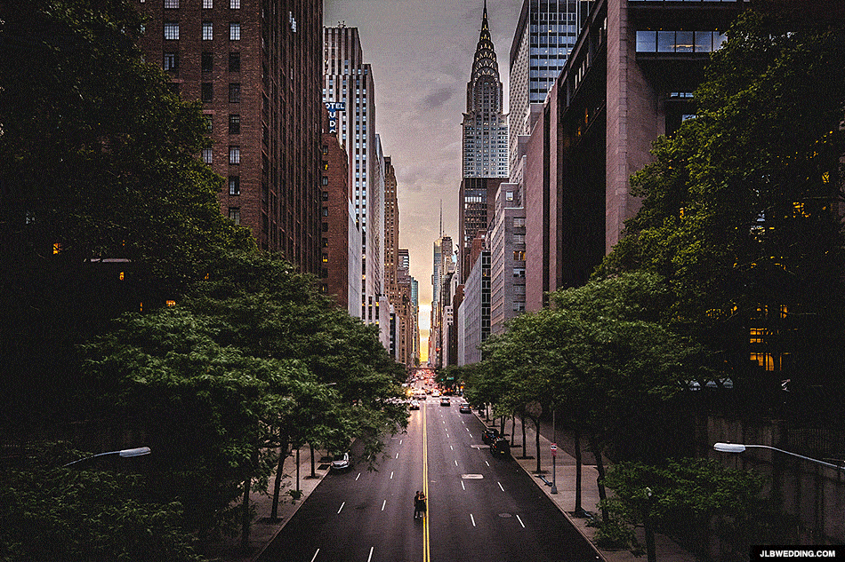
Extreme Long Shot/Wide Shot/Establishing Shot
These three shots give us the most detail of the surroundings

Slide 21
Angle/Level Shots & Placement
Advanced camera shots, are those that indicate camera angle and placement.
These are often used to affect the mood or narrative of the film, rather than indicate size and spatial awareness.

Slide 22
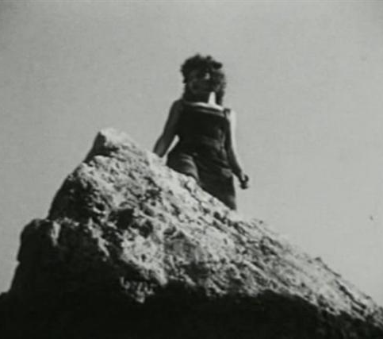
Low Angle Shots
Subjects or objects shot from a low-angle create intimidation.
From our point of view, we feel inferior to the subject as an audience

Slide 24
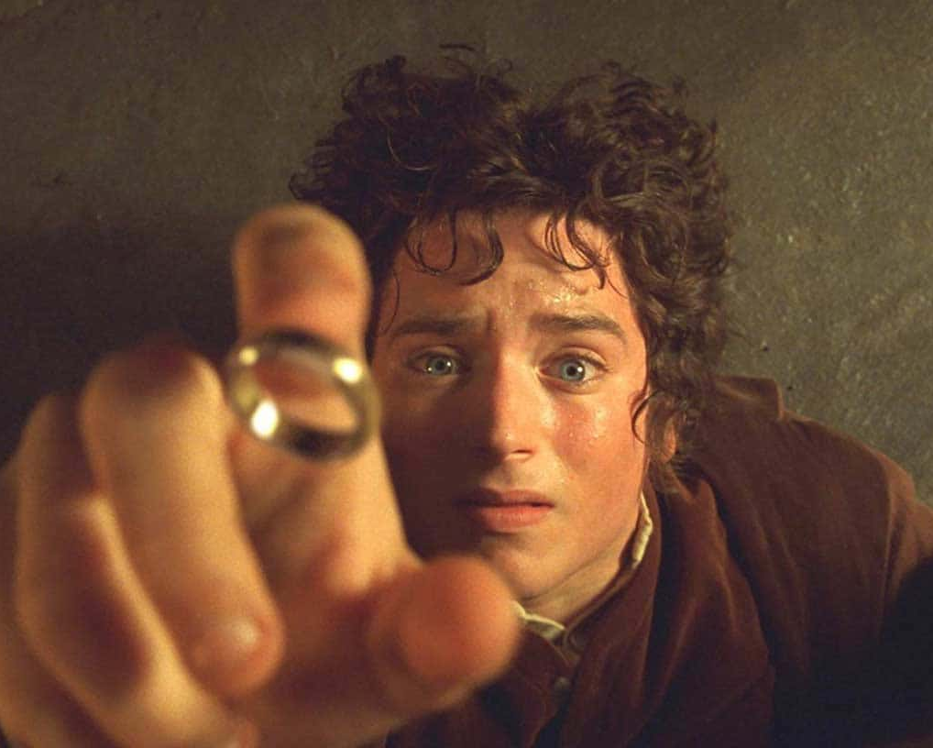
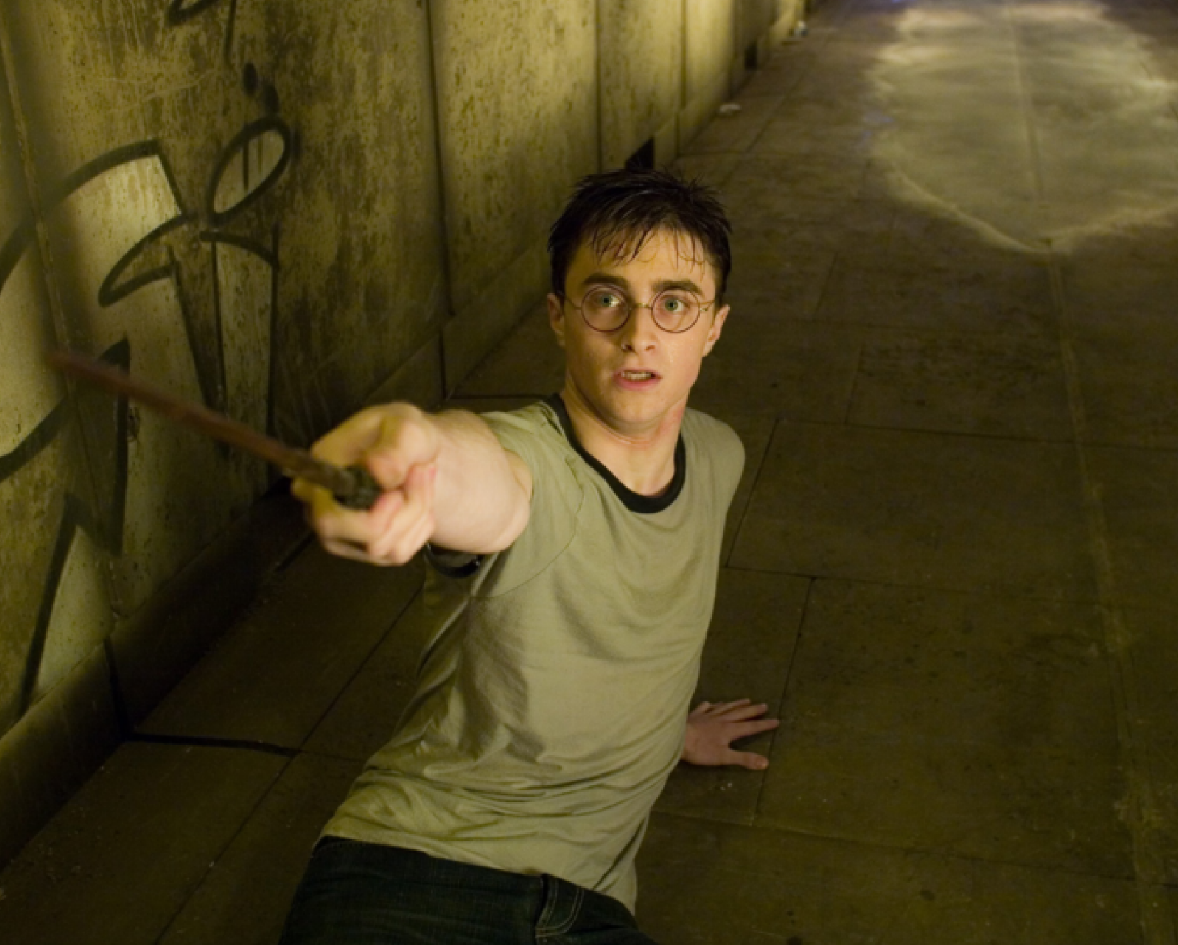
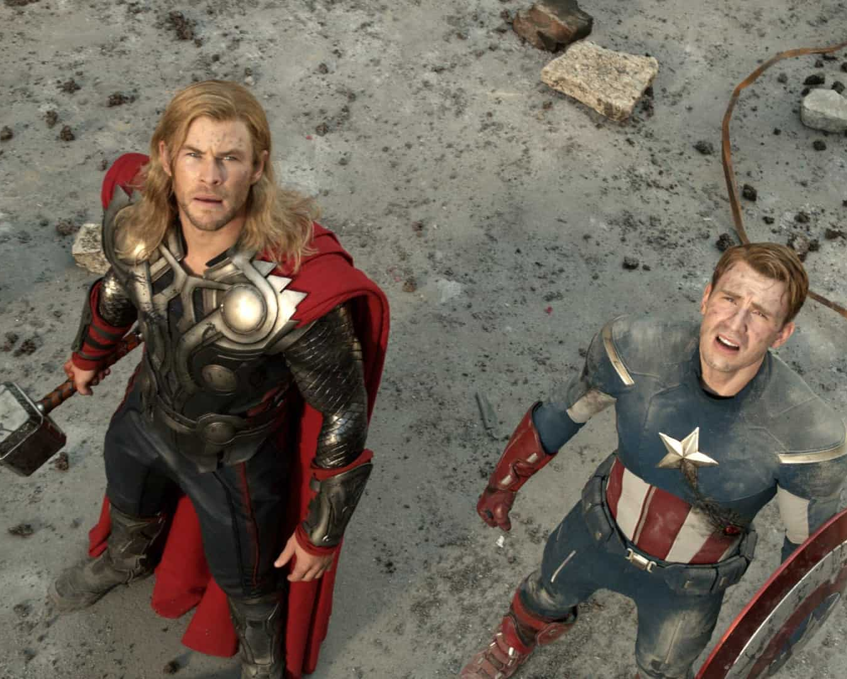
High Angle Shots
If you want to create a feeling of weakness with a child being threatened by the bully, use a High Angle Shot.
The figure seems intimidated, or inferior to your audience.

Slide 26
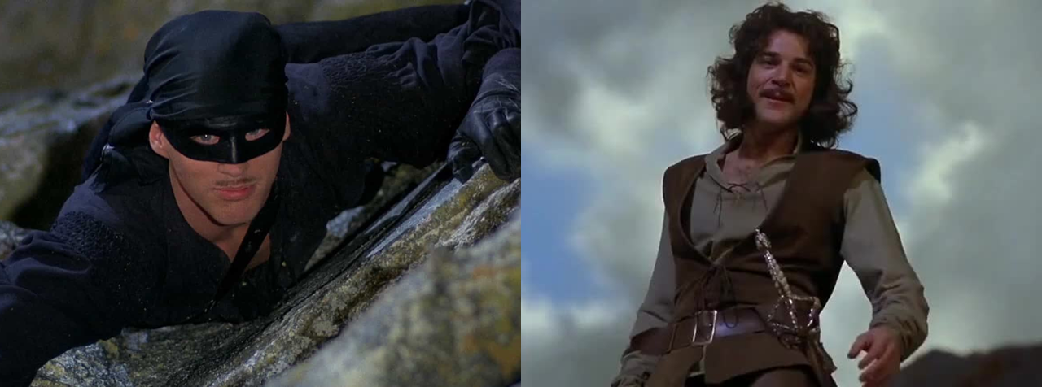
Which one is which?

Slide 27
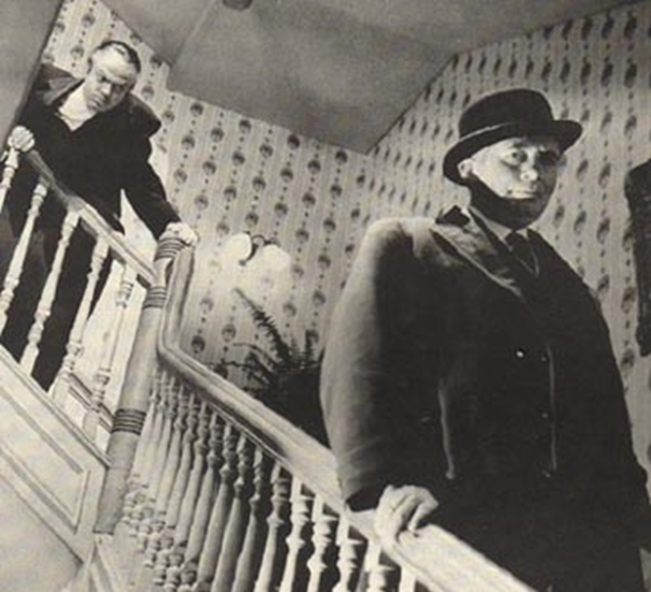
What type of shot is this?
Who has the power in this shot?

Slide 28
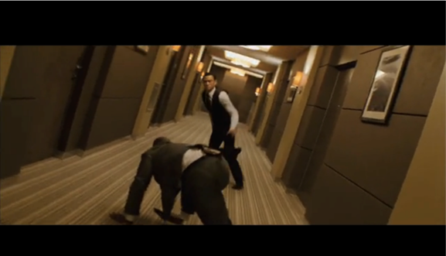
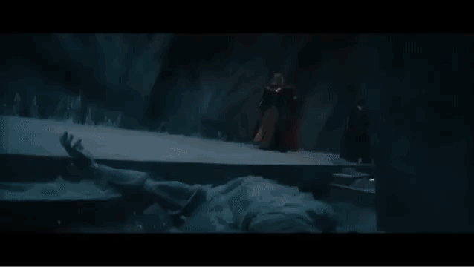
Canted Angle Shots
◦Camera is placed on an angle to film the action.
◦It can be used as a POV shot, or sometimes to create interesting speed images.

Slide 29
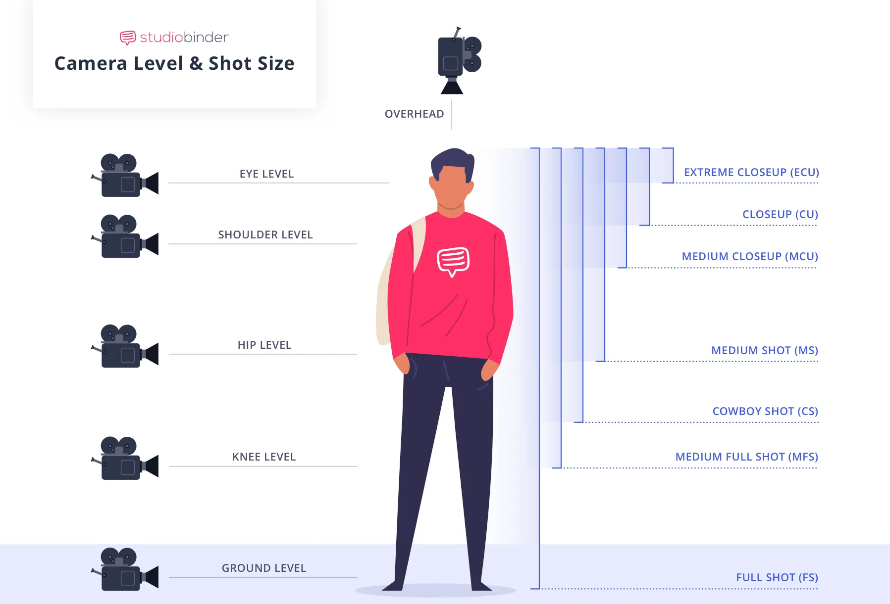

Slide 30
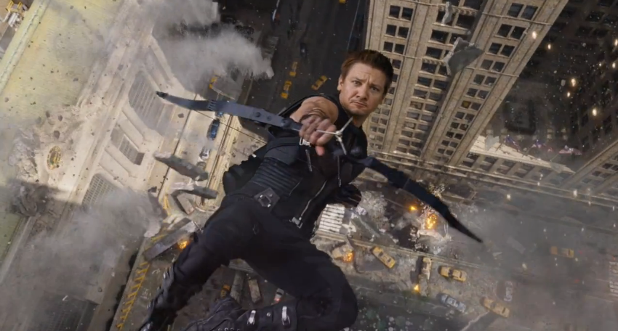
Aerial Shot or Bird’s Eye Shot
Taken from a helicopter, plane, or drone.
Used to a give birds-eye view of the action, the sensation of flying or extreme Long-Distance establishing shots.

Slide 32
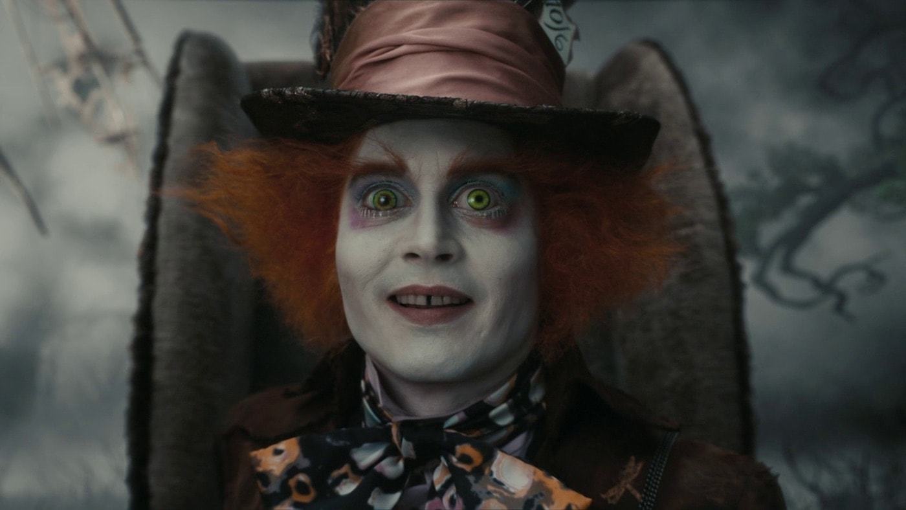
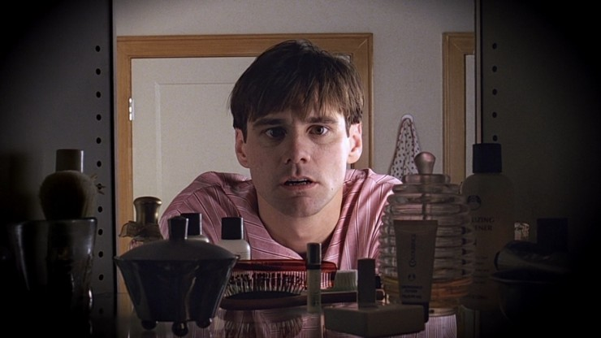
Eye Level Angle or Straight on Angle
An eye level shot refers to when the level of your camera is placed at the same height as the eyes of the characters in your frame
This involves the audience in the action as they are also on the same level as the subject.
Notes:
https://www.youtube.com/watch?v=FLOjzZ2Y5iw

Slide 33
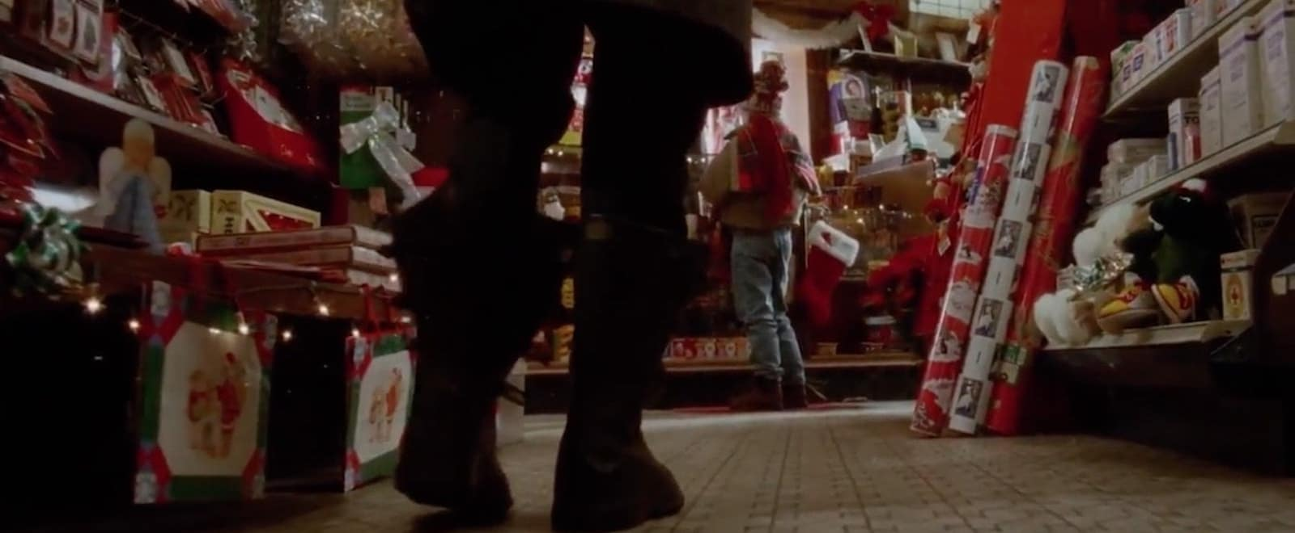
Knee Level - can be paired with low angle to show superiority

Slide 34
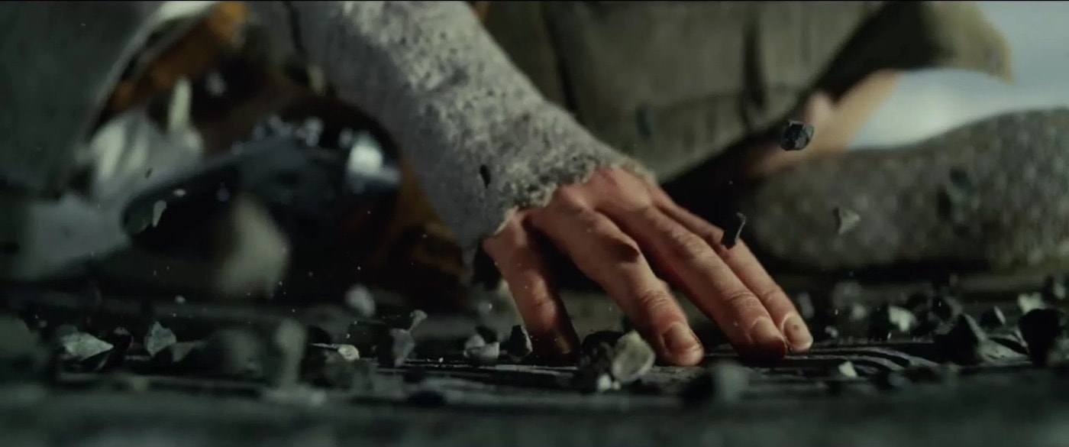
Ground Level - captures what’s going on the ground your subject stands on

Slide 35
Shots Described By Their Purpose
•The following shots can consist of many different types of shots, but we describe them by their purpose, as they must include some elements within the frame.

Slide 36
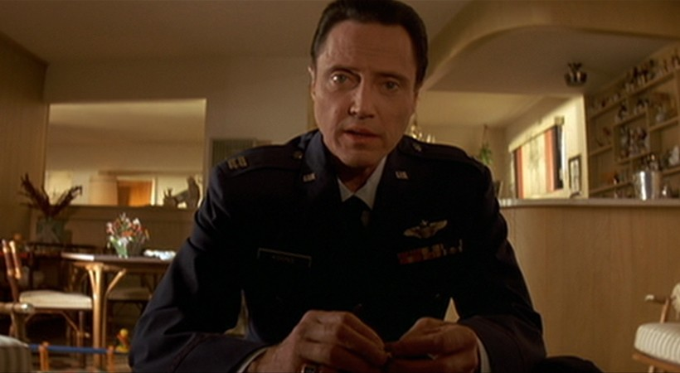
Point of View Shot
This is what the character would see and is a first person or subjective shot.
It puts the audience right into the minds of the character and often moves the way the character’s head moves e.g. the Terminator films use this to show the POV of the machines, including scopes and computer files.

Slide 37
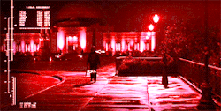
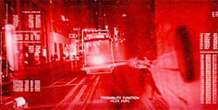
POV shots from Terminator’s eye

Slide 38
Over the Shoulder Shot
This is a technique used to film conversations.
The camera seems to shoot over the shoulder of one person to film what the person talking to them is saying.
It is usually used with a reverse angle shot, which shows the other character’s dialogue.

Slide 39
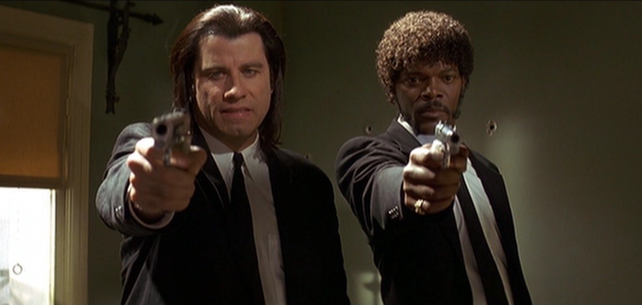
Two shot
This is a shot of two people that shows the relationship between them.
It can be used to show dialogue, with OTS and/or close-ups

Slide 40
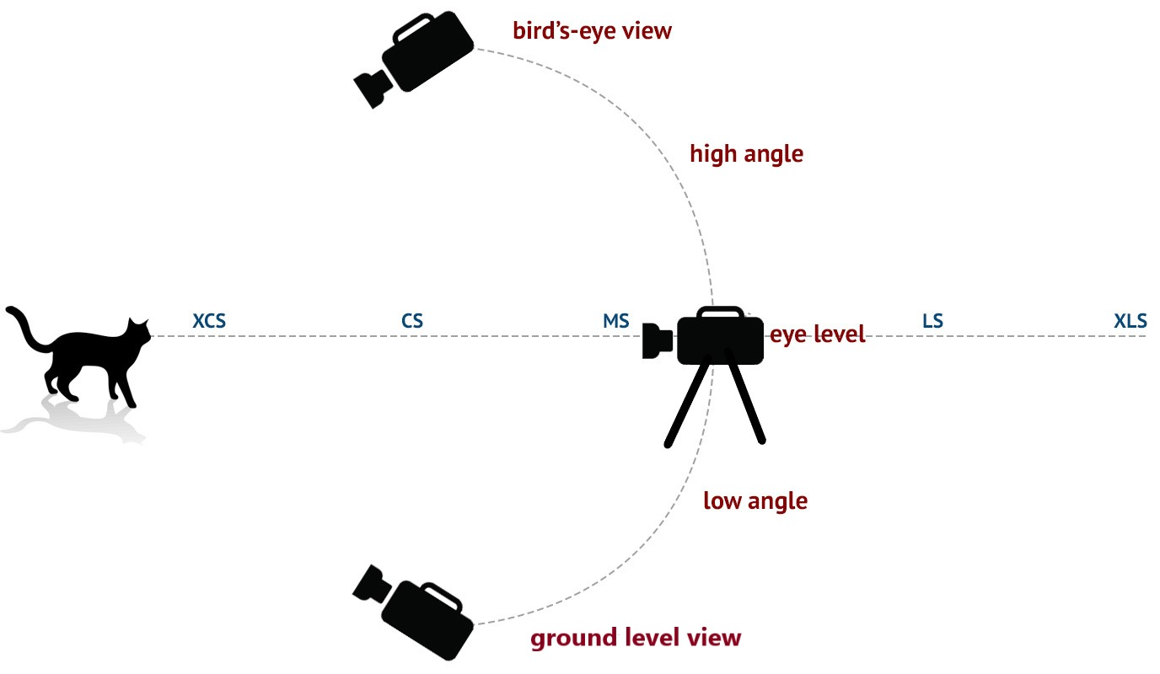

Slide 41
Think about:

Slide 42
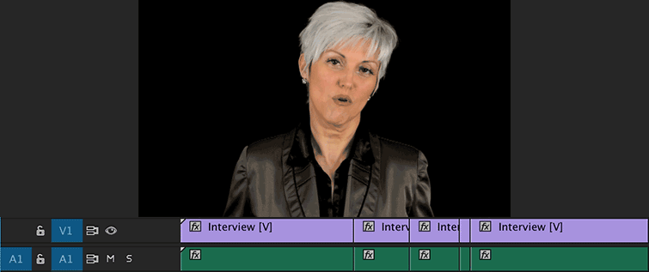
Example of Jumpcut
We are going to talk about different types of cuts in the Post Production unit.

Slide 43
Assignment: Shot & Angle Matrix
Work in groups to take photos of the shots and angles listed in the matrix assignment in google classroom.
Each person will then fill in the assignment individually and turn in the assignment before the end of class.
This is a graded assignment.

Slide 44
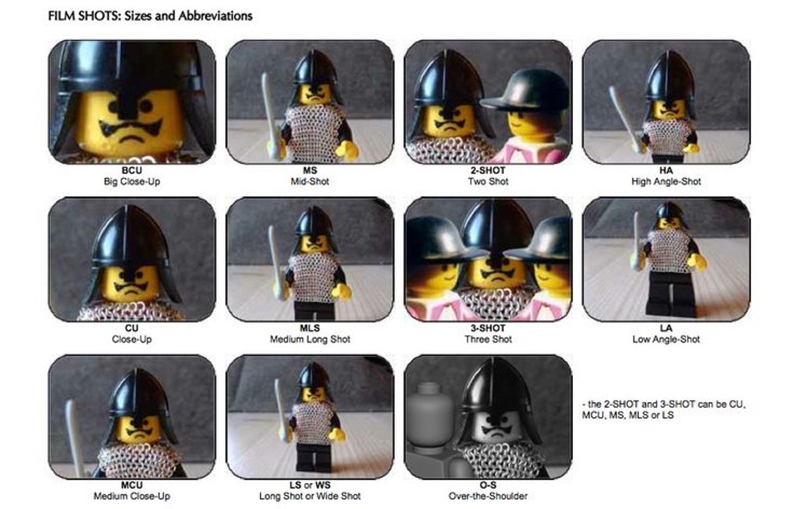

Slide 45
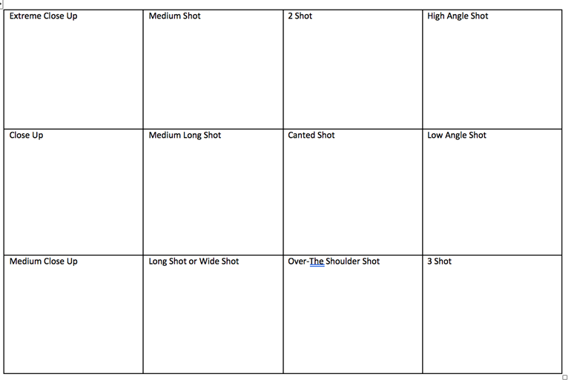

Slide 46
ECU, CU, MCU, MS, MLS, LS/Full,
Canted Angle, High Angle, Low Angle, Over-the shoulder, 2 Shot, Eye-Level

