Slide 1
Pre-Production: Scripts
Objective: 1.02

Slide 2
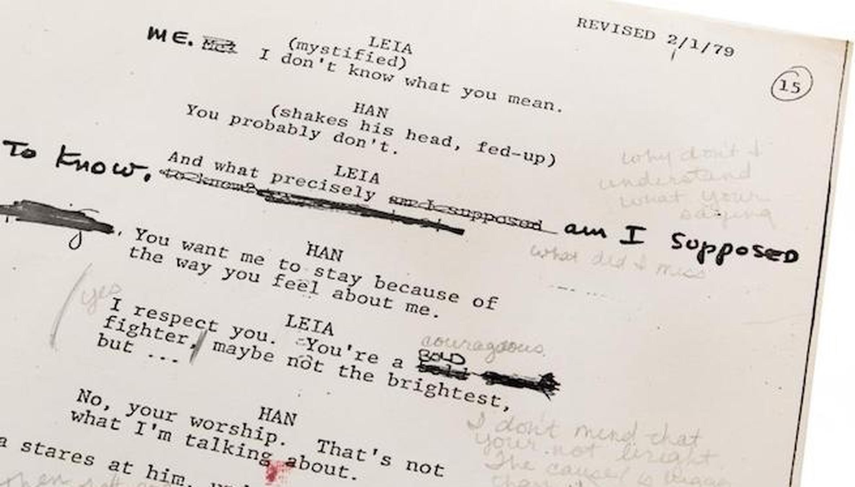
Scripts

Slide 3
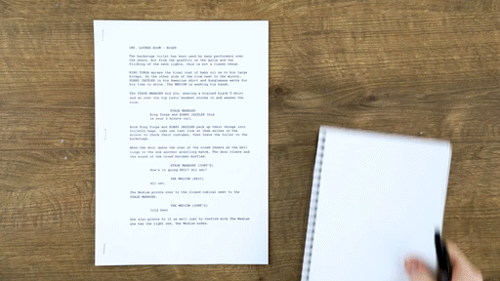
1 way of creating a shot list using a script

Slide 4
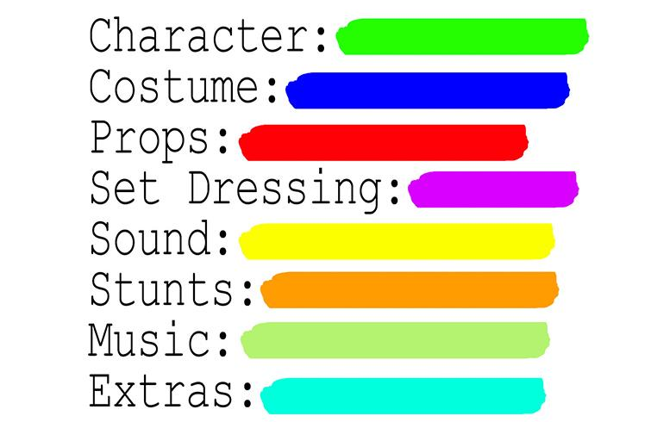
Color Coding can help break down the script when we are planning out budget, casting, designing, etc.

Slide 5
Screenplays
A screenplay is an instructional manual for the production of a film including dialogue and descriptions of characters, action, and sets.
Screenplays can be original works (original screenplay) or adaptations from existing pieces of writing (adapted screenplay). An adapted screenplay may be based on a book, play, poem, etc.

Slide 6
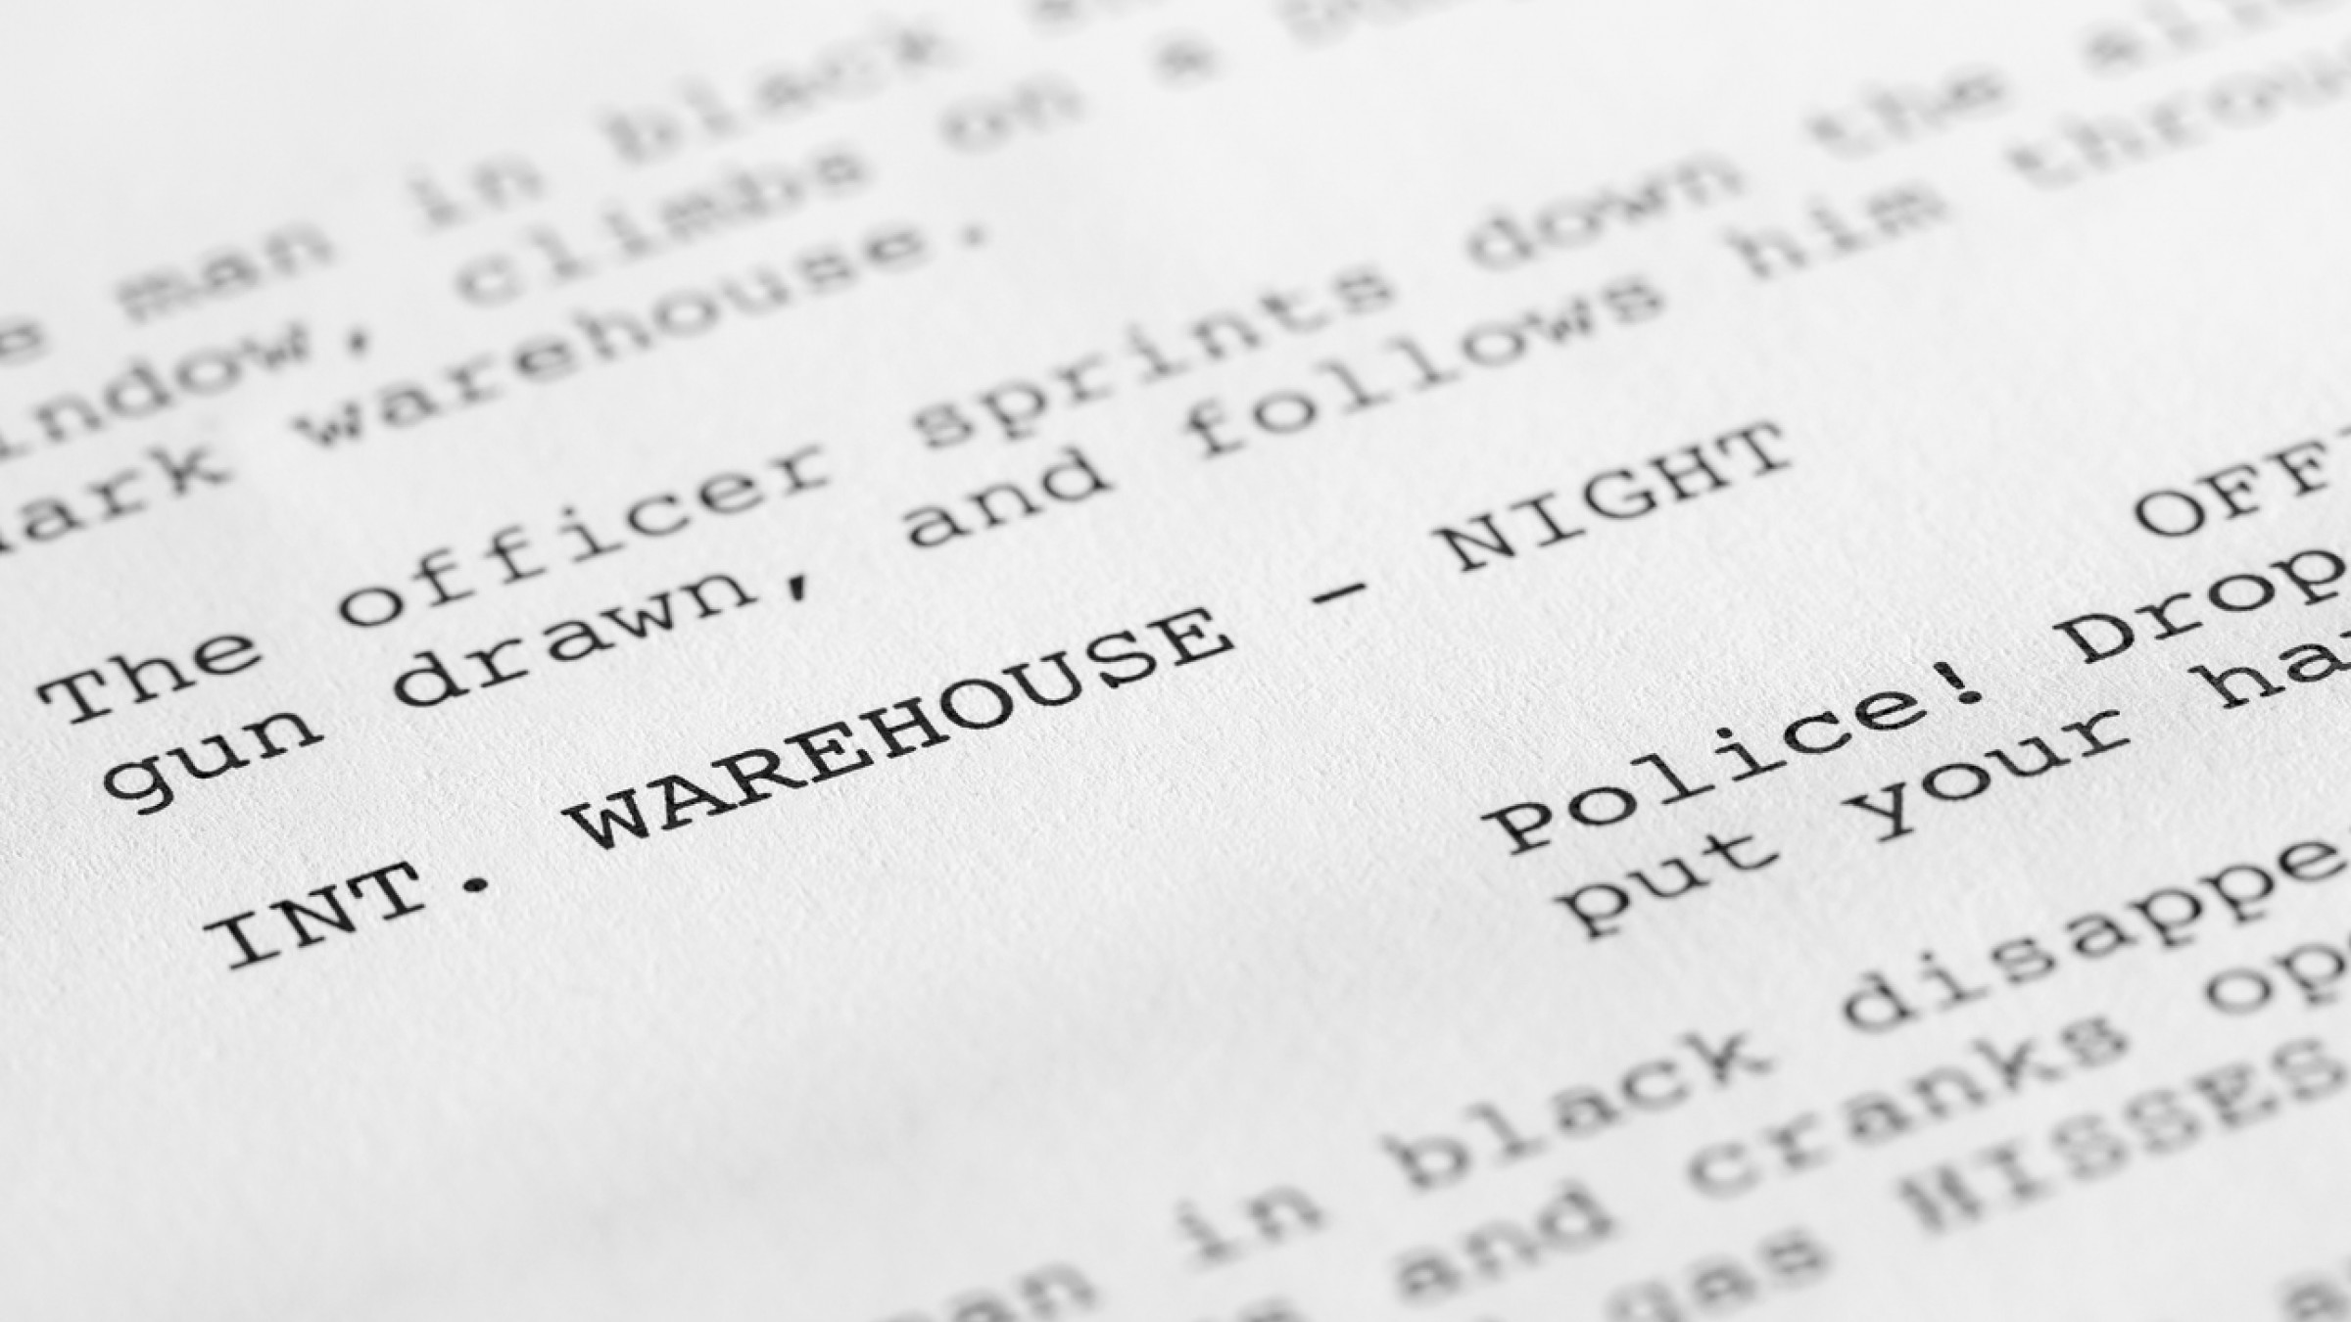
Film and video are visual mediums
You don’t tell the story, you show the story.
You must learn to write a screenplay VISUALLY.
Write what they will SEE,
Write what they will HEAR.

Slide 7
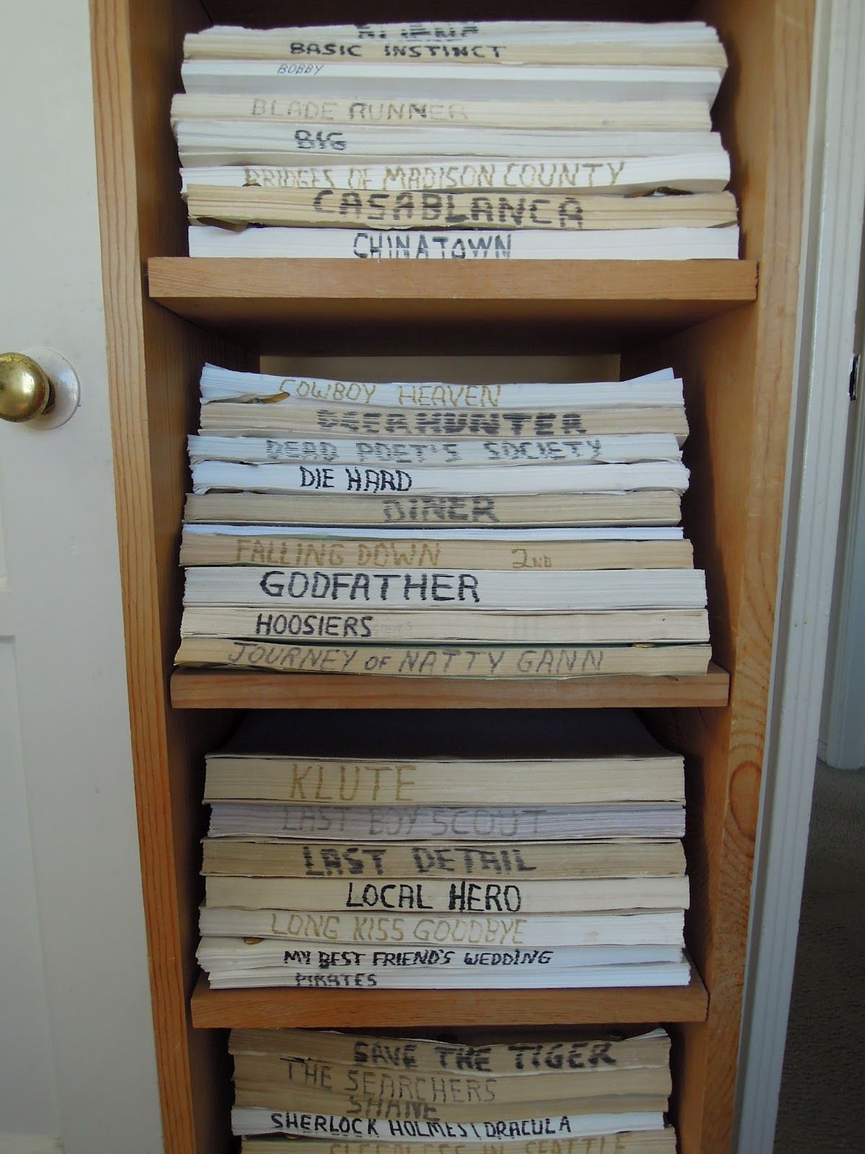
Screenplays
The average feature screenplay, traditionally, is between 95 and 125 pages long.
In Hollywood these days scripts generally don't run longer than 114 pages.
Comedy scripts are typically shorter, dramas longer.

Slide 8
Another Important Step

Slide 9
BUDGET
Production Budgets must account for all expenses incurred for the life of the project, including pre-production, production, and post-production expenses.
It must cover equipment, costs of cast and crew, and locations.
Most production coordinators and supervisors are the ones in charge of a production budget.
A budget is used for every TV show, movie, and commercial you have seen.

Slide 10
Break down your script into pages per day
The first step of formulating a film production budget is deciding how many pages you plan to shoot for each scheduled production day.
While there’s no set number of pages to shoot per day, it typically breaks down to this:
Major Hollywood films typically shoot about one page per day.
Well-funded indie films often shoot about four to five pages per day.
Low and micro-budget films may shoot eight or more pages per day.

Slide 11
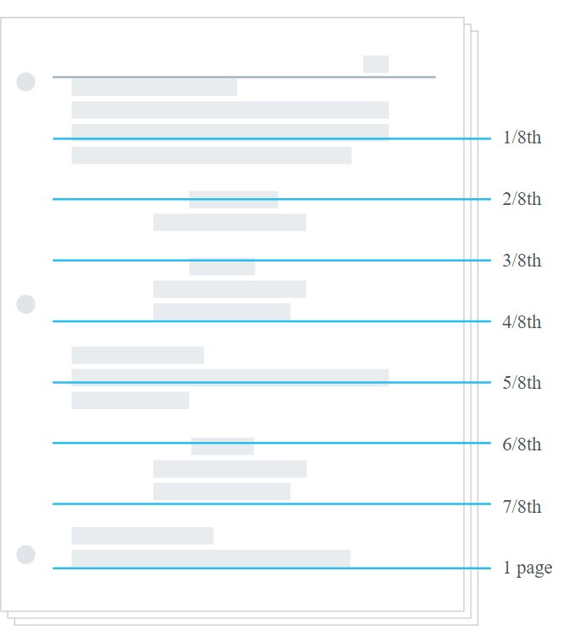
Fun Fact 1 script page roughly equals one minute of screen time.
The 1st AD takes a script and break a page up into 8-1inch sections.
This is used to measure a scene. To determine the length of a scene, the scene in the script is measured out by how many inches of the page it takes up.
A scene that is 5/8ths would be 5 inches out of 1 full script page. In screen time, that would be just over half a minute for that one scene.

Slide 12
Scriptwriting Elements and Formats

Slide 13
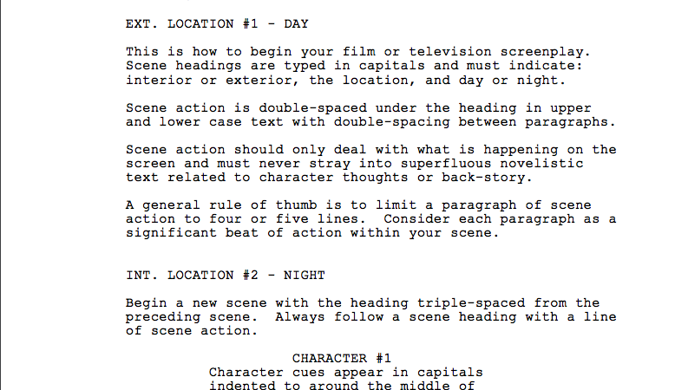

Slide 14
Scene Heading also known as a SLUG
Scene headings denote the time and place where a scene takes place. The first part of a scene heading specifies whether it is inside our outside, written as ‘INT’. or ‘EXT.’ (Interior or Exterior). If a scene is taking place both inside and outside, you can write ‘INT. / EXT.’.
The second part of your scene heading will refer to the setting – a house, a plane, a farm, whatever. Just make sure its capitalized.
The third part will specify time of day, usually in relation to the prevailing lighting conditions that you envision. ‘DAY’ and ‘NIGHT’ are the most common, but you can use more specific words, i.e. ‘AFTERNOON’ or ‘DUSK’.
A properly formatted scene heading should look like this:
If you wish to add more elements to your scene heading, such as shot types or subjects, separate them with a dash. A good rule of thumb is to go from general to specific in terms of these elements, for example:

Slide 15
Scene Heading - Slug
1st Part - Tell us location - Ext. or Int.
2nd Part - Tell us time of day - Day/Night, Afternoon/Dusk
You may include shot types if you want to add more detail
Will always be CAPITALIZED
Should also be highlighted at the top of each scene
Left aligned

Slide 16
Action
The meat of your script, action describes everything that is happening within a scene outside of dialog.
Action is written in standard paragraphical format, albeit with a few quirks. The most important quirks are the rules surrounding capitalization.
There are three things that, as a rule, should always be capitalized in a piece of action: the initial appearance of a character with dialogue, sound effects (and, if present, the objects producing the sound), and camera directions. For example:

Slide 17
Action
Description of what is happening in our script
Comes right after the Slug but can also be added throughout the scene.
Left aligned
Rules to Capitalization in the action portion:
initial appearance of a character with dialogue
sound effects
camera directions

Slide 18
Characters
Should be center aligned
Characters name should always be capitalized
Always goes before the actual dialog being spoken
Can use short hand for other description of the person talking. O.S. if person is off screen talking, V.O. if it is a voice over (dialog narration). VO can be used for telephone, radio, or a narrator.

Slide 19
Characters
The character element proceeds any dialog spoken by that character. The character’s name should always be capitalized. If the dialog spoken by a character is appearing Off-Screen (for example, a person yelling from outside a house), you must specify it as follows:
If a character is not on screen but the source of their dialog is, such as a telephone or radio, or if the dialog is narration, then you specify it as Voice Over, like so:

Slide 20
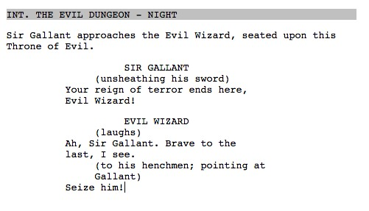
Parentheticals
For example:
Parenthetical direction is inserted into dialog to describe what a character is doing while they speak, or how they are speaking. They should not include punctuation nor should they be capitalized.
Try to keep them short, telegraphically written, and if you are describing multiple actions you should link them together with semicolons. Never end a piece of dialog with a parenthetical.

Slide 21
Parentheticals
Used to give action or direction of what a character is doing while speaking or how they are speaking
Centered aligned and placed in parentheses
No punctuation used and should not be capitalized
Keep it short, you can use semicolons to link multiple actions together
NEVER end dialog with a parenthetical

Slide 22
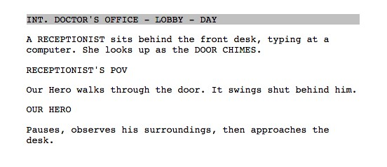
Shots
The shot element allows you to specify a subject within your scene, guiding the reader’s perspective. Shots are always capitalized, and separated from the action by a line break. For example:

Slide 23
Angles
A common method of being more specific with your shot lines is to use phrases like ‘ANGLE ON‘ or ‘CLOSE ON’ to preface the subject of the shot. Avoid using too many articles in your shot descriptions – try to make them as short as possible. Shots can also be used to specify on-screen text, such as superimpositions. For example:

Slide 24
Shots
Always capitalized
Separated from the action by a line break
Gives the reader a perspective of how it should look, but is not always needed,
We will learn shot types later this week

Slide 25
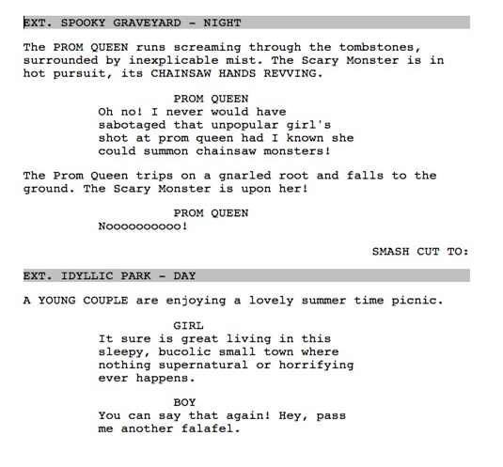
Transitions
Transitions describe how each scene leads into the next. We all know the standard ‘FADE IN:’ and ‘FADE OUT’. These kinds of transitions are largely anachronistic in contemporary screenwriting.
The careful use of specifying cuts can add great tempo and impact to your scenes. Common cuts include ‘CUT TO BLACK’, ‘SMASH CUT’, ‘TIME CUT’, and ‘MATCH CUT’.
Also this is Right Aligned

Slide 26
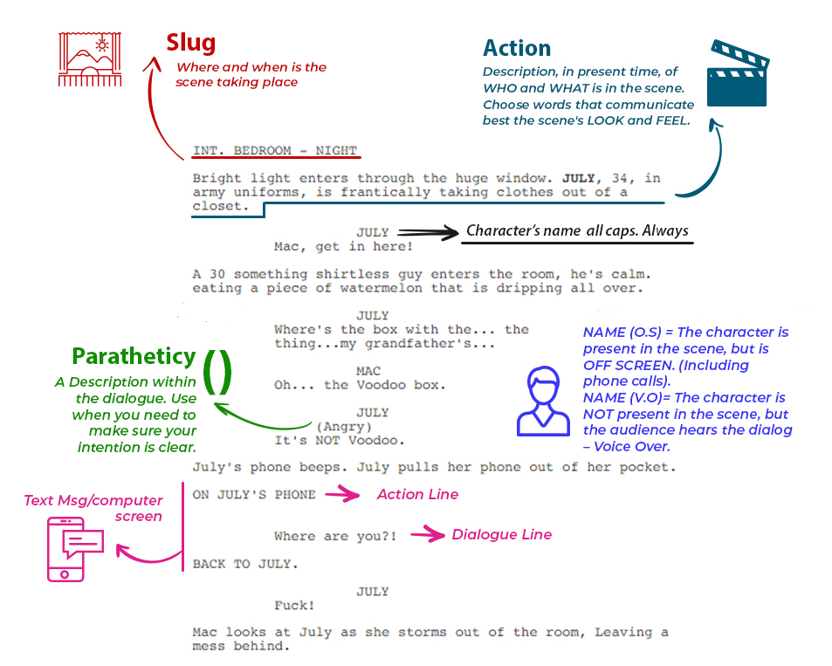
How to Format
Crap!

Slide 27
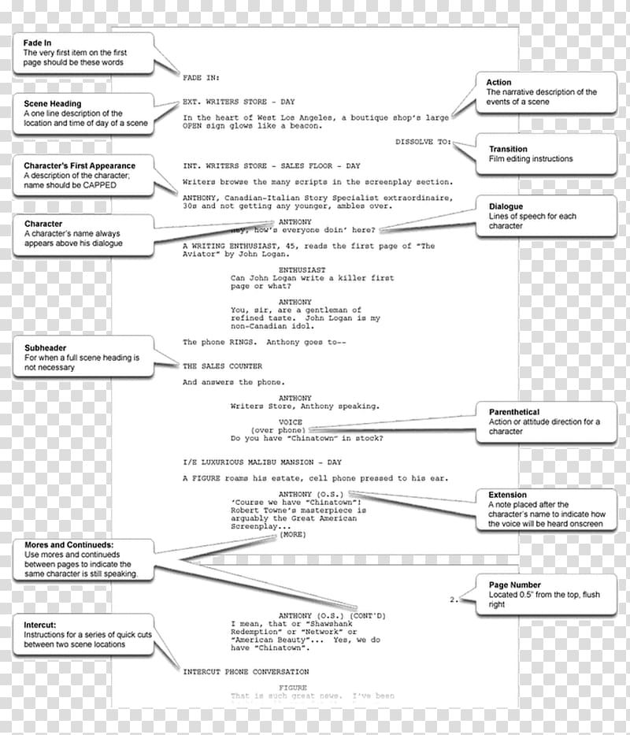

Slide 29
Scriptwriting Activity
Use the info you learned about scriptwriting to help you create a fun script to go with one of the cartoons.
Your script must include:
Scene Heading
Action
Characters
Dialogue
It must also include:
Parentheticals
Transitions
Shots
Notes:
Each page of script represents approximately 1 minute of production time

Slide 30
Title: Letter for Blanket
Characters: Snoopy & Linus
Slug Line:
Int. Linus House - Day
LINUS is writing a letter while SNOOPY watches
LINUS
(writing)
I would like to recommend Snoopy for Neighborhood Dog of the Year. He is truly a dog among dogs.
(turning to Snoopy)
How’s that?
SNOOPY
(Gives Linus his blanket)
Great!
LINUS
What a way to get your blanket back!
SNOOPY
What a way to get a letter of recommendation!

Slide 31
1
2
3

Slide 32
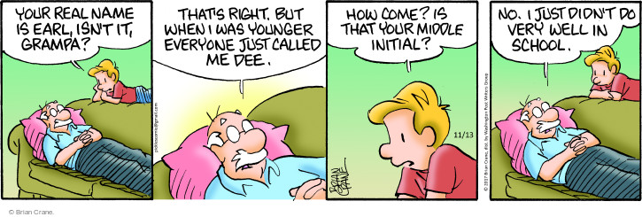
4
5

Slide 33
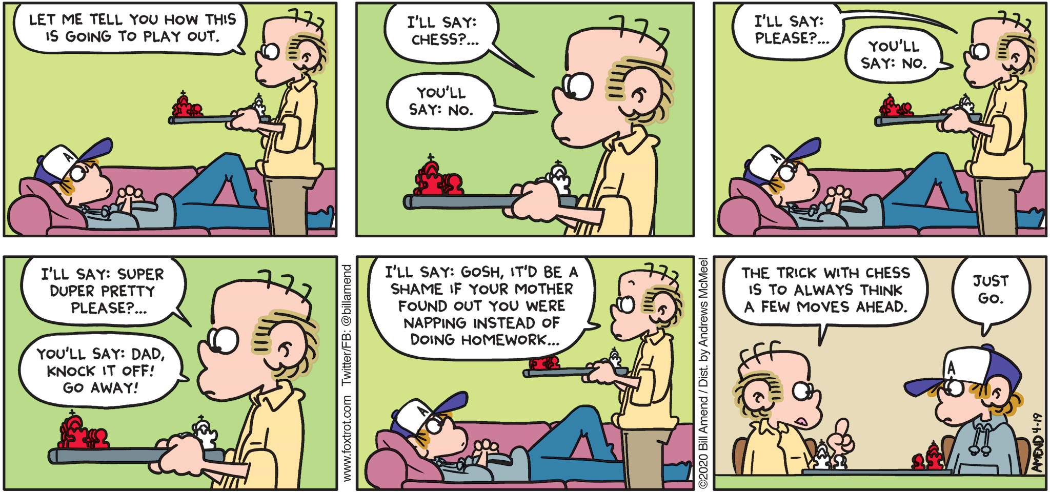
6

Slide 34
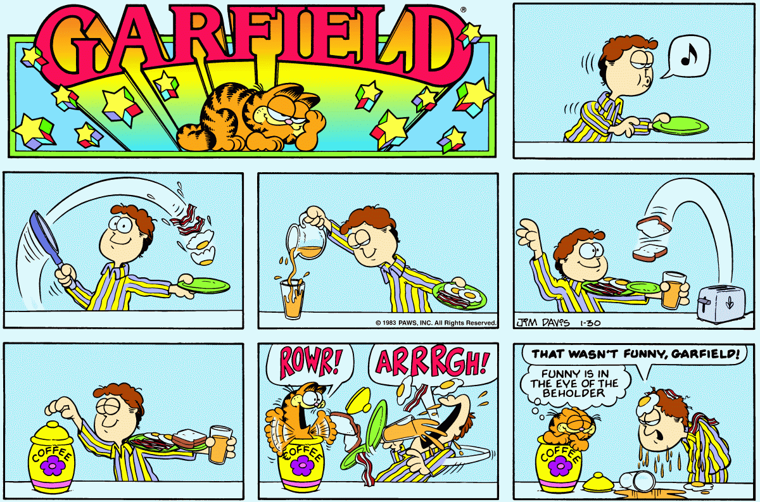
7

Slide 36
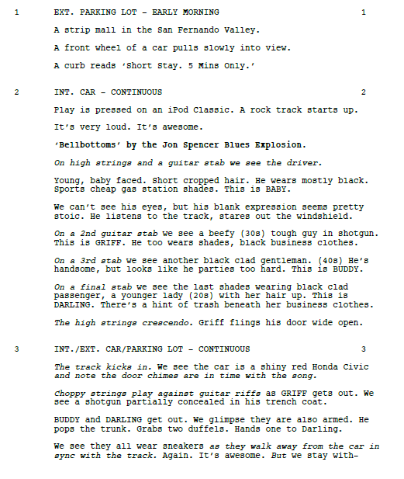
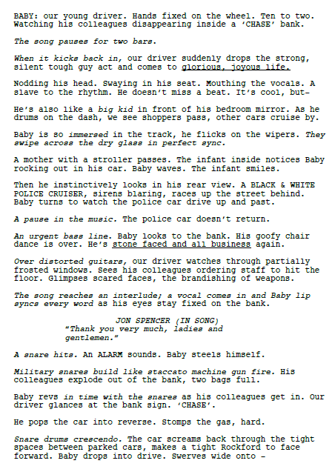

Slide 37
