Slide 1
Hardware: Cameras and Equipment

Slide 2
What do you already know about cameras?
What kind of equipment do we use for filming?
What do you want to take away from today’s lesson?

Slide 3
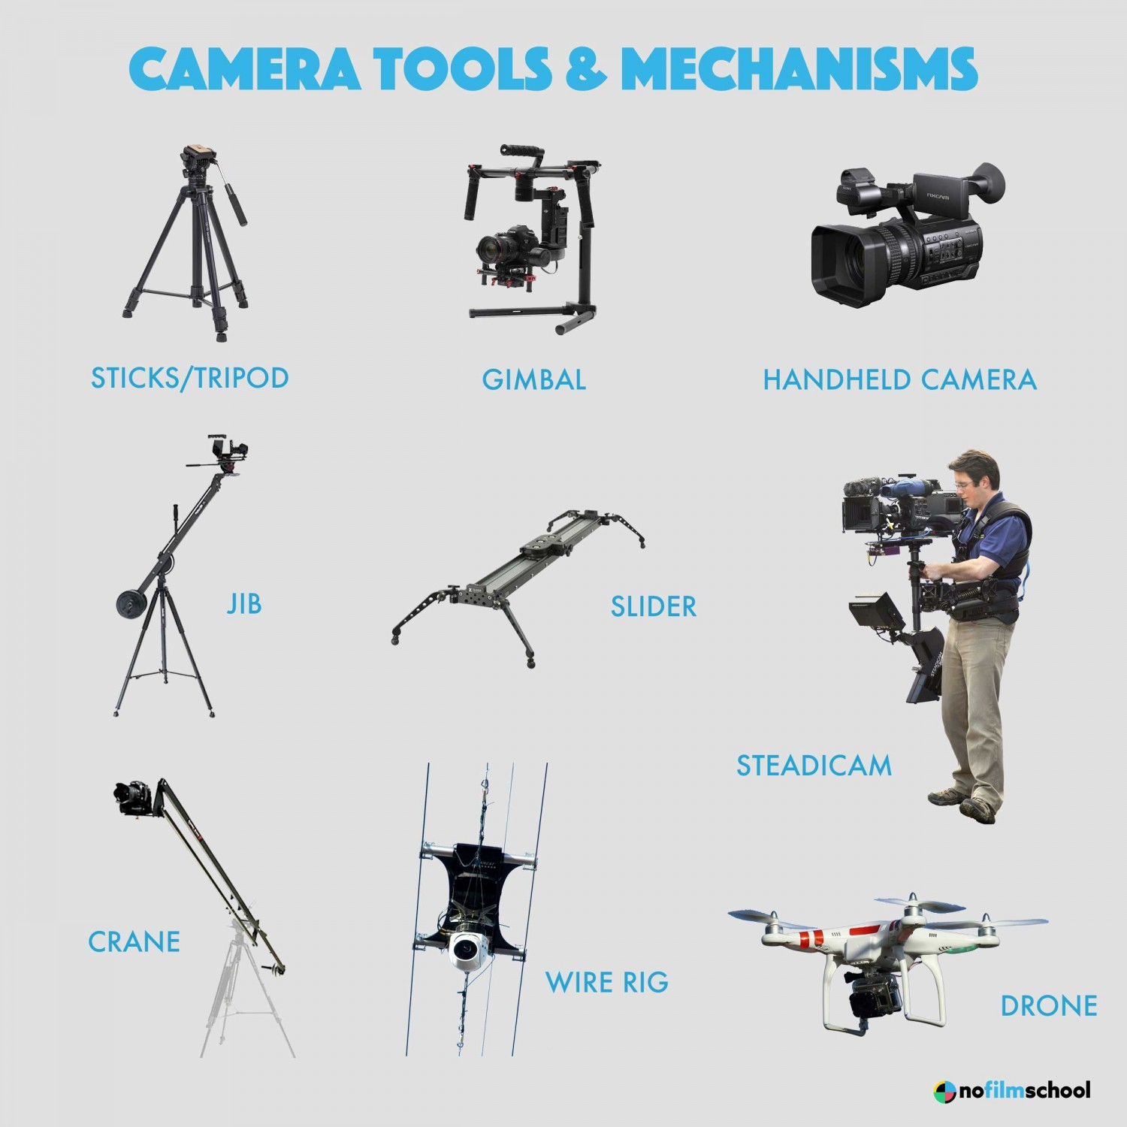
Most Common Items
Here are a few items that support the Camera

Slide 4
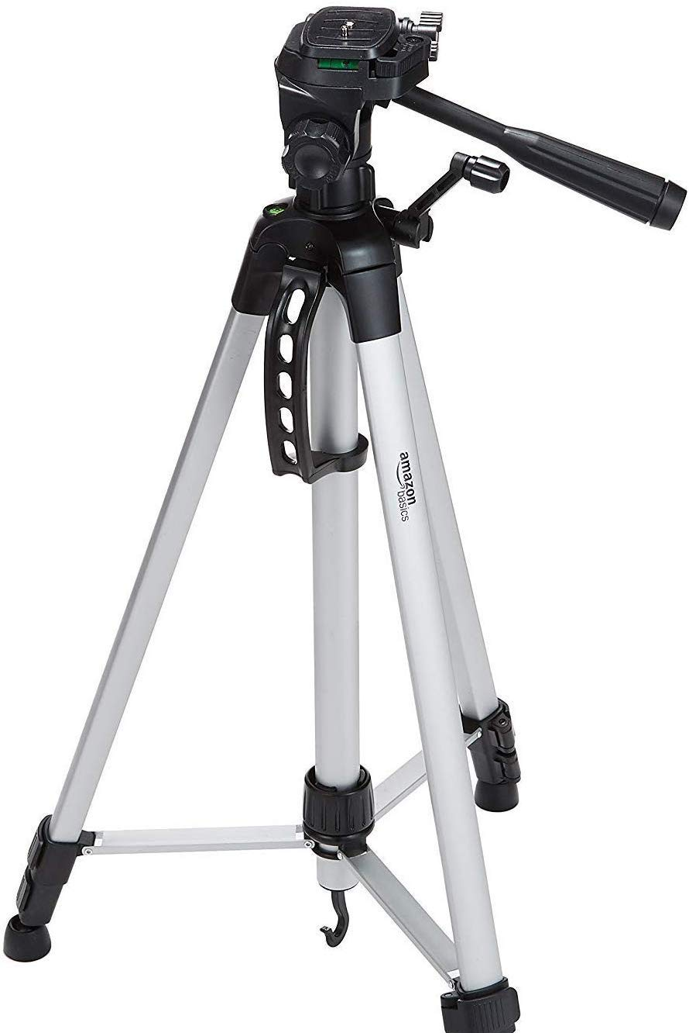
Tripod
Three legs
Length of each leg can be independently extended
Sometimes has vertical column in center which can be raised and lowered
This is what the camera sits on
Notes:
Tripod

Slide 5
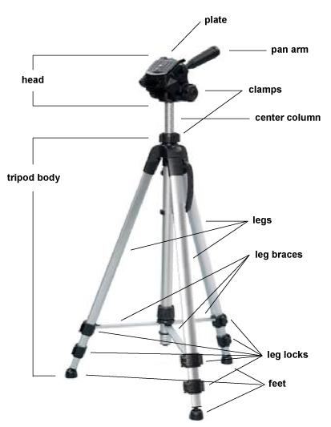
Tripod Head
The plate attaches to top of tripod
Camera attaches to tripod plate
Head allows pans and tilts to occur
Head has one or two pan handles attached so operator can stand behind camera and move it with handle

Slide 6
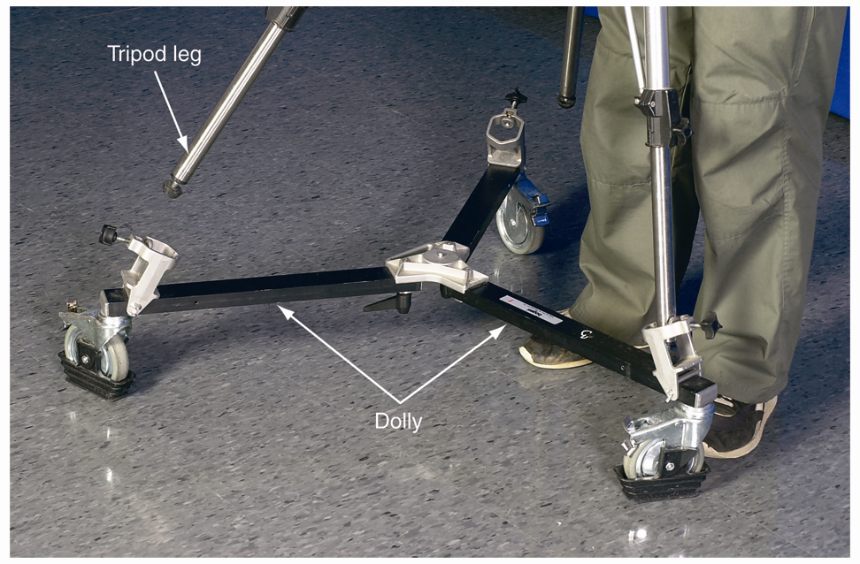
Tripod with Dolly
Dolly has three wheels with tripod legs that fit into it

Slide 7
Cameras
Captures still images or used to record moving images
Consists of a lens which focuses light from the scene
The camera body holds the image capture mechanism.

Slide 8
Parts of a DSLR Camera
D = Digital. In an SLR (single lens reflex), the photographer sees the image through the actual picture lens.

Slide 9
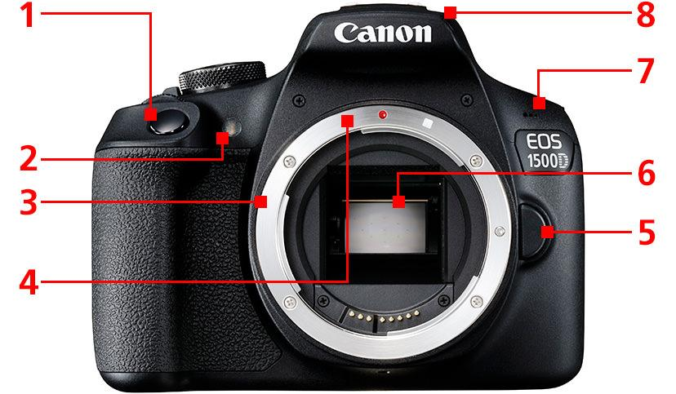
Built-in flash
Shutter Button
Red-eye reduction/self-timer lamp
Built-in Microphone
Mirror
Lens Mount
Lens Release Button
Lens Mount Index

Slide 10
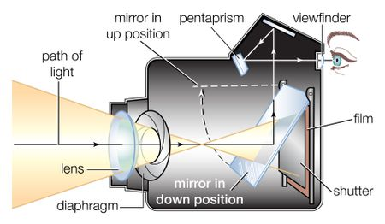
How does it Record Video?
A camera lens takes all the light rays bouncing around and uses glass to redirect them to a single point, creating a sharp image. When all of those light rays meet back together on a digital camera sensor or a piece of film, they create a sharp image.

Slide 11
In this next image, imagine you are driving down the road (or riding in the back/front seat). You or the driver are in the far left lane and then all of a sudden you see that you are about to pass your exit. Wouldn’t it be great if our eyes could zoom in on the signs before we get too close to miss our exit?

Slide 13
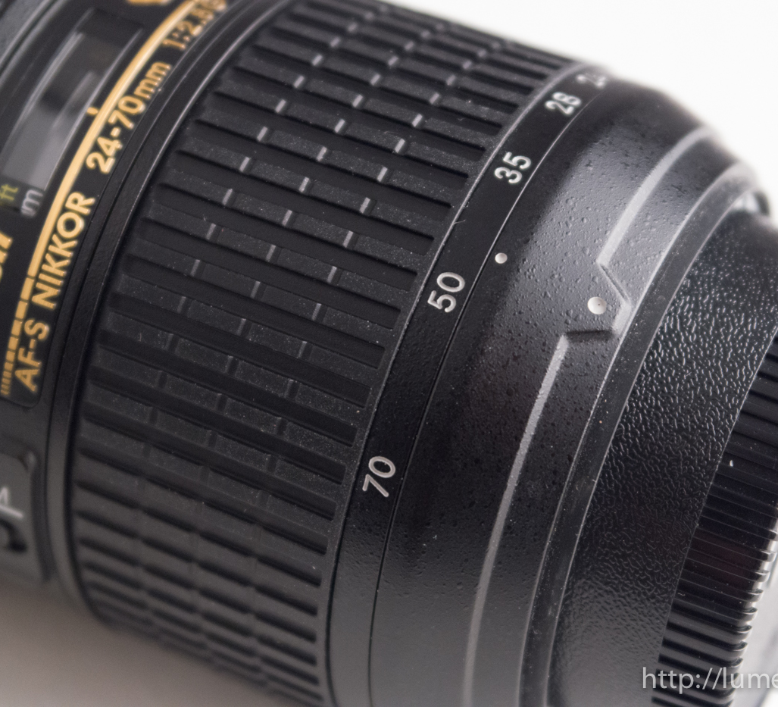
The Zoom ring helps the camera not miss their exit *shot*
Zooming on your digital camera involves getting a closer view of far-away subjects.
Twist to the left to zoom in and twist to the right to zoom out.

Slide 14
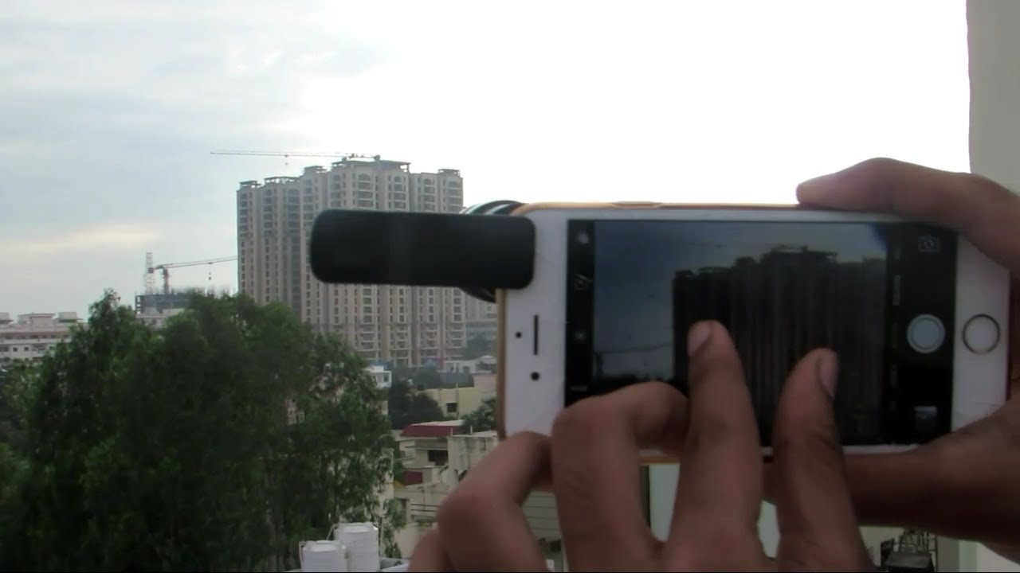
You can still Zoom with your phone, it’s just different

Slide 15
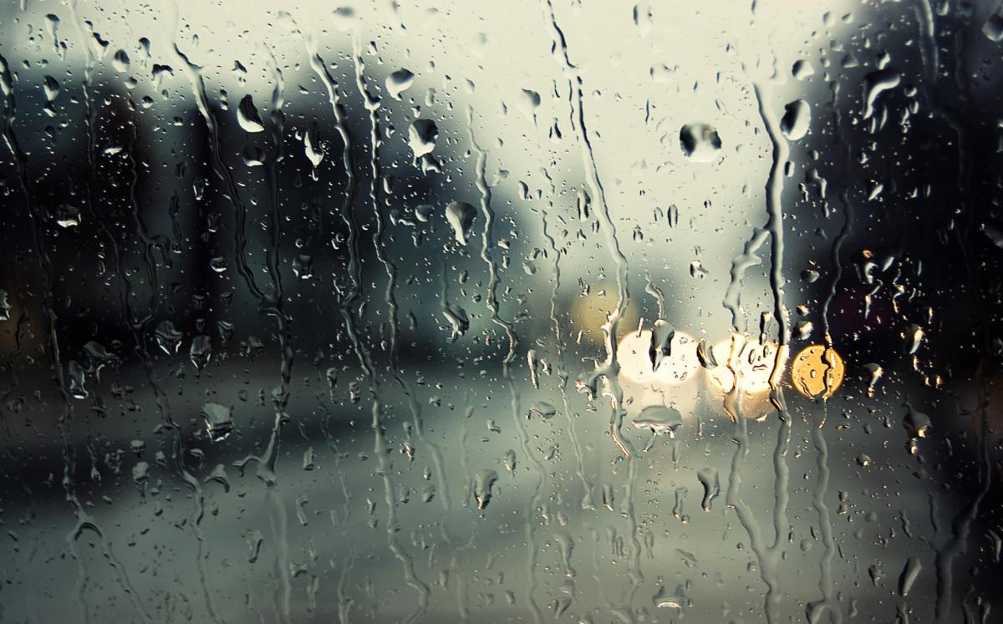
Now think about this raining image. Can you tell what is causing the light in the background? This is similar to a video or picture that is out of focus, we can hardly tell what that item is.

Slide 16
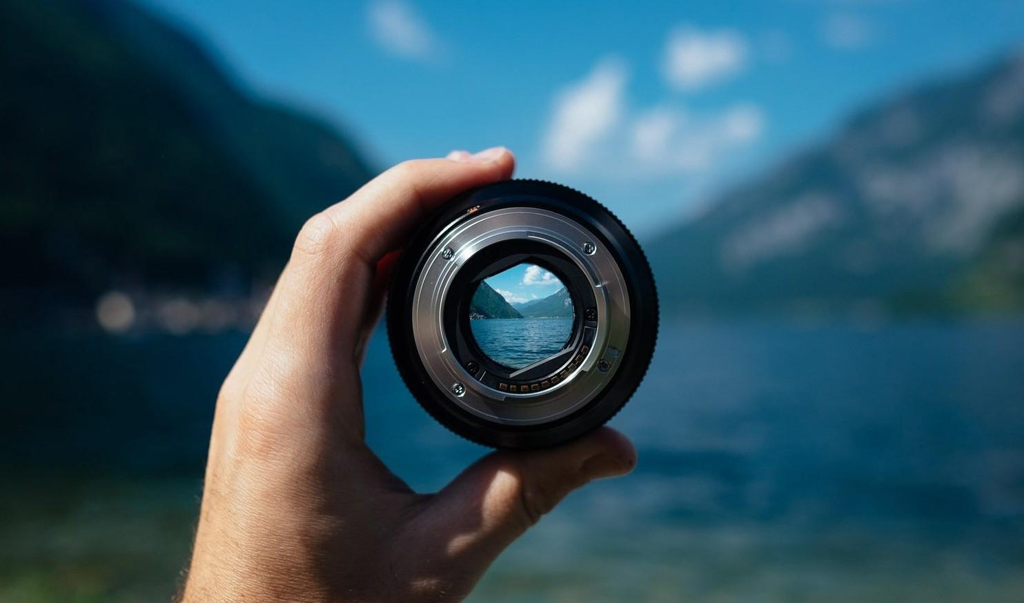
Focus
Adjusting the camera’s lens settings to make the footage of the subject clear and not blurry.

Slide 17
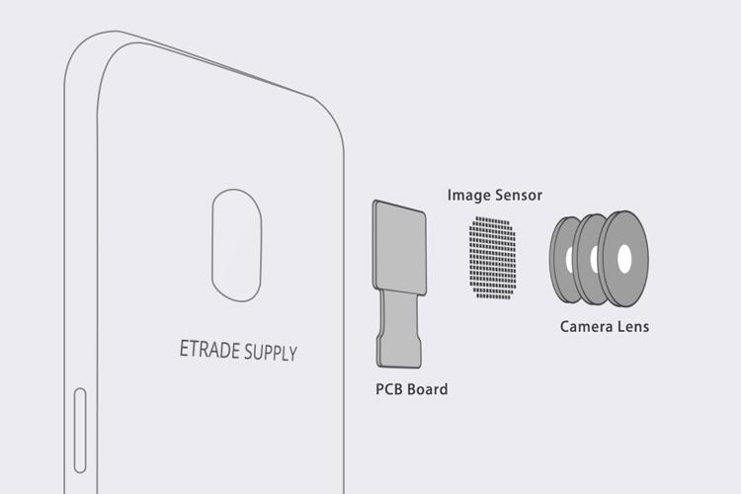
We can manipulate our phone’s lens much like a regular lens with: Zoom & Focus

Slide 18
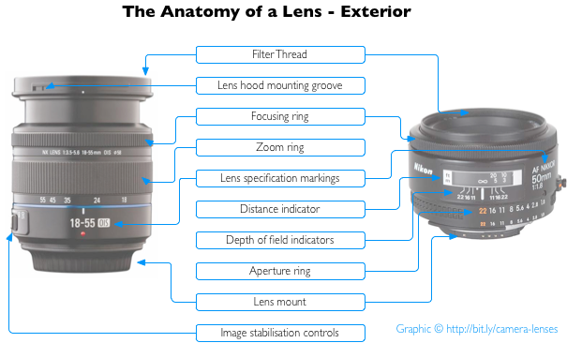

Slide 19
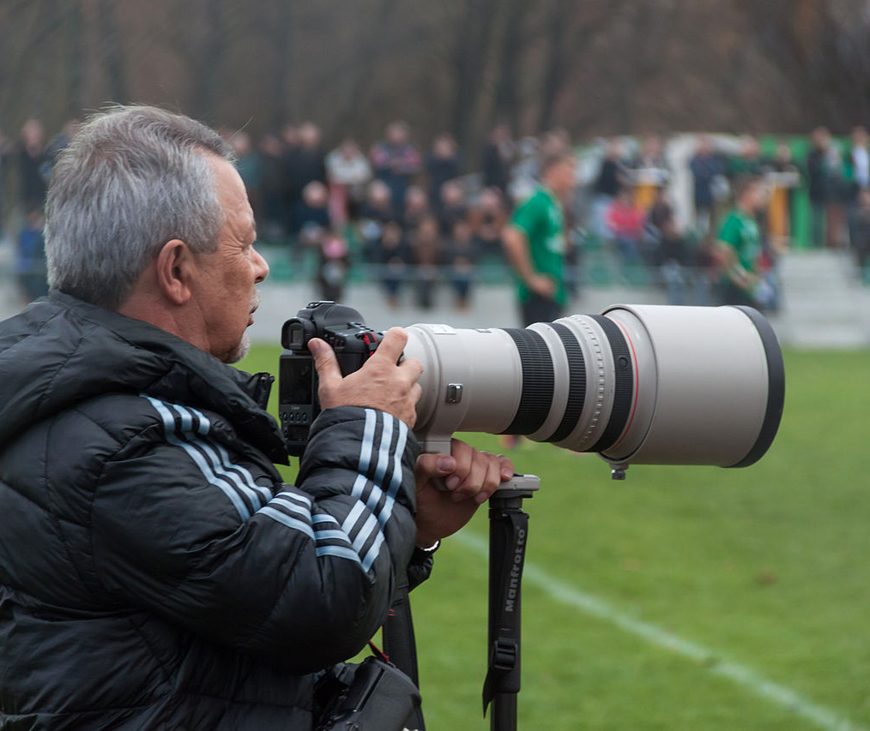
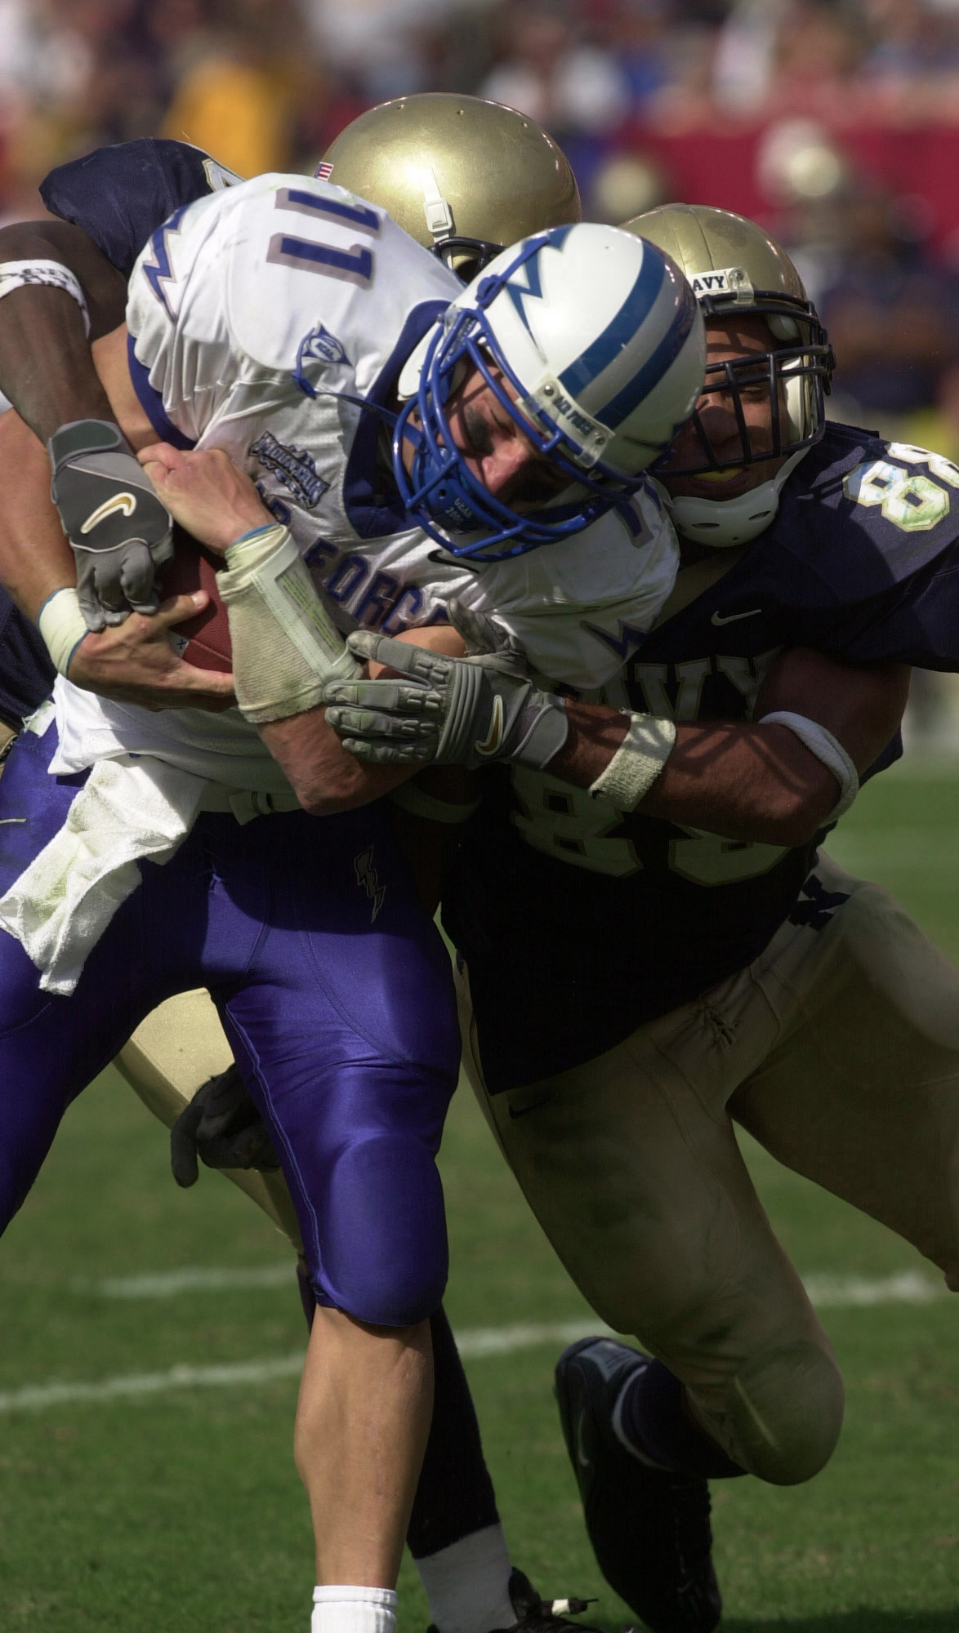
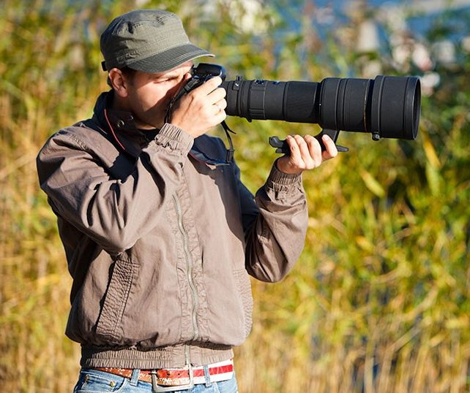
Advanced Camera Lens Terms
Telephoto Lens
Has a longer focal length than a standard lens; provides a more magnified image and narrower field of view; used for far away subject(s).

Slide 20
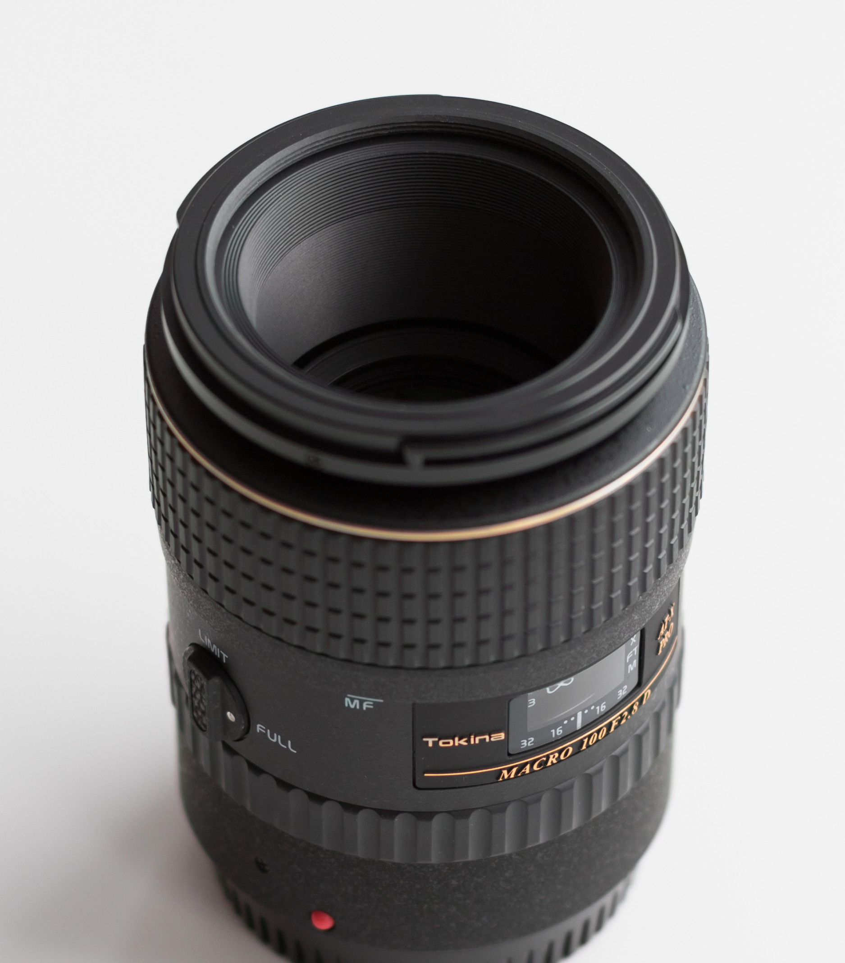
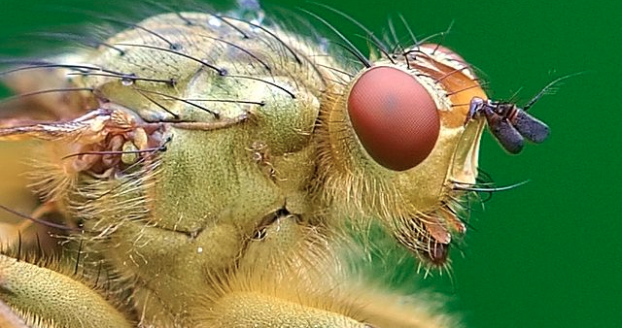
Advanced Camera Lens Terms
Macro Lens
A lens suitable for unusually up-close filming of the subject(s); shows a particular part of the subject in extreme detail.

Slide 21
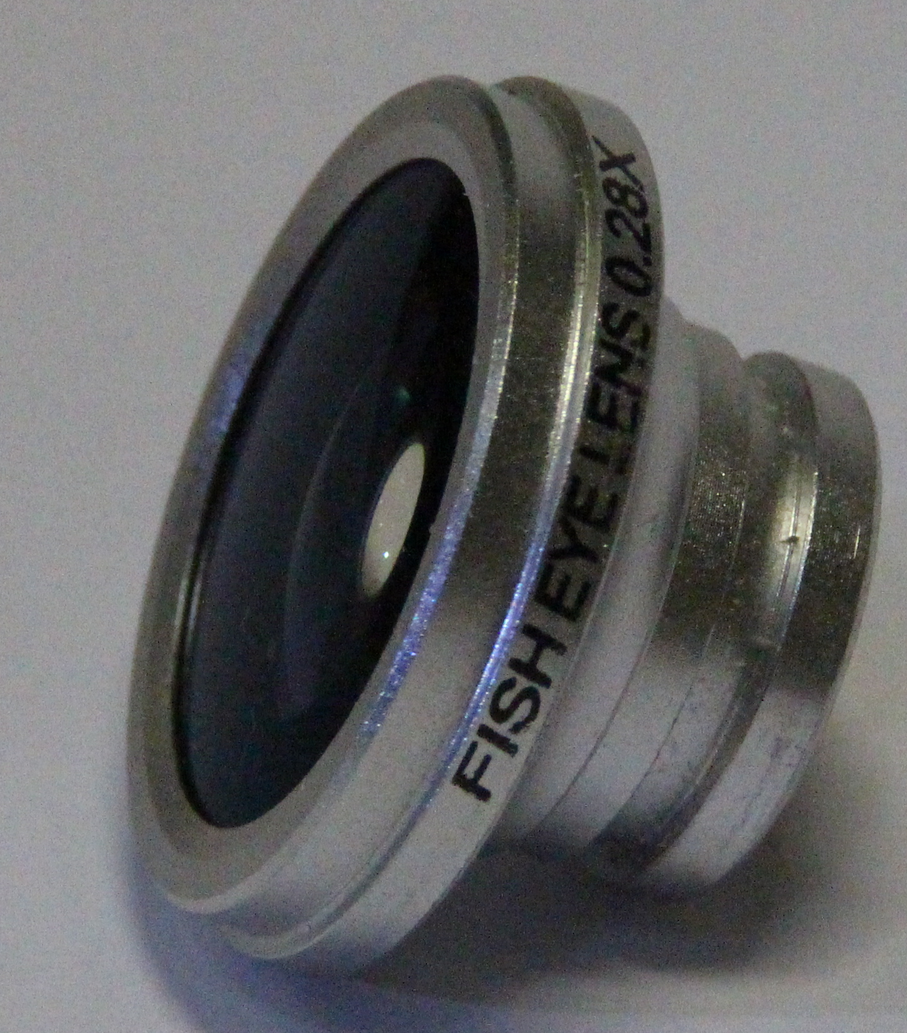
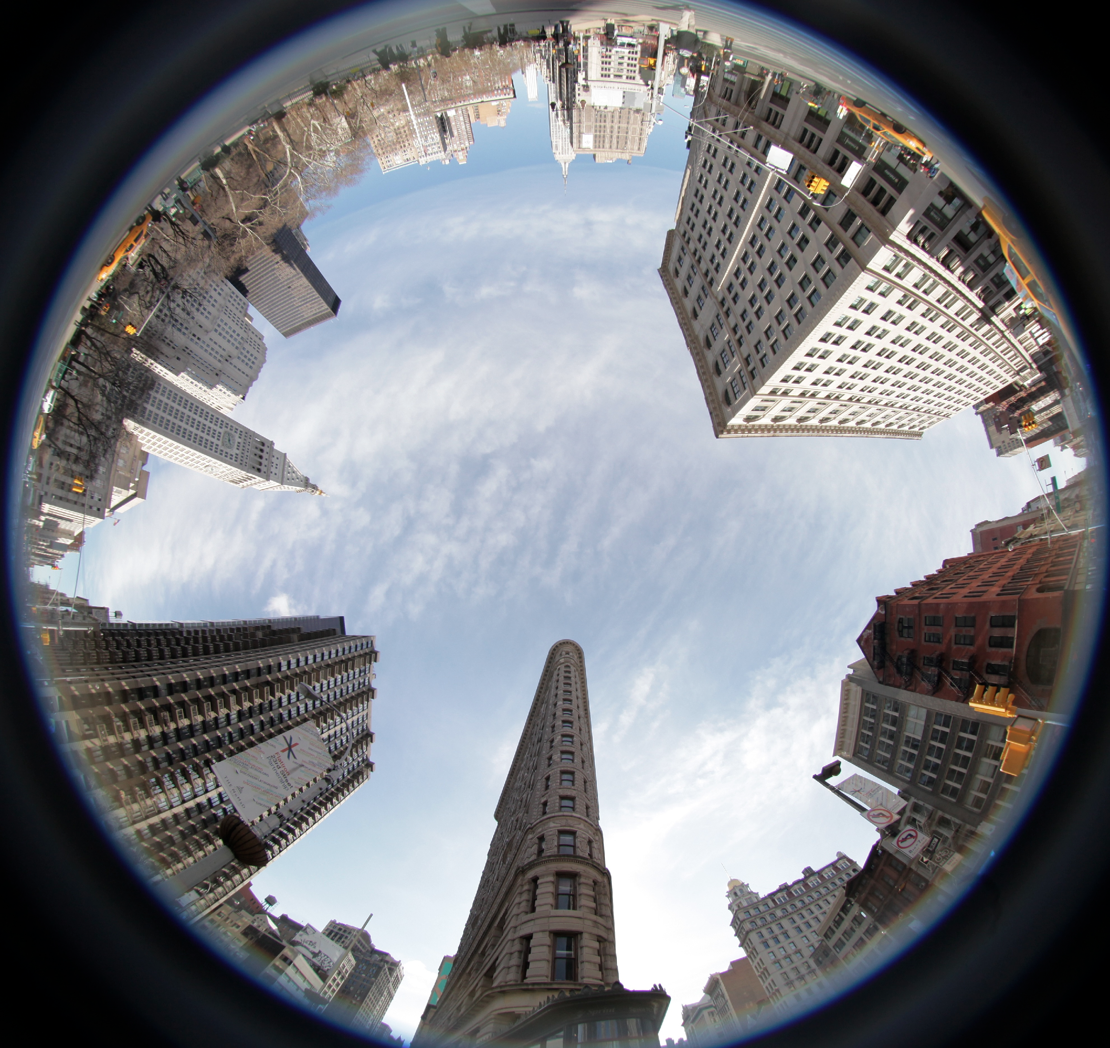
Advanced Camera Lens Terms
Fisheye Lens
A wide-angle lens that has a field of vision covering 180°; creates a circular image with visual distortion around the edges for visual effect.

Slide 22
Camera Operation Terms
White Balance
Iris
Aperture
*Some cameras adjust these properties automatically while shooting. (like your phone)

Slide 23
White Balance
Adjusting the camera’s color settings to match true white; results in all colors becoming balanced.

Slide 24
Iris
Adjusts the camera’s lens settings to allow the appropriate amount of light into the camera.

Slide 25
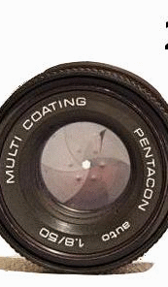
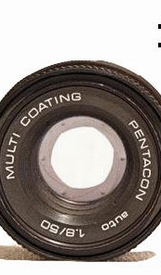
Aperture
The hole in the lens by which light travels through to re-create the image being filmed; size of the hole is controlled by the iris.

Slide 27
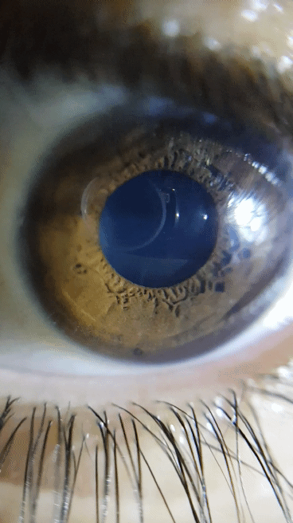
Aperture
Our pupil changes size when exposed to certain amount of light, our pupil is similar to aperture.

