Slide 1
Cut Types
Objective 4.0
Apply procedures for editing digital video using adobe premiere pro cc.

Slide 2
SHOTS VS. CUTS
After cameras and lenses, every video storyteller has two essential tools: shots and cuts. These two tools are much, much more important than the gear you use.

Slide 3
Shot
A shot is how long of a clip you shoot.
As long as there is a beginning and end, your shot can be any length.

Slide 4
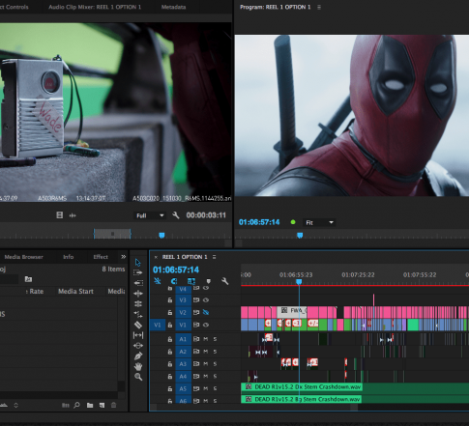
Your cut is how you string your shots out to tell a story.

Slide 5
Standard Cut
Jump cut
Cutaways
J-Cut
L-Cut
Cutting on Action
TYPES OF CUTS

Slide 7
STANDARD CUT
The most used cut out there
Placing a clip next to another clip
This cut is great when you’re trying to keep things simple

Slide 8
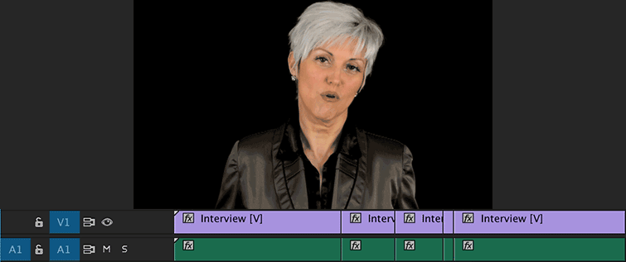
JUMP CUT
Abrupt switch from one scene to another which may be used deliberately to make a dramatic point or can look sloppy if in an interview setting

Slide 11
J-CUT/L-CUT
A J-Cut is when you hear audio from a shot and then see the video. You make the letter J visually in the timeline.
An L-Cut is when you cut to different video z the audio from that previous shot remains.
Notes:
https://www.premiumbeat.com/blog/8-essential-cuts-every-editor-should-know/

Slide 12
How do J & L cuts improve the flow in a scene or between scenes?
What might a conversation scene look like without these types of cuts?

Slide 13
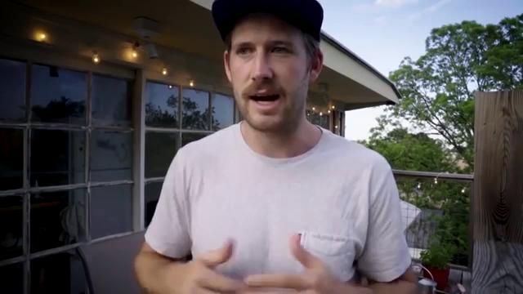

Slide 14
CUTTING ON ACTION
To cut on action, you merge two clips by cutting between them during a moment of action.
This ties the two clips together and tricks the audience into ignoring the cut.
It’s a perfect choice for a fight scene or a chase sequence.

Slide 15
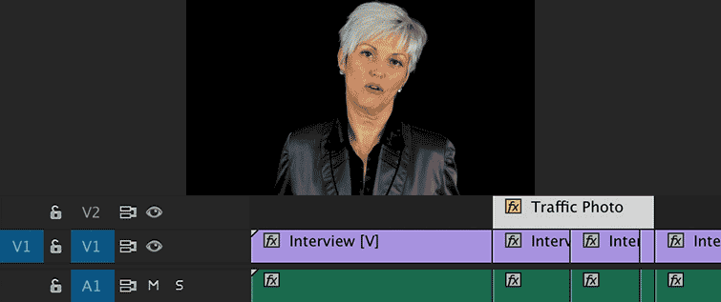
CUTAWAYS
A cutaway shot is a shot that "cuts away" from the main action to any shot that adds visual information, and then returns to the original shot with new meaning.

Slide 16
Cross Cutting
The video editing technique of switching back and forth between scenes, often giving the impression that the action occurring in different locations is unfolding at the same moment.
When should you crosscut?
To capture phone or video conversations.
To build suspense.
To make a point.
To play with time and space.

Slide 17
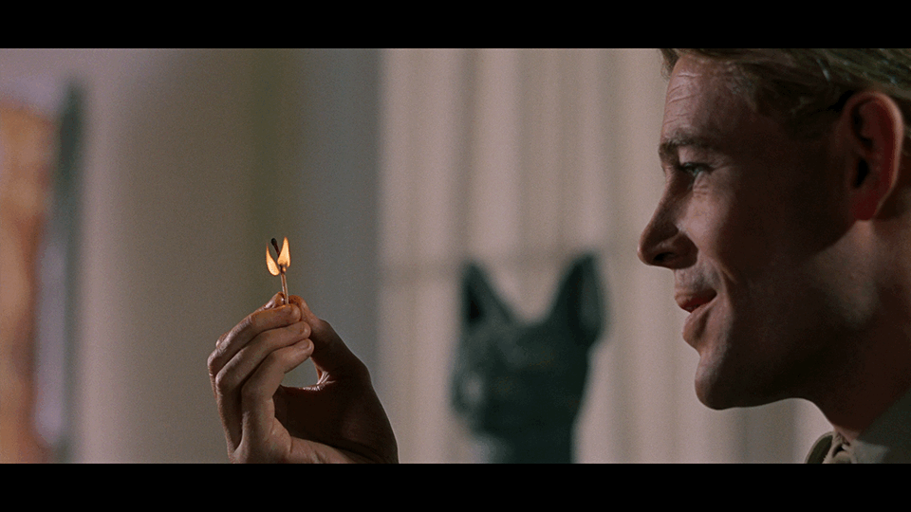
Match Cut
a cut from one shot to another where the composition of the two shots are matched by the action or subject and subject matter.

Slide 18
Tranisitions

Slide 19
A transition moves a scene from one shot to the next.
Video Transitions
The simplest transition is a cut, where the last frame of one clip is immediately followed by the first frame of the next.
Transitions are available in the Video Transitions bins in the Effects panel.

Slide 20
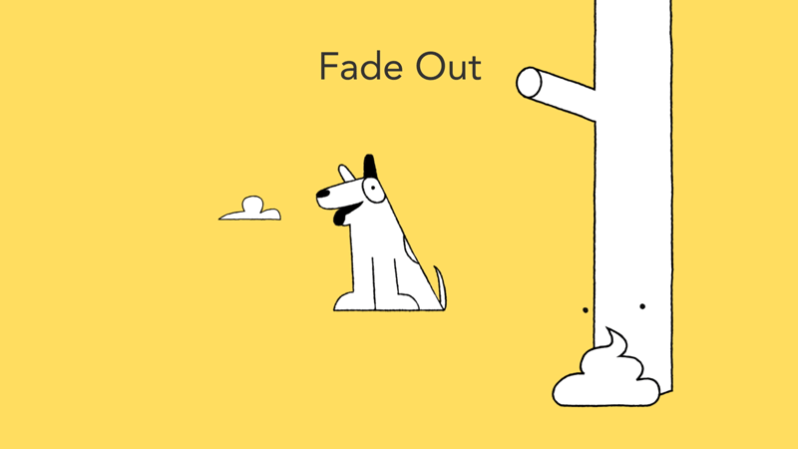
Video Transitions: Basic Types to use
Fade Up or Down
Screen goes gradually black or white to a video clip a vice versa

Slide 21
Video Transitions: Basic Types to use
Dissolve
A gradual blend between one clip and another

Slide 22
Video Transitions: Basic Types to use
Wipe
When one video clip replaces another by traveling from one side of the frame to the other or through a shape

Slide 23
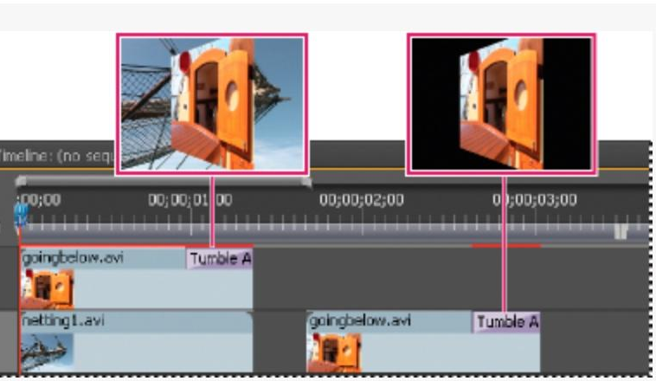
ADDING A TRANSITION
Premiere Pro provides many transitions, including dissolves, wipes, slides, and zooms.
Simply drag the transition to the position on the video track.

Slide 25
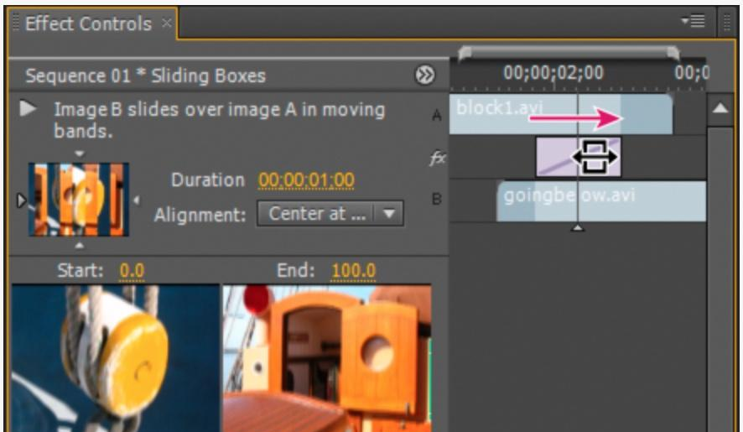
EDIT TRANSITIONS
Transition properties may be edited in the Effects Control Panel.
Properties include duration, alignment, border, direction, etc. depending on the transition chosen.

Slide 26
Additional Editing Tips

Slide 27
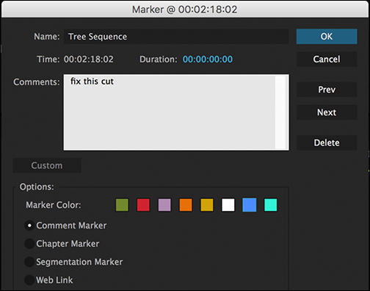
Marking Clips & Setting In and Outs
Setting a clip’s In and Out points.
In a typical workflow, you mark In and Out points for a clip in the Source Monitor.
You define the first frame you want to include in a sequence by marking that frame as the clip’s In point.
Then you define the last frame you want to include by marking it as the Out point.
You then drag the marked clip to the timeline.

Slide 28
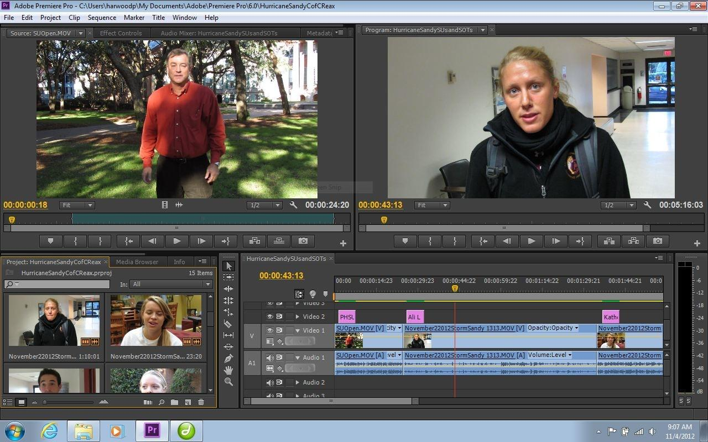
MARKING CLIPS
Source Monitor
In Point Button
Out Point Button

Slide 29
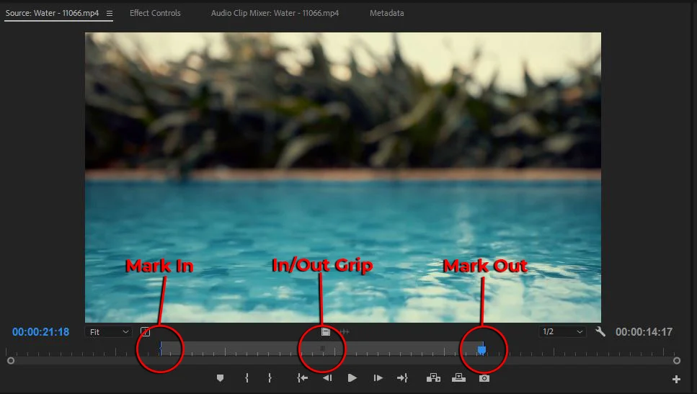

Slide 30
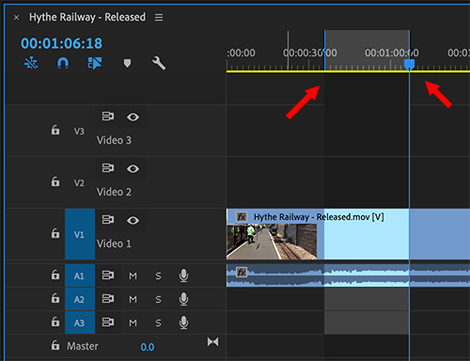
In & Out Points on your timeline.
Shortcut is
I for in point &
O for out point

Slide 31
TRIMMING CLIPS
Clip In Point in Timeline View
Adjusting a clip's In and Out points after it is already edited into a sequence is called trimming.
You can trim clips by dragging the edge of a clip in the timeline.

Slide 32
EDITING AUDIO IN VIDEO EDITOR
When you add a video clip to the timeline, the video and audio appear as two objects, each in its own track.
The video and audio portions of the clip are linked so that when you drag the video portion, the linked audio moves with it, and vice versa.
When you want to work with the audio and video individually, you can unlink them. This allows you to delete or edit them separately.

Slide 33
EDITING AUDIO IN VIDEO EDITOR
Linked Audio Layer

Slide 34
LAYERING AUDIO
Audio layers can be used to add music, narration and sound effects.
Audio editing for video works in much the same way as when using an audio editor.
When making audio adjustments of any kind, determine whether the change is applied to the entire track or to individual clips. Audio tracks and clips are edited in different ways.

Slide 35
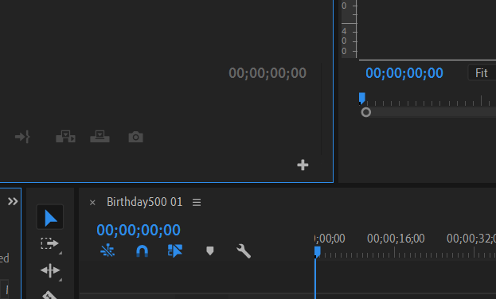
Timecode
Timecode is recorded in every video shot and allows us to access information in our editing system. Timecode will always be read as Hours:Minutes:Seconds:Frames (think back to when we talked about Frame Rate and Frames per second).
You have the ability to change the amount of frames per second in your editing software.

Slide 36
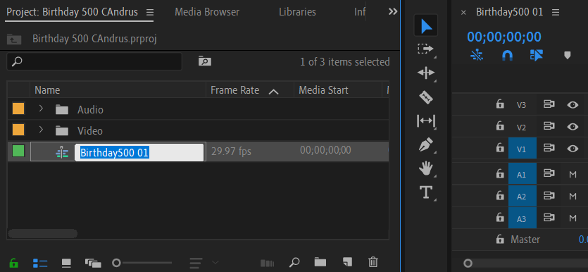
Naming your sequence
Any easy way to keep track of your sequence in the project panel is to name your sequence. Click directly on the name of the sequence and it will allow you to rename it.
This makes it easier when you go to export it, you already have your sequence named.

Slide 37
EXPORT VIDEO PROJECT
To export a video in Premiere Pro select the Timeline Panel. Then go to File>Export>Media. This will bring up your export settings window.
Choose format, file name and other settings.
May export entire or selected sequence, audio or video.
Make sure your sequence that you want to export is selected when you do this.

Slide 38
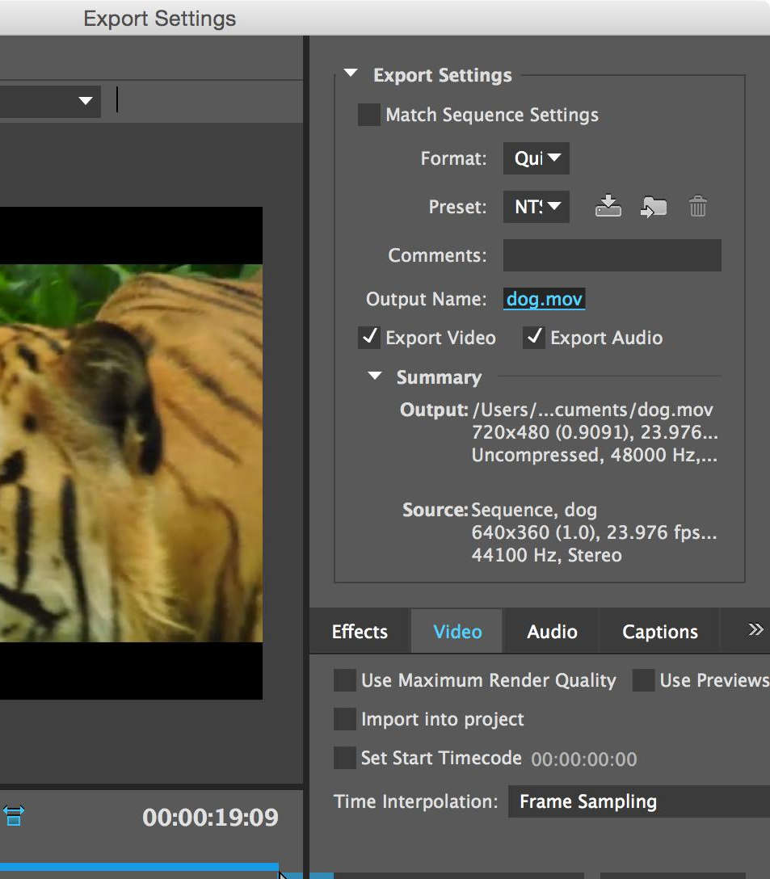
EXPORT SETTINGS
Format Options
File Save As Options
Other Options

Slide 39
OUTPUT NAME
Name and Location (Important)

Slide 40
H.264 VS. MP4
H.264 – Video Codec
Most frequently-used video codec
requires a video container to host the encoded video
Could also be contained in an AVI file
MP4 – a container format
most popular video format at present
it allows a combination of audio, video, subtitles and images to be held in the one single file

Slide 41
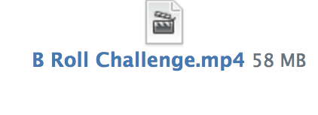
WHEN YOU UPLOAD YOUR ASSIGNMENTS
Do NOT
upload your project files
Upload your .Mp4 files

