Slide 1
A Brief History of Film
A Few Highlights to Give Context to Our Fascination With This Visual Medium

Slide 2
Roots: Machines, Action and Actors
If you were a teen in 1898, you would have been entertained by a MAGIC LANTERN SHOW, also sometimes called a “stereopticon show.” From the early 1700’s, scenes had been painted on glass and projected on a wall or sheet, using a candle or a lantern as a light source. Magic lantern shows were the combination of projected images, live narration, and live music that inspired the creation of the medium called movies. They were incredibly popular 100 years ago.

Slide 3
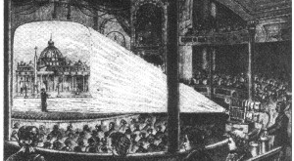
A nineteenth century magic-lantern show, using the "stereopticon" (double lens) magic-lantern, lit with limelight.

Slide 4
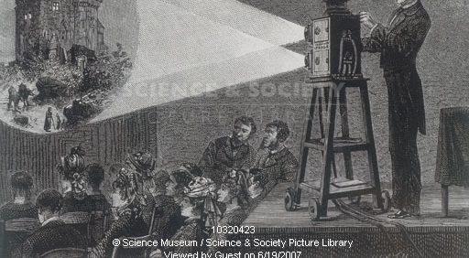
This engraving of a magic lantern show dates from 1881. The image being projected shows a castle at night.

Slide 5
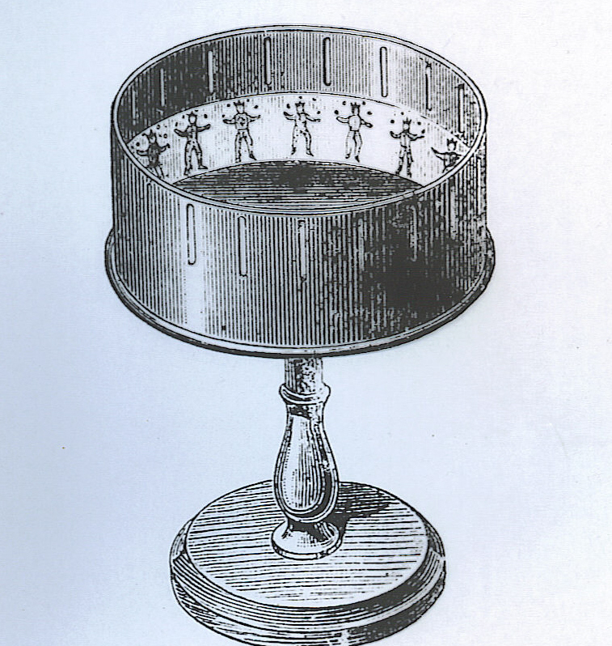
In 1834, George Homer popularized a device that simulated movement called a ZOETROPE.

Slide 6
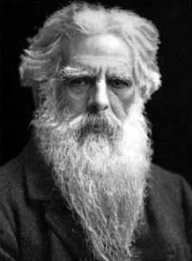
Birth of “Motion” Pictures
Leland Stanford unwittingly started a chain of events that contributed to the development of motion pictures. To settle a wager regarding the position of a trotting horse's legs, he sent for Eadweard Muybridge, a British photographer who had recently been acclaimed for his photographs of Yosemite.

Slide 7
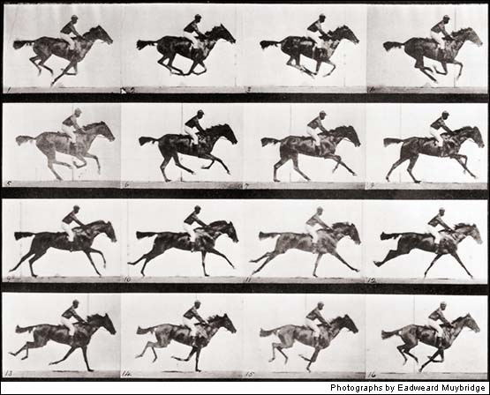
Although Muybridge initially considered the task impossible, he made history when he arranged 12 cameras alongside a race track. Each was fitted with a shutter working at a speed he claimed to be "less than the two-thousandth part of a second." Strings attached to electric switches were stretched across the track; the horse, rushing past, breasted the strings and broke them, one after the other; the shutters were released by an electromagnetic control, and a series of negatives made.

Slide 8
Though the photographs were hardly more than silhouettes, they clearly showed that the feet of the horse were all off the ground at one phase of the gallop. Moreover, to the surprise of the world, the feet were bunched together under the belly. None of the horses photographed showed the "hobbyhorse attitude" - front legs stretched forward and hind legs backward -so traditional in painting. The photos were widely published in America and Europe.

Slide 9
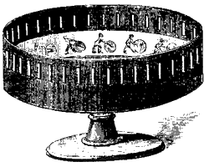
The Scientific American printed eighteen drawings from Muybridge's photographs on the first page of its October 19, 1878 issue. Readers were invited to paste the pictures on strips and to view them in the popular toy known as the zoetrope, a precursor of motion pictures. It was an open drum with slits in its side, mounted horizontally on a spindle so it could be twirled. Drawings showing successive phases of action placed inside the drum and viewed through the slits were seen one after the other, so quickly that the images merged in the mind to produce the illusion of motion.

Slide 10
Zoetrope
In fact, the earliest elementary zoetrope was created in China around 180 A.D. by the prolific inventor Ting Huan. Driven by convection, Ting Huan's device hung over a lamp. The rising air turned vanes at the top, from which were hung translucent paper or mica panels. Pictures painted on the panels would appear to move if the device spun fast enough.

Slide 11
You might decide to head out to the local VAUDEVILLE THEATRE (even most small towns had them). Here you would see live entertainment from traveling entertainers who specialized in this. Vaudeville flourished in the years between 1850 and 1900, though its heyday began in 1875, and lasted for several years after that, into the 1930’s. Many film actors started their training and careers here.

Slide 12
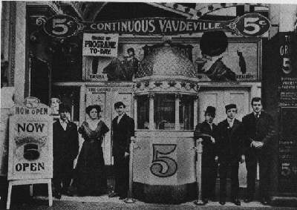
"The acrobats, the animal acts, the dancers, the singers and the old-time comedians have taken their final bows and disappeared into the wings of obscurity. For 50 years from 1875 to 1925 - vaudeville was the popular entertainment of the masses. The vaudeville actor roamed the country with a smile and a suitcase. With his brash manner, flashy clothes, capes and cane, and accompanied by his gaudy womenfolk, the vaudevillian brought happiness and excitement to the communities that were visited."
Notes:
From The Vintage Vaudeville & Ragtime Show (http://www.bestwebs.com/vaudeville/index.shtml)

Slide 13
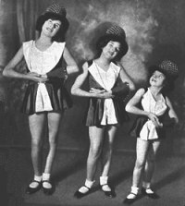
The Gumm Sisters, in their Vaudeville costumes, 1929. The girl on the right, Baby Frances Gumm, would later achieve great fame through the 30’s, 40’s and 50’s using her later stage name, Judy Garland.

Slide 14
The Revolution Begins & Escalates
The demise of Vaudeville and its traveling entertainers was soon to come, for in 1899, William Dickson, working for Thomas Edison’s famous laboratory in West Orange, New Jersey, invented the first successful motion picture camera. Edison’s team produced a KINETOSCOPE, a device for viewing films.

Slide 15
One person at a time could look through a peephole in the top of a box, while turning a crank to make the film loop move and thus simulate action. These PEEP SHOWS were very popular, so much so that stylish parlours were built to house the machines.

Slide 16
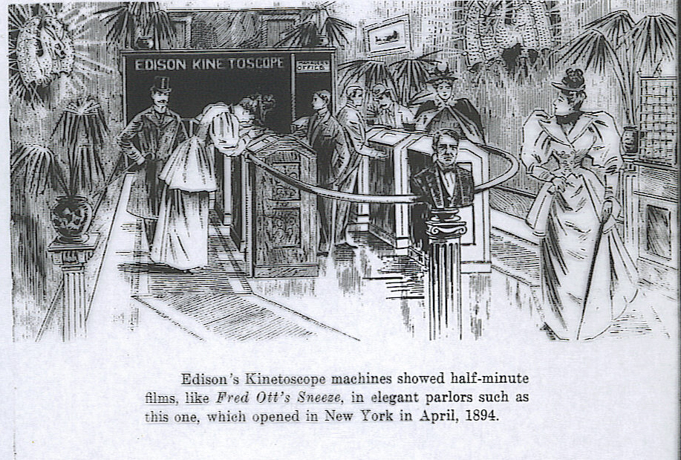

Slide 17
These early films were not told in story form. They were moving scenes of about one minute in duration each: a dog barking, a dancer moving, or in the first and therefore most famous example, a simple sneeze.

Slide 18
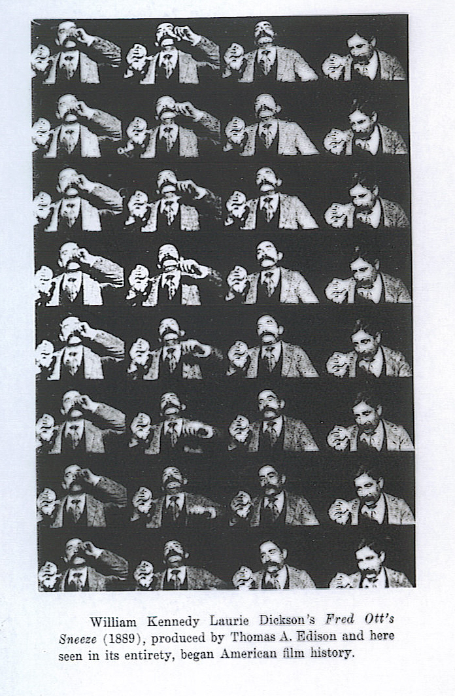

Slide 19
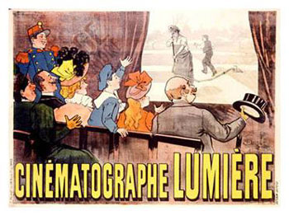
CINEMATOGRAPHE
In France, two brothers, LOUIS & AUGUSTE LUMIERE, invented a camera which could not only take a picture, but could also project it onto a screen. It was called a CINEMATOGRAPHE.

Slide 20
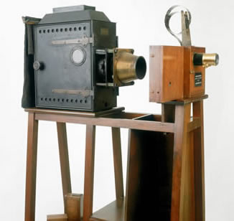
CINEMATOGRAPHE
The brothers Louis and Auguste Lumière were two of the earliest players in the development of motion pictures. Their cinématographe device, patented in 1895, was a combined cine-camera and projector, using an intermittent claw derived from the mechanism used in sewing machines. It was used to show the first projected cinema film to a paying audience, in the basement of the Grand Café, Paris, on 28 December 1895. This example is the earliest surviving from the subsequent production run.

Slide 21
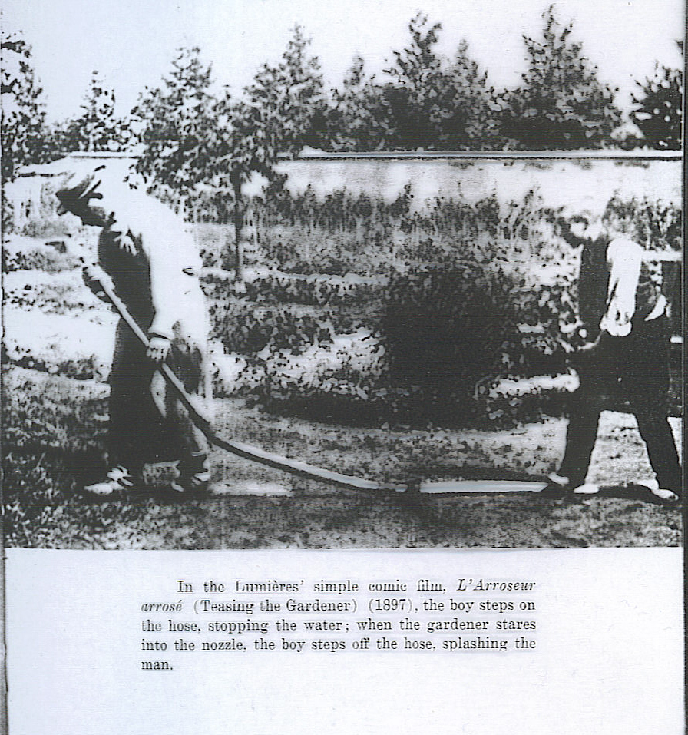

Slide 22
VITASCOPE
Vaudeville houses began renting these early machines and using them to attract audiences in conjunction with their live performers. The usual choice in these cases was Edison’s early motion picture projector called the VITASCOPE.

Slide 23
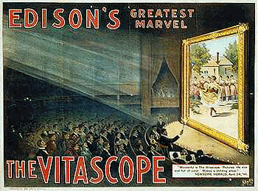
“There were two decisive steps in the creation of the modern motion picture: the transition from the "peep show" to the projection of images over a distance, accomplished in the 1890s by Thomas A. Edison's (1847-1931) Vitascope; and the talking picture, introduced in the American movie The Jazz Singer in 1927.”

Slide 24
The Revolution Organizes
As film projectors became more readily available, back rooms of stores and businesses (and any other available free space) became projection rooms. These spaces were the origins of the later NICKELODEONS, where one could see a film all day long for a nickel. (These short films were shown continuously from morning to night).

Slide 25
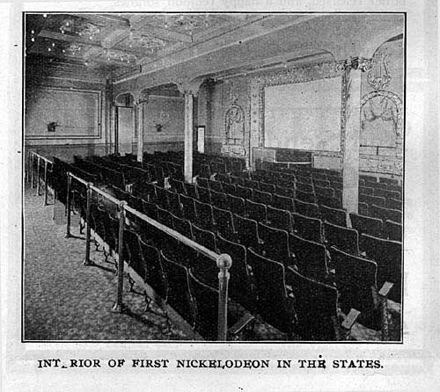
Interior of a nickelodeon theater in Pittsburg. It was claimed to be the first nickelodeon in the United States. The Moving Picture World, November 30, 1907.

Slide 26
Nickelodeons
These nickelodeons served many of the poor and immigrant peoples who were flooding into North America at that time, and by 1908, there were over 10,000 nickelodeons in the US.
In fact, the success of these silent films was because there was no language at all to deter the viewer from understanding and enjoying the films.

Slide 27
As the popularity of the medium grew, so did production companies grow to meet the ever-increasing demand for more product. Production companies were founded in the eastern U.S. to meet the demand.
However, because of the poor weather and the growth of TRUSTS, many independent companies headed for California to make their motion pictures or “movies”.
TRUSTS are motion picture companies that held patents for film making and projection technologies that prevented any other new companies from making motion pictures.

Slide 28
The Stars
Motion picture companies from the start were reluctant to name their featured players to the public. They knew that name recognition would drive up salary demands from these “stars”.

Slide 29
The Stars
However, audiences began to identify and name their favorites. “Let’s go see the Biograph Girl or Bronco Billy” eventually led to the realization that it was often the actor who attracted audiences to the movies.
For example, Carl Laemmle, a producer of early films, hired away the BIOGRAPH GIRL, Florence Lawrence, from Biograph Studios, and used her popularity and name to attract people to his films. This phenomenon was the root of the star system and the accompanying salaries we see in film today.

Slide 30
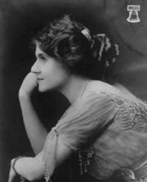
The Stars
Florence Lawrence (January 2, 1886 – December 28, 1938) was an inventor and silent film actress, who is often referred to as "The First Movie Star."
She was also known as "The Biograph Girl" and "The Girl of a Thousand Faces". During her lifetime, Lawrence appeared in more than 270 films for various motion picture companies.

Slide 31
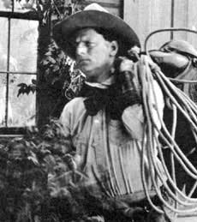
The Stars
American actor-director-writer-producer, father of the movie cowboy, and the first Western star, Anderson gained enormous popularity in a series of hundreds of Western shorts, playing the first real cowboy hero, "Bronco Billy”. He made 100’s of films starring as Bronco Billy.

Slide 32
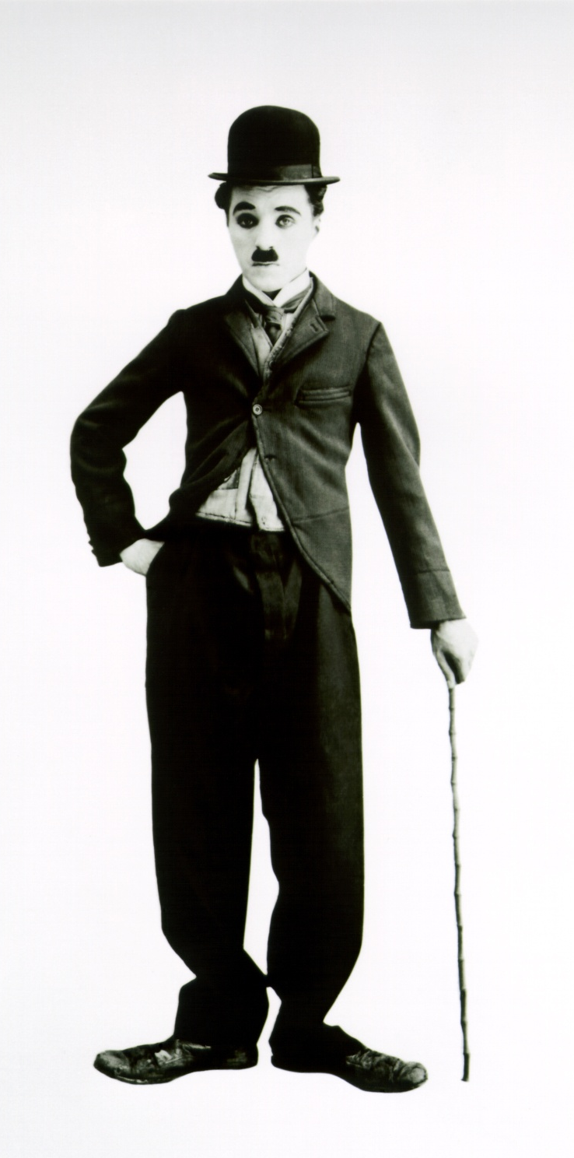
The Stars
Charlie Chaplin, one of the most famous actors from this era and still known today, benefited from this system.
His salaries:
1913: $150/ week
1914: $1250/ week
1915: $10,000/ week
1916: $1,000,000 for 8 short films made in 18 weeks.
He was 27 years old, and there was no income tax!
Charlie Chaplin, in his most recognizable film costume, the “Little Tramp”.

Slide 33
A New Revolution
Keep in mind that all of this discussion is about film without a soundtrack or SILENTS. Film with sound was being developed, but most makers of motion pictures saw the combination as a gimmick only, because of the over-whelming acceptance and success of the silent motion picture. They were also reluctant to add to the expense of film production which would result from the addition of sound.

Slide 34
Silent Films
Silent films were accompanied by music almost from the time that they began to tell a story. At first, a tinkling piano would be used to add to the emotion of the film, but as time passed, special musical scores were written that would use the piano and a small band; eventually, especially in larger cities and venues, full and extravagant orchestrations for elaborate musical scores would be played live by large symphony orchestras.

Slide 35
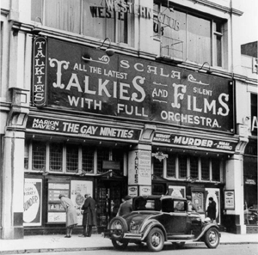
Pianists, theater organists, and percussionists were in high demand during the silent movie era to provide appropriate musical accompaniments.

Slide 36
Theatres
And these movie theatres were large. Many of them featured marble foyers, balconies and boxes, plush seats, ornate decorations, huge chandeliers, elaborate staircases, and French, Oriental or Persian motifs. For example, did you know the beautiful Imperial Theatre in Saint John with its Italian Renaissance décor opened in 1913 for the performance of vaudeville AND silent movies?

Slide 37
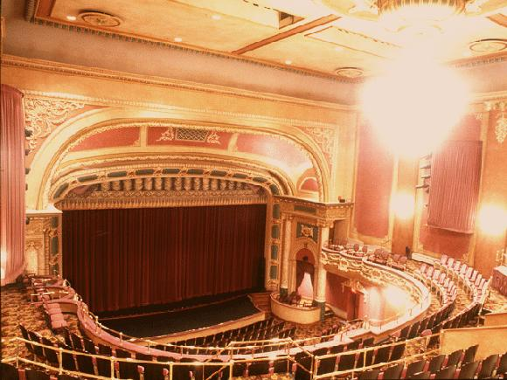

Slide 38
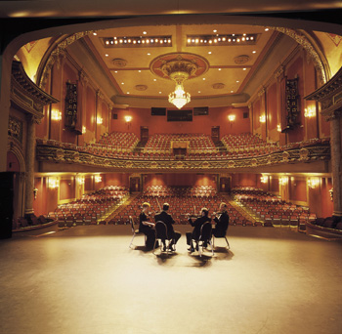

Slide 39
The Jazz Singer
Despite the resistance to change in the film industry, WARNER BROTHERS STUDIO, relatively small at the time, was looking for a way to increase film sales.
It bought GENERAL ELECTRIC’s sound system known as VITAPHONE and made movie history with a movie called THE JAZZ SINGER in 1927, thus changing the course of film-making forever.

Slide 40
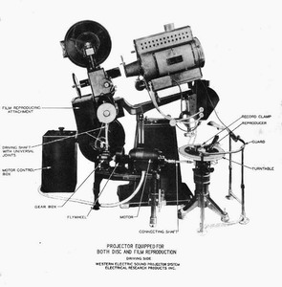

Slide 41
Talkie Films
Though experimentation with film sound had been happening in the industry for a few years before this, The Jazz Singer is acknowledged as the first TALKIE, or film with a synchronized, pre-recorded soundtrack that included dialogue.

Slide 42
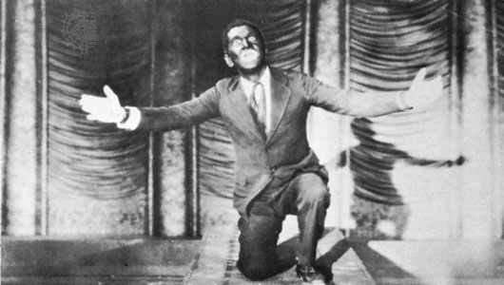

Slide 43
Talkies
Some great careers were lost by this change to sound pictures. Some great studios and directors were lost as well. This phenomenon is parodied to comical effect in the celebrated 1952 musical-comedy film, Singin’ In The Rain, which we will view and discuss as a class.

Slide 44
Film Industry
However, the movie-making business only flourished with the change and became major businesses with highly structured organizations. Most of the big companies strove to make, market and house their own films, and many successfully did so.
For example, Warner Brothers Studio would show their films at Warners’ Theatres first and foremost; other film houses that wanted to show one of their films would be charged a premium to do so, thus pressuring the independent to join the Warners’ chain.

Slide 45
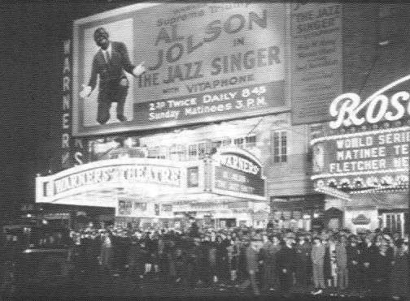

Slide 46
The Industry Grows & Matures
With their success came criticism, and thus began the business of the CRITIC. Almost from the beginning of the silent film days, studios faced harsh criticism from critics concerning the use of sexuality, violence, crime, and general moral values depicted in films. Of course, this criticism has continued, now levied at TV and video games as well as film.

Slide 47
The Industry Grows & Matures
The motion picture companies banded together in the 1920’s to hold off government controls and hired WILL HAYS in 1922 to “keep movies clean”.
In 1930, his office developed the Motion Picture Production Code which banned what they considered to be sexually suggestive acts in movies (even the showing of double beds), as well as language considered offensive. The code demanded that movie lawbreakers be punished.

Slide 48
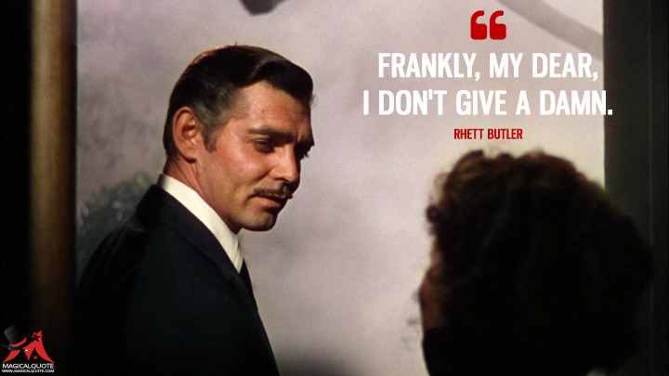
As the years went by, this code was softened, until in 1939, Rhett Butler is allowed to utter in contempt to Scarlett O’Hara in GONE WITH THE WIND:

Slide 49
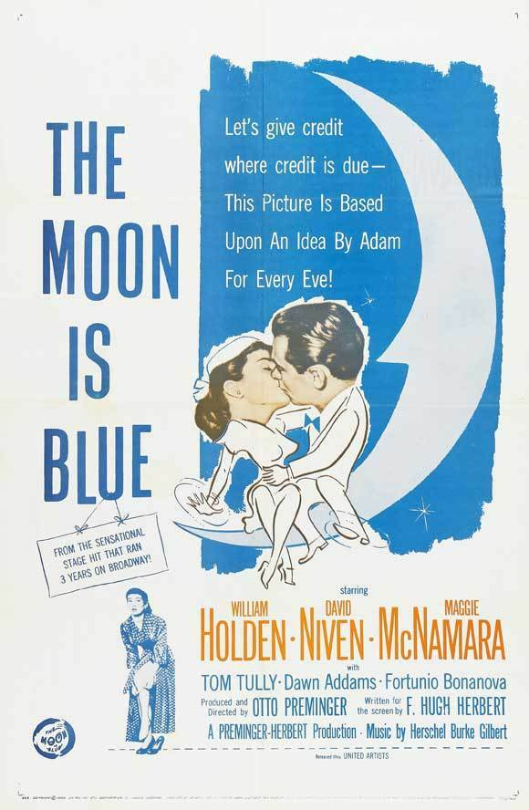
The Code
In 1953, the movie THE MOON IS BLUE used the word…
“virgin”.

Slide 50
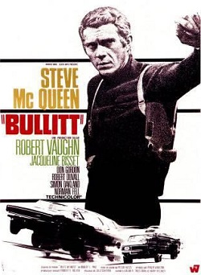
By the 1960’s, movies such as BULLIT could use a few “blue” words (“hell” & the “s” words, for example) and violence in general became more prevalent.

Slide 51
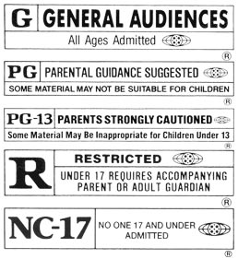
Movie Code
Today, the movie code with which we are familiar is a labeling system which classifies films as G (General), PG (Parental Guidance), 14 (Adult Accompaniment), 18 (18 Years and over), XXX (Explicit Material) and E (Exempt).

Slide 52
This presentation is by no means inclusive, but meant to give an overview of film history highlights. Find out more through the hundreds of web sites dedicated to film studies and its history.
The End.

