Slide 1
Getting Started in Video Design
Objective: 1.00
Understand project requirements of video projects.

Slide 2
Digital Video
Moving images that have been captured, created, or edited electronically.
Digital video signals transmit information in the form of individual bits of data.
Analog (non-digital) video signals transmit information continuously in the form of a wave.

Slide 3
Streaming Video
Transmitting video files that can begin playing over the Internet as the remaining data is still being downloaded.
Creates little to no wait time to begin viewing the video file.
Example websites that use streaming video technology include: YouTube, Netflix, Vimeo, UStream, etc.

Slide 4
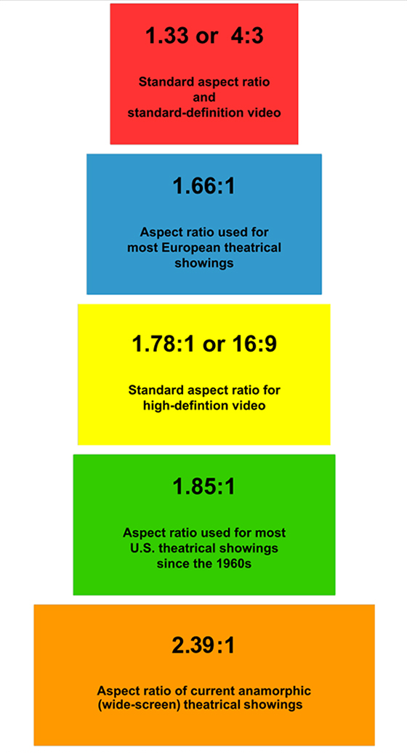
Characteristics of Digital Video
Aspect Ratio
Ratio of a video screen’s width and height dimension; common ratios are standard (4:3) and widescreen (16:9).
Frame Rate
Speed at which video frames appear on a screen; measured by frames per second (FPS).

Slide 5
Characteristics of Digital Video
Scanning Method
Method by which video picture appears on a screen (720p, 1080i, etc.).
Interlaced (I)
Displays half of the video picture at a time (odd lines, then even); alternates too quickly for human eye to notice.
Progressive (p)
Displays the entire video picture at all times; greatly reduces any flickering of picture; better quality image than interlaced.

Slide 6
Pre-Production
Meet with the client to create a project plan:
Determine the purpose of the video production.
Define a target audience.
Set overall goals of the video.
Agree on deadlines for phases of the project.
Create a budget for the production.
Decide what equipment will be necessary to create the video project.

Slide 7
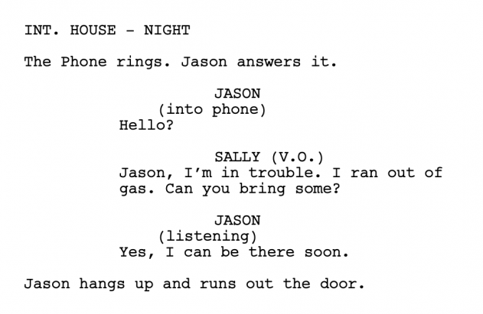
Pre-Production
Script Writing
Script is needed to tell the actors (both on screen and for a voiceover) what to say and when. The script also gives direction to set lighting, sound effects, and other components of the project.
It is important to consider the following:
The overall goals of the video project.
The target audience of the project.
The accepted vernacular of the target audience.
The readers (performers) of the script.

Slide 8
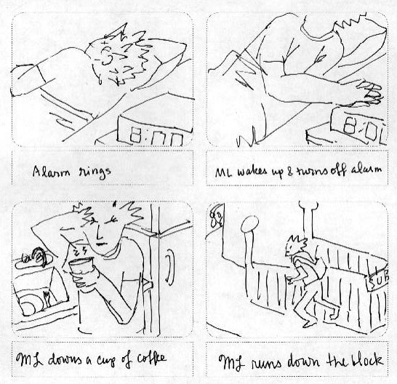
Pre-Production
Create the storyboard:
Sketch out a visual representation of each major scene or major phase of the video project.
Provide information about the audio sources, camera movements, and transitions.

Slide 9
STORYBOARD

Slide 10
Pre-Production
Create a shot list in the sequence of the storyboard for the camera operators.
Get any actors or other on-camera participants to sign a talent release document.
Gather and manage information and digital assets provided by the client.
Create a file-naming convention to assure proper organization and storage.
Save and organize files for easy and quick access.

Slide 11
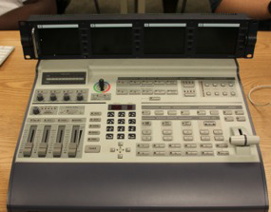
Pre-Production
Choose appropriate equipment:
Choose camera(s)
Choose microphone(s)
Choose cables
Other equipment (video mixer).
Mostly used for live video productions.
Accepts multiple camera sources and combines them into one production.
Can automatically add transitions and effects to the input sources.

Slide 12
CHOOSE SOFTWARE
Video Editing Software
Captures video from the original source and imports it into the editing software (Example: Adobe Premiere, Final Cut Pro).
Manipulates video clips and adds the desired audio and effects to convey the intended message.

Slide 13
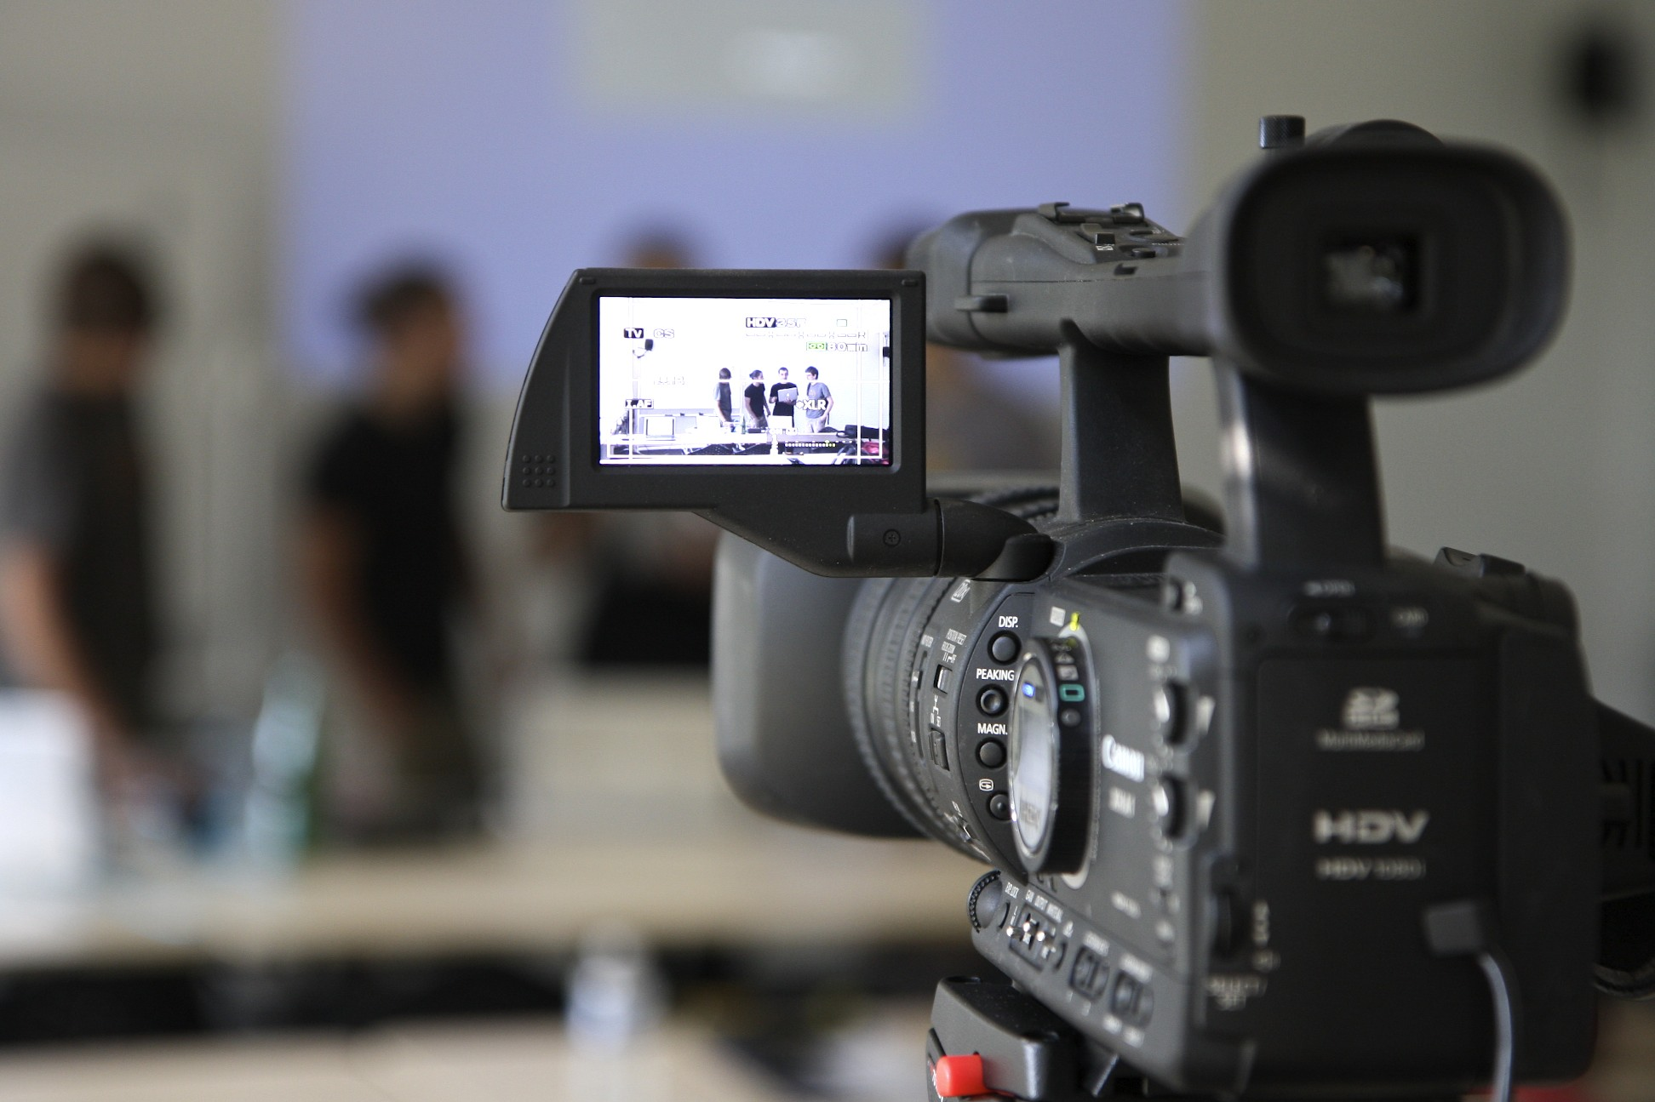
Production
In video production, the production phase consists only of recording footage with a camera.
NO editing!

Slide 14
Post-Production
Capture and name video footage.
Edit video footage to match project needs.
Apply special effects.
Add audio.
Add transitions.
Add titles.
Export final video to selected format.

Slide 15
Post-Production
Re-design the video production on client feedback (if necessary).
Render the video and re-export after addressing feedback.
Watch the exported video in its entirety to check for quality assurance.

Slide 16
Post-Production
Optimize based on specific client needs:
File Format Requirements
Video files also use codecs.
File Size Requirements
File Name Requirements

Slide 17
Broadcasting Systems
National Television System Committee (NTSC)
Standard used in North America and most of South America. In NTSC, 30 frames are transmitted each second.
Phase Alternating Line (PAL)
Standard mostly used overseas. In PAL, 25 frames are transmitted each second.
Sequential Color with Memory (SECAM)
French and Asian broadcast television standard.

Slide 18
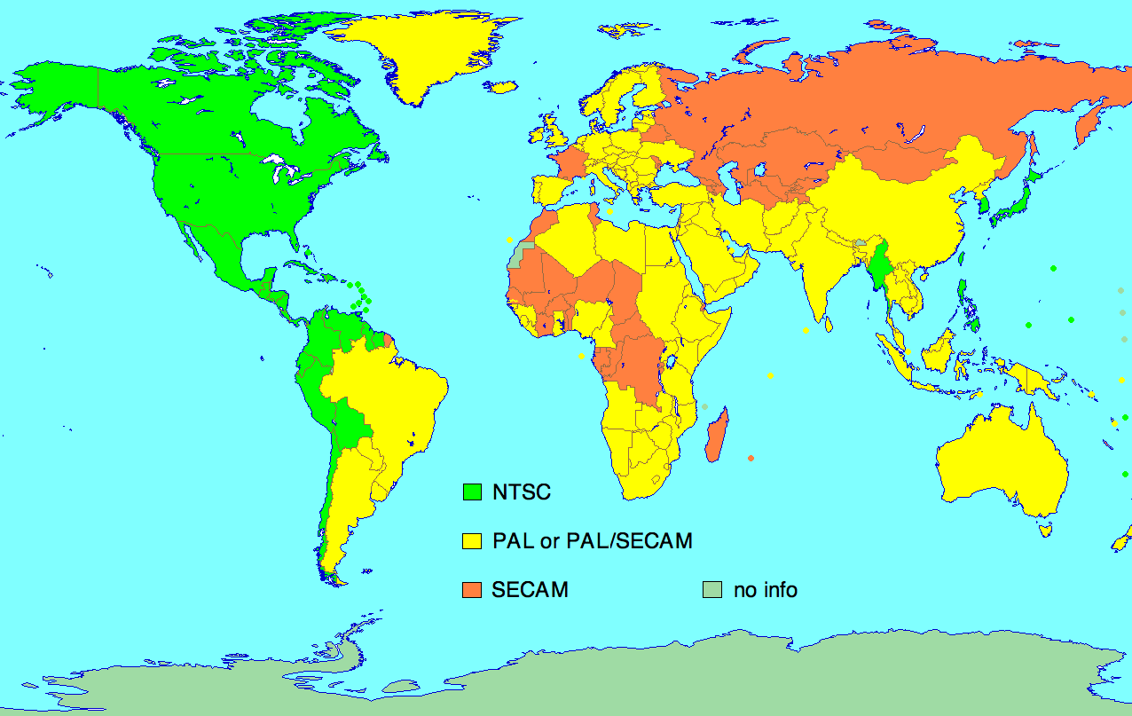
Broadcasting Systems

Slide 19
Common Video File Formats
.MOV
Uses the Quicktime player for video playback.
Standard video format for Apple computers.
.AVI
Standard video format for Microsoft PCs .
.WMV
Uses the Windows Media Player for video playback.
Microsoft file format used for streaming on the Internet.

Slide 20
Common Video File Formats
.FLV
Uses the Adobe Flash Player for video playback.
Commonly used for embedding videos on the Internet.
.MPEG-2
Format used for DVDs.
.MPEG-4
Format used for Blu-Ray Discs (better quality than MPEG-2).
Standard for streaming videos over the Internet.

