Slide 1
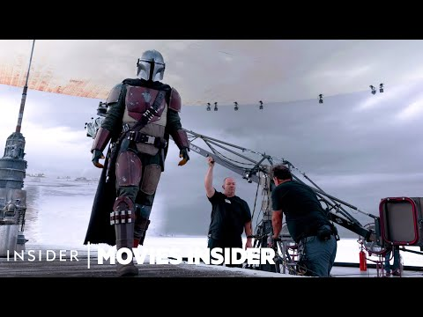

Slide 2

Effects
Objective 4.08
Add and manage effects in a video sequence

Slide 3
VIDEO EFFECTS
There are a variety of effects that can be applied to video.
Many can be used with anchor points (key frames) to animate the effects.
Effects are available in the Video Effects bin of the Effects panel.
The presets bin contains presets for popular effects. You can save time by using a preset made for a specific purpose.

Slide 4

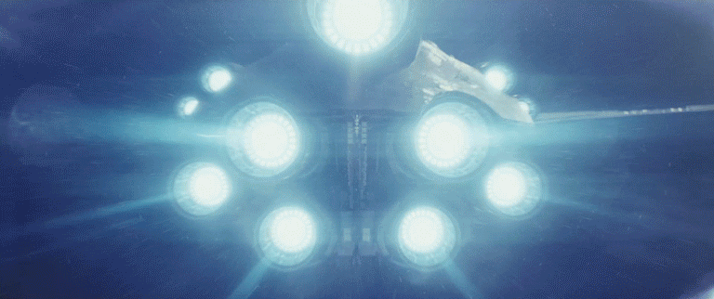
VIDEO EFFECTS
Main effect groups include:
  Blur and Sharpen Effects
  Color Correction
  Distort Effects
  Image Control Effects.

Slide 5
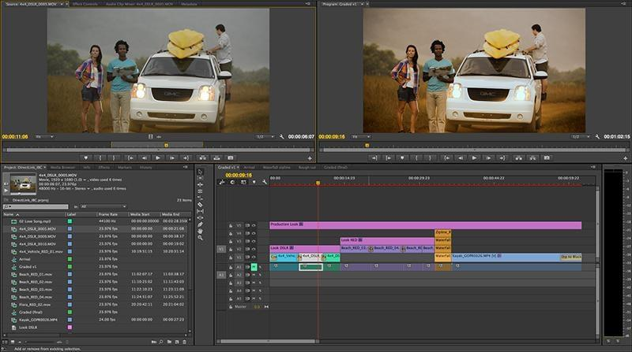
COMPOSITING
means taking two or more elements and blending them into a seamless shot

Slide 6
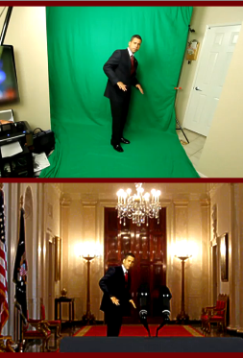
CHROMA KEYING /
ULTRA KEY
Recording a video clip in front of a solid color background, then using a video editor to replace the background with another one.
Any color could be removed - but Green or Blue are the most common because they don’t naturally occur in nature at that vibrancy

Slide 7
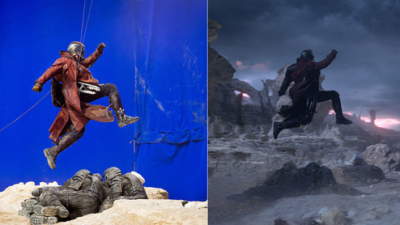
If you’ve ever watched a behind the scenes video for a blockbuster film – ex) a superhero or an action movie - you’ve probably seen a big studio stage with a bright green or blue background up on the walls.

Slide 8
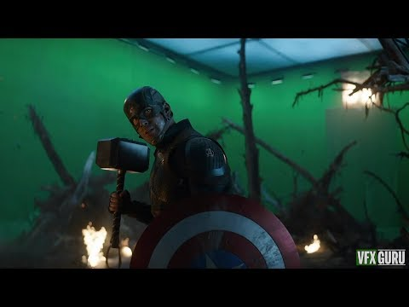

Slide 9
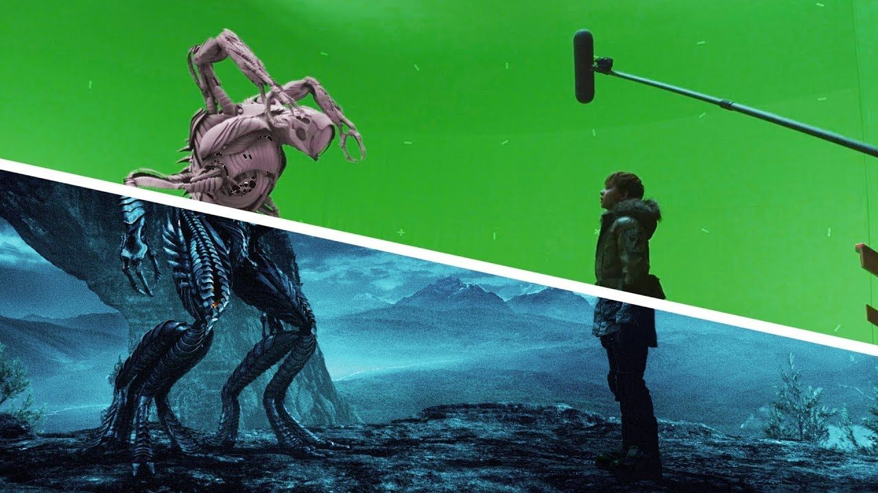

Slide 10
QUESTIONS TO DISCUSS
How do you think green screen technology has changed the way films are made?
Do you think it’s cheaper to film on location or to add the location after filming via green screen?

Slide 11

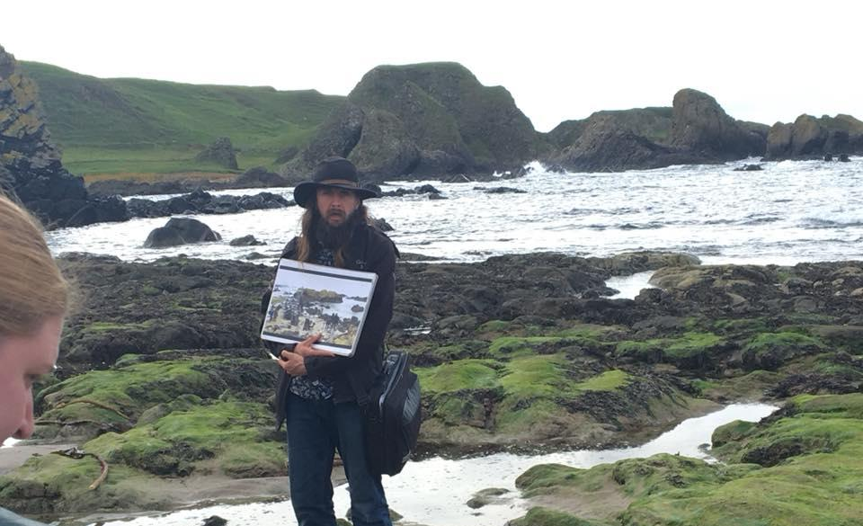

Slide 12
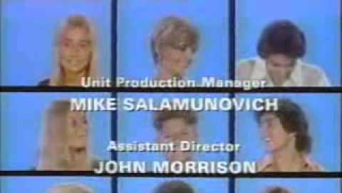
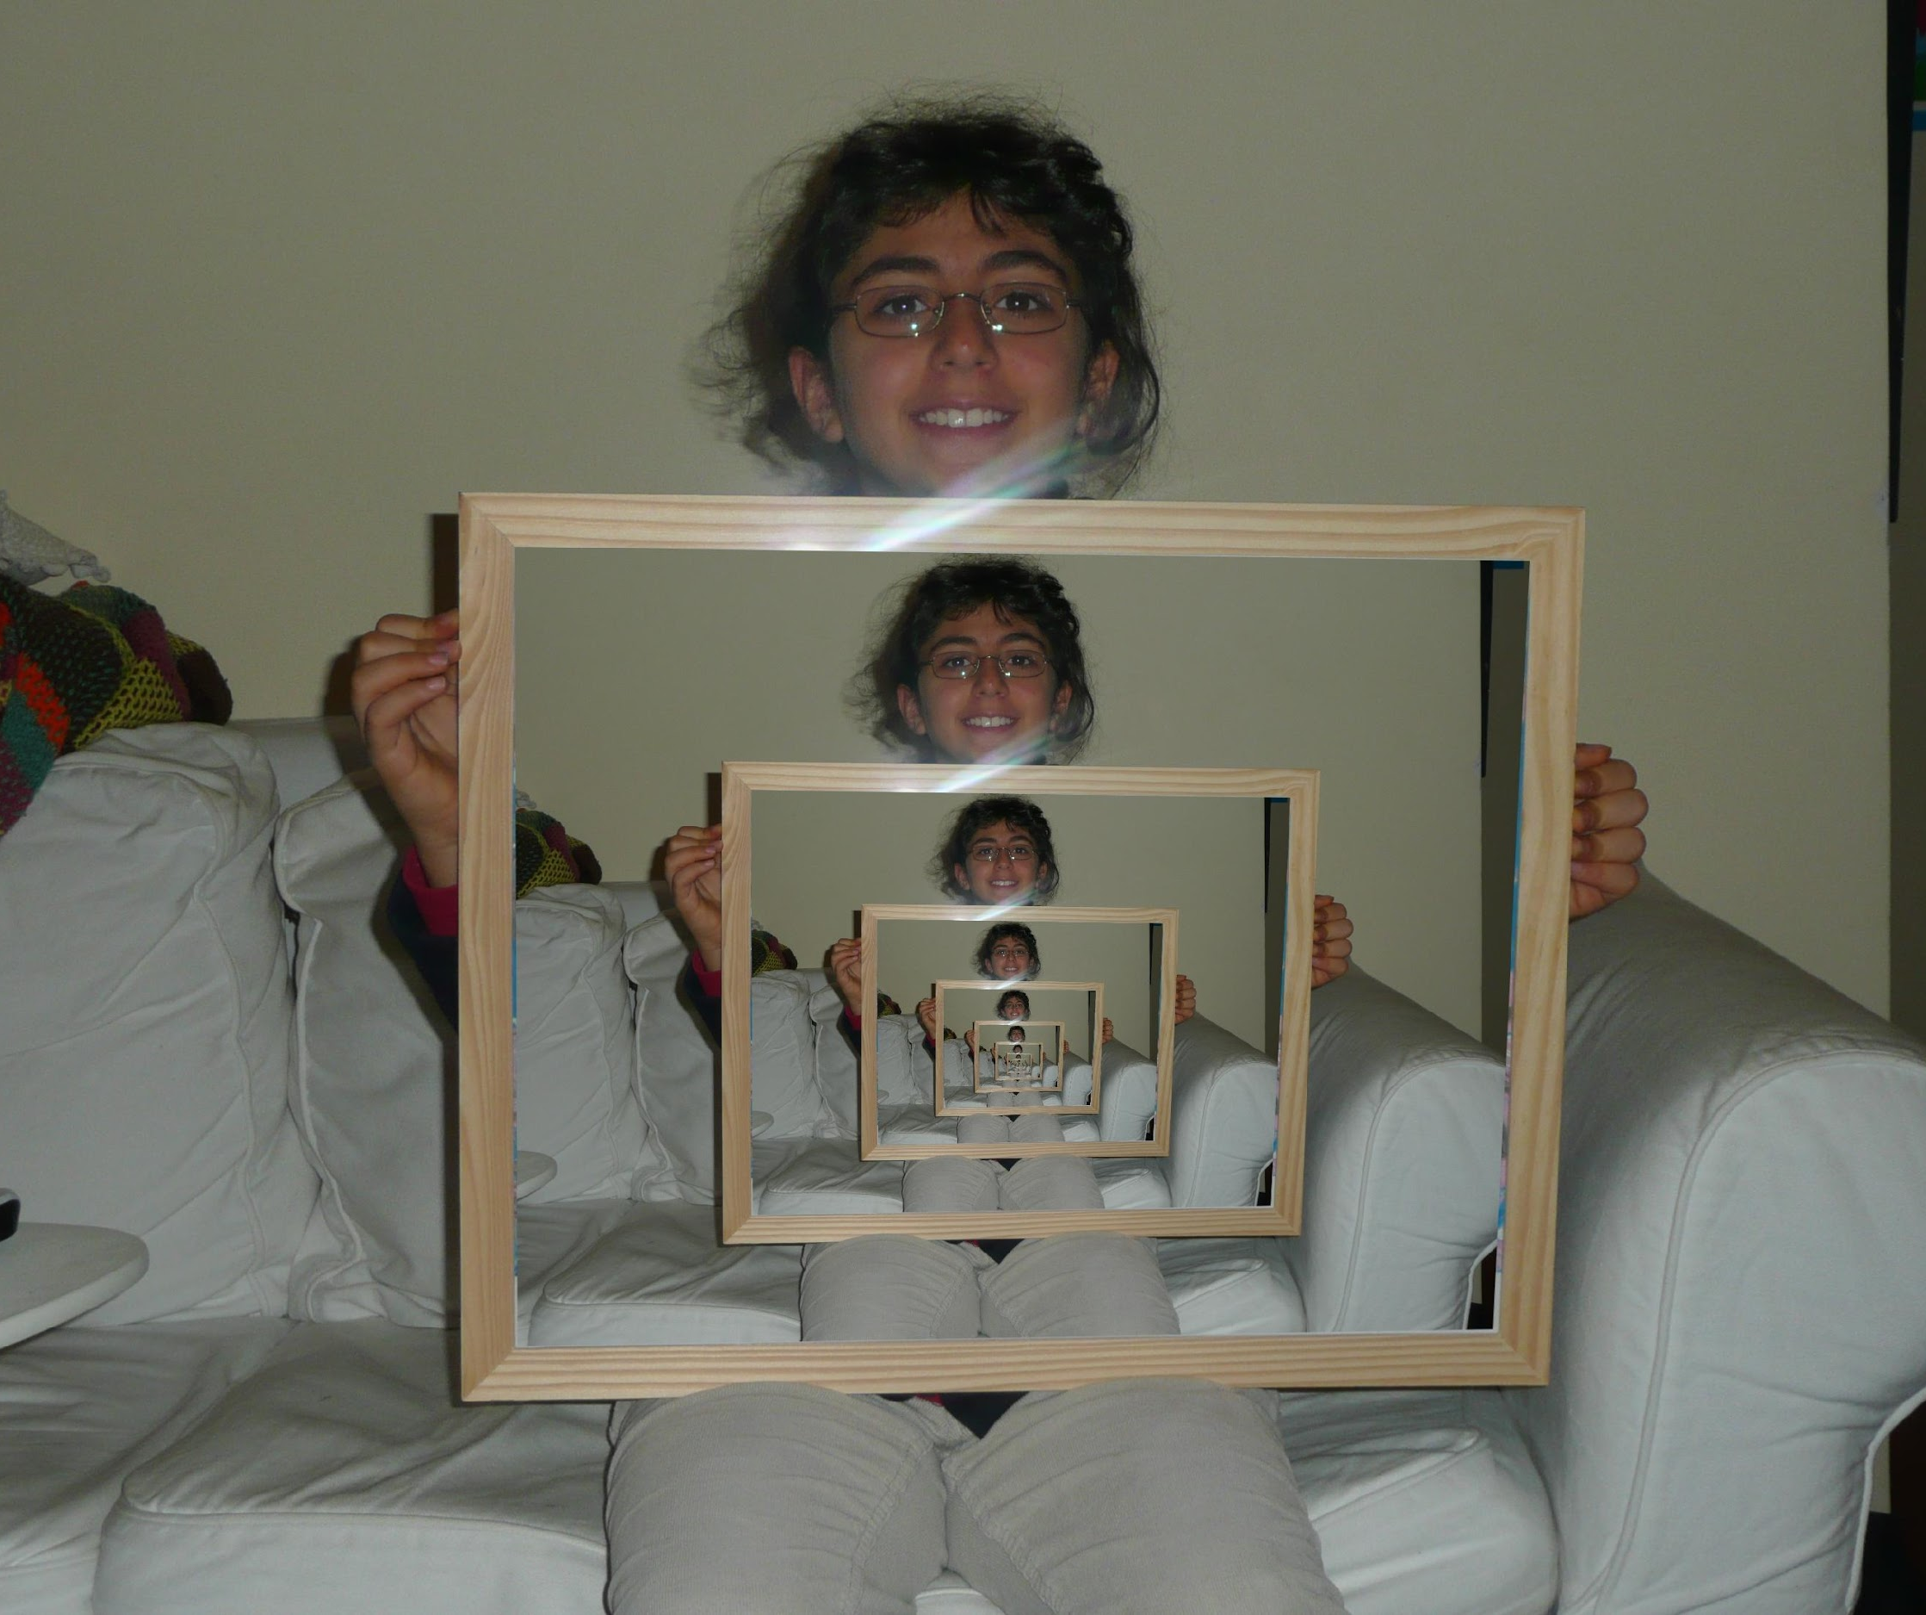
LAYERING VIDEO
By scaling video clips and layering multiple clips you can create the “Brady Bunch” effect.
You can place one video clip in a small frame over a background video clip that covers the entire screen. This effect is called a picture-in-picture overlay.

Slide 13
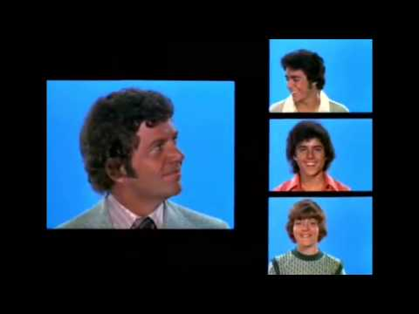

Slide 14
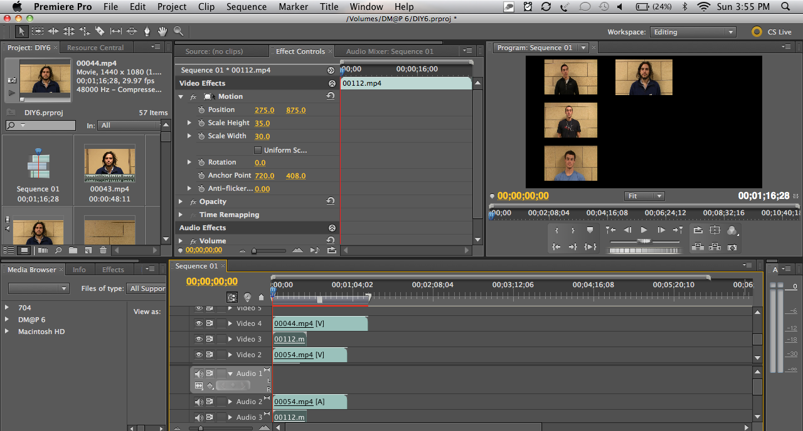

Slide 15
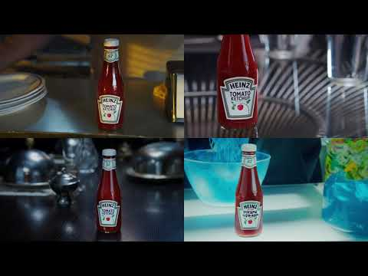
Notes:
Heinz superbowl commercial with 4 quadrants

Slide 16
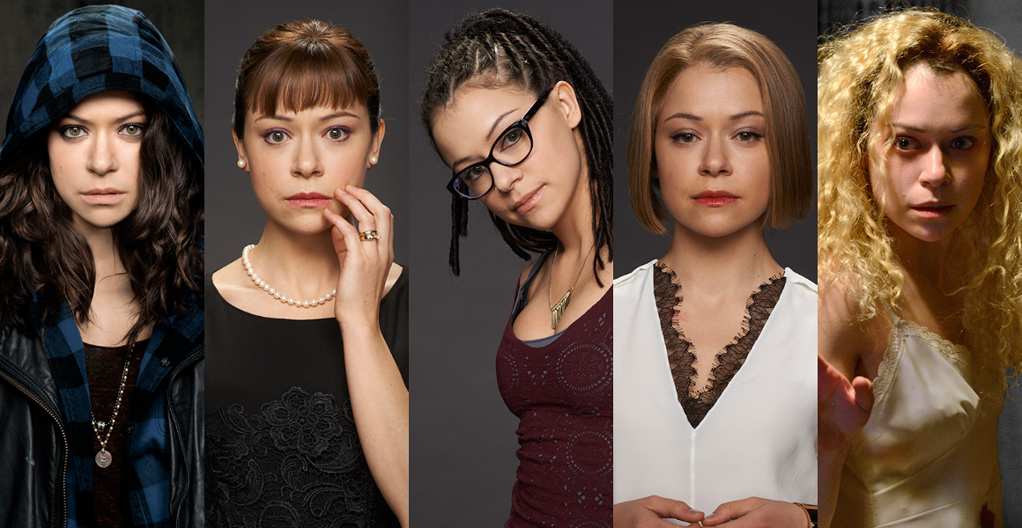
TV show Orphan Black, has 1 actress that plays multiple characters. The use of layering is seen throughout the whole show.

Slide 17
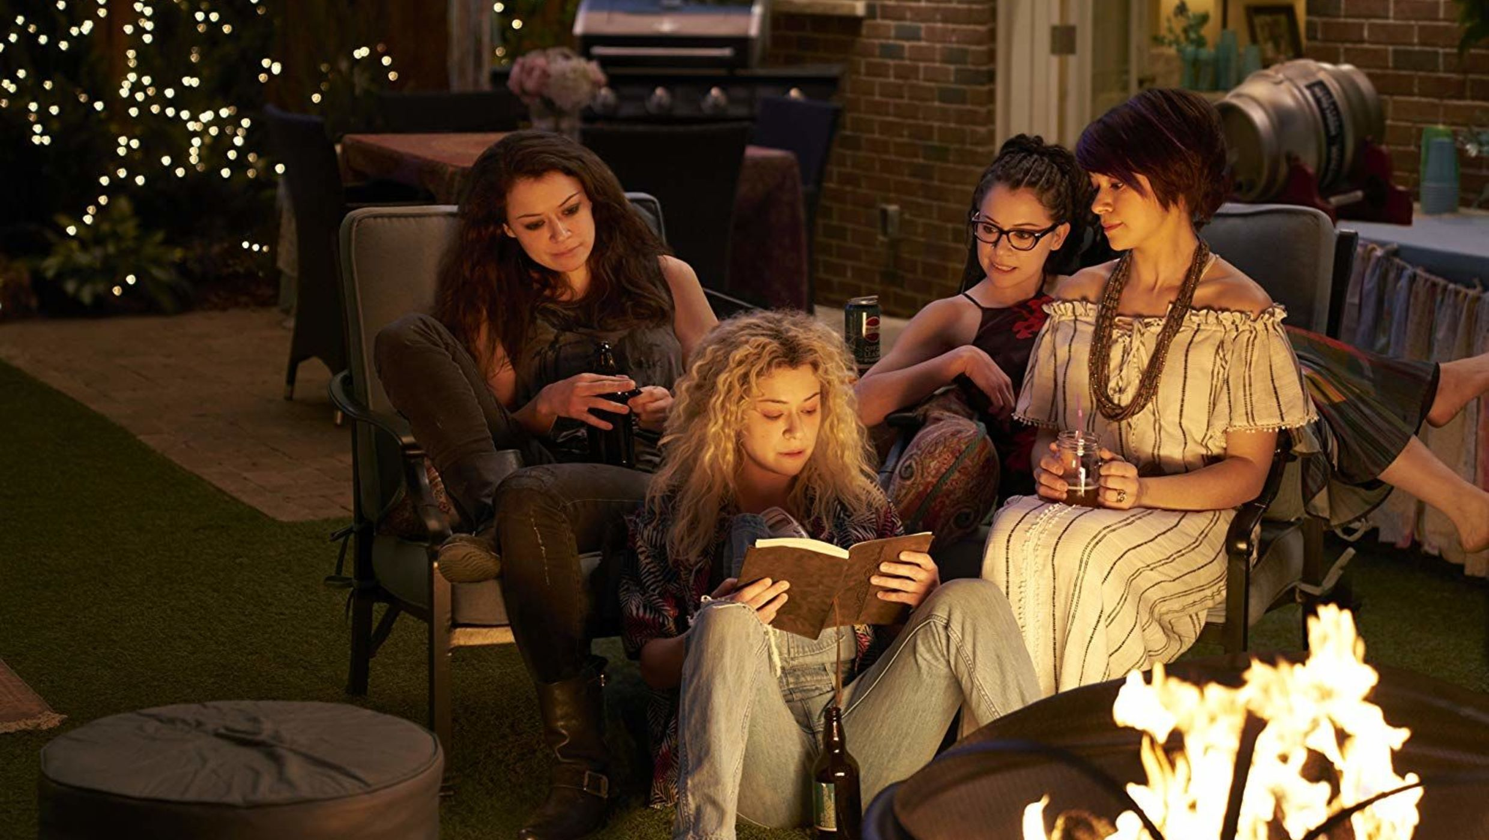
All the same actress. None of them are touching so that they can layer and then cut out or MASK each character into the scene.

Slide 18

MASKING
*Think back to when we did the masking of the text behind an object in the donut titles
Similar to masking in graphics and animation; showing or hiding specific area(s) of a video clip.

Slide 19


Slide 20
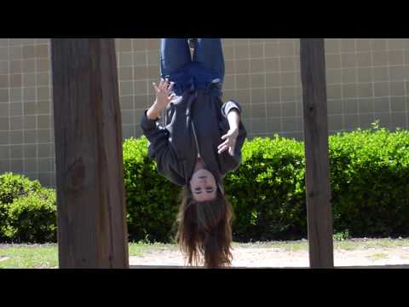

Slide 21
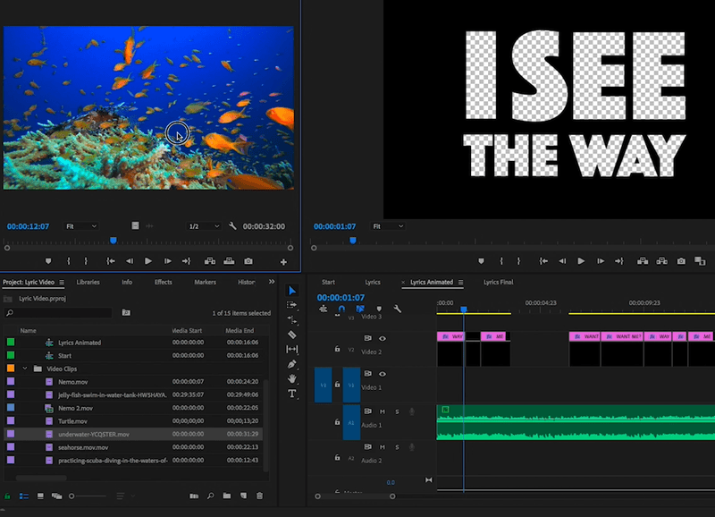

Slide 22

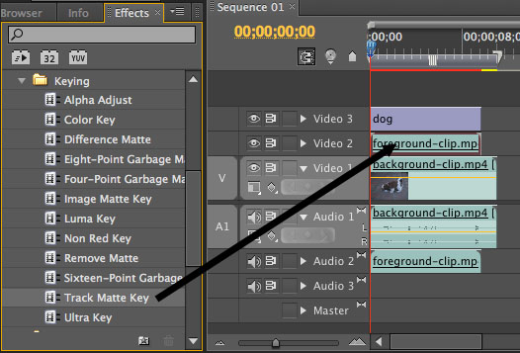
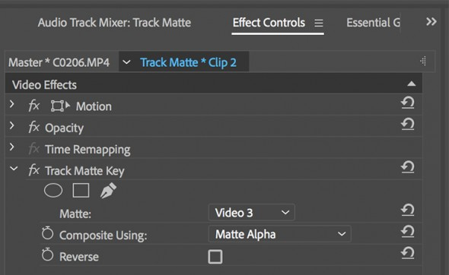
Using the Track Matte Key effect in Premiere allows you to bring video inside Text. This is a certification task you will have to complete.
You place the text on the top track, the video to show through on the bottom track and place the track matte key on video clip. You then need to go to Effect Controls and tell the effect to register the Text Track so then you video pops through the Text.

Slide 23
QUESTIONS TO DISCUSS
How do video effects enhance the video?
Where do the video effects live in Premiere?

Slide 24
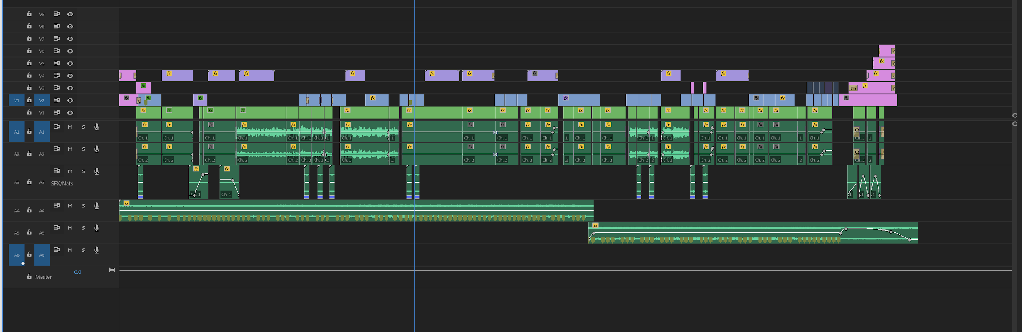
Not an effect but you should know –
Nested Sequences
Nesting clips in Premiere Pro allows you to use an entire sequence as a clip.
When used correctly, nesting clips is a great way to save time and cut down on complexity in your video editing.

Slide 25
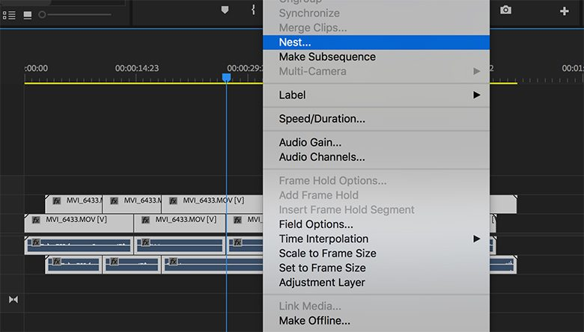
You would select all your clips and then right clip and select Nest

