Slide 1
Adobe Illustrator Basics

Slide 2
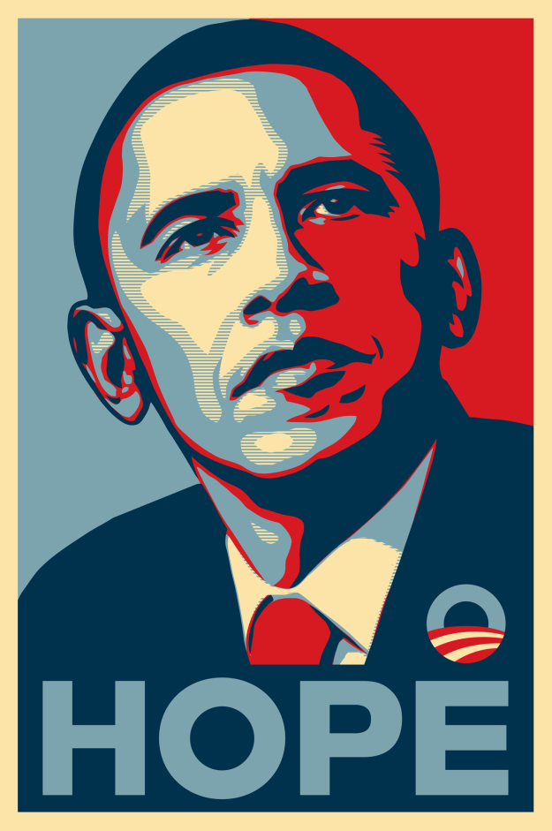
Intro
Adobe Illustrator:
Drawing Program
Vector
Great for logos, icons, posters, etc.

Slide 3
Starting Tools (Hot Keys)
Tools:
Direct Selection Tool (V)
Selection Tool (A)
Rectangle Tool (M)
Rounded Rectangle
Ellipse
Polygon
Star
Flare

Slide 4
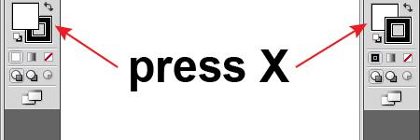
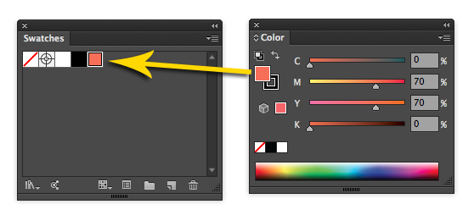
Color
Fill Color (X) and Stroke Color (X)
(X) Toggles between each other.
Swatches
Drag Specific Colors to Swatches to Save

Slide 5
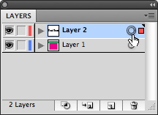
Layers
Layers
“Folders” that contain your work.
Organization = EXTREMELY IMPORTANT!
Layers and Sub-layers

Slide 6
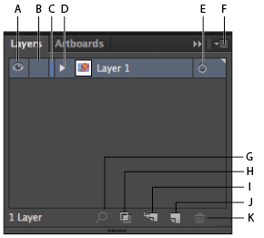
Layers Chart
Toggles Visibility
Toggles Locked
The Color Represented
for that Layer
Layers Drop Down
Click to select all in that
specific Layer
More Options

Slide 7
Layers Chart (Cont.)
Search For Layer
Make/Release Clipping
Mask
Create New Sub-Layer
Create New Layer
Delete Selection

Slide 8
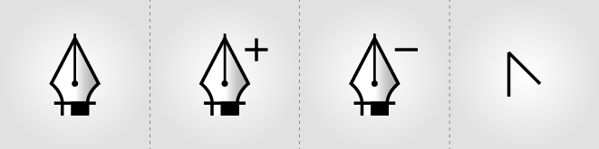
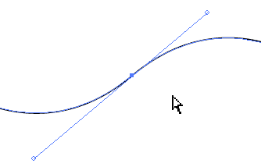
Pen Tool
Pen tool (P)
click and drag. CLICK and drag. CLICK AND drag. CLICK AND DRAG!
Handles
Practice makes perfect… A LOT OF PRACTICE!

