Slide 1
Copyright

Slide 2
WHAT IS COPYRIGHT?
A copyright is the legal term that gives the creator of an original work exclusive rights to it. Any material that is copyrighted requires an end user to obtain permission from its copyright holder in order to use it. Without such permission, it is illegal to use that material.
Based on a copyright agreement the creator may give the “right to copy”—i.e., use of the material—to an end user.

Slide 3
So what can be covered?
Copyright law protects original, creative works of authorship such as books, manuscripts, music, film and video productions, computer code and works of art such as paintings and photos—among other things. Authors of these works have exclusive rights to do the following with their work:
Reproduce the work
Distribute copies of the work to the public
Perform the work publicly
Display the copyrighted work publicly
Prepare derivative works based upon the work

Slide 4
So what can NOT be covered?
Ideas
Facts
Short words or phrases
Other people’s work
Slogans
Familiar logos or symbols

Slide 5
Copyright protects creators even if the work isn’t published. The U.S. Copyright Office states: “Copyright is a form of protection provided by the laws of the United States…to the authors of ‘original works of authorship,’ including literary, dramatic, musical, artistic, and certain other intellectual works. This protection is available to both published and unpublished works.”

Slide 6
THE COPYRIGHT NOTICE
The U.S. Copyright Office recommends the following three elements when including a copyright notice on any copyrighted work:
The symbol © (the letter C in a circle), the word “Copyright” or the abbreviation “Copr.”
The year of first publication of the work
The name of the owner of copyright in the work
Example: © 2014 Jane Doe

Slide 7
A work does not require the copyright notice or registration to be copyrighted under law.

Slide 8
Who owns what?
You will be the owner of all materials you create except in two cases
1) if you happen to be an employee working within the course and scope of employment. Then your employer is the author.
2) Or if you are a work for hire. A contractor or freelancer. Then again you are creating content for someone else who would be the owner of the material

Slide 9
Who owns what?
Work for hire was added as an exception when we had a huge technological innovation – the motion pictures. The early producers realized they had to do something, because so many creative types have a hand in putting a movie together. They petitioned Congress to add work made for hire to the copyright law so they would be the sole owner of the idea even though so many people worked on the motion pictures.

Slide 10
WHAT ARE COPYRIGHT RULES?
You generally cannot copy, manipulate, reuse in a “derivative work,”* or distribute a copyrighted work without permission from the copyright holder, who might charge a fee.
Copyright for “works for hire” (aka “intellectual property”) generally belongs to the employer or contractor that commissioned it, not to the creator.
Copyright lasts, in most cases, from the date the work was created, through the creator’s lifetime, plus 70 years after the creator’s death.

Slide 11
WHAT ARE COPYRIGHT RULES?
*Derivative work is a new, original product that includes aspects of a preexisting, already copyrighted work. Also known as a "new version," derivative works can include musical arrangements, motion pictures, art reproductions, sound recordings or translations. They can also include dramatizations and fictionalizations, such as a movie based on a play.

Slide 12
WHY ARE COPYRIGHT RULES IMPORTANT?
It is illegal to use copyrighted works without permission of the copyright owner.
Although there are exceptions, it is safe to assume that most works, including images found online, are copyrighted.

Slide 13
WHAT ARE THE EXCEPTIONS TO THE RULES?
Use of works under the “doctrine of fair use” does not require permission, but “fair use” is hard to determine.
Works whose copyrights have expired are in the “public domain”; you can use them freely and without permission.
“Works by the U.S. government are not eligible for U.S. copyright protection.” —U.S. Copyright Office
Ideas, procedures, names and slogans, and familiar symbols or designs are not given copyright protection.

Slide 14
THE DOCTRINE OF FAIR USE
The “doctrine of fair use” is a complicated exception to the copyright law.
U.S. Copyright Law says: “Fair use of a copyrighted work… for purposes such as criticism, comment, news reporting, teaching, scholarship, or research, is not an infringement of copyright.”

Slide 15
Fair Use Example
Student use of a copyrighted graphic or image for private learning probably is “fair use,” because the use is educational and does not affect the work’s commercial value.
For student use in a portfolio or the like which would never be published or posted, it is not necessary to receive permission.

Slide 16
Fair Use Example
Use of a copyrighted graphic or image to promote a free public event probably is not “fair use.” An event is not among the uses listed as “fair use,” and public use could negatively affect the work’s commercial value.
When in doubt, get permission!

Slide 17
Multimedia Fair Use Guidelines
Medium | Limits
Video | Up to 10% or 3 minutes (whichever is less)
Audio | Up to 10% or 30 seconds (whichever is less)
Text | Up to 10% or 1000 words (whichever is less)
Poetry | Up to 250 words (or entire poem if work is less than 250 words)
Images | Up to 5 complete images from one artist or 15 from a single collected work

Slide 18
WHAT ABOUT GRAPHICS AND IMAGES FROM BLOGS AND WEBSITES?
The Internet is notorious for the illegal use and reuse of graphics and images without permission. This practice is common among amateur and professional bloggers and on websites. Even though this practice is common, it is still illegal.

Slide 19
FINDING GRAPHICS AND IMAGES ON A BUDGET
Not all online graphics and images are off limits. Some photographers or designers want to see their graphics and images distributed widely online—but they don’t want to give up their copyright.
There are legal alternatives when you need free or low-cost graphics and images for your client.

Slide 20
ROYALTY-FREE IMAGE BANKS
Two alternative—and legal—sources for graphics, images, and other digital content are royalty-free stock photos (image banks) and Creative Commons.
Royalty-free images are available from a photo stock agency (image bank). Royalty free means you don’t have to pay a “royalty” fee for each use of the graphic or image.

Slide 21
Public Domain
The term “public domain” refers to creative materials that are not protected by intellectual property laws such as copyright, trademark, or patent laws. The public owns these works, not an individual author or artist. Anyone can use a public domain work without obtaining permission, but no one can ever own it.
All works first published or released before January 1, 1927

Slide 22
Copyright and Websites
A website is not explicitly recognized as a type of copyrightable subject matter under the Copyright Act.
Therefore, you should not list “website” as the type of authorship that you will submit with your copyright application.
However, the individual parts are subject to copyright law.

Slide 23
Copyright and Websites
For example, if you want to protect a blog post consisting mainly of text, you can register the blog entry as a literary work.
If you want to protect a musical work that is available on a website, you can register it as a work of the performing arts.
Or a photographer who displays or distributes her photographs on a website can register these images as visual art works.

Slide 24
Copyright and Websites
In order to protect your website, what you need to protect is the content on your site:
Videos or animation, with or without sound
Audio content, music, voice, ambient sounds or anything recorded
Images, whatever the format, GIF, PNG, JPEG or otherwise
Literary content like blogs, posts, editorial, and advertorial
Artworks, drawings, graphic art
Designs, schematic drawings, blueprints, patented concepts
Tables of words or schemes
Logos, watermarks, some color schemes and branding
The coding and structure of the website

Slide 25
Registering a Copyright
The only way to be fully protected against copyright infringement is to register your copyright.
In the United States, it’s done through the US Copyright Office. You have to fill out an application, pay a non-refundable fee, and provide the content you want to protect. The content is given in a non-returnable “deposit”, defined as the entire work to be copyrighted. This can be all or part of your website.

Slide 26
Registering a Copyright
The registered copyright applies to works included in the deposit. Anything you add to the website after registering the copyright will not be considered part of the registered content.
The US Copyright Office will issue a certificate of registration. That provides a public record of ownership, and, as we were saying before, registration is required before you can file an infringement suit in court. For the copyright holder, registration is the most powerful part of the legal doctrine that defines copyright because it allows for “statutory” damages.

Slide 27
Creative Commons

Slide 28
CREATIVE COMMONS
A nonprofit organization, Creative Commons (CC) establishes standards and methods for copyright owners to state the uses they allow for their works to be published on the Internet.
From CC’s website, you can filter Google, Flickr, and other image searches by type of CC license.
Under CC licensing, the copyright stays with the creator. CC licensing does not substitute or replace a copyright.

Slide 30
Attribution
Some copyright owners will allow you to use their work as long as you give them attribution.
Attribution is acknowledgement as credit to the copyright holder or author of a work.
For example: Saying I was not the creator of this content

Slide 31
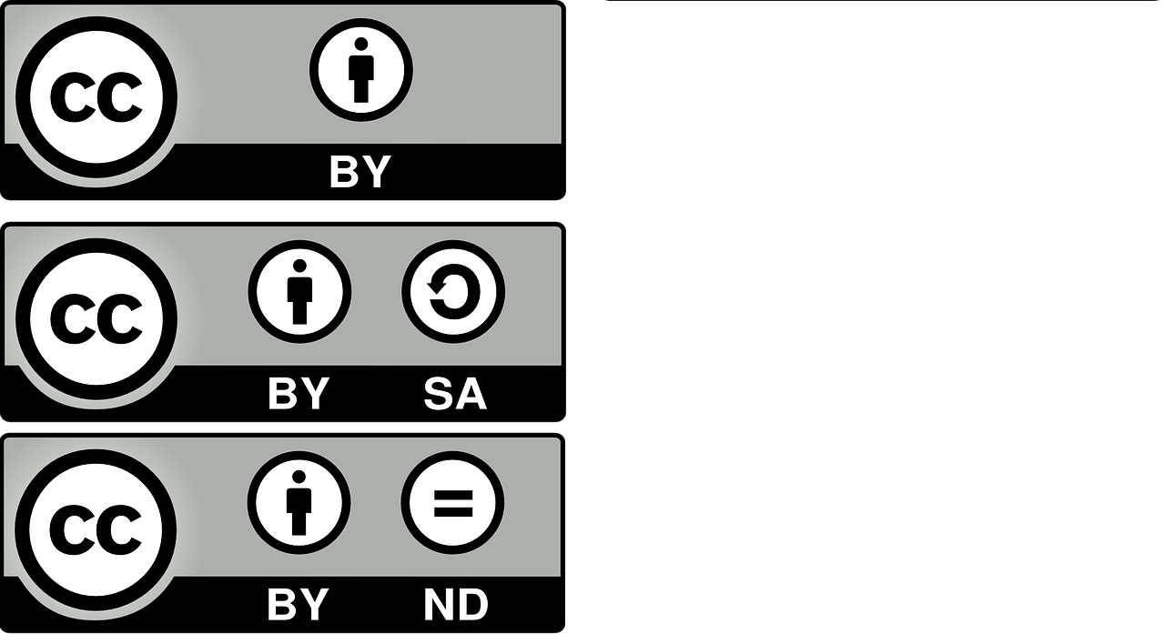
1) By Attribution Permits all uses of the original work as long as it credits the original author
2) By Attribution – Share Alike Same as above but any derivative work must also use a similar license
3) By Attribution – No Derivatives Licensed works are free to use/ share w/ attribution but does not permit derivative works from the original

Slide 32
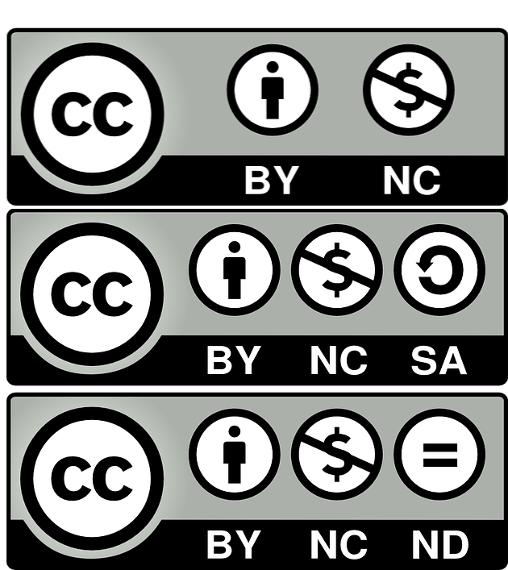
4) By Attribution – Non-Commercial Licensed works are free to use/share/remix w/ attribution but does not permit commercial use
5) By Attribution – Non-Commercial – Share Alike Does not permit commercial use of the original work and any derivatives from it must use a similar license
6) By Attribution – Non-Commercial – No Derivatives Does not permit any commercial use or derivatives of the original work (this is the most restrictive of CC licenses)

Slide 33
WAYS TO FIND AN IMAGE’S COPYRIGHT
In an online search, it is often impossible to tell who created a found image in the first place, much less how to contact the creator to ask permission.

Slide 34
COPYRIGHT’S PROTECT CREATORS
Copyright rules protect creators from unauthorized use of their work, including as online images.
It is illegal to copy, reuse in a “derivative work,” or distribute a copyrighted work without permission from the copyright owner.
Copyrights last until 70 years after the death of the creator.
The standard copyright notice contains three elements and looks like this: © 2014 Jane Doe
Notes:
In copyright law, a derivative work is an expressive creation that includes major copyrightable elements of an original, previously created first work. The derivative work becomes a second, separate work independent in form from the first

Slide 35
WHEN IN DOUBT, DON’T USE IT
“Fair use” of a copyrighted work does not require permission but is very complex.
Copyrighted material used purely for educational purposes is okay (demo files, projects, and in-class presentations).
Public use, even for a good cause, is probably not okay.

Slide 36
Three Ways to Find Content

Slide 37
In your software
Content Included with Software You Already Own: All video editing software packages contain some kind of sample and/or royalty-free content. This may include audio (sound effects, background music, etc.), images/graphics (static or motion graphics to be layered or used with effects), and other "plug-ins" that are used to create elements such as text effects, transitions, and generators.

Slide 38
Buying Content
Royalty-Free Content That May be Purchased: Royalty-Free simply means that you don't have to pay per-use royalty fees to the original creator. That does NOT mean that you do not have to pay for the content. There are many companies who create content for purchase such as Digital Juice, Pond5, iStockPhoto, and FCPEffects.com (effects plug-ins).
Notes:
In a nutshell Royalty Free Music or Royalty Free Video refers to a type of music or video licensing that allows the purchaser to pay for the music or video license only once and to use the music or video for as long as desired

Slide 39
Public Domain & Other Free Sources
Public Domain, Creative Commons and Free Royalty-Free Sources: These are sites that allow users to freely download content that can be used for any purpose. Public Domain mainly consists of older content that the copyright has run out on and content produced by government agencies. Creative Commons content is created by people who are willing to share their original content with a few rules. Free Royalty-Free sites have no restrictions on content use. It is also worth noting that some of the companies listed in previous slide also have Public Domain content libraries available and/or free samples that can be downloaded.
Notes:
Sometimes when using Free Royalty Free sites, they have certain requirements that you must follow to use their content instead of paying them. One example is giving them some form of credit in your video, whether it is their name over that video clip or in the end credits.

Slide 40
Parody Use or Copyright Infringement?
Parody:
is a work created to imitate, make fun of, or comment on an original work—its subject, author, style, or some other target—by means of satiric or ironic imitation
Infringement:
(also referred to as piracy) is the use of works protected by copyright law without permission for a usage where such permission is required

Slide 41
Parody Use or Copyright Infringement?
This is great example of using "parody" within the boundaries of fair use, though some content may not fall under these guidelines and will require direct communication with the creator/owner of the work.
While using short clips of video for the purposes of parody can be fun, there may be folks out there who don't appreciate your sense of humor.
There are people out there who may try to sue others for defamation of character.
As a general rule, it is always better to gain permission before using other people's content.

Slide 42
Parody Use or Copyright Infringement?
A parody, because it is a method of criticism, must in some way or form make use of another creative work.
This creates a conflict between the creator of the work that is being parodied (as no one likes to be criticized, made fun of or ridiculed) and the creator of the parody.
It is also highly unlikely that a copyright owner will grant permission or a license to a parodist to use their copyright protected work in creating a parody.
If it can be proven as an actual parody, then you are usually covered under the Fair Use law.

