Slide 1
Objective 4.00
Apply procedures for editing Digital Video using Adobe Premiere Pro CC.

Slide 2
IMPORTING FILES
Importing is not the same as capturing.
Import loads files that are already in your storage into the project.
Many video, audio, and image formats can be imported into Premiere.
Supported file formats: https://helpx.adobe.com/premiere-pro/using/supported-file-formats.html

Slide 3
IMPORT MEDIA ASSETS
Files should be imported from the hard drive, so first move files from camera, cloud storage, etc. to the hard drive.
Import files by using:
Media Browser
Import command.

Slide 4
Import Command
Choose File > Import.
Select one or more files from the list.
Files will be added to the Project panel.
You may select an entire folder, which is added as a new bin in the Project panel.

Slide 5
QUESTIONS TO CONSIDER
What is the difference between importing and capturing?
What can be imported into Premiere?
Where should files be located before importing into Premiere?
How do you import files into Premiere?

Slide 6
ORGANIZE VIDEO CLIPS
Assembly Cut
Rough Cut
First stage of editing, when the raw video clips from a production are arranged into the proper sequence inside the project’s timeline.
Second stage of editing, when the video clips are edited down using the correct in and out points, and initial transitions or special effects are added.

Slide 7
ORGANIZE VIDEO CLIPS
Final Cut
Nested Sequence
Third stage of editing, when all of the transitions, special effects, and other editing techniques are finished; step preceding rendering and exporting.
Embedding multiple sequences of edited clips into a master composition to ease the overall editing and compositing process.

Slide 8
MARKING CLIPS
Setting a clip’s In and Out points.
In a typical workflow, you mark In and Out points for a clip in the Source Monitor.
You define the first frame you want to include in a sequence by marking that frame as the clip’s In point.
Then you define the last frame you want to include by marking it as the Out point.
You then drag the marked clip to the timeline.

Slide 9
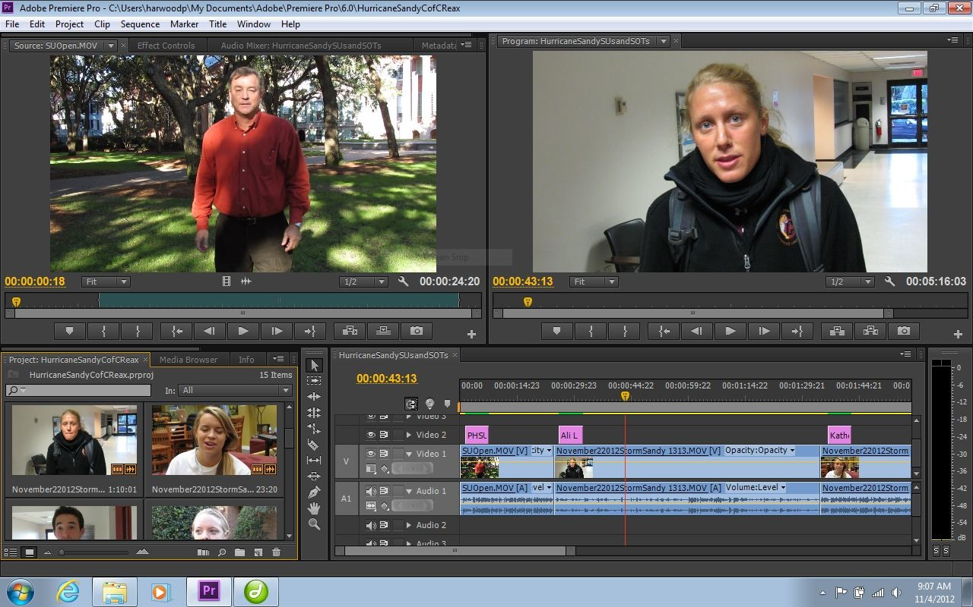
MARKING CLIPS
Source Monitor
In Point Button
Out Point Button

Slide 10
TRIMMING CLIPS
Adjusting a clip's In and Out points after it is already edited into a sequence is called trimming.
You can trim clips by dragging the edge of a clip in the timeline.
Clip In Point in Timeline View

Slide 11
EDITING AUDIO IN VIDEO EDITOR
When you add a video clip to the timeline, the video and audio appear as two objects, each in its own track.
The video and audio portions of the clip are linked so that when you drag the video portion, the linked audio moves with it, and vice versa.
When you want to work with the audio and video individually, you can unlink them. This allows you to delete or edit them separately.

Slide 12
EDITING AUDIO IN VIDEO EDITOR
Linked Audio Layer

Slide 13
LAYERING AUDIO
Audio layers can be used to add music, narration and sound effects.
Audio editing for video works in much the same way as when using an audio editor.
When making audio adjustments of any kind, determine whether the change is applied to the entire track or to individual clips. Audio tracks and clips are edited in different ways.

Slide 14
QUESTIONS TO CONSIDER
Do you think room tone is just the sound recorded during the initial filming or is it added later?
How important is audio to the overall quality of a video product?

Slide 15
VIDEO TITLES
The Titler is a versatile tool enabling you to create not just titles and credits, but animated graphics and text as well.
Titles may be placed over video, still images or in separate frames.
Still Title

Slide 16
STILL TITLE
A title (block of text with or without an accompanying graphic) that appears on the screen, remains motionless, and then disappears.

Slide 17
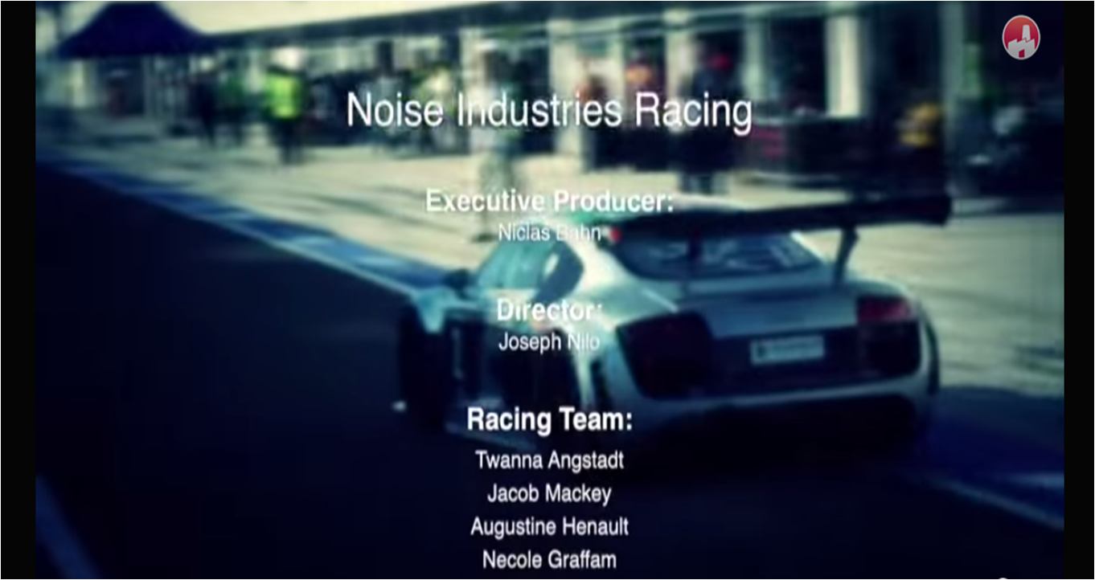
ROLL TITLE
Appears from either the top or the bottom and moves vertically through the field of view and off the other side.

Slide 18
CRAWL TITLE
Appears from either the left or the right and moves horizontally through the field of view and off the other side.

Slide 19
SUPERIMPOSITION TITLE
(Super or Lower Third) A title that relays information (their name, position or title, statistics, etc.) usually appears in the lower third of the screen.

Slide 20
QUESTIONS TO CONSIDER
Can you think of examples in movies and TV shows when different titles are used?
Why is it important to use Lower Thirds to introduce people in interviews?

Slide 21
VIDEO TRANSITIONS
Changing from one video clip to another in a video production.
Four basic types of transitions:
Cut
Dissolve
Fade Up or Fade Down
Wipe

Slide 22
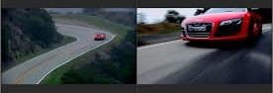
CUT
An instantaneous transition from one video clip to the next.

Slide 23
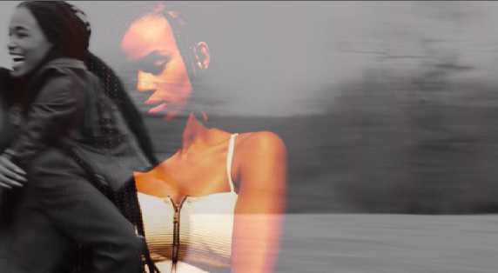
DISSOLVE
A gradual blend between one video clip and another.

Slide 24
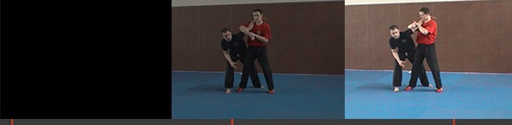
FADE UP OR FADE DOWN
When the screen goes gradually from black or white to a video clip, or gradually from a video clip to a black or white screen.

Slide 25
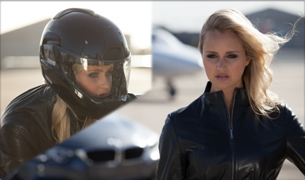
WIPE
When one video clip replaces another by traveling from one side of the frame to the other or through a shape.

Slide 26
QUESTIONS TO CONSIDER
What types of transitions do you most commonly see in movies and shows?
When are different types of transitions used?

Slide 27
J-CUT/L-CUT
A J-Cut is when you hear audio from a shot and then see the video. You make the letter J visually in the timeline.
An L-Cut is when you cut to different video but the audio from that previous shot remains.

Slide 28
QUESTIONS TO CONSIDER
How do J & L cuts improve the flow in a scene or between scenes?
What might a conversation scene look like without these types of cuts?

Slide 29
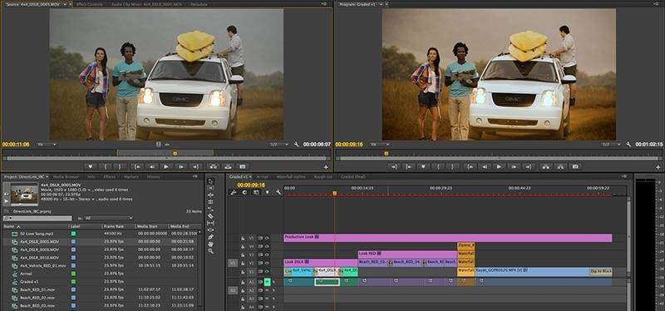
COMPOSITING
Combining several layers of video and/or image sources together to create a final composition.

Slide 30
QUESTIONS TO CONSIDER
Do you think most films have all the objects in them during the actual filming of the scene or is compositing used frequently?

Slide 31
MASKING
Similar to masking in graphics and animation; showing or hiding specific area(s) of a video clip.

Slide 32
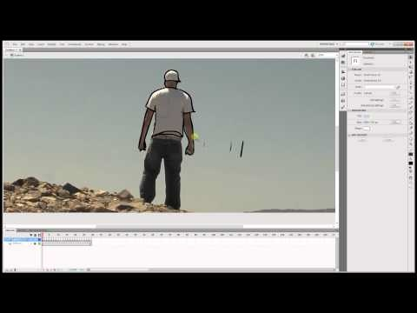
ROTOSCOPING
Masking an object in a video as it moves within the field of view.

Slide 33
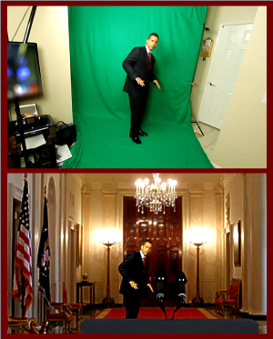
CHROMA KEYING/ULTRA KEY
(Green-Screen) Recording a video clip in front of a solid color background, then using a video editor to replace the background with another one.

Slide 34
QUESTIONS TO CONSIDER
How do you think green screen technology has changed the way films are made?
Do you think it’s cheaper to film on location or to add the location after filming via green screen?

Slide 35
VIDEO EFFECTS
There are a variety of effects that can be applied to video. Many can be used with anchor points to animate the effects occurrence.
Effect groups include:
Blur and Sharpen Effects
Color Correction Effects
Distort Effects
Image Control Effects.

Slide 36
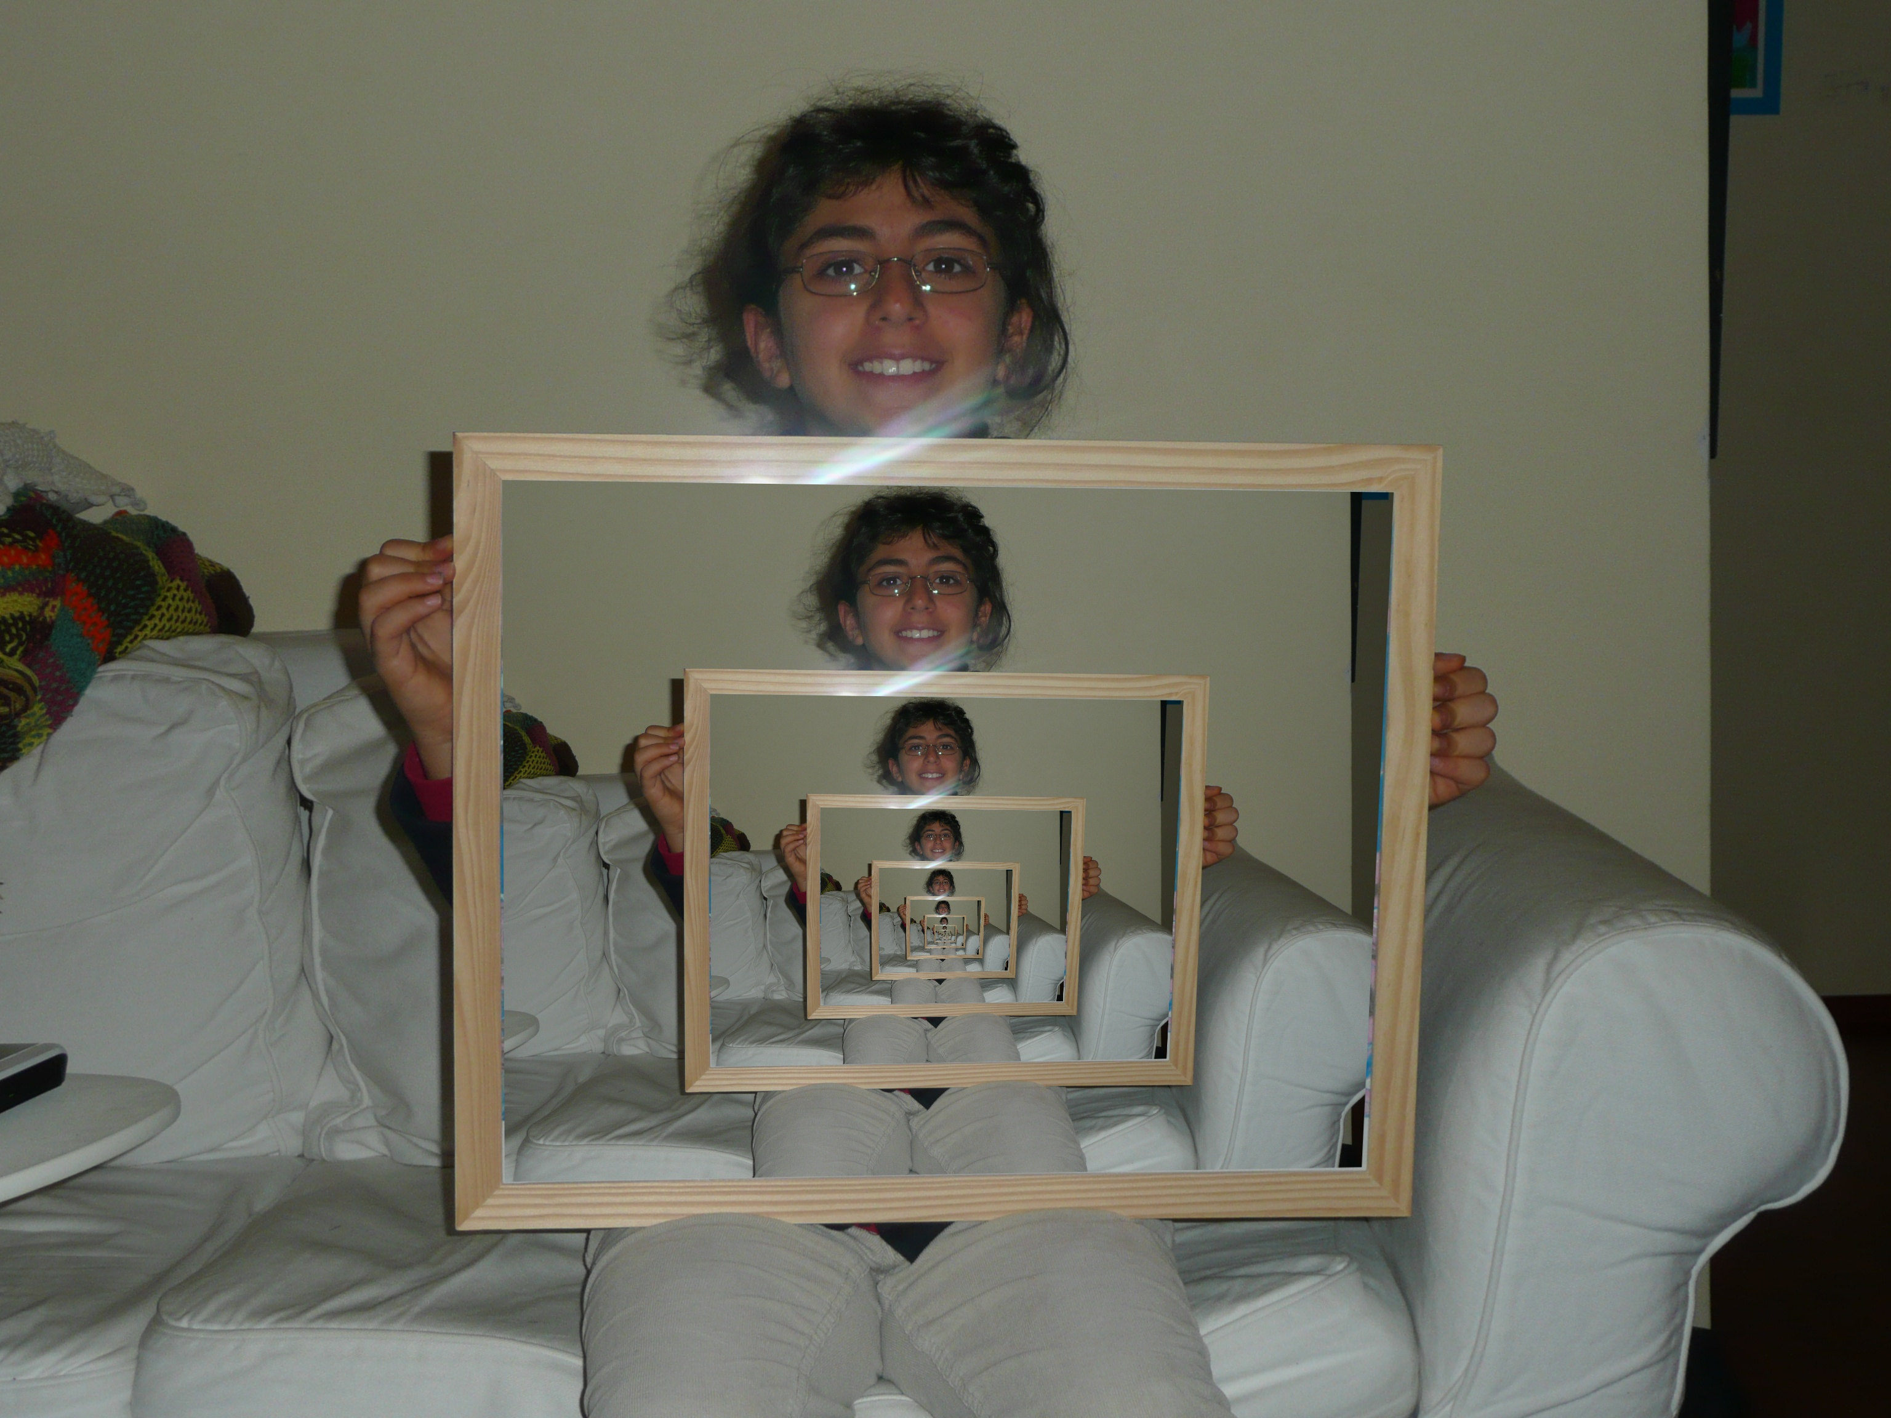
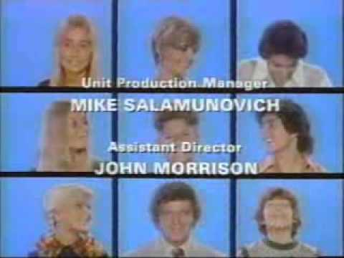
LAYERING VIDEO
You can place one video clip in a small frame over a background video clip that covers the entire screen. This effect is called a picture-in-picture overlay.
By scaling video clips and layering multiple clips you can create the “Brady Bunch” effect.

