Slide 1
Objective 3.00
Understand the Adobe Premiere Pro CC interface.

Slide 2
PREMIERE PRO INTERFACE

Slide 3
PANELS IN EDITING WORKSPACE
Source Monitor
Program Monitor
Timeline
Media Browser
Tools
Effects
Effect Controls
Audio Levels

Slide 4
SOURCE VS. PROGRAM MONITOR
Source Monitor
Used to edit clips before putting on timeline.
Program Monitor
Used to view clip sequences in timeline.

Slide 5
TIMELINE
Used to place and edit all media elements.

Slide 6
MEDIA BROWSER
Media Browser provides access to video, audio and graphic files.
Allows you to preview files.

Slide 7
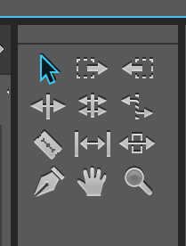
TOOLS PANEL
Tools Panel holds several commonly used tools.
The Selection tool is the default tool. It’s used for everything other than specialized functions. If the program isn’t responding as you expect, make sure that the Selection tool is selected.

Slide 8
EFFECTS PANEL
Contains bins with a variety of audio and video effects, as well as transitions which can be applied to clips.

Slide 9
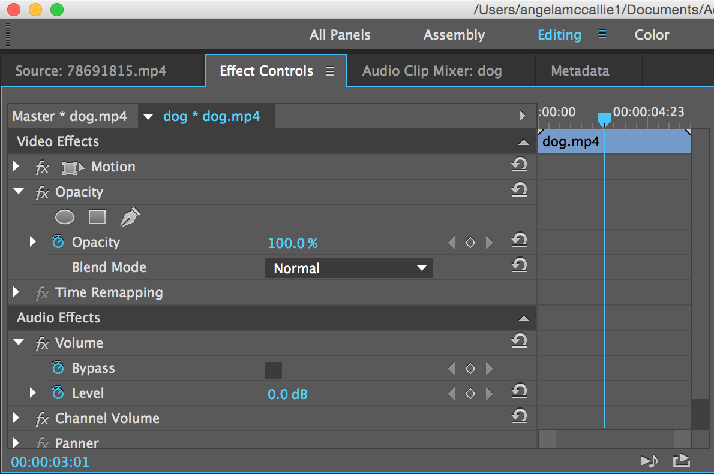
EFFECT CONTROLS
Lists all the effects that are applied to the currently selected clip.
Fixed effects are included with every clip:
Motion, Opacity, and Time Remapping for Video Effects.
Volume effect is listed in the Audio Effects section.

Slide 10
AUDIO LEVELS
Can view the audio level while playing clip sequence.

Slide 11
QUESTIONS TO CONSIDER
Differentiate between the Source Monitor and the Program Monitor.
Summarize the purpose of the Timeline.
Differentiate between the Effects Panel and the Effects Controls Panel.
Why is it important to be able to view the audio level while editing video?

Slide 12
CUSTOMIZE WORKSPACE
Your Premiere workspace can be changed to best meet your needs as a video editor.
Change document views
Rearrange/resize windows and panels
Add or remove tools on toolbar
Create and save custom workspace
These same techniques can be used to customize other Adobe software.

