Slide 1
Objective 2.00
2.00 Understand digital video.

Slide 2
DIGITAL VIDEO HARDWARE
Computer
Video Camera(s)
Professional
Consumer
Drones
Phones
Microphone
Tripod to Steady Camera Shots
Lights (if necessary)

Slide 3
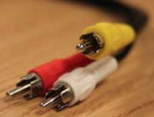
COMPOSITE (RCA) CABLE
Very common video (and audio) cable used in professional and consumer settings alike.
Color coded system makes it easy to distinguish between audio and video plugs.
Used for VCRs, DVD players, and other basic video connections.

Slide 4
FIREWIRE CABLE
High transfer speed digital cable used with computers.
Commonly used to capture audio or video from the recording device into the computer.
Depending on age of equipment, can be Firewire 400, 800, or 4-pin.
Firewire 4-pin
Firewire 800
(9-pin)
Firewire 400
(6-pin)

Slide 5
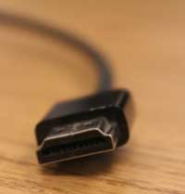
HDMI CABLE
High-definition video cable.
Carries digital audio and video.
Combines audio and video signals into one cable to simplify connection.

Slide 6
QUESTIONS TO CONSIDER
How have cables evolved as technology has improved?

Slide 7
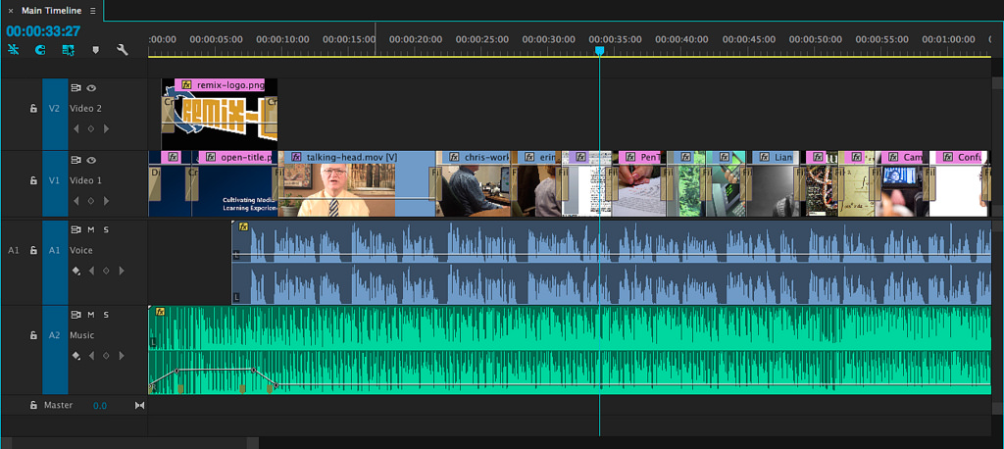
VIDEO EDITING SOFTWARE
Captures video from the camera media and imports into the editing software.
Manipulates video footage and adds the desired effects to convey the intended message. (Example: Adobe Premiere, Final Cut Pro, MovieMaker).

Slide 8
RULE OF THIRDS
Mentally dividing the frame into thirds, both horizontally and vertically (similar to a tic-tac-toe board).
https://www.youtube.com/watch?v=fSSOZxLnNyc

Slide 9
RULE OF THIRDS
The points of interest happen where the 1/3 lines intersect. So there are 4 places where your subject should be placed. Sometimes that means that the subject occupies 2/3 of the image, but often not.
Horizon lines should follow either the lower 1/3 line or the upper 1/3 line, and eyes should always be on (or near) the upper 1/3 line.

Slide 10
QUESTIONS TO CONSIDER
Why do you think the rule of thirds works?
How do directors use the rule of thirds to tell the audience where to look?
Can you think of examples where the rule of thirds isn’t used or wouldn’t need to be utilized?

Slide 11
TAKE
B-ROLL
A sequence of a video production that is recorded continuously, at one time.
Some scenes may require several takes to complete correctly.
Supplemental or alternate footage that is mixed intermittently with the main shot during a video production.

Slide 12
QUESTIONS TO CONSIDER
Can you think of examples of movies or TV shows where B-Roll is used?
How does the use of B-Roll add or detract from what you are watching?

Slide 13
DEPTH OF FIELD
The distance between the nearest and furthest objects in a scene that remain in focus.

Slide 14
QUESTIONS TO CONSIDER
When might someone want to adjust the aperture?
How would the aperture need to be adjusted if you were filming in a dark or bright area?

Slide 15
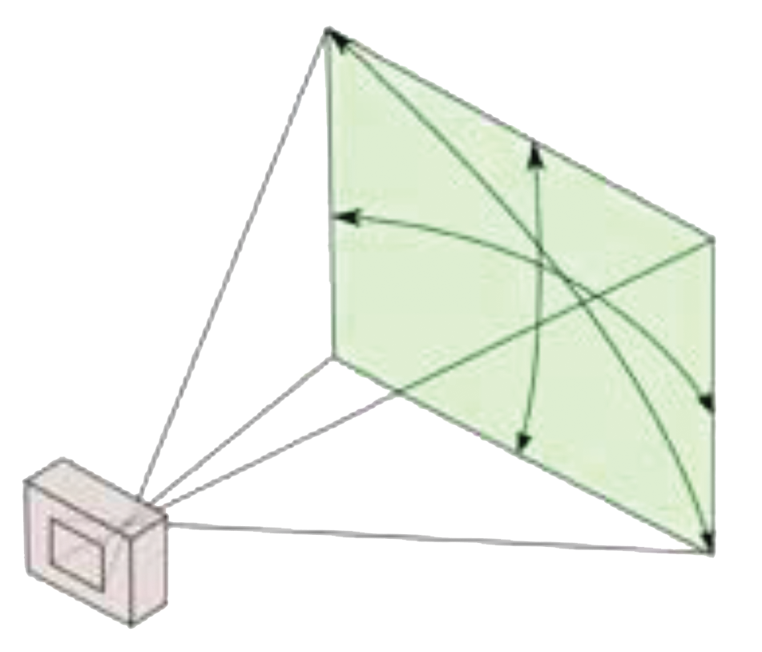
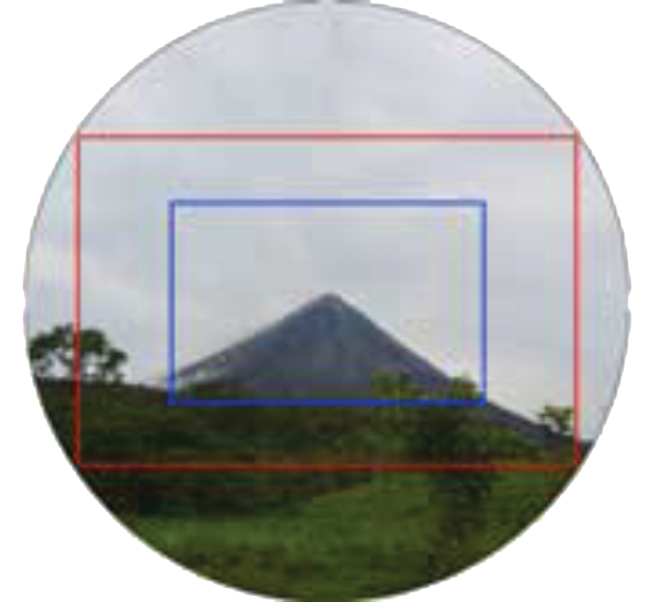
FIELD OF VIEW
The area that is visible through the camera lens.

Slide 16
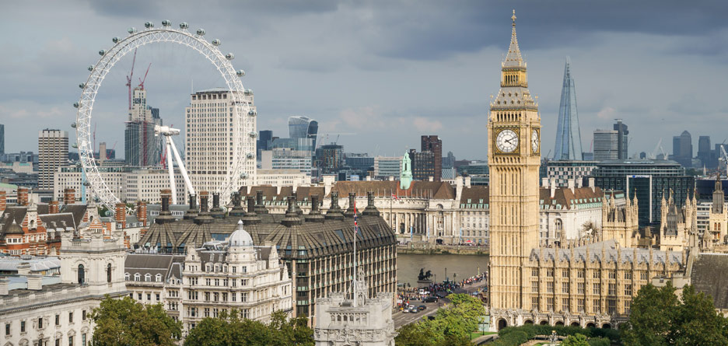
Establishing Shot
Sets up a context for the scene by showing the relationship between the subject(s) and their environment.

Slide 17
QUESTIONS TO CONSIDER
Why is it important to have an establishing shot?
Can you think of examples in movies of establishing shots, with or without characters in them?

Slide 18
WIDE SHOT
Shows subject and location or environment in its entirety.
Example: showing the entire building.

Slide 19
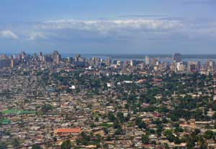
EXTREME WIDE SHOT
Used to show the subject and its environment from further back than a typical wide shot.

Slide 20
MEDIUM SHOT
Shows a part of the subject with more detail while still giving an impression of the location or environment.
Example: framing a subject from waist up.

Slide 21
CLOSE-UP SHOT
Shows a particular part of a subject with more detail.
Example: framing a subject from shoulders up.

Slide 22
EXTREME CLOSE-UP SHOT
Shows a particular part of a subject with extreme detail.

Slide 23
QUESTIONS TO CONSIDER
Think about shot types. Can you see a pattern or order that you might use shots when setting up an entire scene?
Why do you think we use shots in a specific order?
How could we use shots “out of order” to create a specific emotion?

Slide 24
HIGH ANGLE SHOT
When camera location is above normal eye-level compared to the subject.
Makes the subject appear small, weak, inferior, or scared.

Slide 25
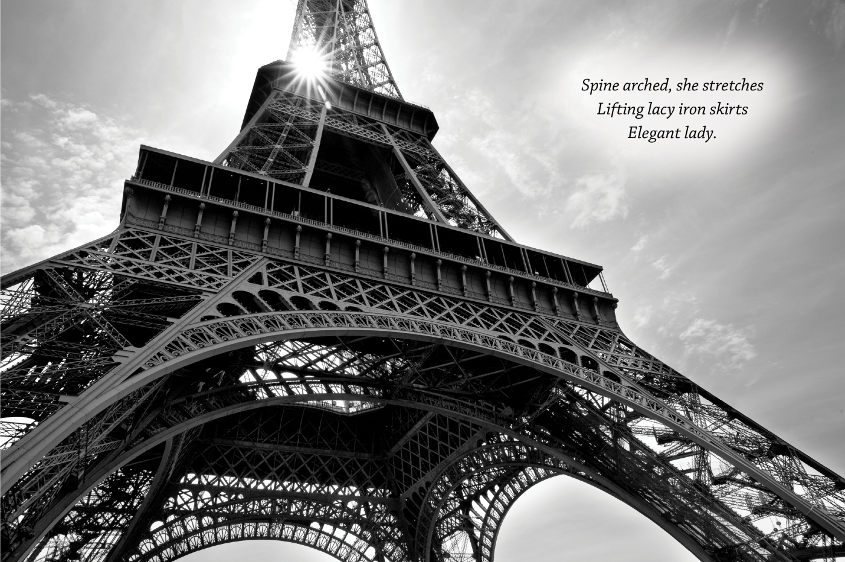
LOW ANGLE SHOT
When camera location is below normal eye-level compared to the subject.
Makes the subject appear tall, powerful, dominating, or scary.

Slide 26
CAMERA MOVEMENTS Zoom
Uses the mechanics of the camera’s lens to make the subject appear closer or further away.
Physical location of the camera does not change.

Slide 27
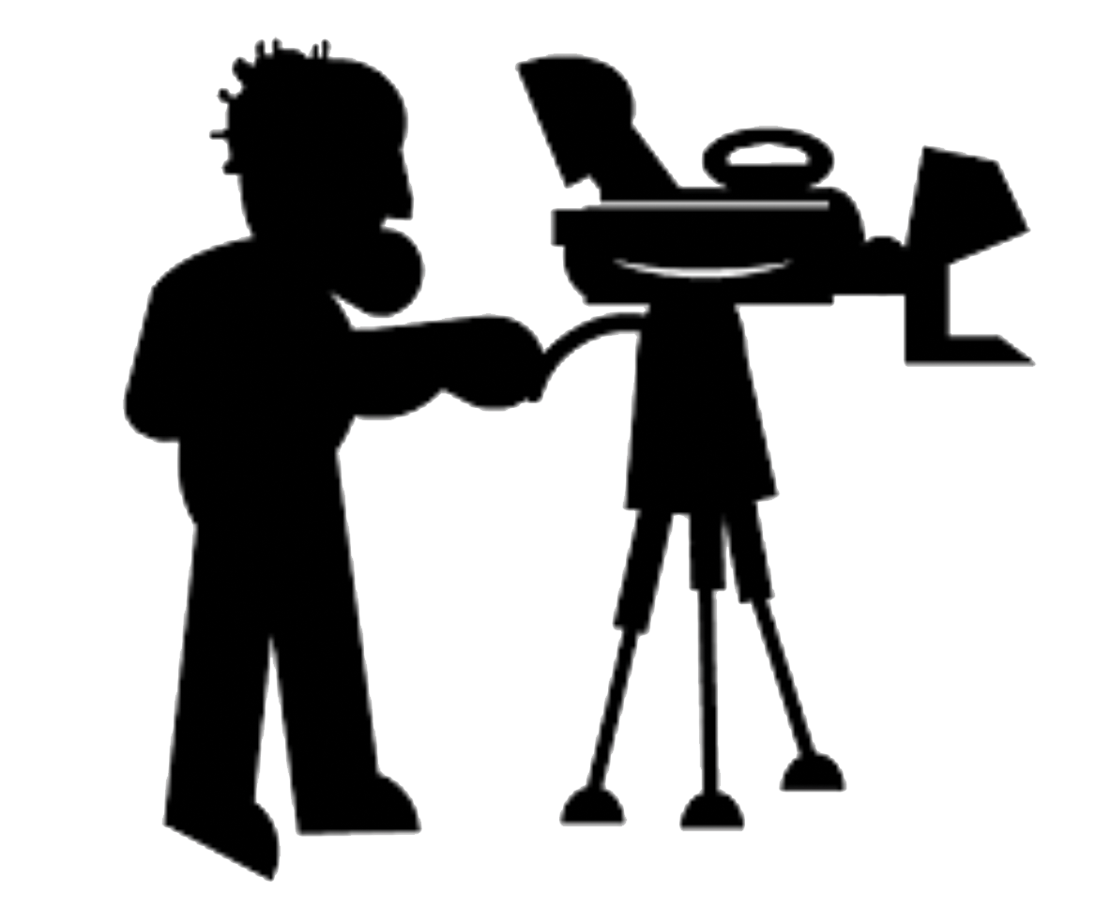
PAN
Horizontally pivoting the camera left or right.
Physical location of the camera does not change.

Slide 28
TILT
Vertically pivoting the camera up or down.
Physical location of the camera does not change.

Slide 29
DOLLY
TRUCK
The camera physically moves toward or away from the subject to make it appear closer or further away.
The camera physically moves horizontally (left or right).

Slide 30
CRANE
The camera physically moves vertically (up or down).

Slide 31
CAMERA SETTINGS
Focus
Adjusting the camera’s lens settings to make the footage of the subject clear and not blurry.
White Balance
Adjusting the camera’s color settings to match true white; results in all colors becoming balanced.
Iris
Adjust the camera’s lens settings to allow the appropriate amount of light into the camera.
*Some cameras adjust these three properties automatically while shooting.

Slide 32
QUESTIONS TO CONSIDER
Each camera movement has it’s own use. Do you think camera movements can be used together?
Can you think of any examples where there are multiple camera movements at the same time?
Does the camera always have to move?

Slide 33
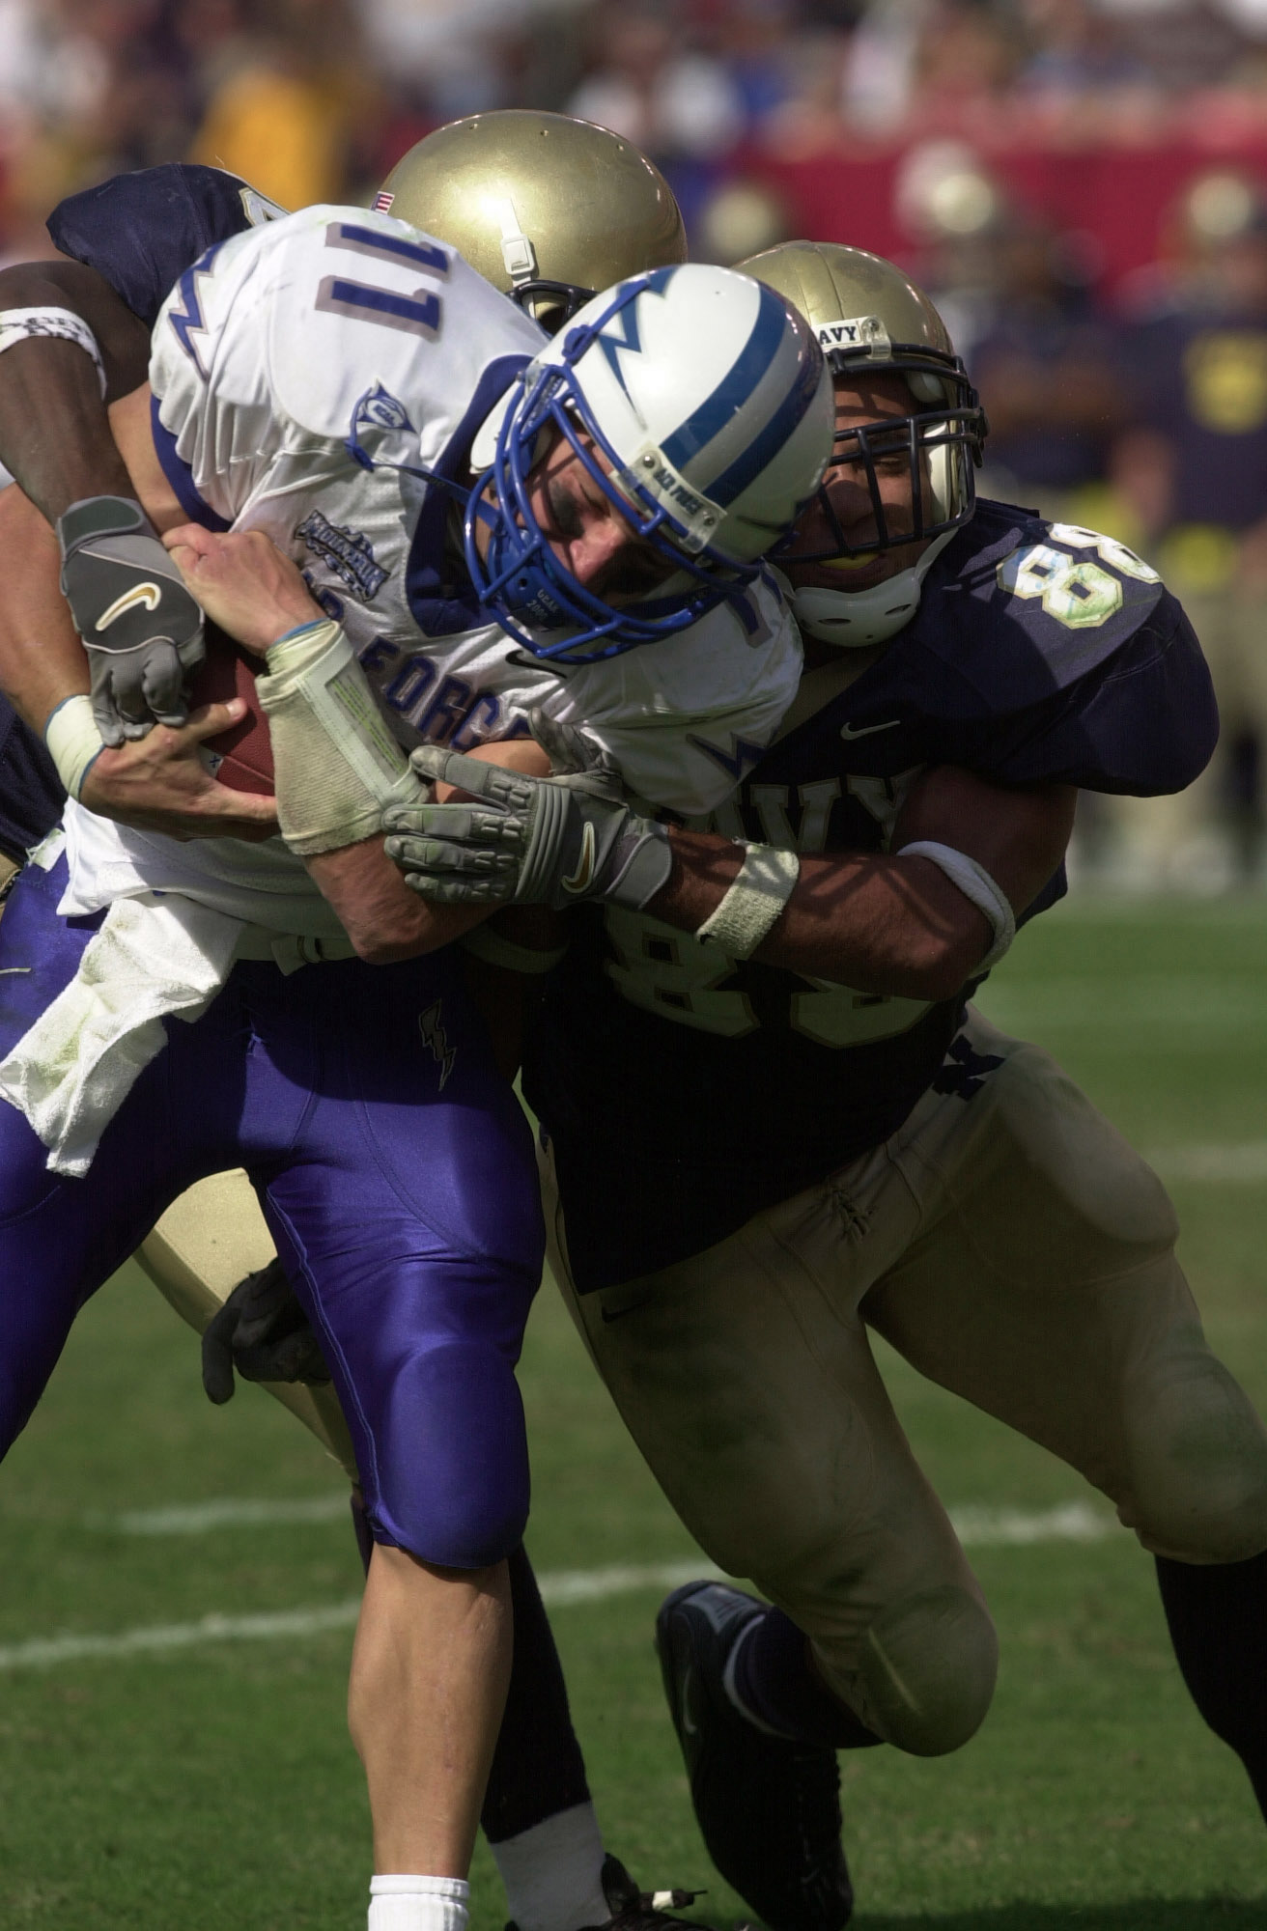
TELEPHOTO LENS
High-def video cable.
Carries digital audio and video.
Combines audio & video signals into one cable to simplify connection.

Slide 34
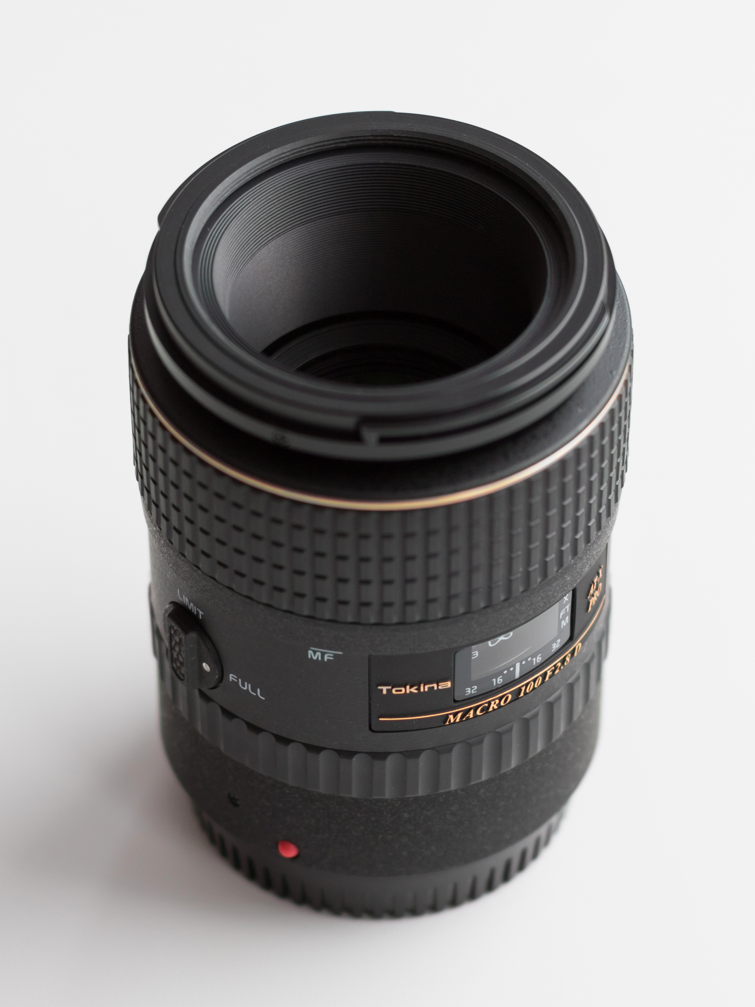
MACRO LENS
A lens suitable for unusually up-close filming of the subject(s); shows a particular part of the subject in extreme detail.

Slide 35
MACRO LENS
A lens suitable for unusually up-close filming of the subject(s); shows a particular part of the subject in extreme detail.

Slide 36
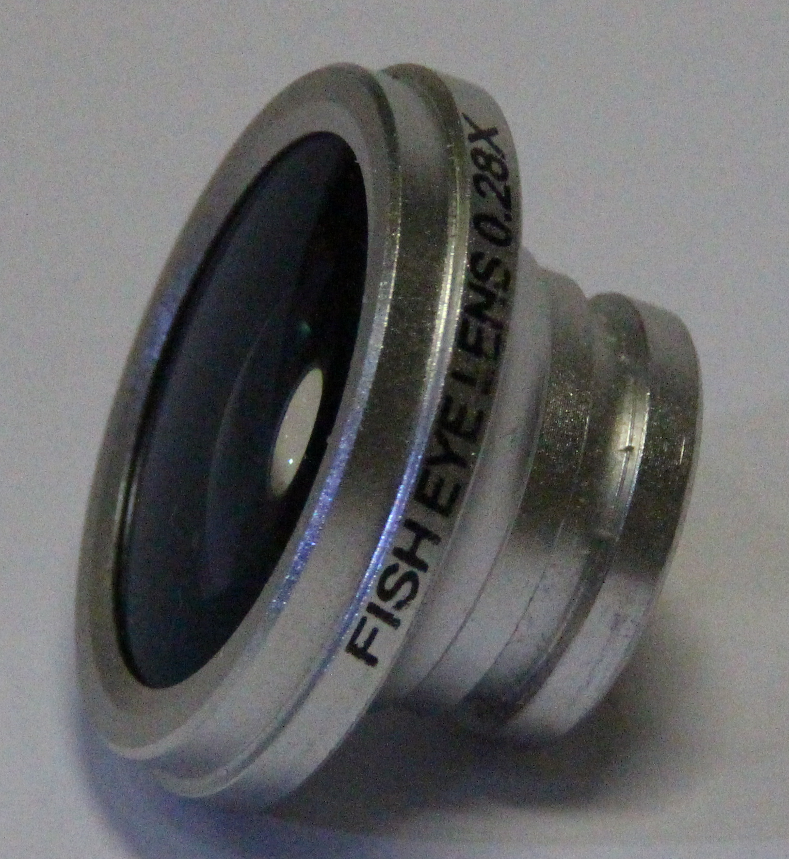
FISHEYE LENS
A wide-angle lens that has a field of vision covering 180°; creates a circular image with visual distortion around the edges for visual effect.

Slide 37
FISHEYE LENS
A wide-angle lens that has a field of vision covering 180°; creates a circular image with visual distortion around the edges for visual effect.

Slide 38
QUESTIONS TO CONSIDER
Why is it important to have multiple lenses and use the correct lens in a given situation?
Can you think of other situations when someone might use each of the lenses?
Telephoto?
Macro?
Fisheye?

Slide 39
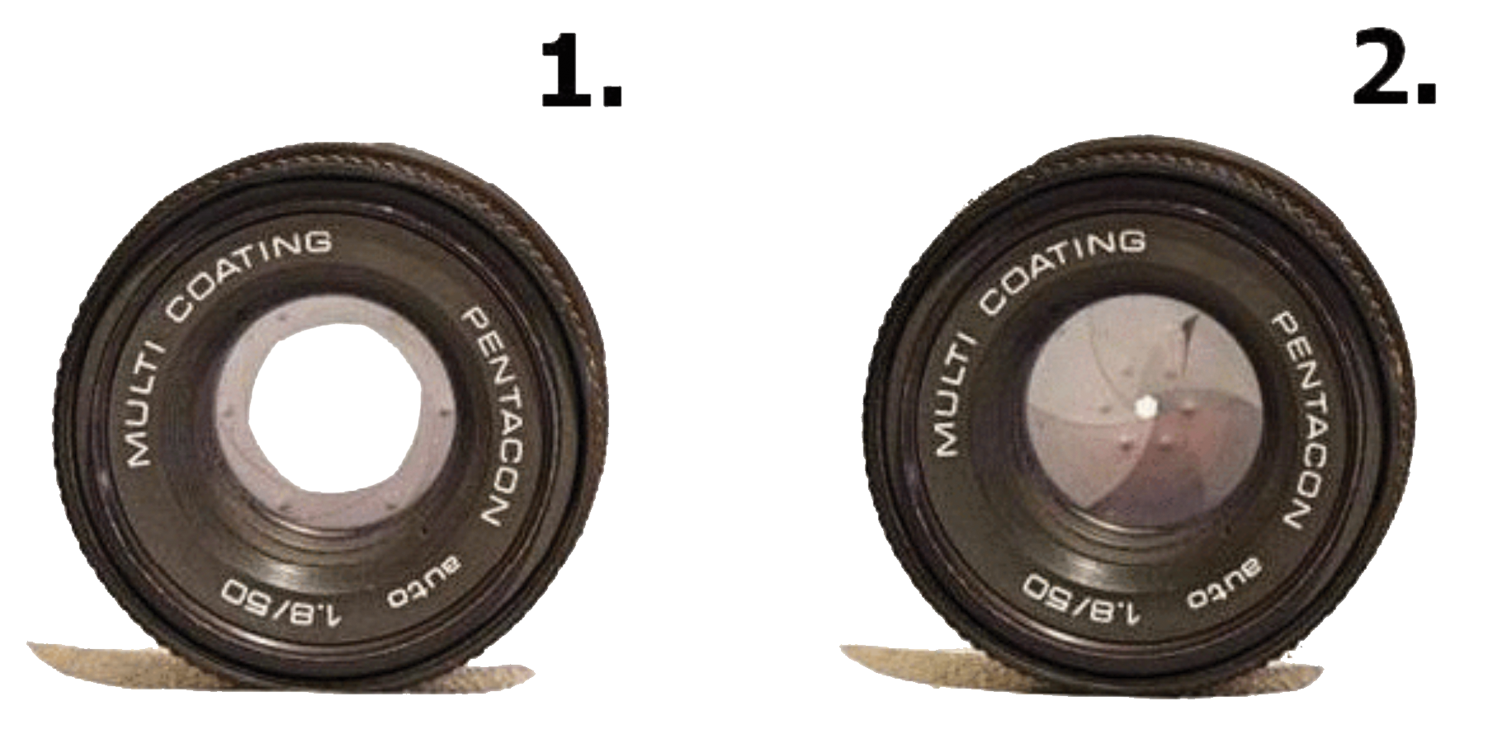
APERTURE
The hole in the lens by which light travels through to re-create the image being filmed; size of the hole is controlled by the iris.

Slide 40
QUESTIONS TO CONSIDER
When might someone want to adjust the aperture?
How would the aperture need to be adjusted if you were filming in a dark or bright area?

Slide 41
LIGHTING TERMS
Key Light
The main source of light for the video production; pointed at the set to illuminate the subject(s).
Fill Light
A less intense light used to eliminate or soften the shadows of the subject(s) in a video production.
Back Light
Used to illuminate the subject(s) of a video production from behind; separates the subject(s) from the background itself.

Slide 43
VIDEO PRODUCTION LIGHTING

Slide 44
QUESTIONS TO CONSIDER
How might a scene look if one of the lights from Three Point Lighting is missing?
Do you think cartoons and stop motion films use three point lighting?

Slide 45
AUDIO TO ENHANCE VIDEO
Natural Sound
(Room Tone)
Recorded Narration (Voiceover)
Using the actual sounds of the environment in which the video takes place.
Typically used to make the video seem more realistic.
Dialogue added to a video production to explain the visual scenario and give the audience more information about what is happening in the video.

Slide 46
AUDIO TO ENHANCE VIDEO
Loop
Used to make a section of audio repeat.
Audio Effects
Adjustments to clips used to change the original sound in order to reach the desired outcome.
Background Audio
Music and/or sounds used to add interest and depth to an audio production.
Voiceover
Voice used to convey a message to the audience.

Slide 47
AUDIO EDITING TERMS
Clip
A section of recorded sound used to create an audio production.
Trim/Splice
Starting and stopping audio clips at a defined point in the recording.
Adjusting Track Levels
Increasing or decreasing the volume of individual tracks to ensure all tracks are audible and blend well together.

Slide 48
AUDIO EDITING TERMS
Fade
Gradual change of volume used to change between clips of audio.
Crossfade
A gradual volume transition from one audio clip to another.

Slide 49
QUESTIONS TO CONSIDER
Why is it important to fade audio in and out?

Slide 50
DIGITAL PROJECT RESEARCH
Once a designer and client have discussed and established the target audience, purpose, and goals of a project, the next step for the designer is to conduct research to prepare for creation.
View a collection of similar projects for ideas and inspiration.
Research possible copyright or trademark issues associated with the nature of the project.
Find assets (pictures, audio, video, etc.) needed to create the project.

Slide 51
ROLES IN DESIGN TEAMS
Writers - responsible for writing all content.
Editors - responsible for editing all content.
Photographers - responsible for all digital photography.
Videographer - responsible for shooting all digital video.
Director - responsible to making rough and final cuts of video production projects.
Designers - responsible for designing elements of layout and look and feel of project.
Project managers - responsible for keeping all members on task for a project. Usually the person who interfaces with the client.

Slide 52
TEAM COMMUNICATION
Decide how the team will communicate.
Determine if one person will be the project manager overseeing all tasks and deliverables.
Select a person who will communicate directly with the client.
Decide how information will be relayed back to the group from the client; email, web conferencing (such as Adobe Connect), Adobe Acrobat, Dropbox or Google Drive.

Slide 53
FEEDBACK
Verbal or written responses containing information about a client’s reaction to a designer’s performance of a task.
Feedback should be specific and offered during the construction of the project, as well as at the end.
Performance feedback is used to shape the redesign process and improve the overall project.

Slide 54
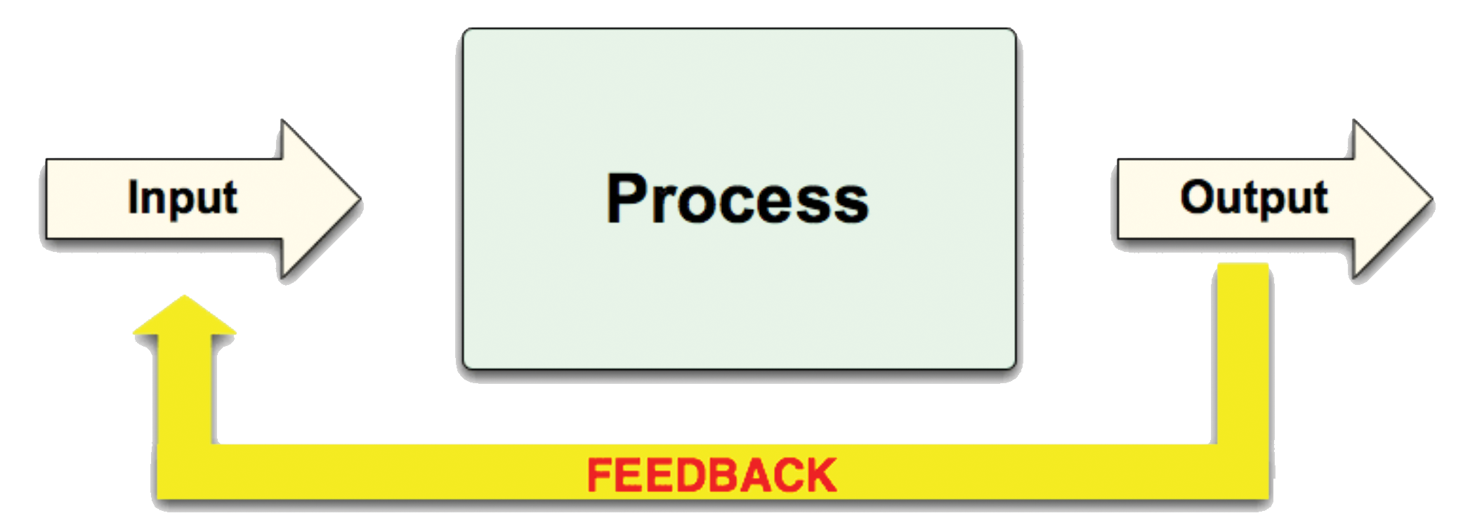
REDESIGN
The designer uses the provided feedback to make changes to the original project with the ultimate goal of meeting the client’s needs. This process could occur several times throughout the time span of a particular project.

Slide 55
COLLABORATION
Collaboration is the action of working with someone to produce or create something.
Using technology to assist the collaboration between the designer and client will result in a more efficient and effective workflow.
Cloud storage allows a working document or project to be stored electronically and accessed by different parties simultaneously.
Dropbox, GoogleDocs, iCloud, Box.net, etc.

Slide 56
TEAM COLLABORATION
Be sure to collaborate with your teammates as required to provide feedback or assistance.
All team members should fulfill assigned team roles and contribute equally to project work.
Working collaboratively means you will consult with other team members on major project decisions.
Teammates should make an effort to help each other succeed and build skills.

Slide 57
QUESTIONS TO CONSIDER
Why is collaboration so important?
How does good collaboration improve the end result of the project?

