Slide 1
PRODUCTION PHASES CHANGES
There are changes in the production phases terminology as related to the Adobe certification test objectives. We have added new phase names as identified by Adobe resources linked here:
https://edex.adobe.com/resource/-26bb6/
Each software area will repeat some of the same production phase content with tasks unique to that specific digital media identified for easy reference.

Slide 2
Objective 1.00
1.00 Understand project requirements for video projects.

Slide 3
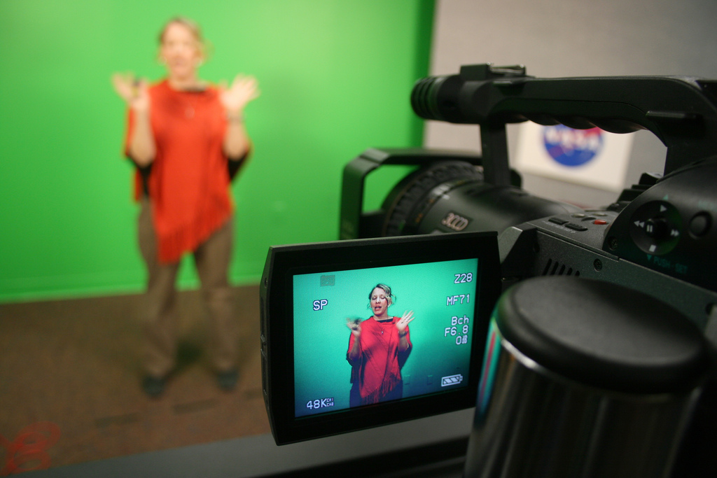
DIGITAL VIDEO
Moving images that have been captured, created, or edited electronically.
Digital video signals transmit information in the form of individual bits of data.
Analog (non-digital) video signals transmit information continuously in the form of a wave.

Slide 4
QUESTIONS TO CONSIDER
Do you think most modern day movies are digital or analog?
When you go to the theater are you watching a digital video or an analog video? Do you think you could tell the difference between the two?

Slide 5
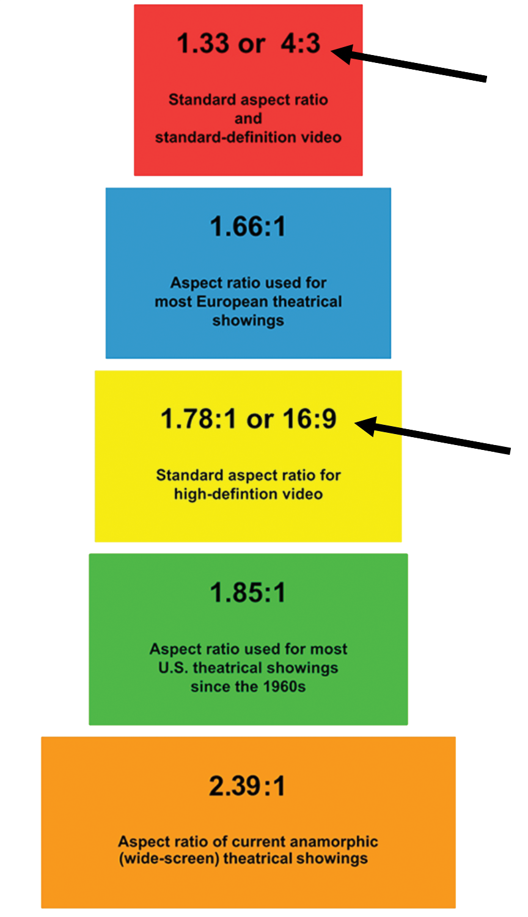
CHARACTERISTICS OF DIGITAL VIDEO
Aspect Ratio
Ratio of a video screen’s width and height dimension; common ratios are standard (4:3) and widescreen (16:9).
Frame Rate
Speed at which video frames appear on a screen; measured by frames per second (FPS).

Slide 6
CHARACTERISTICS OF DIGITAL VIDEO
Scanning Method
Method by which video picture appears on a screen (720p, 1080i, etc.).
Interlaced (I)
Displays half of the video picture at a time (odd lines, then even); alternates too quickly for human eye to notice.
Progressive (p)
Displays the entire video picture at all times; greatly reduces any flickering of picture; better quality image than interlaced.

Slide 7
QUESTIONS TO CONSIDER
Why might someone use interlaced scanning instead of progressive scanning video? Can you think of any possible advantage of only seeing, or having, half of the image appear at once?

Slide 8
BROADCASTING SYSTEMS
National Television System Committee (NTSC)
Standard used in North America and most of South America. In NTSC, 30 frames are transmitted each second.
Phase Alternating Line (PAL)
Standard mostly used overseas. In PAL, 25 frames are transmitted each second.
Sequential Color with Memory (SECAM)
French and Asian broadcast television standard.

Slide 9
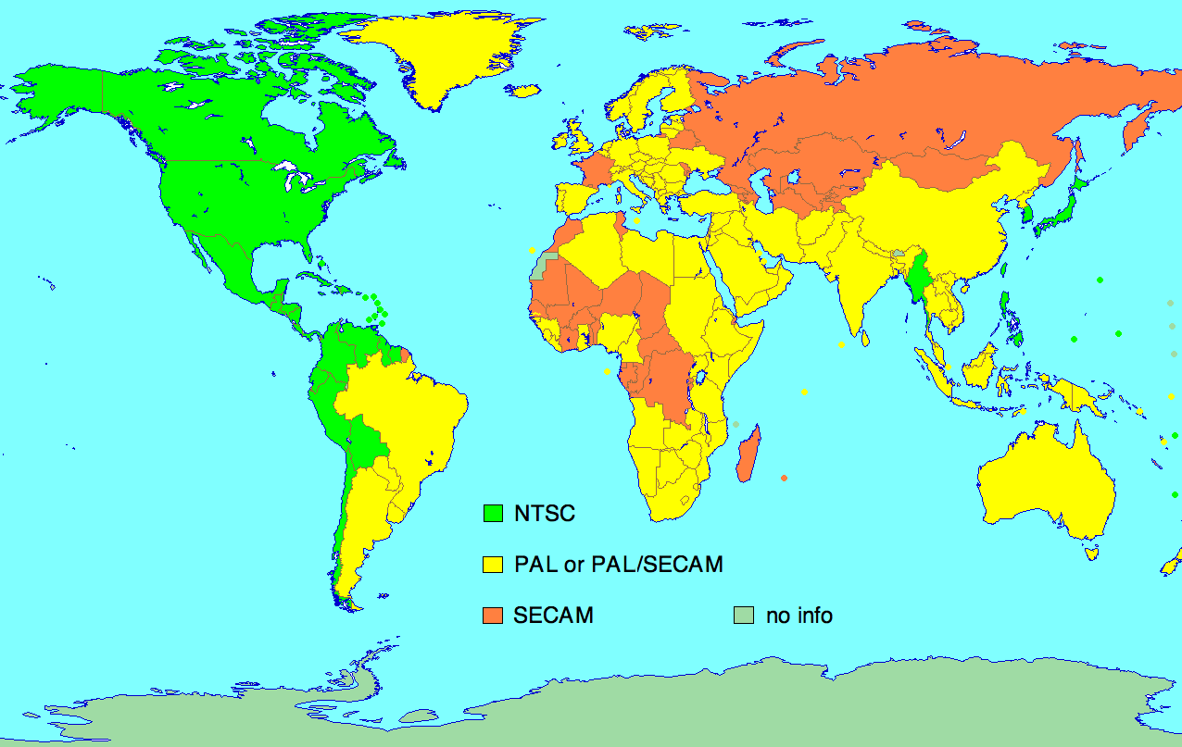
BROADCASTING SYSTEMS

Slide 10
STREAMING VIDEO
Transmitting video files that can begin playing over the Internet as the remaining data is still being downloaded.
Creates little to no wait time to begin viewing the video file.
Example websites that use streaming video technology include: YouTube, Netflix, Vimeo, UStream, etc.

Slide 11
QUESTIONS TO CONSIDER
How has streaming video changed the way we watch videos?
What do you think are some of the most important aspects of creating videos for streaming? What possible problems exist for streaming videos?

Slide 12
PROJECT MANAGEMENT
Beginning a digital media project from scratch and carrying it through to its final completion takes a unified effort from all parties involved.
Creating a Project Plan helps the process move forward quickly and efficiently. It helps the team avoid:
mistakes
arguments
tension within the team
wasted time.

Slide 13
DESIGN DOCUMENTS
Consistently uses design documents to guide the design and development process.
Within the project plan, create a schedule with specific deliverables and due dates.

Slide 14
DESIGN DOCUMENTS
Consistently track your milestones in order to produce deliverables and meet deadlines.
Assign roles when working in teams and define and prioritize tasks for you and all teammates.
Objective ____ or Task ____
Steps to complete
Write Materials on the sides.

Slide 15
TIME MANAGEMENT
Review your project plan daily and give brief daily status reports within your team.
Make sure to use contingency planning for any unforeseen delays and reprioritize and update the tasks and deliverables in your project plans when needed.
Beware of Scope Creep
Incremental expansion of the project scope.
Introducing features not originally planned.
Delays project and adds cost.

Slide 16
PROFESSIONALISM
Punctuality
Dressing well when interviewing peers and clients
Promptly replying to peers and clients
Listening to suggestions and working well in groups

Slide 17
COMMUNICATION
Respond to feedback and offer feedback.
Decide which feedback improves the content and design of the project and incorporate this feedback into the redesign.
When critiquing each other's work be sensitive to the feelings of others and use constructive comments and words.

Slide 18
QUESTIONS TO CONSIDER
How do you think project management affects film production?
What are some results of poor project management?

Slide 19
PRE-PRODUCTION PHASE
DEFINE
Determine type of digital media.
Set overall goals for design.
Define target audience.
Agree on deadlines.
Create a budget.
Meet with clients to create project plan.

Slide 20
QUESTIONS TO CONSIDER
Which of the following do you think is the most important define step? Why?
Determine type of digital media.
Set overall goals for design.
Define target audience.
Agree on deadlines.
Create a budget.
Meet with clients to create project plan.

Slide 21
PRE-PRODUCTION PHASE
STRUCTURE
Gather and manage information and digital assets (music, etc.) provided by the client.
Create a file-naming convention to assure proper organization and storage.
Save and organize files for easy and quick access.
Create any necessary design documents.
Get any actors or other on-camera participants to sign a talent release document.

Slide 22
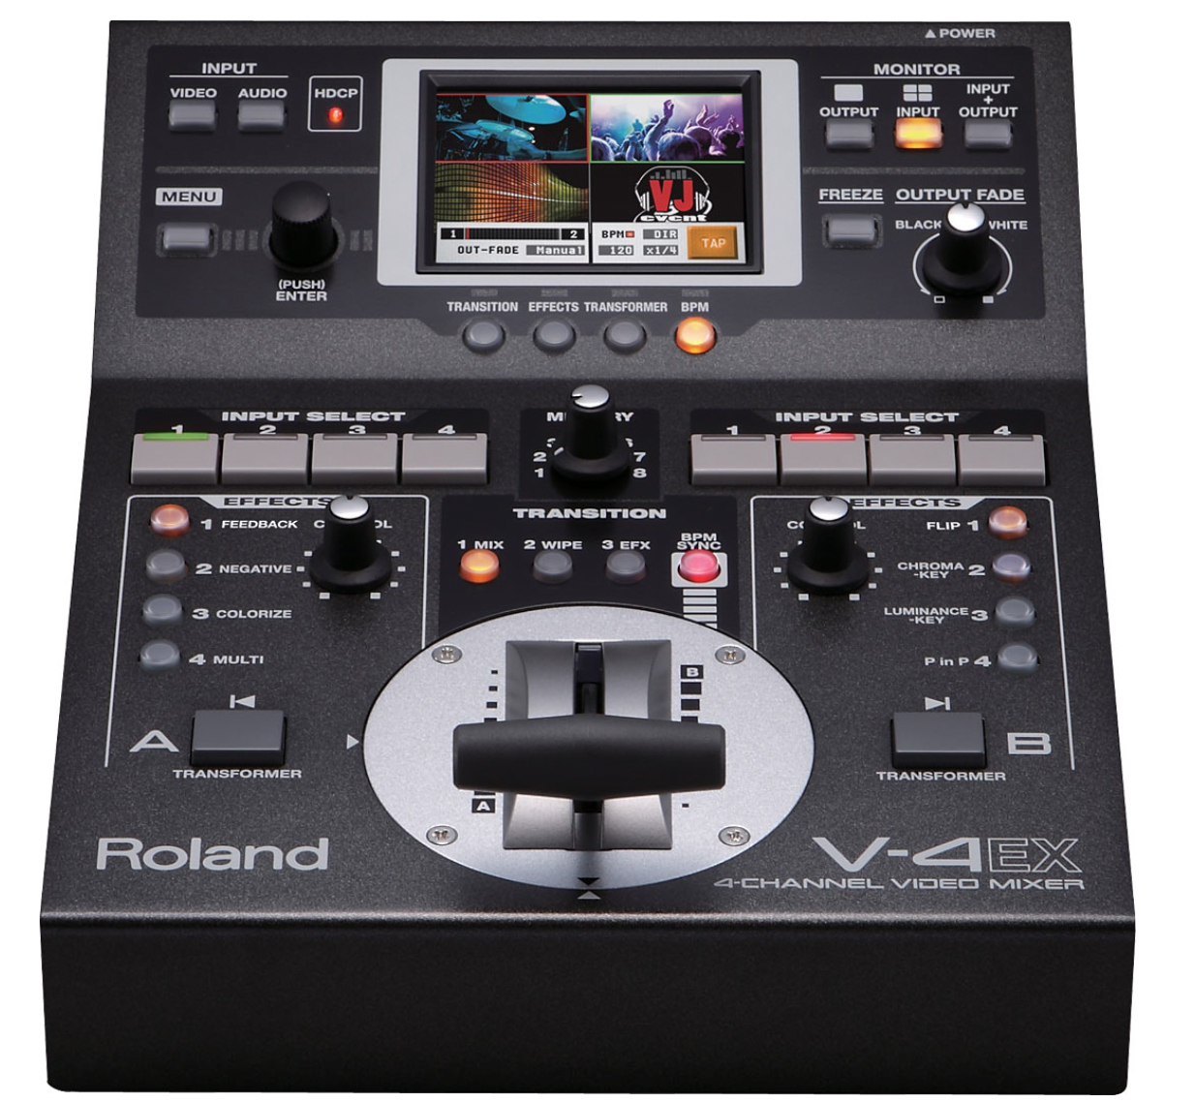
PRE-PRODUCTION PHASE
STRUCTURE
Choose appropriate equipment:
Choose camera(s)
Choose microphone(s)
Choose cables
Other equipment (video mixer).
Mostly used for live video productions.
Accepts multiple camera sources and combines them into one production.
Can automatically add transitions and effects to the input sources.

Slide 23
PRE-PRODUCTION PHASE
DESIGN
Write a script that effectively conveys the intended message to the audience. Consider the following:
The accepted vernacular of the target audience.
The readers (performers) of the script.
Script is needed to tell the actors (both on screen and for a voiceover) what to say and when.
Gives direction to set lighting, sound effects, and other components of the project.

Slide 24
QUESTIONS TO CONSIDER
What should a script include?
What do you think will happen if you don’t write a script for a video?

Slide 25
PRE-PRODUCTION PHASE
DESIGN
Create storyboard (animation & video).
Sketch out a visual representation of each major scene or major phase of the video project.
Provide information about the audio sources, camera movements, and transitions.

Slide 26
STORYBOARD

Slide 27
PRE-PRODUCTION PHASE
DESIGN
Create a shot list in the sequence of the storyboard for the camera operators.
Present script and storyboard to client for review and feedback.
Redesign and resubmit for approval.

Slide 28
QUESTIONS TO CONSIDER
Why is it important to create storyboards before filming?
Do you think all films have storyboards, even documentaries?

Slide 29
PRODUCTION PHASE
BUILD & TEST
Setup equipment such as tripods, cameras, and lighting.
Record footage according to the storyboard.
Capture and name recorded footage.
Import recorded footage into the video editing software or gather existing footage from outside sources.
Select, edit, and assemble the video clips according to the storyboard.

Slide 30
PRODUCTION PHASE
BUILD & TEST
Adjust audio levels, add titles, add transitions to the video clips to convey the intended message to the audience.
Export final video to selected format.
Check for errors and quality.
Revision based on test results.
Preview the final version.
Preview to see how the digital media will look on a particular output device (computer monitor, tablet, phone, etc.).

Slide 31
POST-PRODUCTION PHASE
DELIVERY
Optimize the digital media for specific client needs, including:
File format requirements (Codecs)
File size requirements
File name requirements
Submit the finalized version(s) of the digital media to the client.
Outline a project launch plan (if needed).

Slide 32
LEGAL TERMS IN DIGITAL MEDIA
Intellectual Property
Copyright
Original creations of the mind that can be protected by law; literary and artistic works, designs, symbols, images, names, etc.
The exclusive legal right to reproduce, publish, sell or distribute the expression of an intellectual property (literature, design, audio, video, etc.)

Slide 33
LEGAL TERMS IN DIGITAL MEDIA
Trademark
Fair Use
A mark (logo, symbol, word, phrase, etc.) legally registered or established by a company to represent a service or product; cannot be used without the permission of the owner.
A legal allowance of using a copyrighted material without permission from the owner, provided the circumstances are reasonable and do not make the material less profitable.

Slide 34
QUESTIONS TO CONSIDER
Differentiate between:
Intellectual property
Copyright
Trademark
Fair Use
What can be copyrighted?
Does a copyright mean it can’t be used?

Slide 35
FAIR USE GUIDELINES
For use of media to fall under fair use guidelines, the following factors must be considered:
Purpose and character of use—is it for commercial or non-profit education use.
What is the nature of the copyrighted work.
The amount of the portion being used.
The effect of the use on the potential market value of the product.

Slide 36
CREATIVE COMMONS
A nonprofit organization that enables the sharing and use of creativity and knowledge through free legal tools.
Free, easy-to-use copyright licenses provide a simple, standardized way to give the public permission to share and use your creative work — on conditions of your choice.
Creative Commons licenses are not an alternative to copyright. They work alongside copyright and enable you to modify your copyright terms to best suit your needs.

Slide 37
CREATIVE COMMONS
Creative Commons Video
Creative Commons Licenses
Six types with different features

Slide 38
QUESTIONS TO CONSIDER
Explain how a copyrighted work could be used under Fair Use guidelines.
Which Creative Commons license could you use
For an educational project?
For a company logo?
For a song that you wanted to use in a mix?

