Slide 1
Typography Basics

Slide 2
What is the purpose of design?
To grab the attention of the viewer.
This is accomplished through:
Typography
Design Elements
Design Principles
Design Composition Theory
Notes:
Although typography will be the focal point of this PowerPoint, the 3 main topics of objective 1.01 are briefly introduced here.

Slide 3
Typography
Typography is the style, arrangement, and appearance of text.
Text should:
Be appropriate for the medium used
Increase readability

Slide 4
I. Typefaces

Slide 5
Typefaces
A typeface is the basic design of a character.
Each typeface has a design for each letter of the alphabet, numbers, punctuation symbols and may contain other symbols.
Example: Arial
ABCDEFGHIJKLMNOPQRSTUVWXYZ
abcdefghijklmnopqrstuvwxyz
1234567890
!@#$%^&*()_+-=?,.:”’;
Notes:
URL: http://typographica.org

Slide 6
Typeface Categories
Typefaces can be divided into five main categories:
Serif
Sans Serif
Ornamental
Script
Dingbat (Symbol)
There are many other categories of typefaces. One that students should be familiar with but won’t appear of the final exam is:
Blackletter (Gothic)

Slide 7
Serif Typefaces
k
Have serifs (attributes, strokes, tails, feet, etc.) at the tips of the letters
Used for body text in printed publications because it is easier to read than Sans Serif.
Recommended sizes are between 10 and 12 points.
Used for headings in online publications to contrast with body text.
Examples:
Bodoni
Cambria
Courier
Goudy
Times New Roman
Uses:
Business correspondence
Book text
Magazine article
Text
Newsprint
Notes:
Teachers: You may want to explain that serifs make it easier for the reader’s eye to recognize the difference between letters more quickly. Thus, serif typefaces are better suited for body text of printed material. However, sans serif fonts are easier to read on monitors so web pages will use sans serif typefaces for body text.

Slide 8
Sans Serif Typefaces
k
Have no serifs (attributes, strokes, tails, feet, etc.) at the tips of the letters
Used for body text in digital displays because it is easier to display onscreen than Serif.
Used for headings in printed publications to contrast with body text.
Also used for very large or very small text.
Examples:
Arial
Berlin Sans
Calibri
Gill Sans
Verdana
Uses:
Web pages
On-screen display
Headings
Tables
Captions
Headlines

Slide 9
Serif vs. Sans Serif
Serif
The ends of each character do have attributes (serifs)
Sans Serif
The ends of each character do not have attributes (serifs)

Slide 10
Ornamental Typefaces
Designed to catch the eye
Should be used sparingly
Can be hard to read
Used for decoration
Should never be used in body text
Examples:
Algerian
Bauhaus
Chiller
Broadway
engravers MT
Jokerman
Uses:
Headlines on flyers or advertisements.

Slide 11
Script Typefaces
Appear to have been written by hand (whether in cursive or with a calligraphy pen)
Should never be keyed in all caps
Conveys either a formal or informal mood
Examples:
French Script
Brush Script
Bradley Hand
Uses:
Formal Invitations
Place cards
Poetry
Announcements

Slide 12
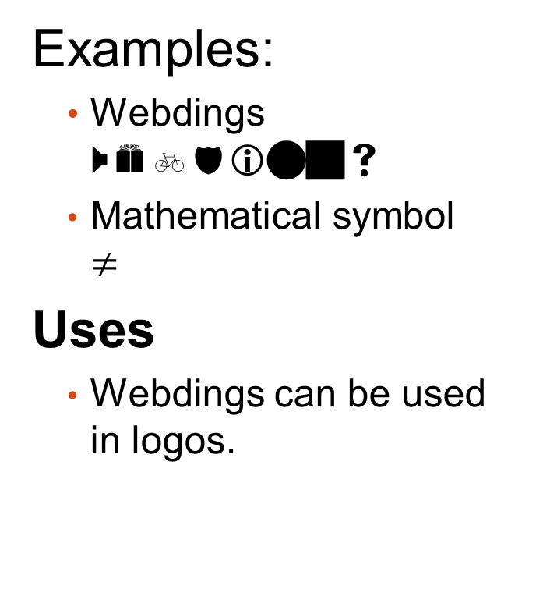
Dingbat (Symbol) Typefaces
Uses decorative pictures or symbols instead of characters
Allows the user to use a symbol to convey the message without importing a graphic
Can be used for specific purposes such as musical notation and mathematical symbols
Examples:
Webdings Webdings
Mathematical symbol $≠$
Uses
Webdings can be used in logos.

Slide 13
II. Fonts

Slide 14
The History of Fonts
It’s easier to understand fonts if you begin with the original definition of a font.
Before desktop publishing, people called ‘typesetters’ set the type by hand using moveable type.
Each character was a separate block of metal.
The letters were “set” on the layout to form the text.
Each typeface had a complete set of metal characters for each size, weight, etc.
Notes:
URL for the link: http://en.wikipedia.org/wiki/File:Metal_movable_type.jpg
Just for fun: You can have your students try to read what it says and figure out the meaning.

Slide 15
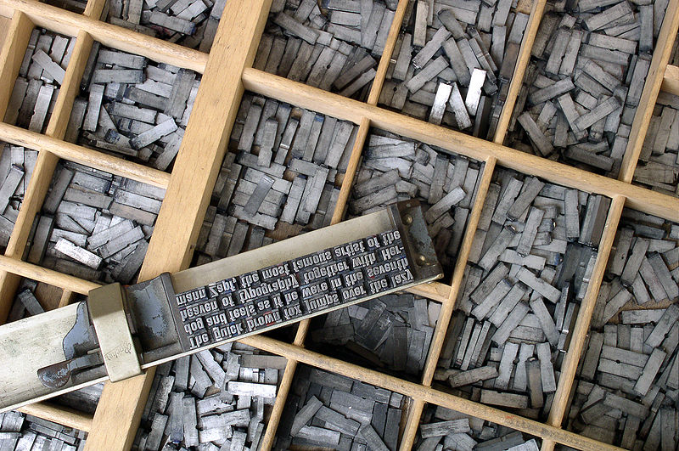
Notes:
It’s easier to understand fonts if you begin with the original definition of a font. Before desktop publishing, people called ‘typesetters’ set the type by hand using moveable type.
Each character was a separate block of metal.
The letters were “set” on the layout to form the text.
Each typeface had a complete set of metal characters for each size, weight, etc.
Each different size or weight required a completely separate set of metal characters.
Each metal set of characters was kept in its own drawer and was called a font.
Just for fun: You can have your students try to read what it says.

Slide 16
Fonts
Each different size or weight required a completely separate set of metal characters.
Each metal set of characters was kept in its own drawer and was called a type font.
So a font is the specific style, weight and size applied to a typeface.
Examples: Arial, bold, 12 point
Arial, italic, 14 point
Arial, 10 point
Arial is the typeface. Arial, bold, 12 point is the font.

Slide 17
Font Style
Font Style refers to the slant, weight and special effects applied to the text.
Examples:
Bold
Italic
Underline
Shadow
Outline
Small Caps

Slide 18
Font Families
A font family is the different sizes, weights and variations of a typeface.
Examples: Arial
Arial Black
Arial Narrow
Arial Rounded MT Bold

Slide 19
III. Typeface spacing

Slide 20
Proportional Typefaces
In Proportional Typefaces the amount of horizontal space for each character will vary with the width of each character.
For example, the letter i is not as wide as the letter m so it is drawn with less space.
All modern typefaces are proportional. Thus all modern documents use them by default.
Times New Roman is proportional.
Courier is monospaced.

Slide 21
Monospaced Typefaces
In Monospaced Typefaces the amount of horizontal space each character takes up is the same regardless of the width of the individual character.
For example, the letter i will take up the same amount of horizontal space on a line as the letter m or w.
It can be harder to read in large amounts.
Times New Roman is proportional.
Courier is monospaced.

Slide 22
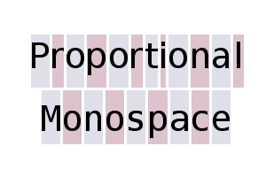
Proportional vs. Monospace

