Slide 1
LOGO DESIGN
LOGO DESIGN
What you chose says a lot about your brand!

Slide 2
Styles of Logos

Slide 3
Styles of Logos
Emblem Logos:
Pictorial Logos:
Letter Logos:
Resembles a badge
Only uses images/pictures
Only uses Type with initials

Slide 4
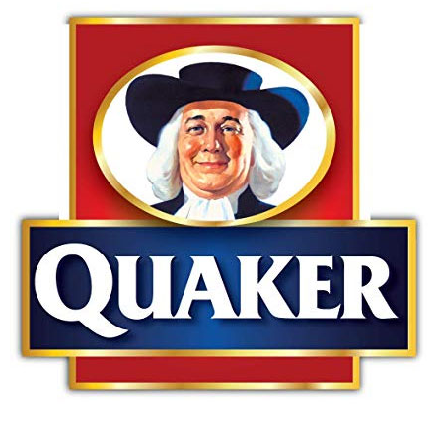
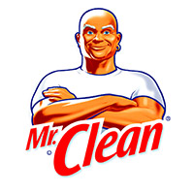
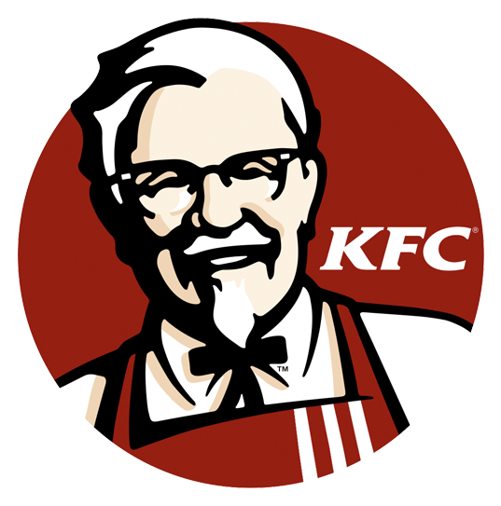
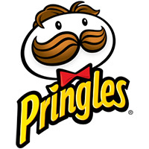
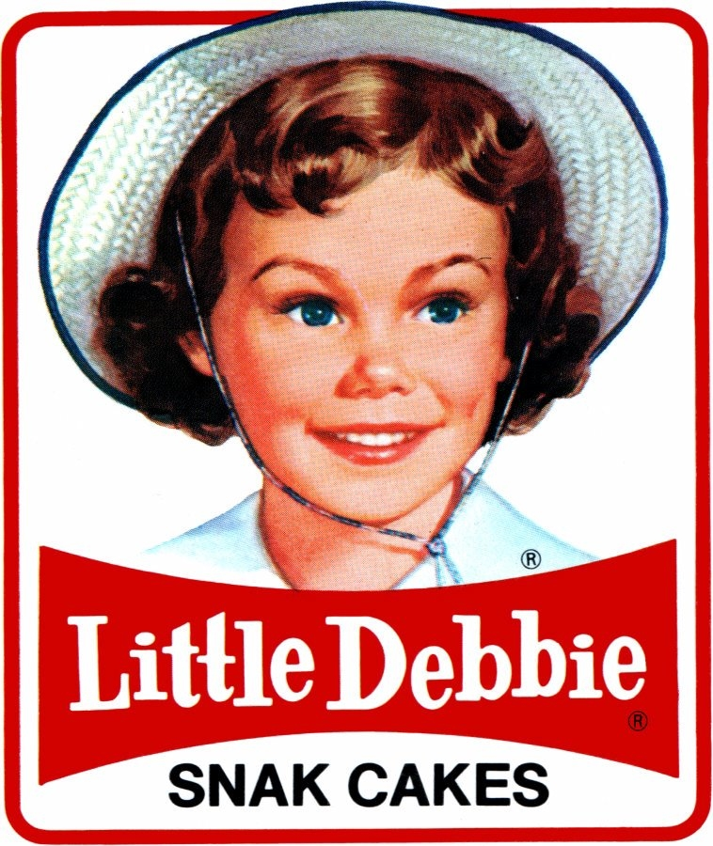
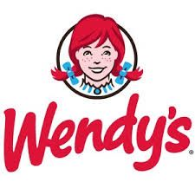
Styles of Logos
Word Mark Logos:
Mascot Logos:
Only uses Type with whole word
Uses the brand’s mascot as the logo

Slide 5
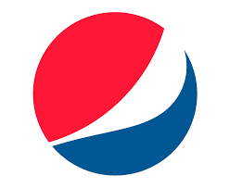
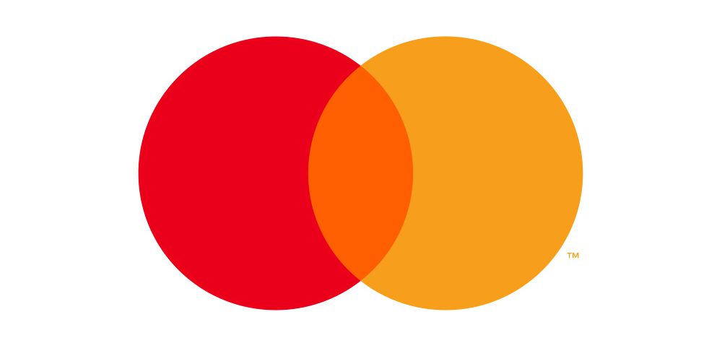
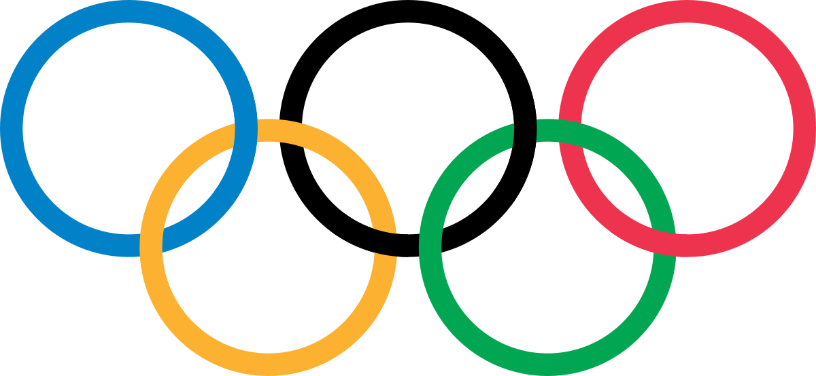
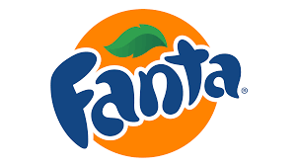
Styles of Logos
Abstract Logos:
Combination Logos:
Logo do not identify with the product
Combines 2 of the 6 previous logo types

Slide 6
Colors!

Slide 7
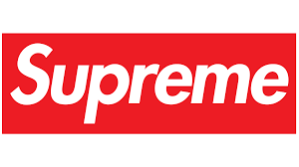
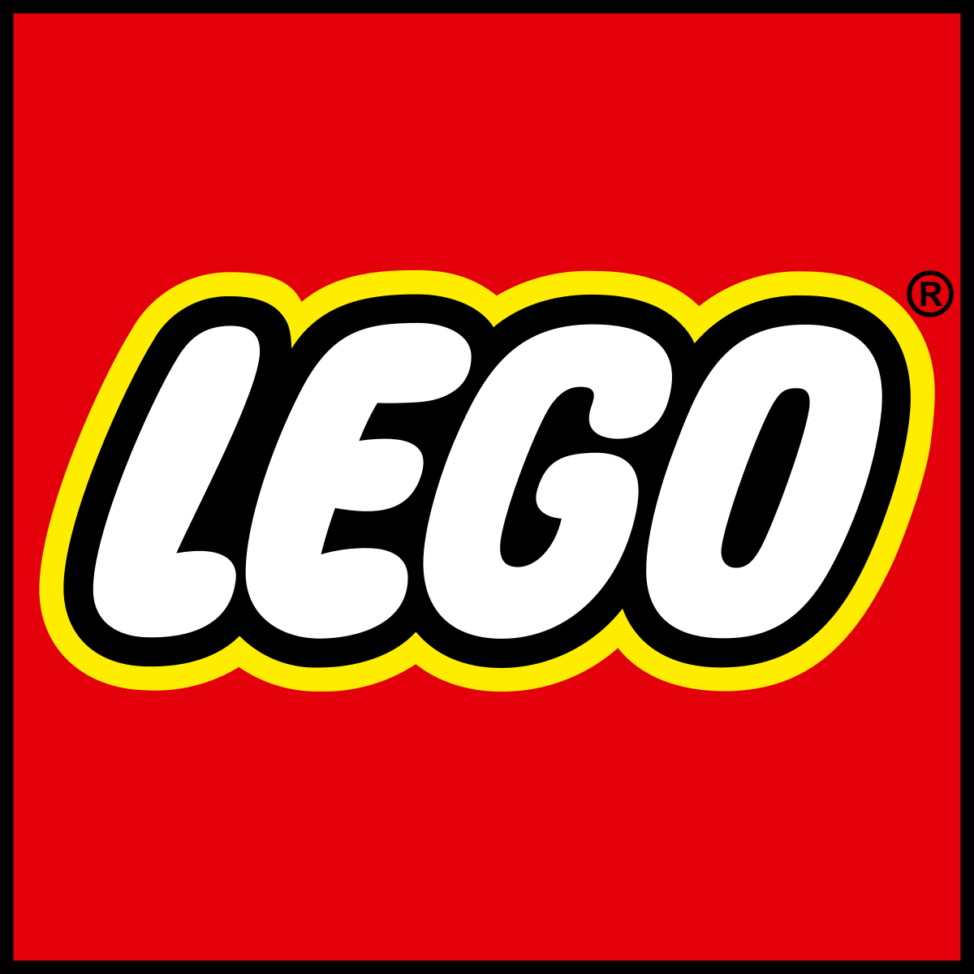
Warm Colors:
Reds:
Oranges
Yellows:
Excitement, Love, Boldness
Friendly, Cheerful, Confident
Happiness, Optimism, Energy

Slide 8
Cool Colors:
Greens
Blues:
Purples:
Peace, Growth, Health
Trust, Strength, Dependable
Nobile, Imaginative, Wise

Slide 9
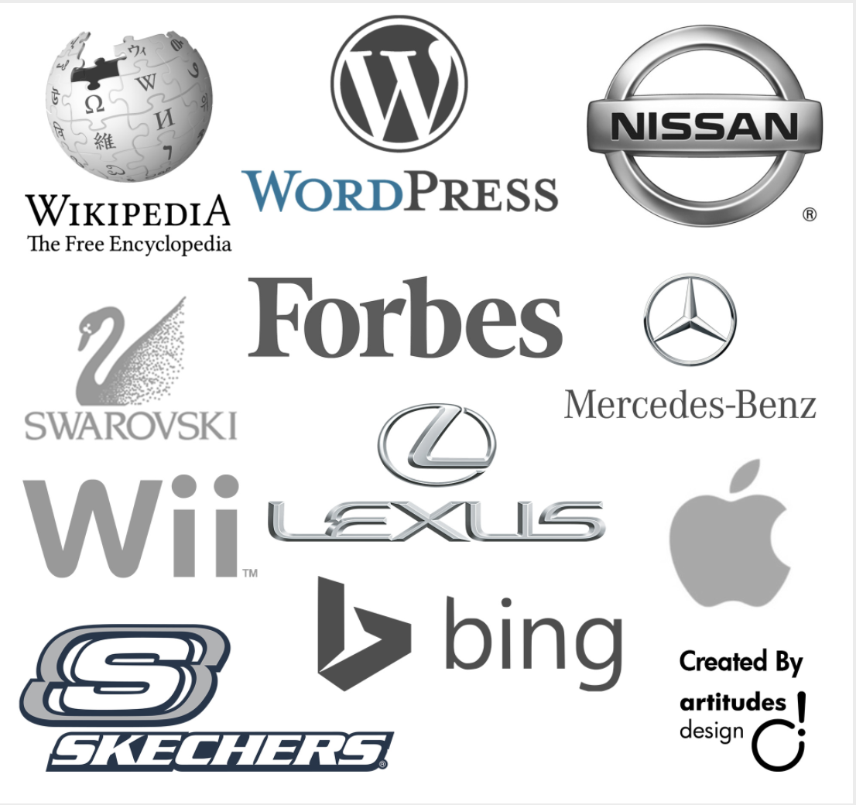
Neutrals Colors:
Greys:
Black:
Calm, Neutral
Classic, Elegance

Slide 10
Shapes!

Slide 11
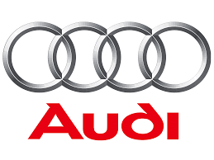
Round Shapes:
Circles:
Rings:
Curves:
Community, Unity, Friendship
Strength, Resolution
Flexibility, Adaptability, Compliance

Slide 12
Sharp Shapes:
Squares:
Triangles:
Stability, Consistency
Power, Science

Slide 13
Line Shapes:
Horizontal:
Vertical:
Spirals:
Calm, Tranquility
Endurance, Strength, Power
Hypnotic, Calming, Flowing

