Slide 1
Examples of Product Labeling
Food and Other Items

Slide 2
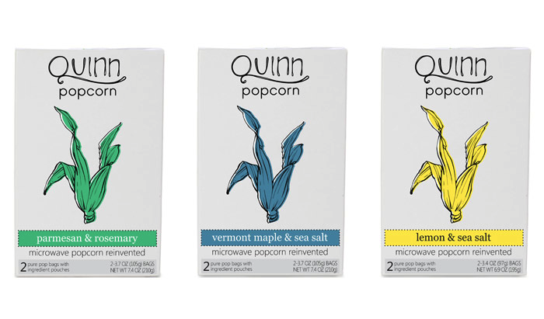
Packaging How do you know they are related?

Slide 3
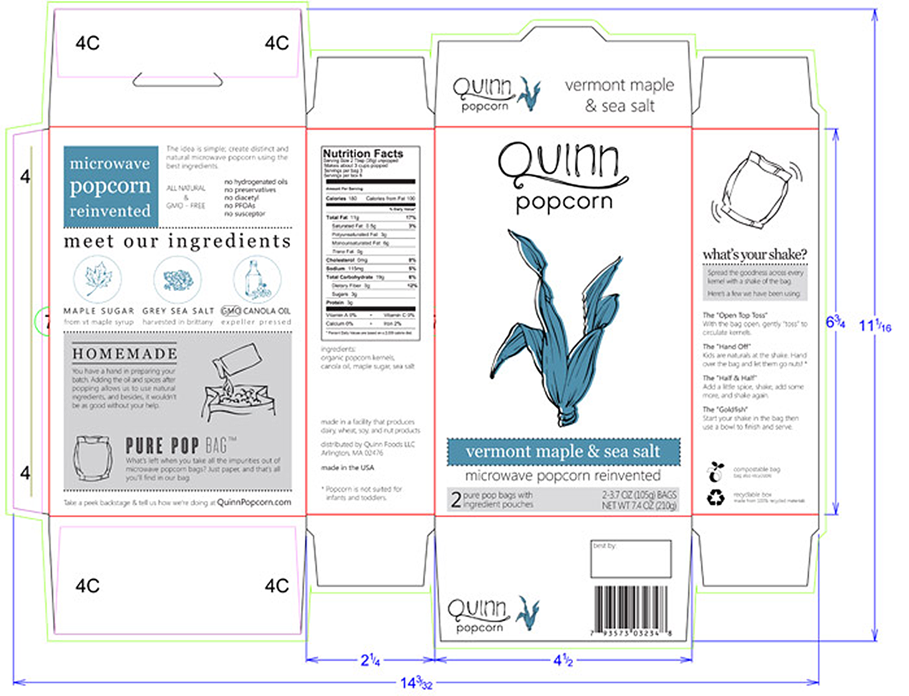
Flattened Popcorn Package Layout

Slide 4
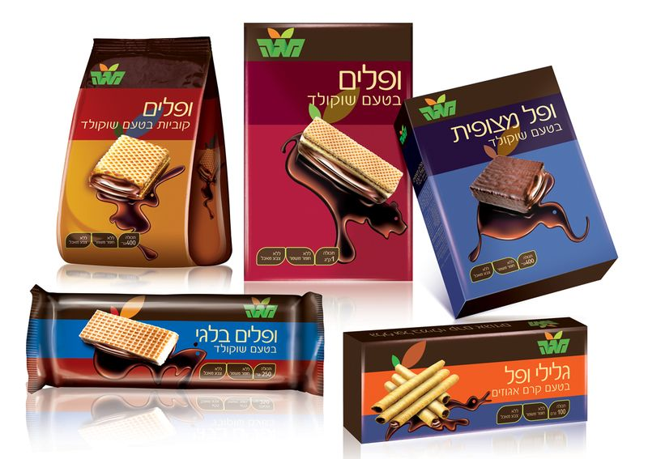
Cookie Containers (Notice placement of logos and layout theme.) What tells you these are from the same product line?

Slide 5
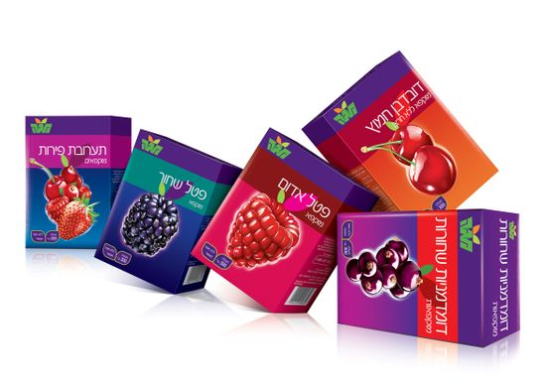
Fruit Treat Boxes Find the commonalities in these packages.

Slide 6
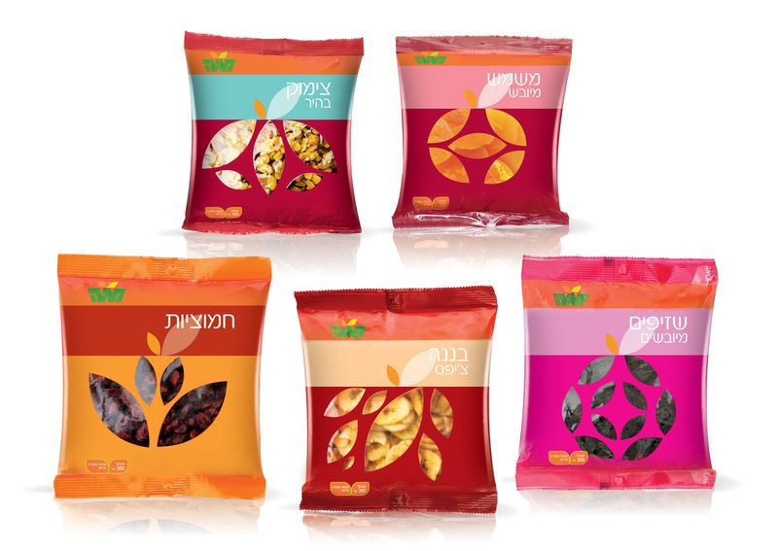
Snack Food Packages

Slide 7
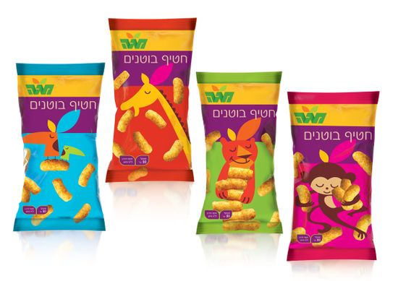
Snack Food Packages
Is this the same company? How do you know?
Notice the photos on the package of contents.
Why do these?

Slide 8
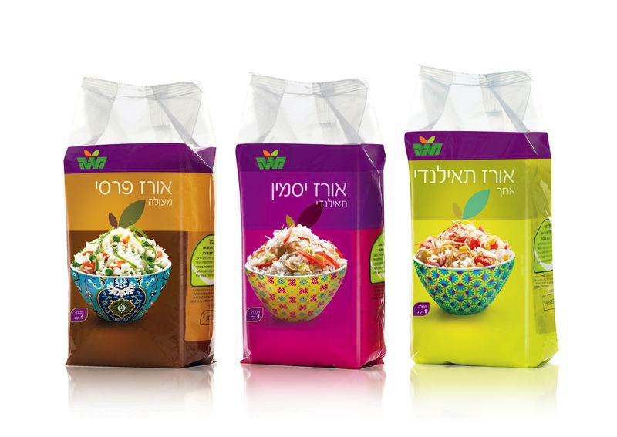
Rice Mix Food Packages

Slide 9
Think about the last FIVE slides.
What makes such diverse packages tell you instinctively they are all produced by the same company?
How do you think this commonality helps the company sell their product?
Would you buy from this company?
What makes you want to, or not want to, purchase their products?

Slide 10
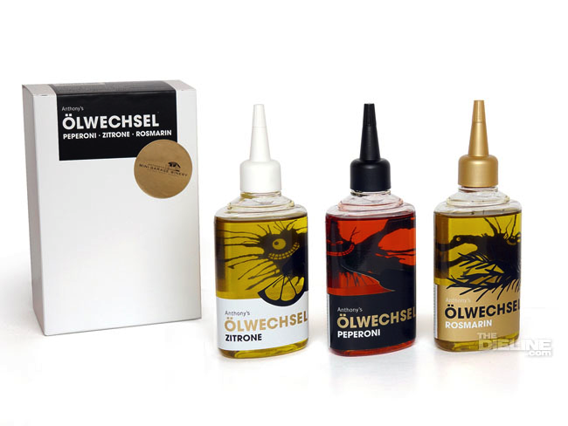
Mini Garage Winery —Food Seasoning Oils

Slide 11
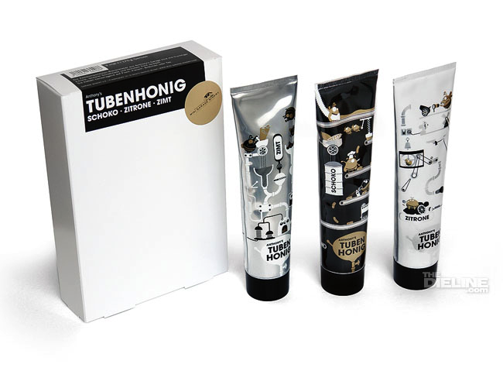
Mini Garage Winery—Honey Assortment

Slide 12
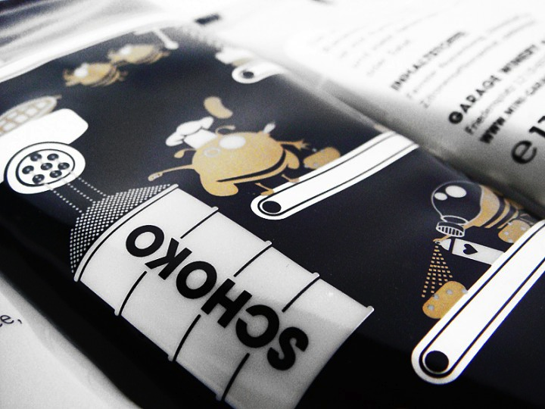
Mini Garage Winery —Close-up of one Honey package

Slide 13
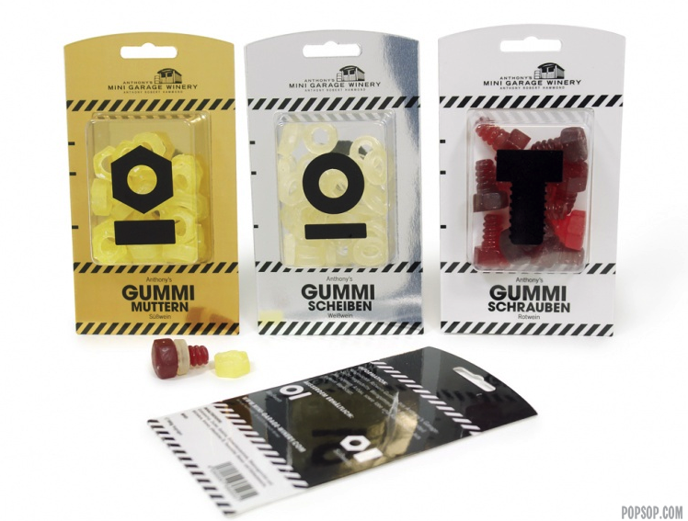
Mini Garage Winery—Gummi Candies

Slide 14
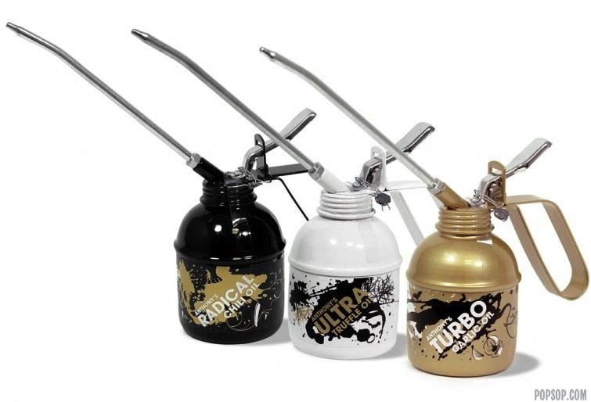
Mini Garage Winery—Flavored Oils

Slide 15
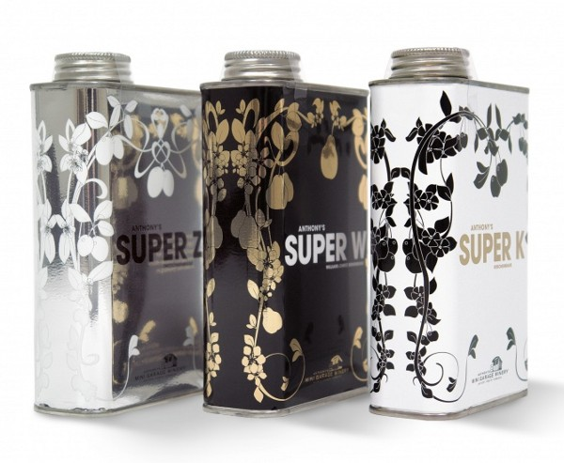
Mini Garage Winery —Wine Containers

Slide 16
Mini Garage Winery
What advantages could the Mini Garage Winery container choices give this company?
What disadvantages might they create?
Would you recognize these as food containers? Why or why not?
What does you think the graphic choices on the containers do for the company and packages?

Slide 17
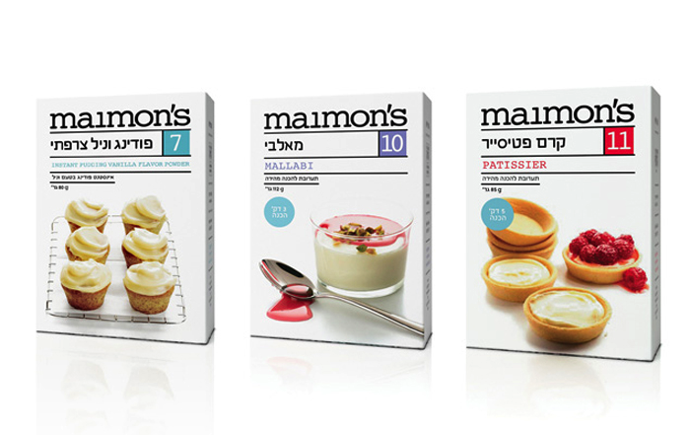
Maimon’s Baking Products Notice the pictures of the products on the packages. What advantage to they provide the product producer?

Slide 18
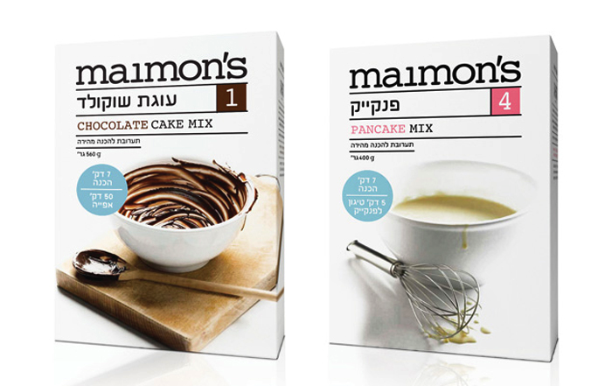
Maimon’s Baking Products
What does these pictures on these packages do for the product?
How are they different from the last slide?

Slide 19
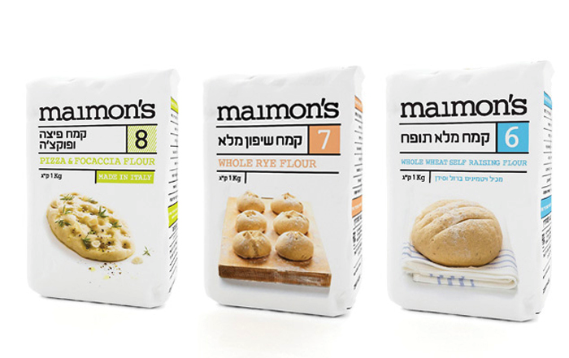
Maimon’s Baking Products

Slide 20
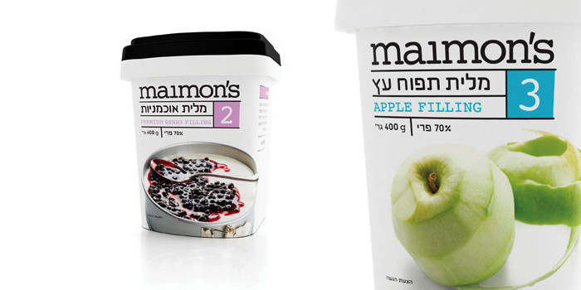
Maimon’s Baking Products

Slide 21
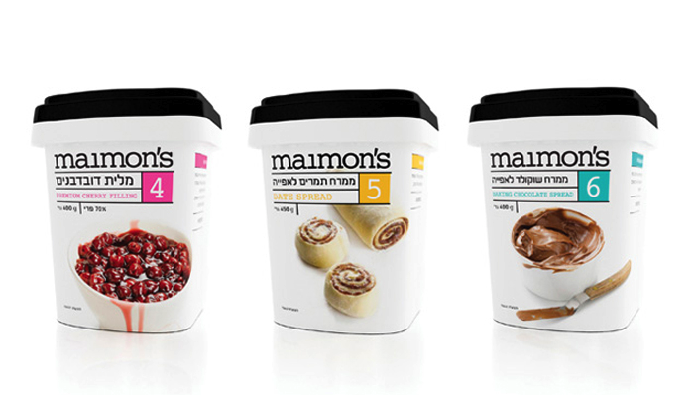
Maimon’s Baking Products

Slide 22
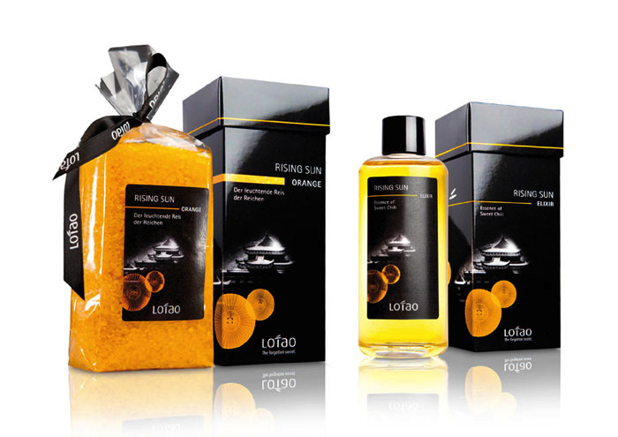
Oriental Rice Flavors

Slide 23
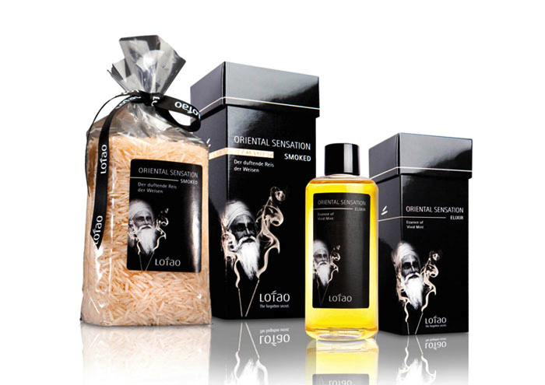
Oriental Rice Flavors

Slide 24
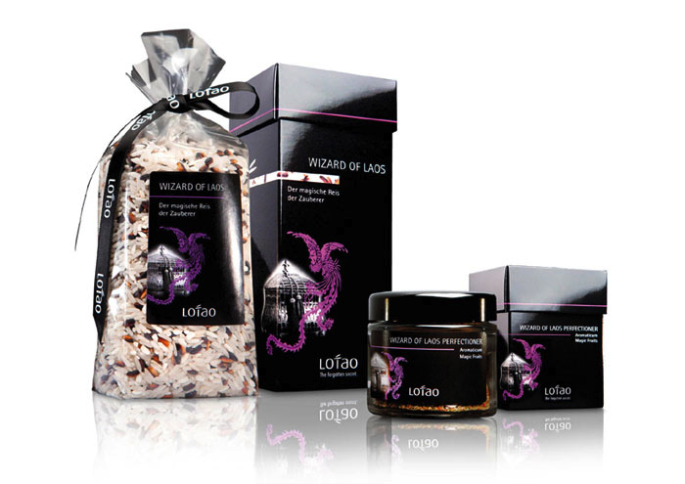
Oriental Rice Flavors

Slide 25
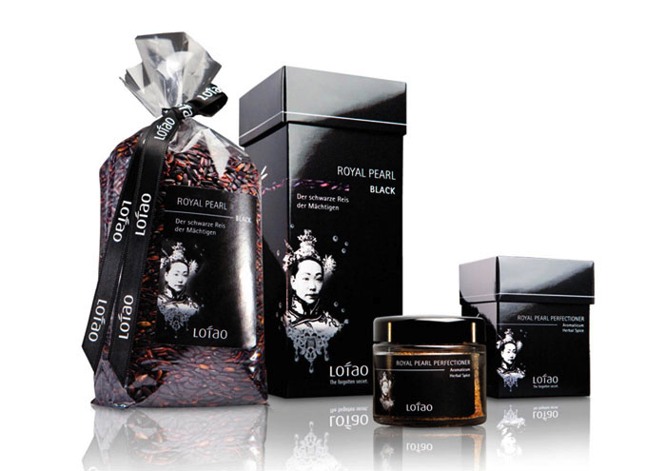
Oriental Rice Flavors

Slide 26
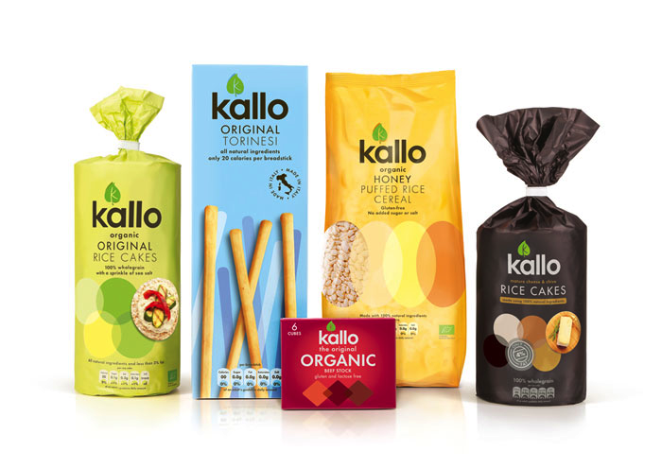
Variety of Products from Kallo

Slide 27
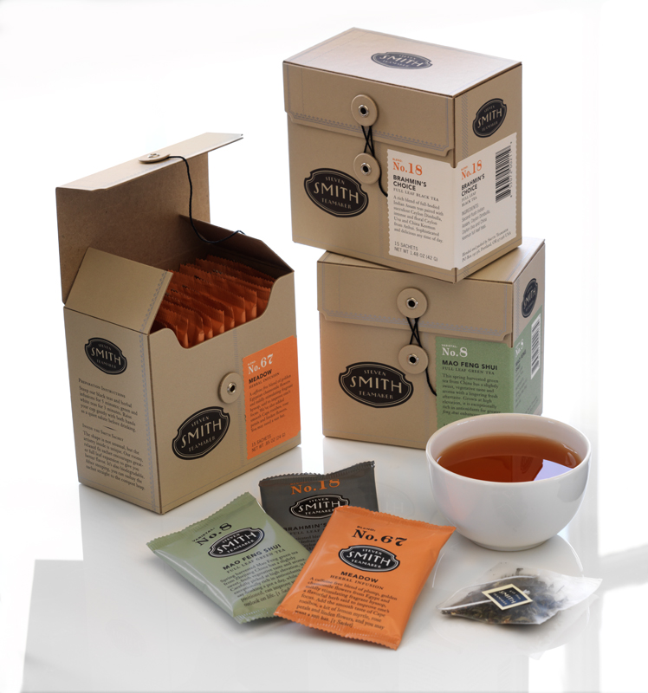
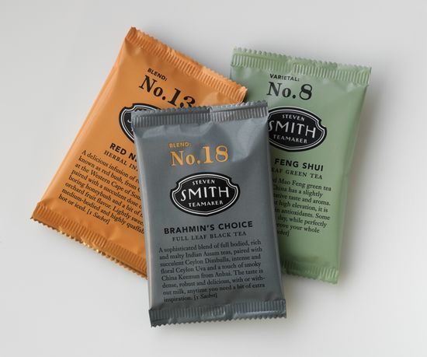
Tea Bags and Boxes
What do you think the material used for the boxes and colors of the tea packs suggest to the buyer?

Slide 28
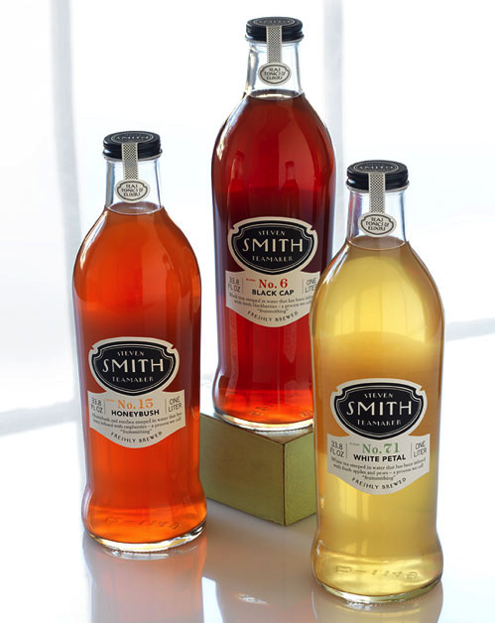
Bottled Tea Drinks
What does the labels on these bottles have in
common with the bags besides their label?

Slide 29
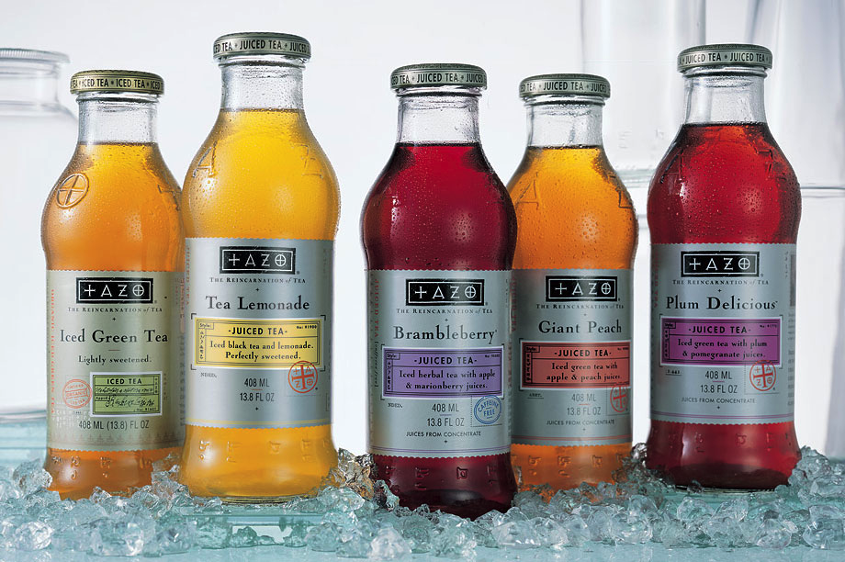
TAZO Ice Bottled Tea Beverages
How are these similar to the Smith brand’s labeling?
Why do you think they are similar?

Slide 30
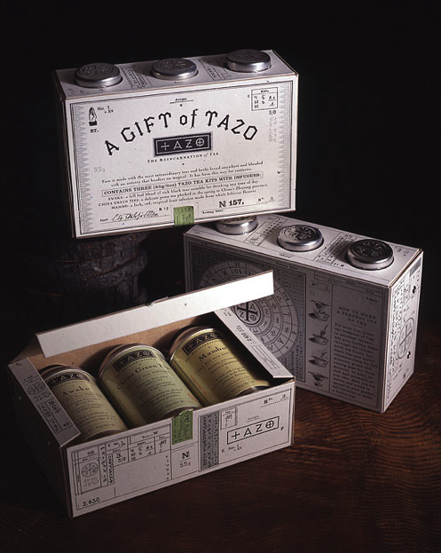
Tea Boxed Multipacks

Slide 31
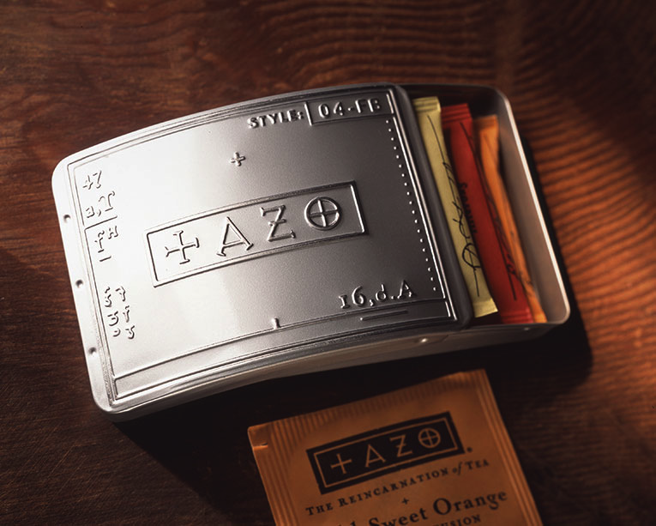
Tea Bag Container

Slide 32
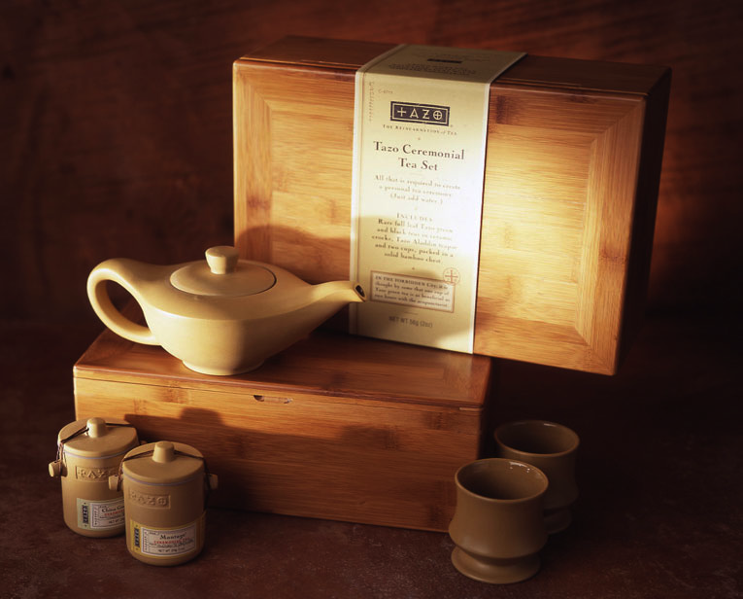
Tea Sold in Special Gift Boxes

Slide 33
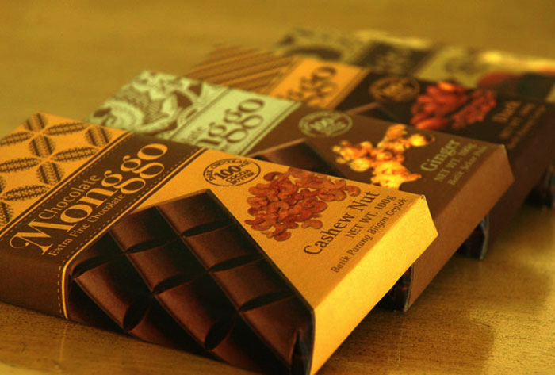
Monggo Chocolate Candies

Slide 34
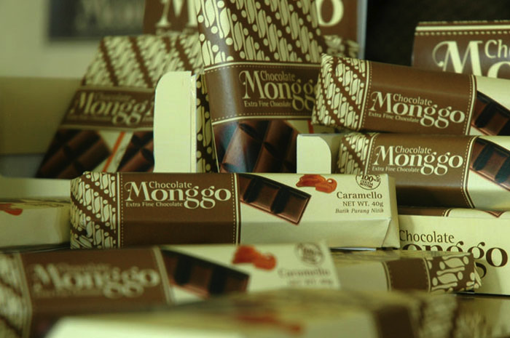
Monggo Chocolate Candy—Caramello

Slide 35
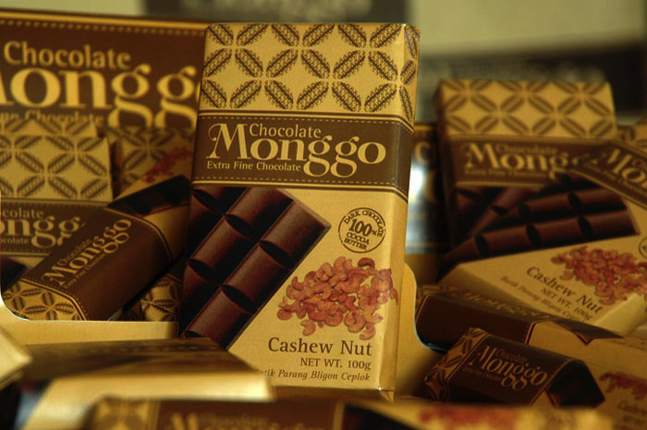
Chocolate Candy—Cashew Nut

Slide 36
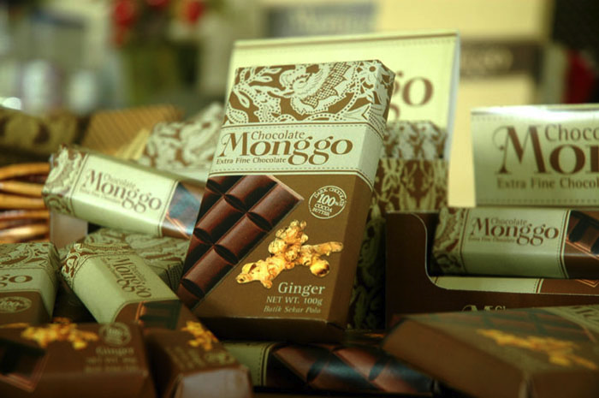
Monggo Chocolate Candy—Ginger

Slide 37
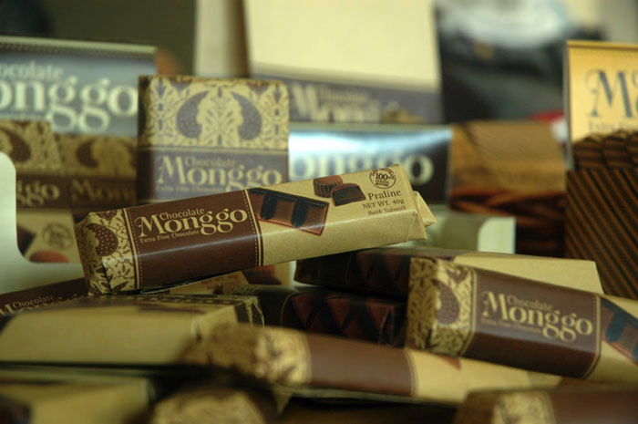
Monggo Chocolate Candy—Praline

Slide 38
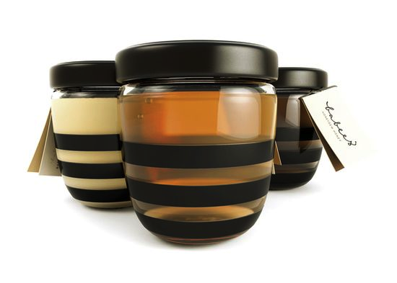
Different takes on Honey Containers

Slide 39
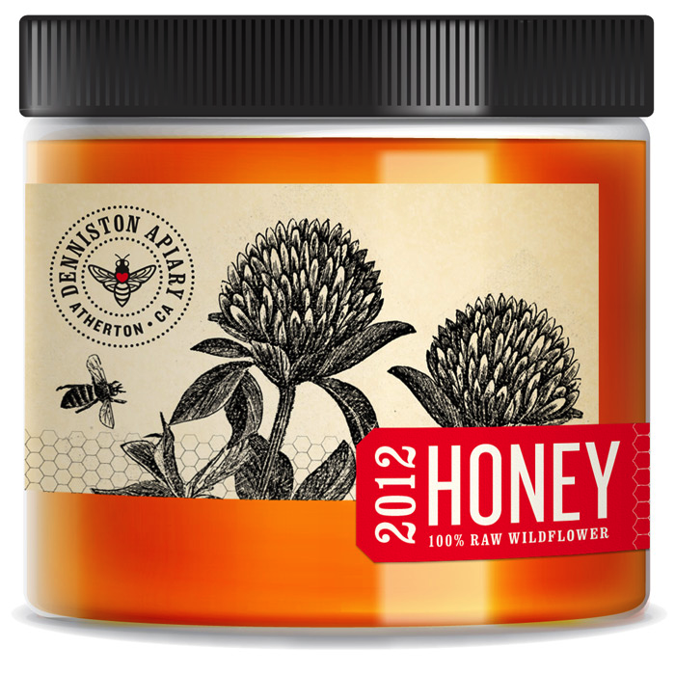
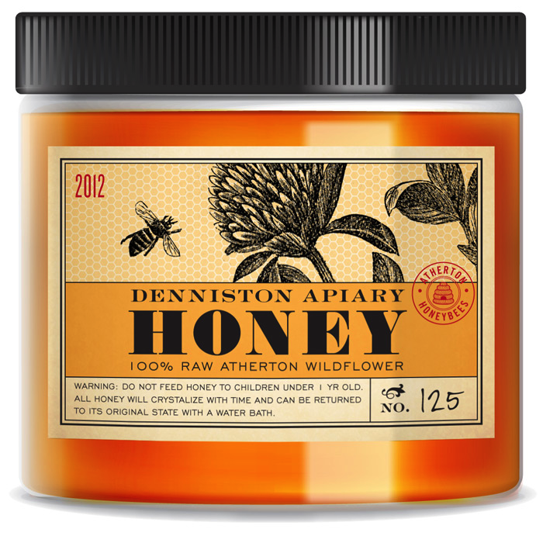
Honey Containers: Continued

Slide 40
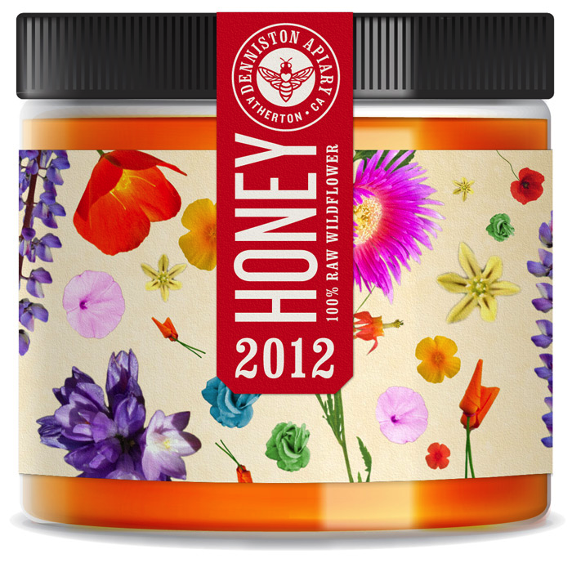
Honey Containers: Continued

Slide 41
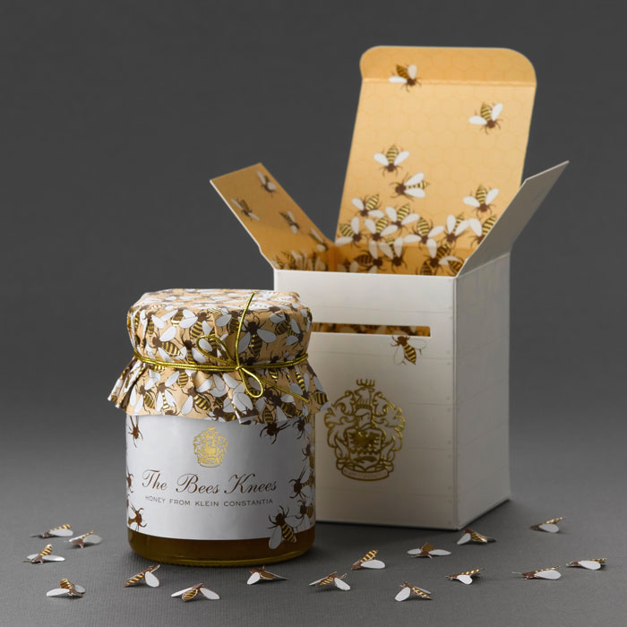
Honey Containers: Continued

Slide 42
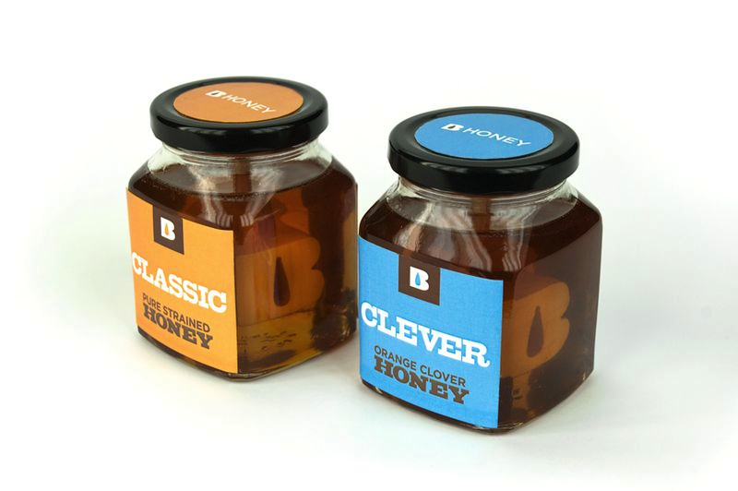
Honey Containers: Continued

Slide 43
Honey Containers: Different Takes
What do the various containers use as their focus?
What mood do the different bottles provide?
Which would you expect cost the most to produce?
Which one evokes the image of honey?

Slide 44
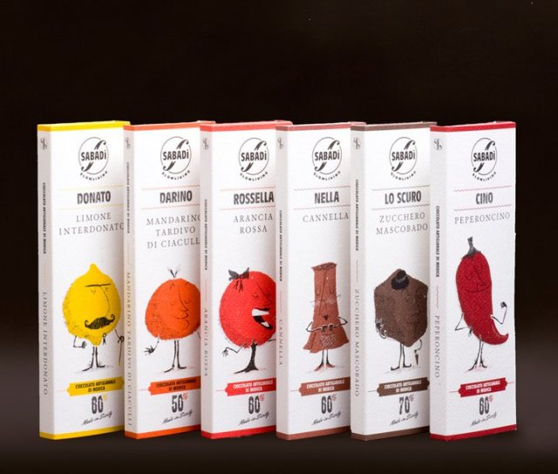
Individual Chocolate Bars

Slide 45
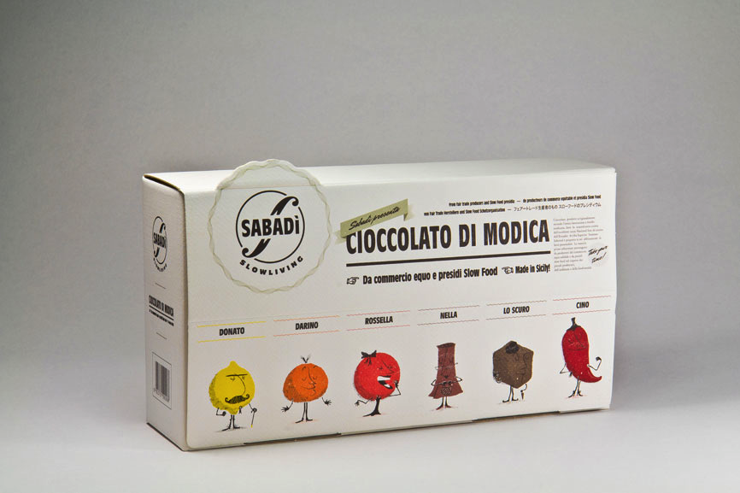
Chocolate Display Box

Slide 46
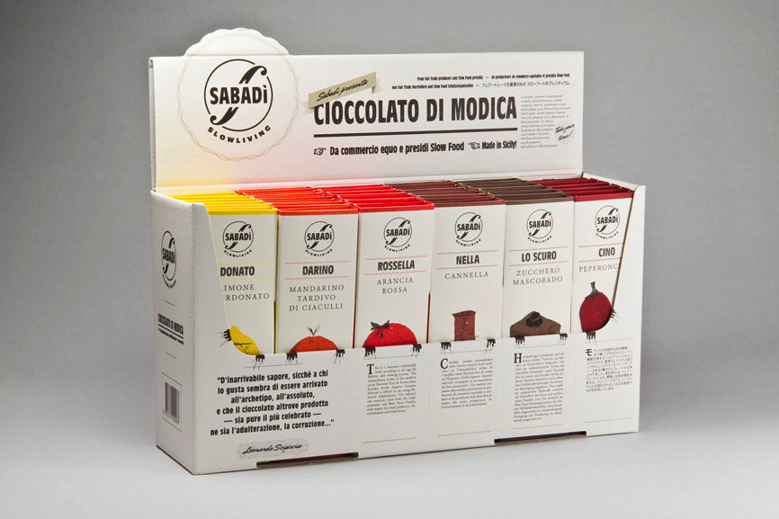
Chocolate Display Box

Slide 47
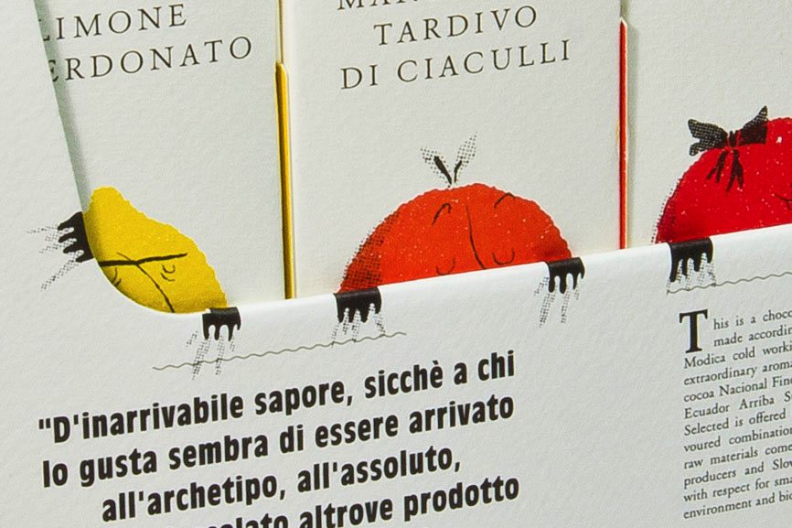
Close-up of Chocolate Display Box

Slide 48
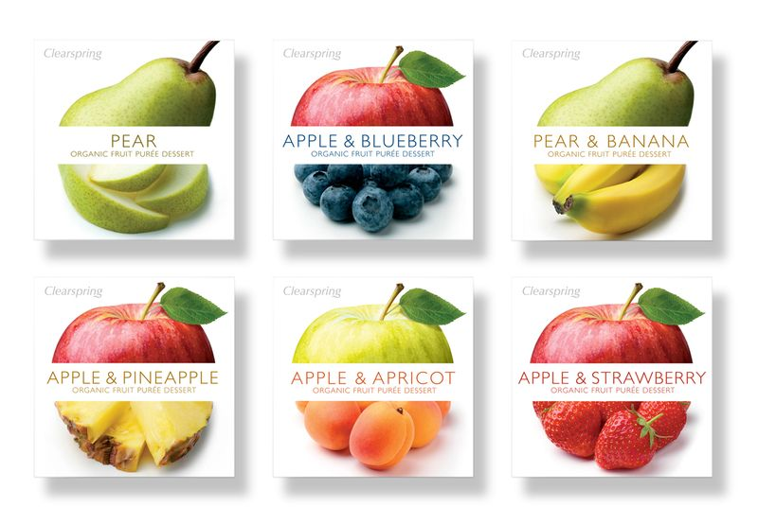
Combining Different Images on a Label What is the settle image suggested here?

Slide 49
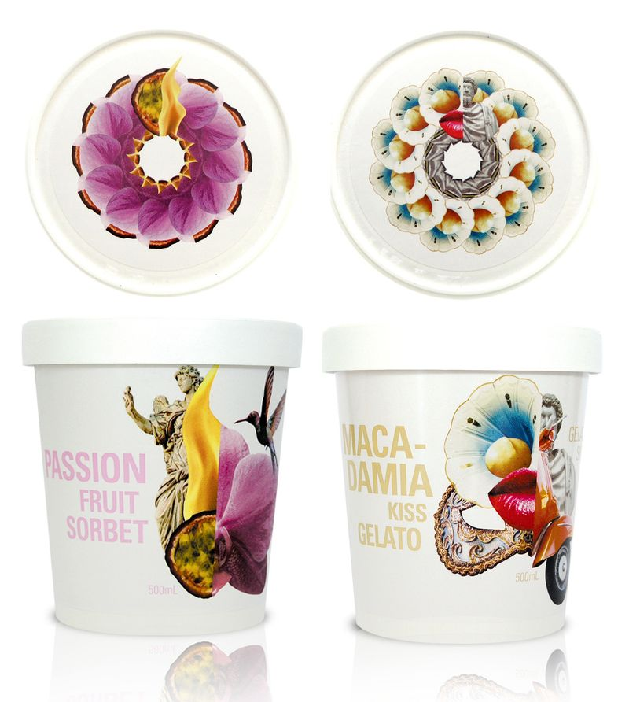
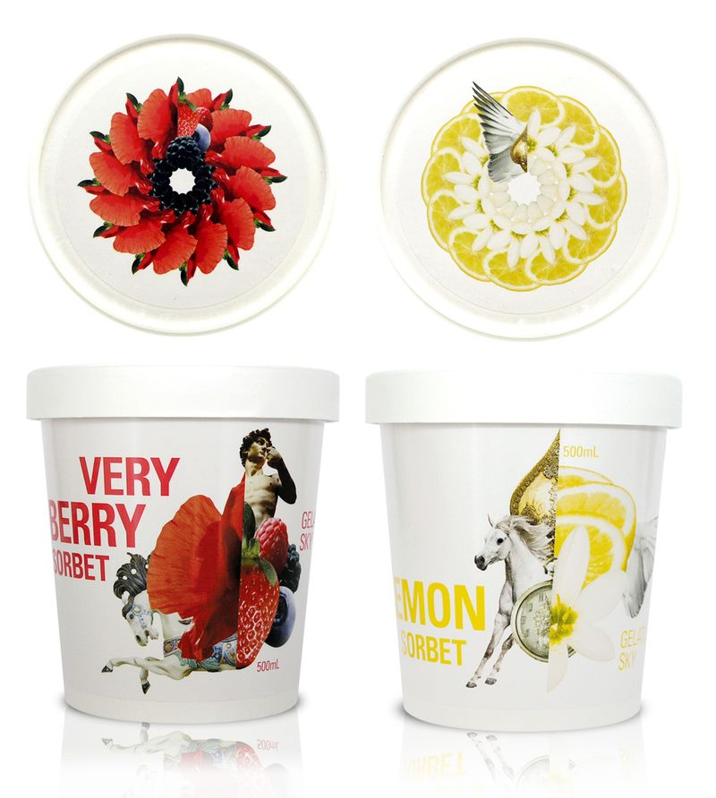
Sorbet Containers With a Twist

Slide 50
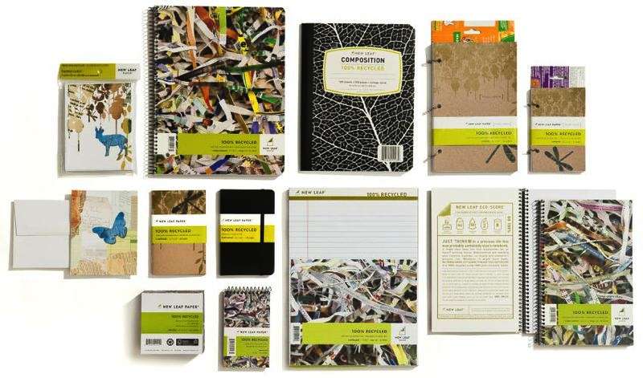
School Supply Line

Slide 51
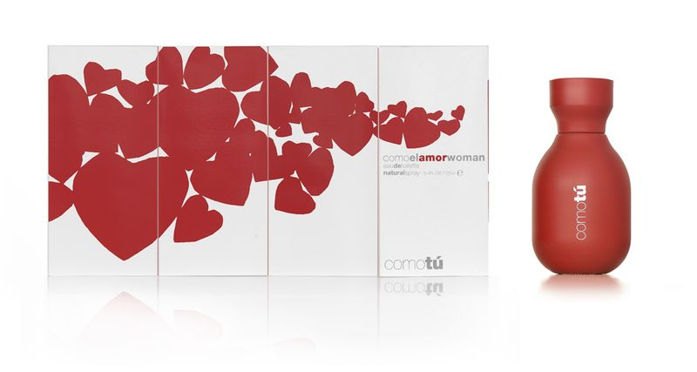
Unified Design for Perfume Container, Box, and Bag

Slide 52
Wrap-Around Label
If this label was to be a continuous design, how would it need to be changed?

Slide 53
What does this company wants their image to be?

Slide 54
What does this company wants their image to be? Who are they appealing to?

