Slide 1
Introduction to vector graphics
Emily Scoggins
Wakefield High School
Raleigh, NC

Slide 2
2 Types of Graphics
Vector
Bitmap

Slide 3
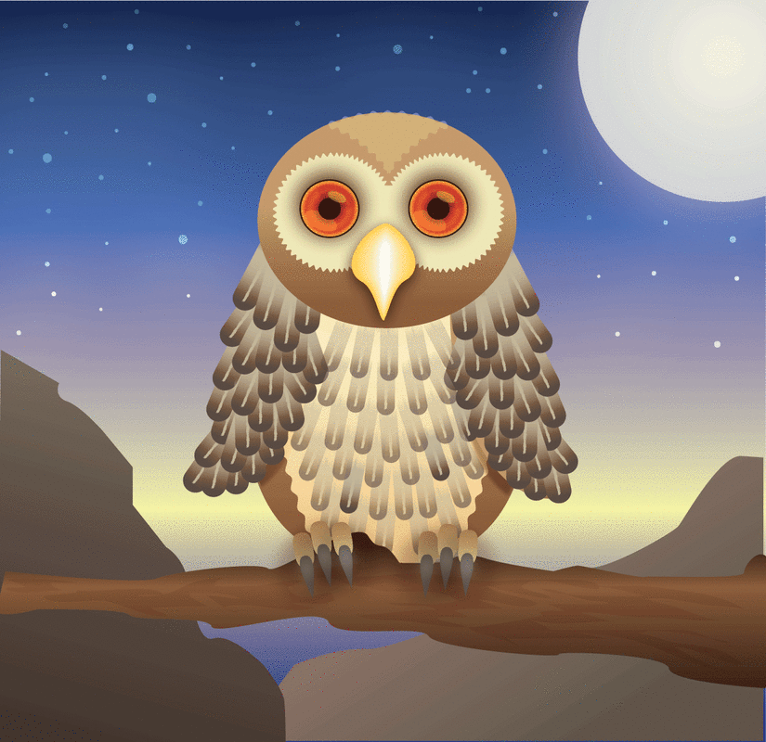
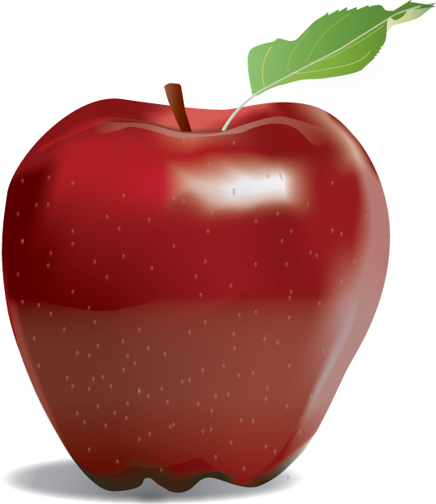
Examples of vector art

Slide 4
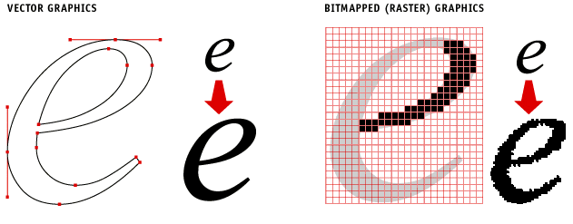
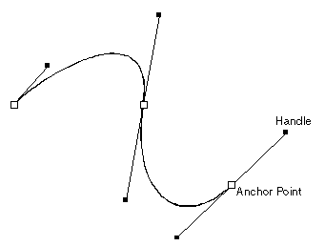
Vector Graphics
Vector graphics are created from mathematical formulas used to define lines, shapes, and curves
Best for Large Scale printing
Edited in Drawing programs
ex. Adobe Illustrator or CorelDraw
Shapes can be edited by moving points called nodes or drawing points

Slide 5
Uses of vector graphics
Logos
Icons
Web Graphics
Print Projects
Cartoons/Clip Art
Fonts

Slide 6
Why Use Vector graphics?
Small File Size
Easily transferred via the internet
Resolution Independent
No matter how much you scale a vector graphic up or down, the quality of your graphic stays clear and sharp

Slide 7
Disadvantages of vector
Not good for Photographic images
Lower color quality that raster images
Don’t support as many colors

Slide 8
Vector file formats
.AI – Adobe Illustrator
Industry standard file type used to develop vector graphics, contains layers
EPS – Encapsulated Postscript
Vector graphic format that can be opened by any computer running different software and/or versions
Can be edited
Preferred format for logos and illustrations

