Slide 1
Introduction to Illustrator
Michael Poller and Emily Scales

Slide 2
Vector Graphics
Intro to Illustrator

Slide 3
2 Types of Graphics
Vector
Bitmap

Slide 4
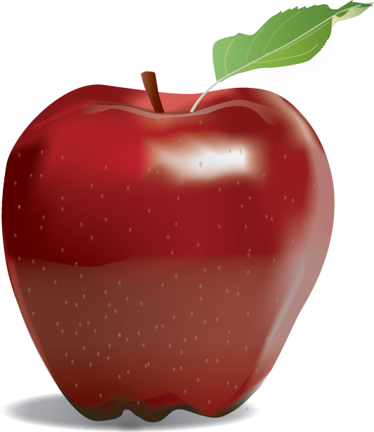
Examples of vector art

Slide 5
Vector Graphics
Vector graphics are created from mathematical formulas used to define lines, shapes, and curves
Best for Large Scale printing
Can be scaled infinitely, without any loss of quality or fidelity.
Watch this video:
https://helpx.adobe.com/illustrator/how-to/what-is-illustrator.html?set=illustrator--get-started-

Slide 6
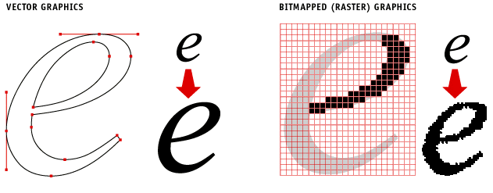
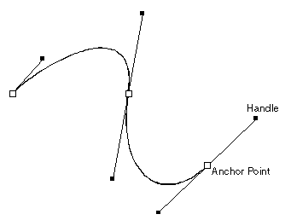
Vector Graphics
Edited in Drawing programs
ex. Adobe Illustrator or CorelDraw
Shapes can be edited by moving points called nodes or drawing points

Slide 7
Uses of vector graphics
Logos
Icons
Web Graphics
Print Projects
Cartoons/Clip Art
Fonts

Slide 8
Why Use Vector graphics?
Small File Size
Easily transferred via the internet
Resolution Independent
No matter how much you scale a vector graphic up or down, the quality of your graphic stays clear and sharp

Slide 9
Disadvantages of vector
Not good for Photographic images
Lower color quality that raster images
Don’t support as many colors

Slide 10
Vector file formats
.AI – Adobe Illustrator
Industry standard file type used to develop vector graphics, contains layers
EPS – Encapsulated Postscript
Vector graphic format that can be opened by any computer running different software and/or versions
Can be edited
Preferred format for logos and illustrations

Slide 11
Vector file formats
.PDF – Portable Document Format
All computers can open this file type while mainlining the vector imaging
.SVG – Scalable Vector Graphic
Vector graphic format that can be opened by any computer running different software and/or versions
For 2D graphics

Slide 12
The Interface
Adobe Illustrator

Slide 13
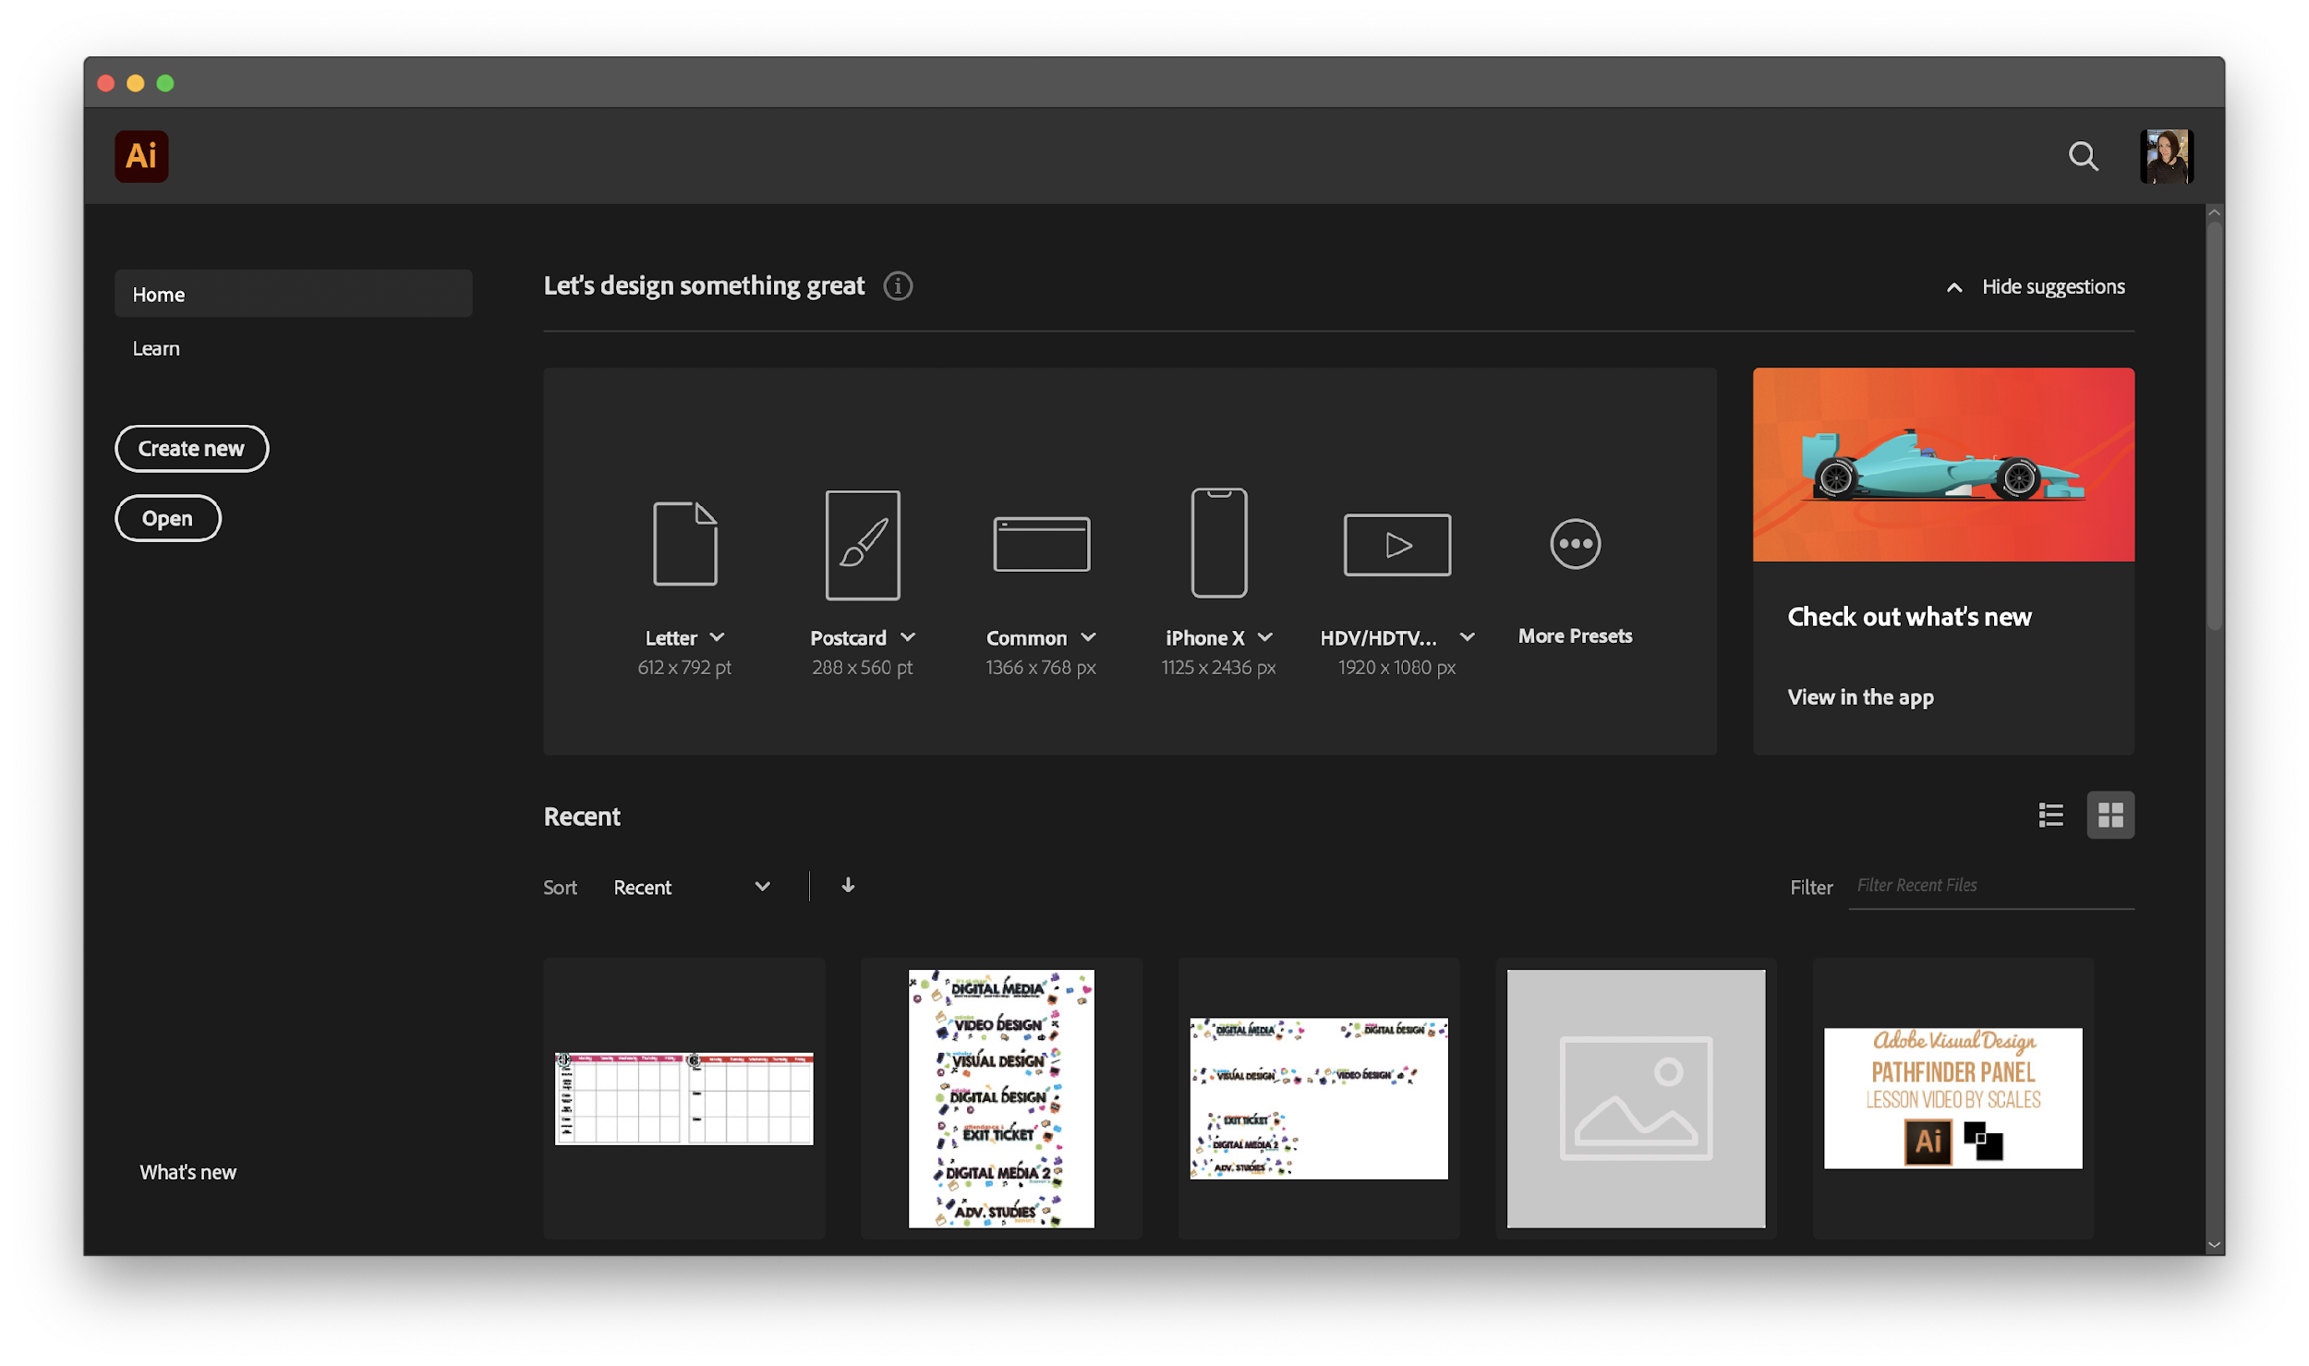
The Home Screen
Create a New Document: There are two ways to create a new document. 1.) Click “Create New” after the program loads. 2.) File > New (using the menu bar at the top of your screen)
Open a File: There are two ways to open a file. 1.) Click “Open…” after the program loads. 2.) File > Open (using the menu bar at the top of your screen)
Recent: Displays your recent images and projects as tiles in a grid format. The tiles show a preview of what the project looks like.

Slide 14
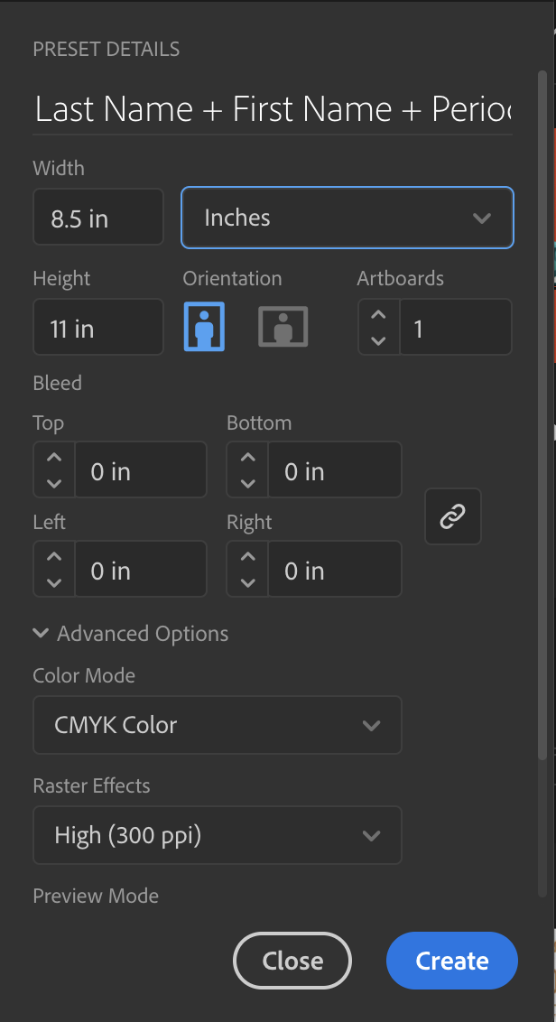
Creating a New Document
Project Name
The title of your project. When you save, it will default to the Project name and add the proper file extension to it.
Image Size
Determines the size and resolution of your artboard. You can change units of measure (i.e. pixels, inches, picas, etc.) in the drop down to the right.
Orientation
Portrait is when the image is taller than it is wide. Landscape is when the image is wider than it is tall.
Bleed
Bleed is the amount of artwork that falls outside the printing area or artboard and will display when printed.
Color Mode
Limits the amount of colors available to match the output settings of your project. For instance, RGB color is meant for screens; whereas CMYK is meant for printers.
Raster Effects
The resolution your art will be created in. This can be adjusted to High, Medium, Low, and for Complex Art

Slide 15
Illustrator Layout:
A. Control panel
displays options for the currently selected tool.
B. Menu Bar
gives you access to a wide range of functions and extra commands.
C. Collapsed Panel Bar
a series of useful panels which provide extra functionality and give you quick access to many tools that make modifying artwork easier.
D. Toolbar
contains tools for creating and editing images, artwork, page elements, and so on. Related tools are grouped.
E. Document Window
displays the file you’re working on. Document windows can be tabbed and, in certain cases, grouped and docked.
F. Artboard
where you design your art, artboards can be adjusted, and you can have multiple artboards.
G. Properties panel
this will change based on the tool you are using and give you a variety of useful options and commands.
B
c
A
G
D
E
F

Slide 16
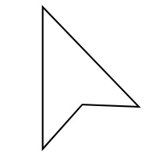
The Toolbar
Illustrator has a lot of tools that you can use. These tools can be accessed through the “Tool Bar” [usually found on the left]. If you do not see the toolbar, you can load it by going to Window > Tools at the menu bar on the top of your screen.
Tools are grouped together with similar function. If you click and hold the icon on the toolbar, a dropdown will appear with other possible tools. You can also access these tools using keyboard commands (by holding “Shift” + [the proper keyboard letter]. By doing so it will toggle between all of the tools in that category. The default tools are defined in the next page.
Each tool changes the “Control” panel options (located above your “Document Window”). You can also see a change in the cursor icon to let you know what tool is being used [as well as the cursors size & shape}
You can add or remove tools as needed by clicking on the 3 dots at the bottom of the tool bar.
Cursor examples:
Selection Tool
Direct Selection Tool

Slide 17
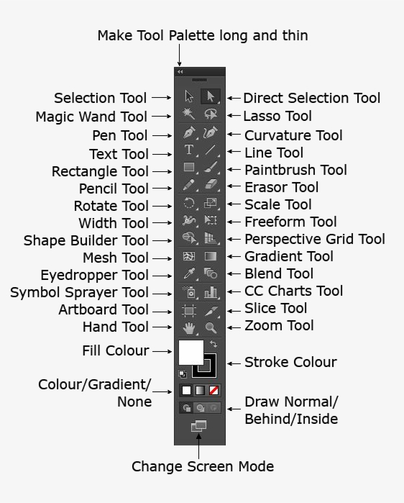
The Tools Panel
Tools grouped and hidden similar to Photoshop.
Note new Illustrator tools.

Slide 18
Non-Printing Design Options
Rulers help you accurately place and measure objects in an document.
Grid appears behind your artwork and helps you align items on the canvas.
Guides help you align text and graphic objects. You can create vertical or horizontal ruler guides.
Smart Guides are temporary snap-to guides that appear when you move objects. They help you align, edit, and transform objects relative to other objects.

Slide 19
Artboards
Artboards represent the regions that can contain printable artwork. Learn more here.
Can have 1 to 100 artboards per document depending on size.
You can create artboards in different sizes and resize them by using the Artboard tool.
Options to reorder and rearrange artboards are in the Artboards panel.

Slide 20
Hands on Learning
Adobe Illustrator

Slide 21
Let’s start here…
Go to the CTE Summer Conference site or whsdigitalmedia.weebly.com/forteachers and download the the CTE Summer Intro to Illustrator.Ai File. This presentation is also available!
This is a multi page worksheet that will open in Adobe Illustrator and includes directions.

Slide 22
The Pen Tool
The Pen Tool (P) is a foundation to using Adobe Illustrator!
For this worksheet, you will learn how to make straight lines and curves! Blue dots are for single clicks, Red dots are the place you pull a handle too, and the Green dots are where you adjust a handle too.
Anchor Point: the points in which let you manage the direction and curve of a path
Handles: allows you to adjust the direction and depth of a curve on an anchor point
Open Path: creates a line
Closed Paths: you return to the starting point to create a shape
Direct Select Tool (A): allows you to adjust a single anchor point
Anchor Point Tool (Shift + C): allows you change an anchor point to a smooth or corner point

Slide 23
The Curvature Pen Tool
The Curvature Pen Tool (Shift + `) allows you to draw curved and straight lines very quickly, one you get some practice with this tool you will fly through creating complex shapes!
In this worksheet you will use anchor point and handles to create open and closed Paths to practice using this tool.
When you start with this tool it will automatically make smooth points, to adjust a point to a corner point, you will simply double click that point. You can do this as you draw or go back!
Smooth Point: a round or soft curved point
Corner Point: a point that comes to a sharp angle

Slide 24
The Shapes Tools
While you can use the Pen Tools to create shapes, Illustrator has plenty of tools to help you do this easily! This worksheet will help you practice how to create a variety of shapes and adjust them to create more complex objects!
Rectangle Tool (M): create squares and rectangles
Rounded Rectangle Tool: creates rounded squares and rectangles
Ellipse Tool (L): creates circles and ovals
Polygon Tool: creates multi sided shapes (click once to open dialogue box to change number of sides)
Star Tool: create multi point star shapes (click once to open dialogue box to change number of points)
Flare Tool: creates unique light flare shape

Slide 25
Pathfinder & Align Panels
Now that you have learned to create simple shapes, we can use these to make more and more complex shapes. We will start by aligning the objects first and then use the pathfinder to create our new objects!
Align Panel: allows you to arrange 2 or more objects either left, right, or centered
Pathfinder Panel: allows you to combine paths, divide objects and subtract shapes

Slide 26
EXTRA! Shape Builder Tool
The Shape Builder (Shift + M) allows you to combine and remove parts of objects very quickly and easily!
Scribble Actions: while holding your mouse down and “scribbling” objects you can merge objects or remove objects
Option Key: allows you to switch to negative

