Slide 2
As you watch the behind the scenes video, make sure to check out the job titles of the people talking

Slide 4
Working in the Television Production Industry

Slide 5
We have instant access to tv and video every day of our lives.
But do you know the amount of work and people that goes into that one video you watch?

Slide 6
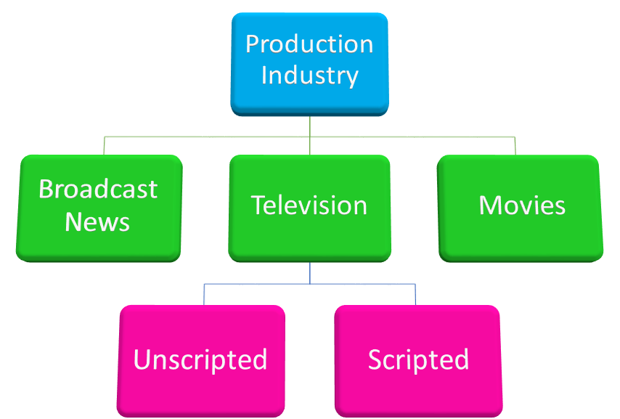
Three Main Sections

Slide 7
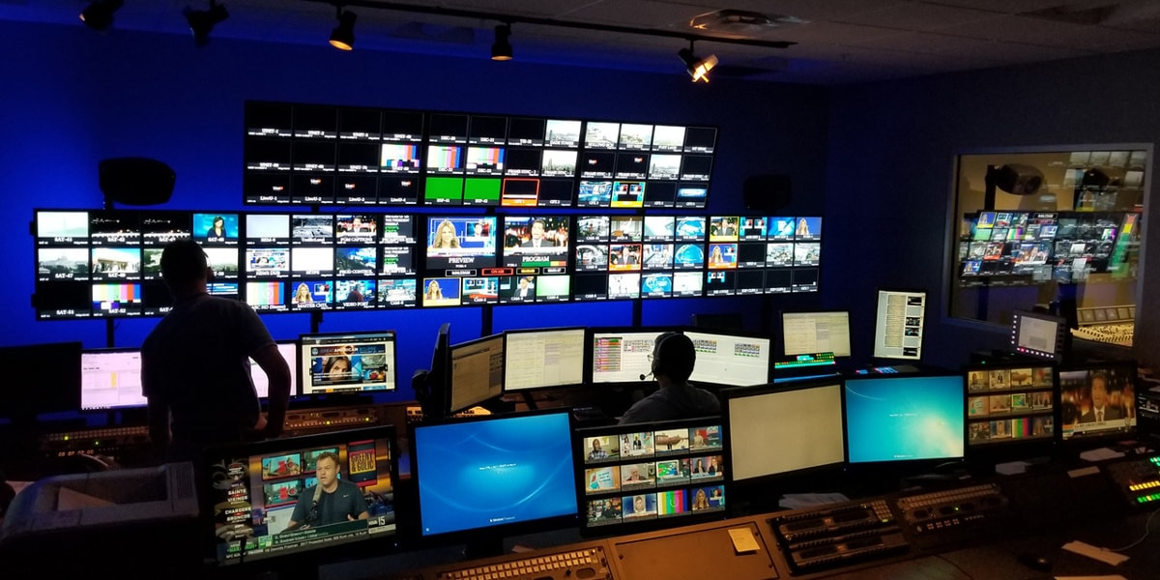
Broadcast News….
What does that mean?
Broadcasting is the distribution of audio or video content to an audience via any electronic mass communications medium. Broadcast news is news events that are shared through TV, radio or cable. Everything runs through a newsroom.
A newsroom is the central place where journalists—reporters, editors, and producers, associative producers, news anchors, associate editor, and other staff members—work to gather news.

Slide 8
How do scripted shows and film get made?

Slide 9
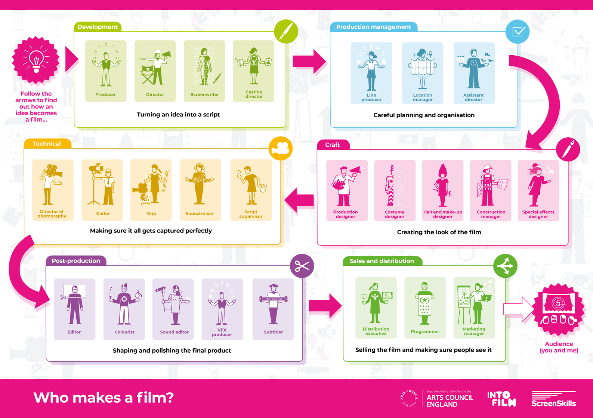

Slide 10
Let’s take a look at how many people are needed to film 1 day on the small tv show Pontoon Payday.
Reminder: This show was just a host on a boat that would drive up to find contestants.

Slide 11
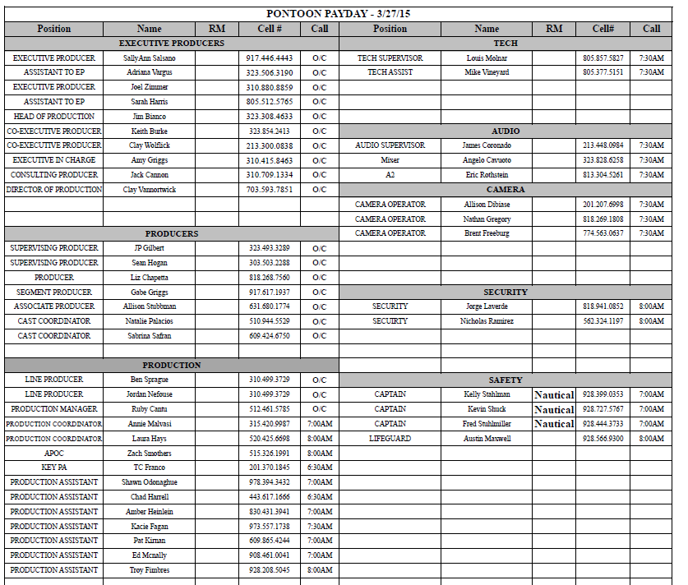

Slide 12
Now let’s take a look at the call sheet for 1 day on the movie Safe Haven

Slide 13
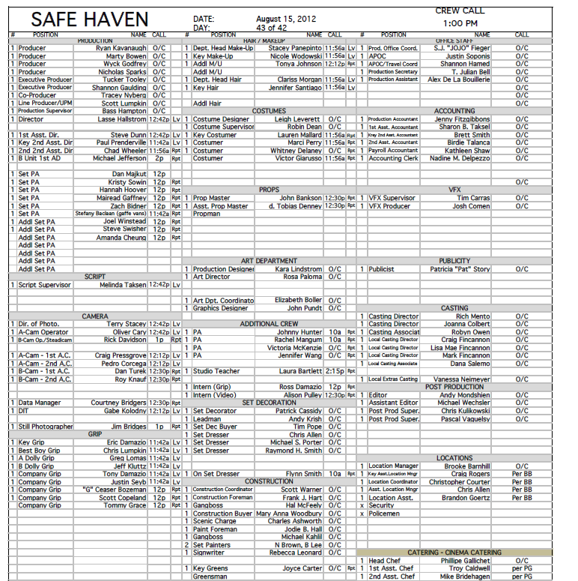

Slide 14
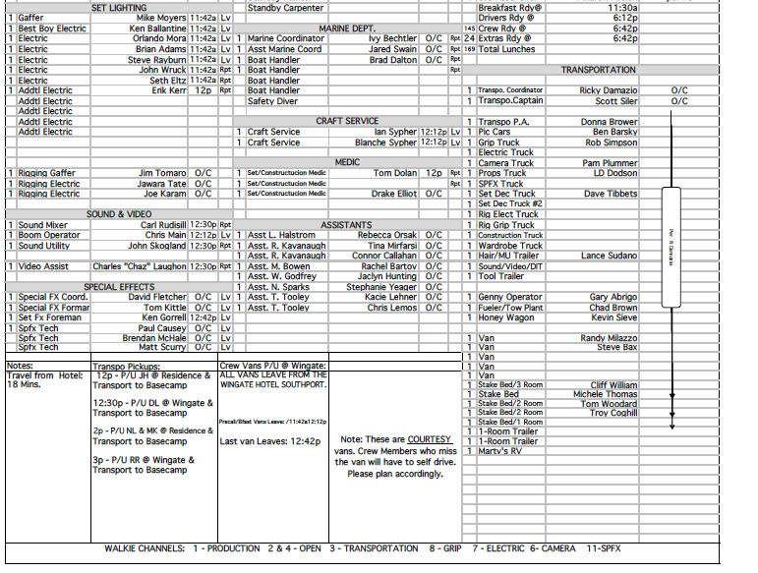

Slide 15
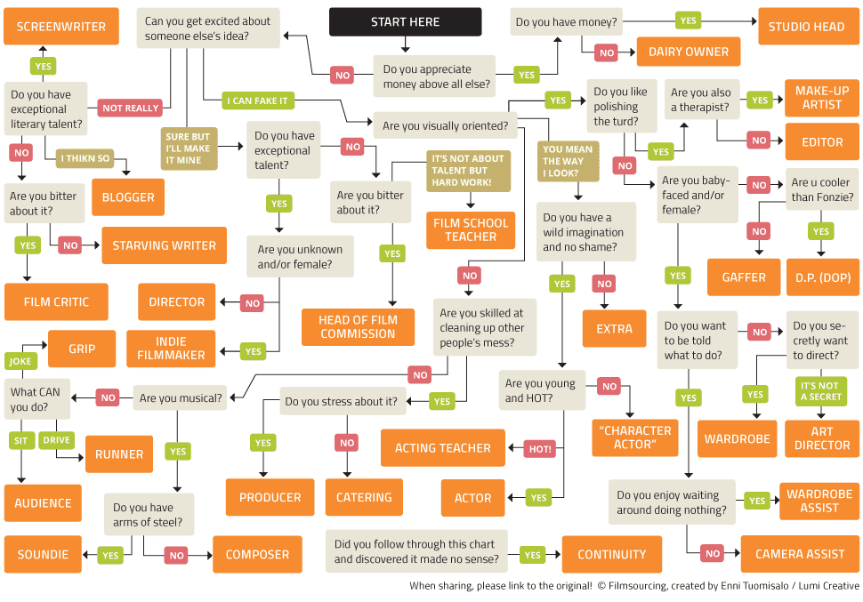
ANY OTHER JOB

Slide 16
Production Staff
Staff
Behind the scenes
Creative, department heads
Crew
Equipment operators
Not seen on camera
Talent or Cast
Anyone seen by camera
Anyone whose voice is heard on program

Slide 17
Networking
Most common way of getting job in industry
Tell professional friends you are looking
They tell their friends, who tell their friends, etc.
Eventually, someone hears of opening
Word comes back to you through network
You apply for the job

Slide 18
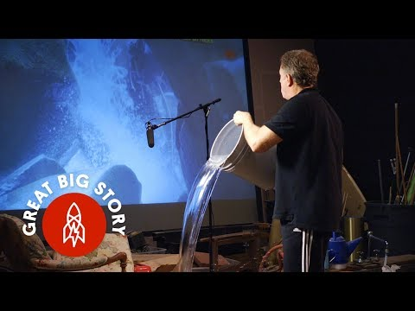

Slide 19
Small Group Activity
Millions of jobs are created with each movie, tv show and news show you have ever watched.
You are going to break into 3 small groups and research the jobs defined under you area.
Then you will create a tree map of the jobs you researched. Who is at the top of the food chain and who is just starting out? Break up the work amongst your group members.

Slide 20
You need to find out:
What does a person do in that position
How much the position makes
What experience is needed to get to that position
You can include pictures and videos.
This should take 30 mins. Then the last 25 mins of class, each group will present their findings on their section of the industry.

