Slide 1
History of Social Media
Adobe Digital Design
Ms. Scales

Slide 2
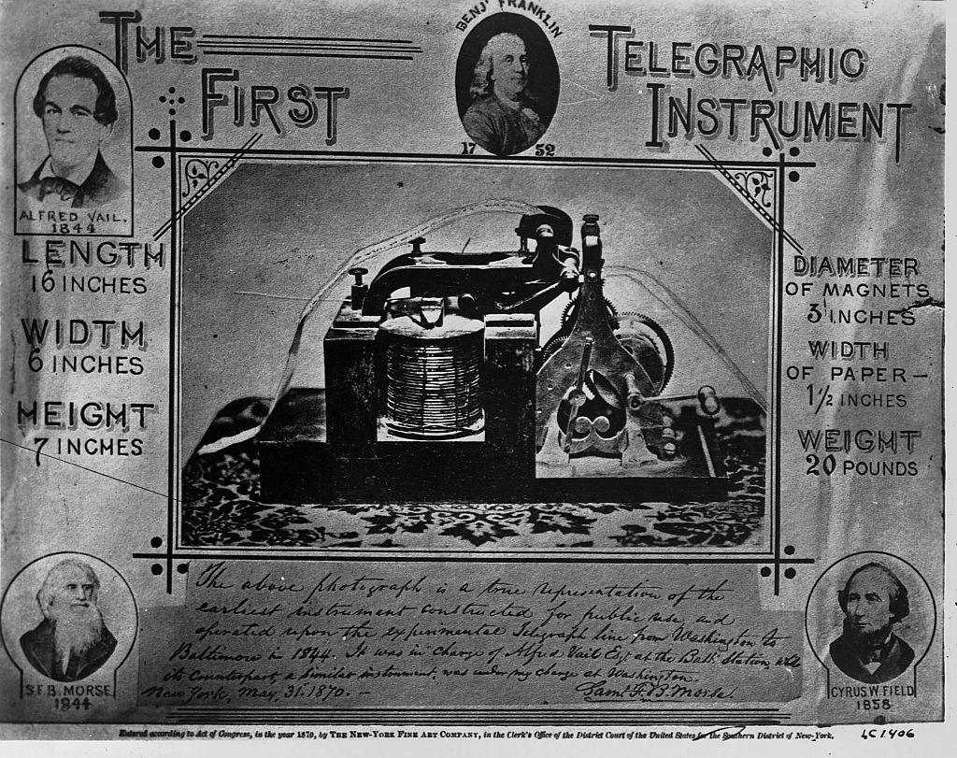
Before the Internet…
In a sense, social media began on May 24, 1844, with a series of electronic dots and dashes tapped out by hand on a Telegraph Machine.
The first electronic message from Baltimore to Washington, D.C., proved Samuel Morse understood the historic ramifications of his scientific achievement: “What hath God wrought?” he wrote.

Slide 3
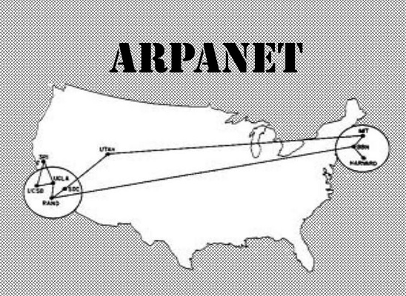
Before the Internet…
While the roots of digital communication run deep, most contemporary accounts of the modern origins of today’s internet and social media point to the emergence in 1969 of the Advanced Research Projects Agency Network — the ARPANET.
This early digital network, created by the United States Department of Defense, allowed scientists at four interconnected universities to share software, hardware, and other data.

Slide 4
Before the Internet…
In 1987, the direct precursor to today’s internet came into being when the National Science Foundation launched a more robust, nationwide digital network known as the NSFNET. A decade later, in 1997, the first true social media platform was launched.

Slide 5
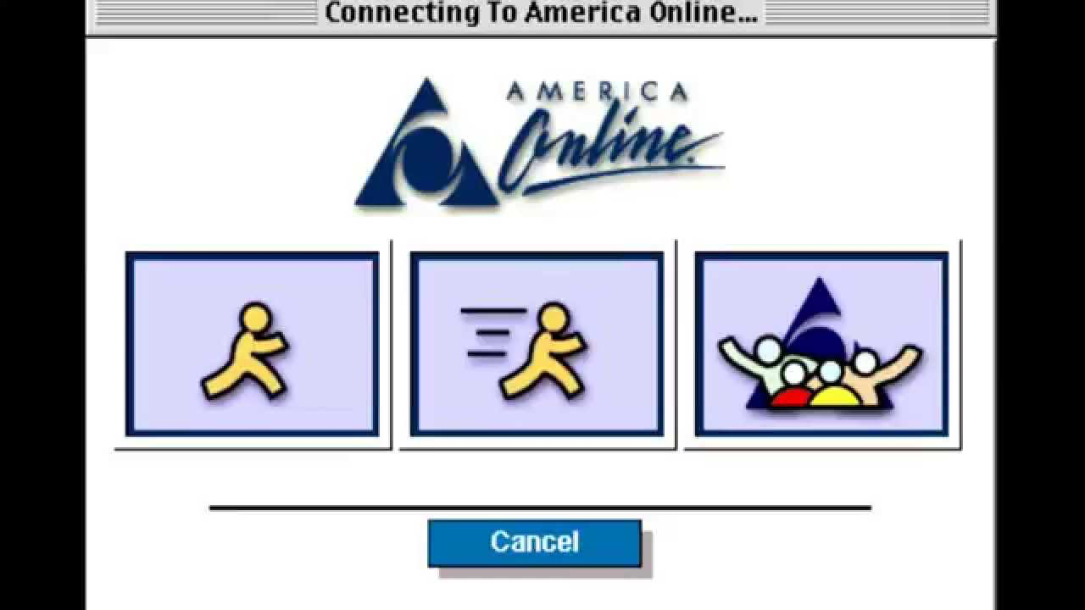
The Launch of Social Sites
In the 1980s and ’90s, the internet’s growth enabled the introduction of online communication services such as CompuServe, America Online, and Prodigy. They introduced users to digital communication through email, bulletin board messaging, and real-time online chatting.

Slide 6
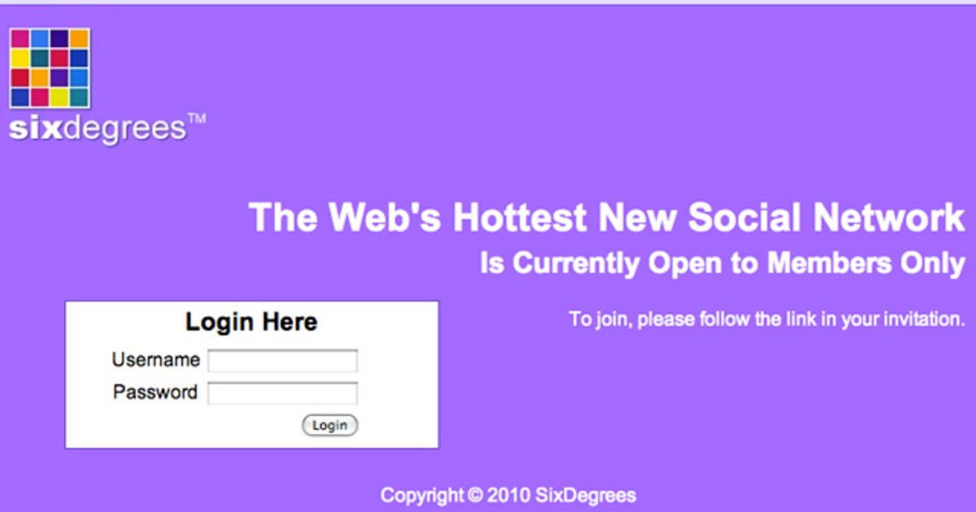
Six Degrees
This gave rise to the earliest social media networks, beginning with the short-lived Six Degrees profile uploading service in 1997.

Slide 7
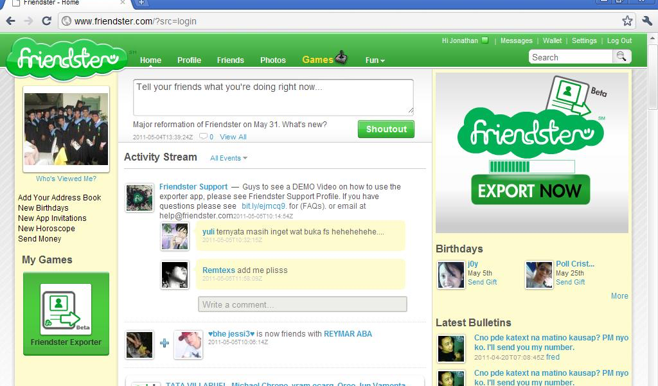
Friendster
This service was followed in 2001 by Friendster. These rudimentary platforms attracted millions of users and enabled email address registration and basic online networking.

Slide 8
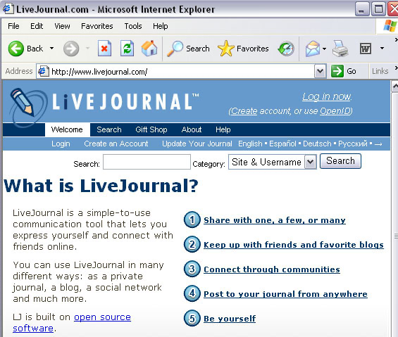
Blogs
Weblogs, or blogs, another early form of digital social communication, began to gain popularity with the 1999 launch of the LiveJournal publishing site. This coincided with the launch of the Blogger publishing platform by the tech company Pyra Labs, which was purchased by Google in 2003.

Slide 9
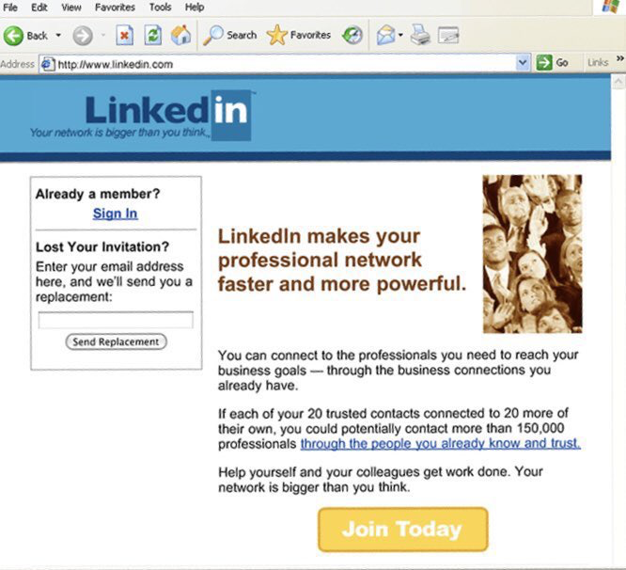
LinkedIn
In 2002, LinkedIn was founded as a networking site for career-minded professionals. By 2020, it had grown to more than 675 million users worldwide. It remains the social media site of choice for job seekers as well as human resources managers searching for qualified candidates.

Slide 10
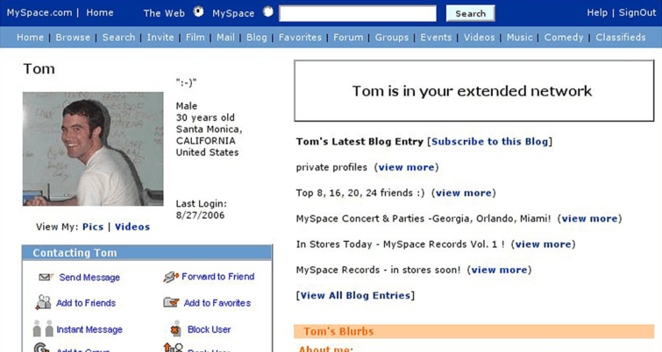
Myspace
In 2003, Myspace launched. By 2006, it was the most visited website on the planet, spurred by users’ ability to share new music directly on their profile pages.
By 2008, it was eclipsed by Facebook. In 2011, Myspace was purchased by musician Justin Timberlake for $35 million, but it has since become a social media afterthought.

Slide 11
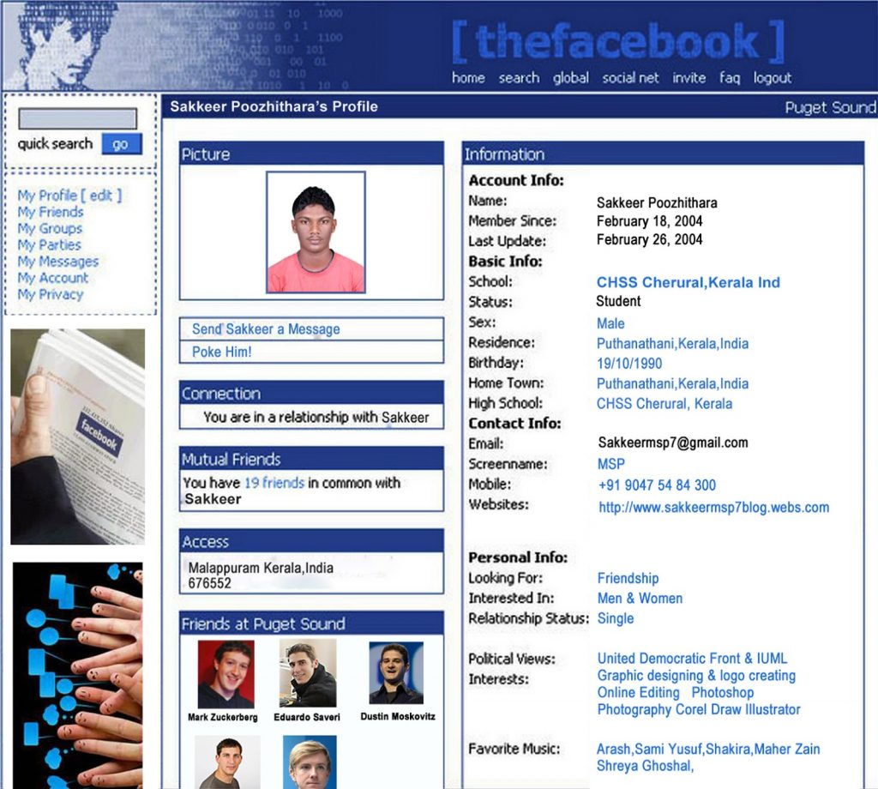
Facebook
Launched in 2004 by Harvard student Mark Zuckerberg, it has nearly 1.7 billion users — including 69% of U.S. adults, according to Pew Research.

Slide 12
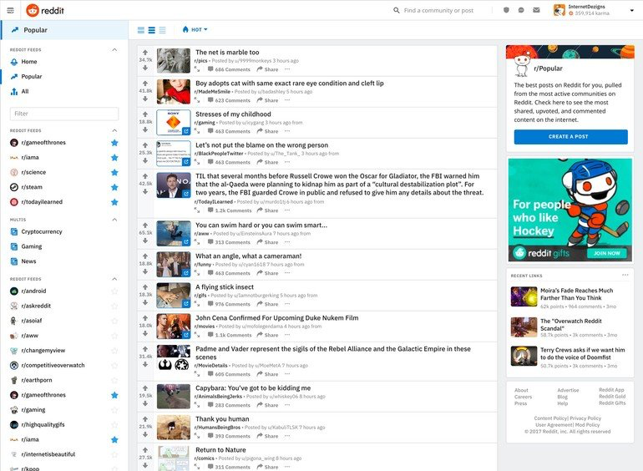
Reddit
Launched in 2005 by Massachusetts 20-somethings Steve Huffman and Alexis Ohanian as a news-sharing platform, its 300 million users have transformed Reddit into a combination news aggregation/social commentary site. Its popularity is based on the ability to “up-vote” and “down-vote” user posts.

Slide 13
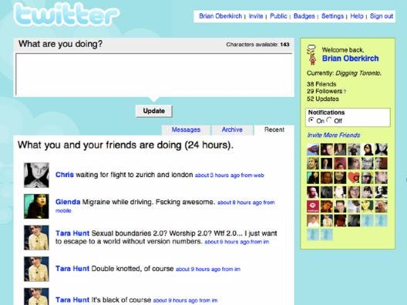
Twitter
Founded in 2006 by Jack Dorsey, Evan Williams, Biz Stone, and others as a microblogging site, by 2020, 22% of U.S. adults were Twitter users, according to Pew Research.

Slide 14
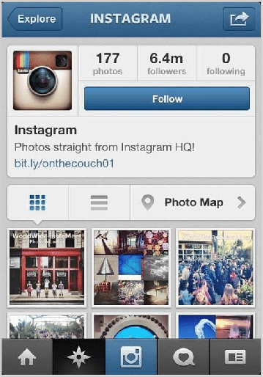
Instagram
Founded in 2010 by Stanford graduate Kevin Systrom as a photo-sharing site and purchased by Facebook in 2012, Instagram has more than 1 billion users worldwide.

Slide 15
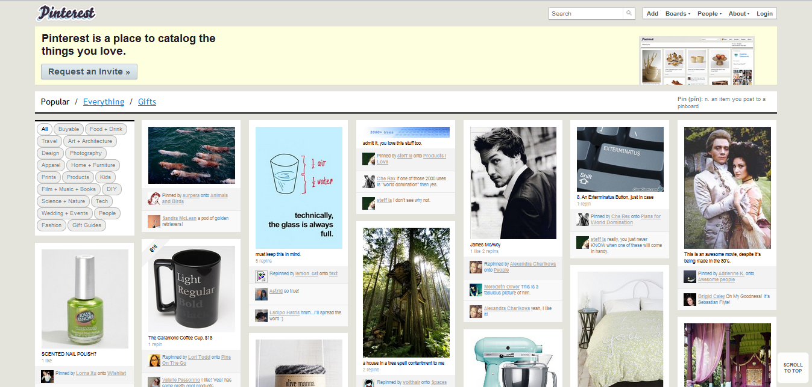
Pinterest
Founded in 2010 by iPhone app developer Ben Silbermann as a visual “pin board,” Pinterest became a publicly traded company in 2019 and has more than 335 million active monthly users.

Slide 16
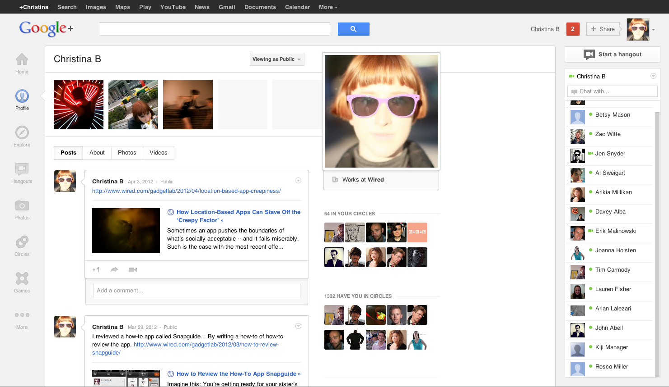
Google+
Google’s attempt to elbow its way into the social media landscape, Google+, launched in 2012. A rocky existence came to an end in 2018, after the private information of nearly 500,000 Google+ users was compromised by a data security breach.

Slide 17
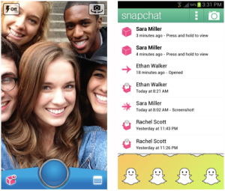
Snapchat
Founded in 2011 by a trio of Stanford students — Evan Spiegel, Reggie Brown, and Bobby Murphy — this video-sharing service introduced the concept of “stories,” or serialized short videos, and “filters,” run for informative digital effects, often based on location.

Slide 18
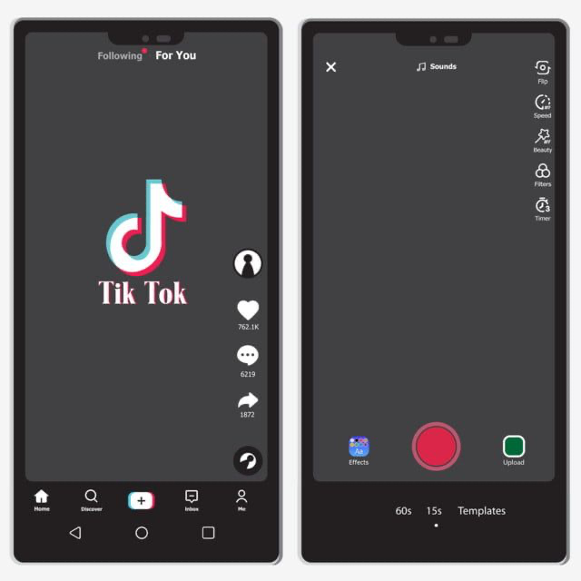
TikTok
Founded in 2016 by Chinese tech company ByteDance, this short-form video-sharing site was merged with the U.S.-based mobile app Musical.ly in 2018 and became popular with American teens and young adults. As of early 2020, it had more than 800 million users worldwide.

Slide 19
Social Media: End Users and Businesses

Slide 20
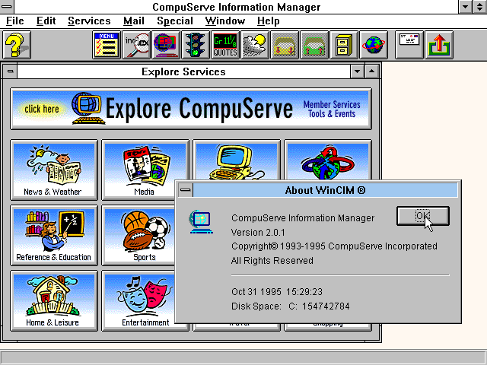
The End-User Experience
At first, social media existed to help end users connect digitally with friends, colleagues, family members, and like-minded individuals they might never have met in person. Desktop access to bulletin board services such as CompuServe and Prodigy made it easier to grow free online communities without ever leaving the house.

Slide 21
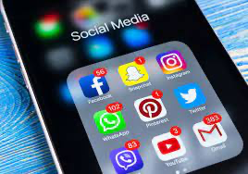
Smartphones
The invention of the smartphone liberated social media from the desktop and laptop computer. Apple’s first iPhone, launched by Steve Jobs in 2007, helped shift the focus of online community building to mobile. Facebook, Twitter, Snapchat, Instagram, TikTok, and other social media services thrived in the mobile app environment.

Slide 22
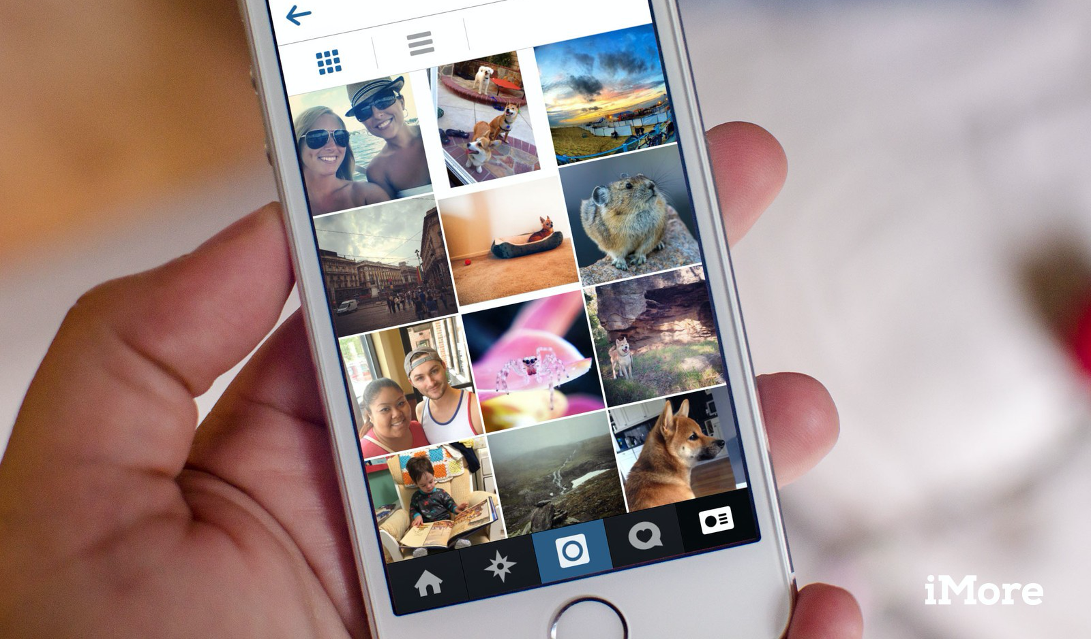
Smartphones
Technological improvements — specifically, powerful in-phone cameras — shifted the focus of mobile apps to video and images. In addition to written messages, end users could now broadcast in real time.
Instagram, in particular, became the app of choice for social media users interested in travel, entertainment, fashion, and other visually oriented topics.

Slide 23
The Business Experience
As social media companies grew their user bases into the hundreds of millions, the business applications of Facebook, Twitter, and other social platforms began to take shape. Social media companies had access to some of the richest trackable user data ever conceived.

Slide 24
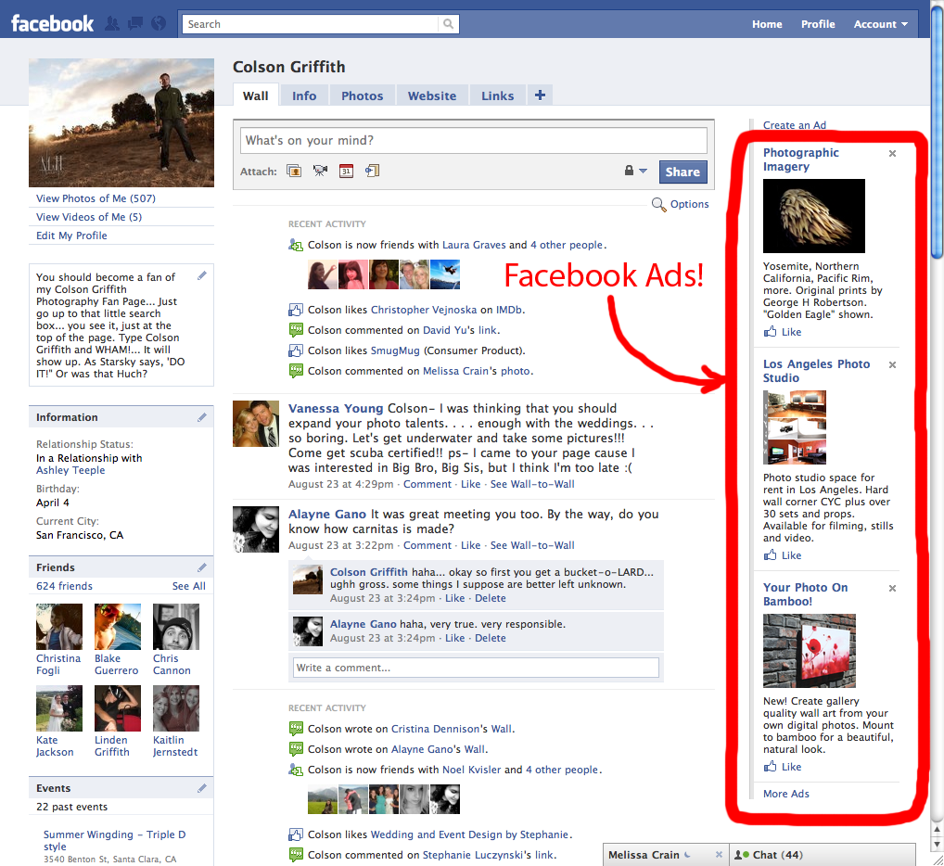
Ads on Social Media
Facebook began to place ads on its platform as early as 2006. Twitter enabled ads in 2010. LinkedIn, Instagram, Pinterest, Snapchat, and TikTok all have attempted to monetize their services through various forms of sponsored advertising.

Slide 25
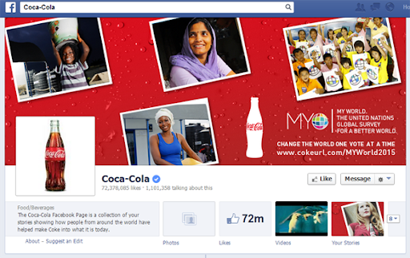
Social Media Ads
In addition to placing ads on social media platforms, companies discovered the potential utility of cultivating an active, engaged social media presence.
Whereas social media advertising must be paid for, the act of creating and sharing informative or entertaining content on Facebook, Instagram, Twitter, and other platforms is an attempt by brands to grow an audience organically, in other words, without paying for it directly.

Slide 26
The Importance of Engagement and Integration
Social media engagement consists of the various ways users respond to a post. This can include comments, follows, shares (retweets on Twitter), and clicks on a shared link. All of these actions are measurable thanks to analytics provided by the social media platforms (Facebook Insights, Twitter Analytics, LinkedIn Page Analytics, etc.).
Each of these engagements presents an opportunity for marketers to influence a customer or group of customers. For example, a company that monitors its Twitter feed in real time — either through an automated service or in person — is positioned to respond quickly to a customer’s request or comment.

Slide 27
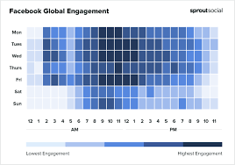
The Importance of Engagement and Integration
In addition, data that reveals users’ habits over time can be integrated into a long-term social media strategy. For example, Facebook Insights shows when users are most active on the platform. This information can be used to determine when is the best time to post new content, giving it a better chance to be seen.
Another way marketers use social media is to monitor cultural trends and, if applicable, incorporate brand-specific concepts that build on those trends to entice customers to engage with the company’s content.

Slide 28
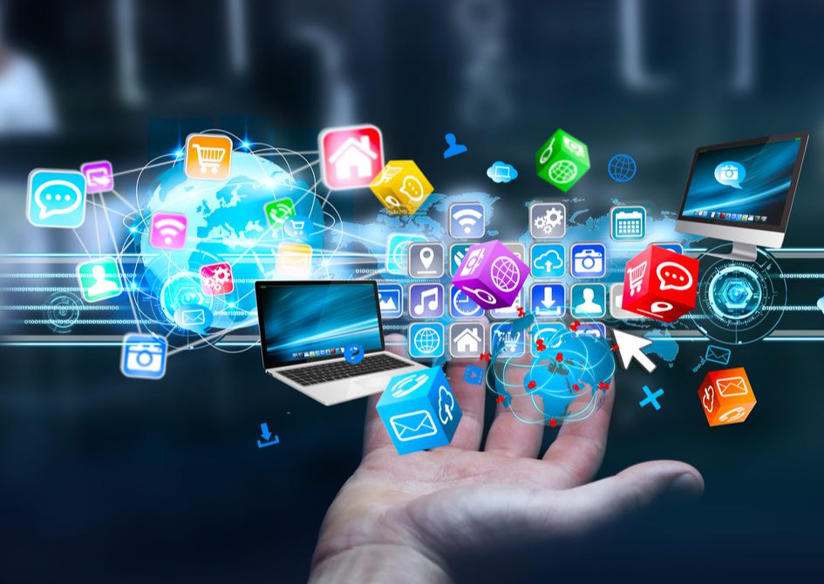
The Future of Social Media
What happens next in social media almost certainly will be shaped by the evolving business model, as well as by advances in storytelling technology. How will mega platforms such as Facebook, Twitter, TikTok, and others make money? How will end users adapt? How will businesses spread their messages and use social media to build audiences? The answers to these questions will determine the next stage of social media’s evolution.

Slide 29
Premium Social Media Services
What does the future hold for social media? According to a recent article in Entrepreneur, “11 Ways Social Media Will Evolve in the Future,” consumers will gravitate toward services that allow them to:
Personalize content at a granular level
Reduce the amount of vitriol and conflict commonly found on public social media feeds
Increase focus on protecting privacy
Take greater advantage of the utility of mobile devices
Focus more on community building

Slide 30
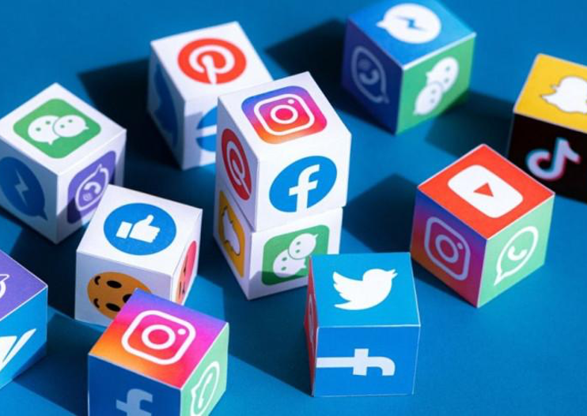
Paid Subscriptions?
This could mean a movement toward paid subscription services on social media, according to Entrepreneur. The challenge for marketing professionals will be to meet the shifting demands of social media users while maintaining an authentic brand voice.

Slide 31
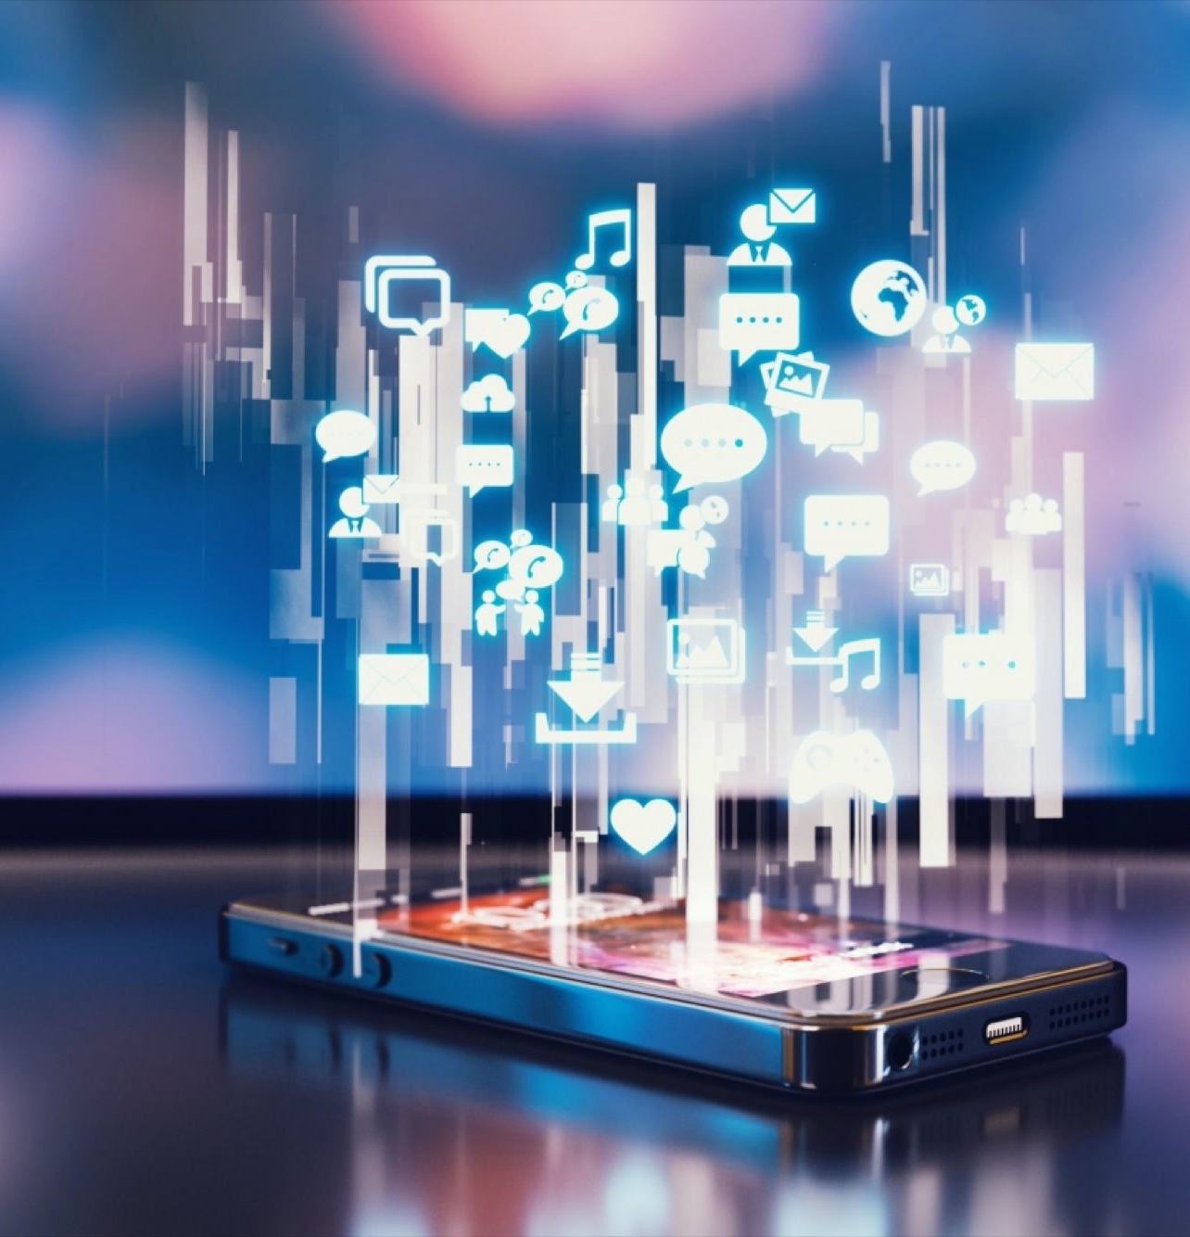
Social Media Video
Another growing point of emphasis for social media in the future, according to Entrepreneur, will be video content. Video marketing already has a substantial presence in the U.S., where it is a $135 billion industry in 2020, according to Social Media Today.
Videos became the No. 1 form of media used in content marketing in 2019, surpassing blogs and e-books for the first time. Video’s prominence as a marketing tool is expected to continue to grow, based on the latest information in Wyzowl’s “The State of Video Marketing in 2020 [New Data].”
This survey found that 88% of marketers received positive returns on investment through video. Perhaps most significantly, 59% of marketers who said they had not previously used video intended to do so in 2020 and beyond.

Slide 32
What’s Next for Social Media?
The future of social media is limited only by the imagination of its stakeholders. The brief history of the industry has proven that the rapid change — advances in technology, more-strident financial demands, shifting cultural dynamics — will transform the current social media landscape.
Will Facebook, Instagram, Twitter and other major platforms go the way of Google+ and MySpace? Will the entrepreneurial heirs of Twitter creator Biz Stone and Facebook founder Mark Zuckerberg build on the success of their predecessors? Can social media maintain its relevance as technology evolves?
Human beings are social creatures. Commerce is driven by human interaction. These two facts will continue to shape the evolution of social media into the next decade and beyond.

