Slide 1
Design Composition Theory

Slide 2
Design Compositions
These concepts will help you arrange elements and use design principles effectively.
Target Audience
Grids
Rule of Thirds
Optical Center
Z - Pattern

Slide 3
Target Audience
Publications are created to convey a message to the intended audience, called the target audience.
The target audience will determine the:
language used
typefaces used
colors used
graphics used

Slide 4
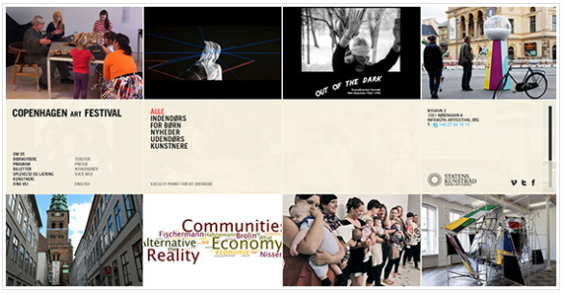
Grids
The use of columns/rows in design
Used frequently in print and web design
Copenhagen Art Festival Web Page

Slide 5
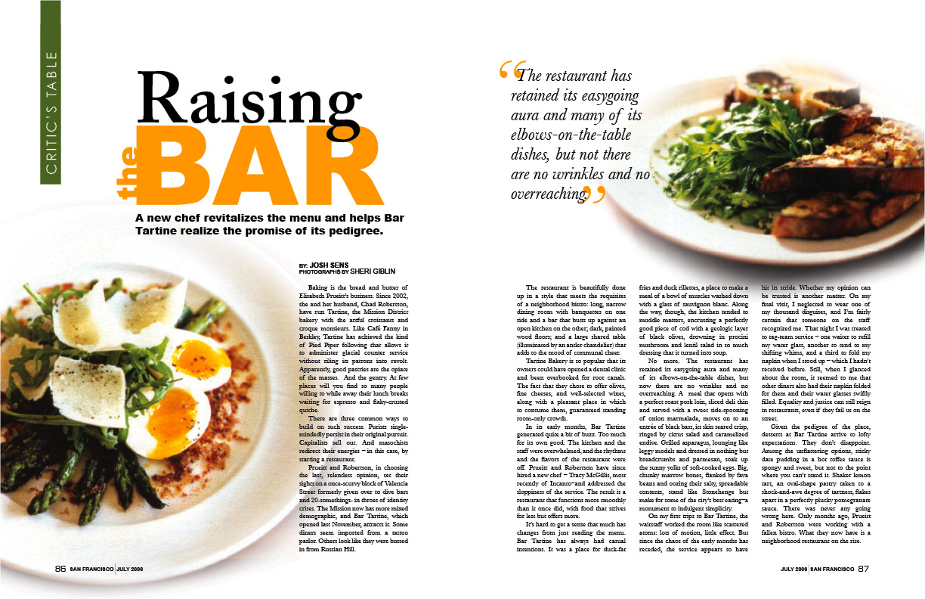
Grids – Example
Notes:
Have students review the design pictured here.
Steps:
Students will think about the design principles present in this design.
Students will pair with a neighbor to discuss their thoughts.
Students will share their thoughts with the class. Teacher will facilitate this discussion to make sure students understand the concepts.

Slide 6
Rule of Thirds
Use imaginary lines to divide a composition into thirds vertically and/or horizontally. Then place the most important elements along those lines or where they intersect.
Splitting a composition into thirds will result in 9 equal sections.

Slide 7
Rule of Thirds – Examples

Slide 8
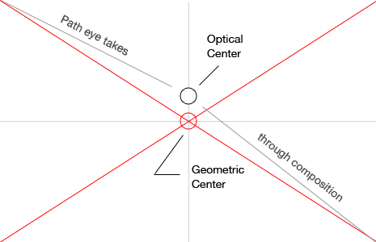
Optical Center
the spot the eye first sees when it encounters a page
It is slightly above the geometric center of the page.
Place the most important design element here.
Notes:
Teacher Note: Look through magazines to find advertisements that illustrate the Rule of Thirds, Optical Center and Z-pattern and use these to illustrate these concepts to your students.

Slide 9
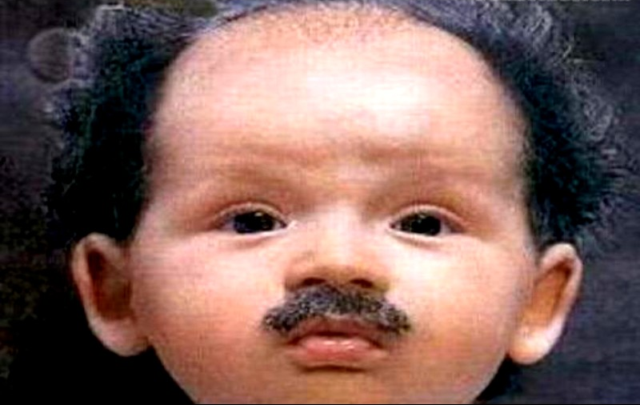
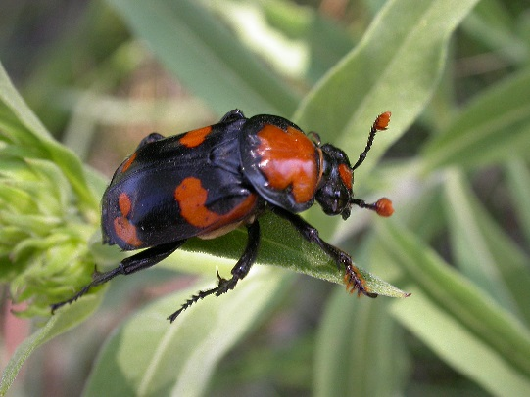
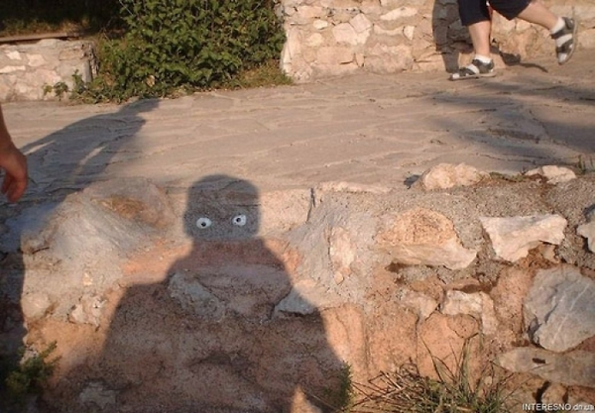
Optical Center – Examples
Notes:
Teacher Note: Look through magazines to find advertisements that illustrate the Rule of Thirds, Optical Center and Z-pattern and use these to illustrate these concepts to your students.

Slide 10
Z Pattern
the pattern the eye follows when scanning a page in western cultures.
We read text starting at the top. We then move across the line and then down to the next line. Repeat. This visual reading pattern is the shape of the letter Z.
Z

Slide 11
Z Pattern – Bad Examples
Beware of violating normal reading patterns!

Slide 12
Composition of a Visual Image
Source: http://riazahmadkarim.wordpress.com/2012/12/02/composition-of-a-visual-image/composition1/
Notes:
Have students review the design pictured here.
Steps:
Students will think about the design principles present in this design.
Students will pair with a neighbor to discuss their thoughts.
Students will share their thoughts with the class. Teacher will facilitate this discussion to make sure students understand the concepts.

