Slide 1
Text Behind Moving Objects!
See Full Tutorial Attached

Slide 2
Before You Begin
You must import the video you will be using into Premiere. Once you have sliced, diced, and arranged your video to look the way you want it, you can then move forward with this effect. Please do not attempt to use this effect until you’ve completed the necessary steps in the editing process first.

Slide 3
01
Decide Where to Add Your Text
What placement will be the most effective?

Slide 4
02
Text Tool
Click on the Text Tool to place your text where desired. Also determine
Font
Text Size
Color
General Style

Slide 5
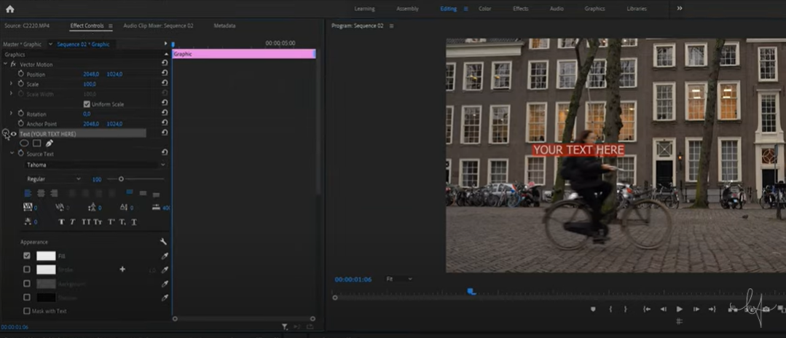

Slide 6
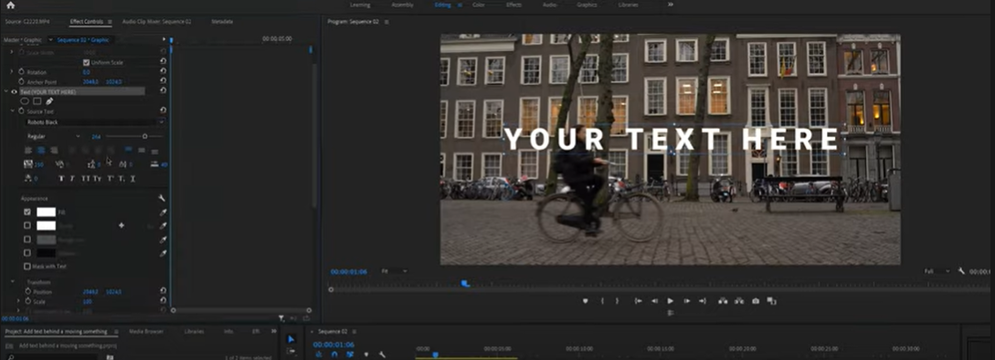

Slide 7
03
Draw Mask
Click on the Pen Tool under Opacity and draw an outline around the object that’s moving.

Slide 8
Creating a Mask:
01
02
03
Ellipse Mask (Circle)
Polygon Mask (rectangle)
Pen Tool Mask
(Free Draw Bezier)
We will use this tool to draw a mask around the person or object that’s moving.

Slide 9
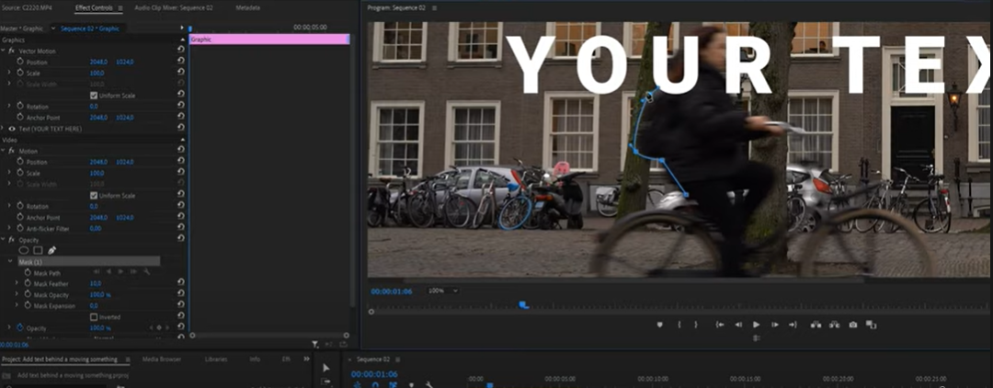

Slide 10
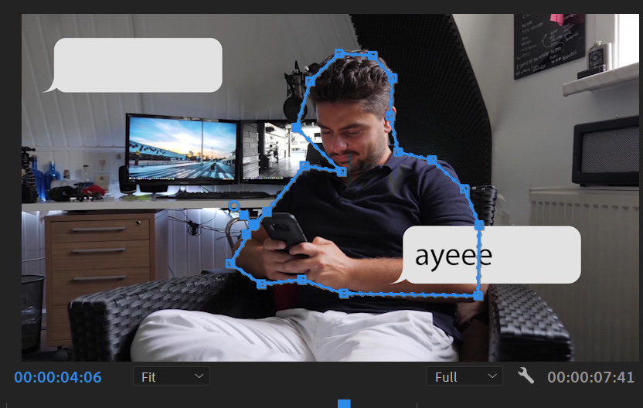

Don’t Worry!
If you’re mask isn’t perfect while drawing lines...
just keep making points until you connect the dots &
Reshape the mask by pulling on the drawn points

Slide 11
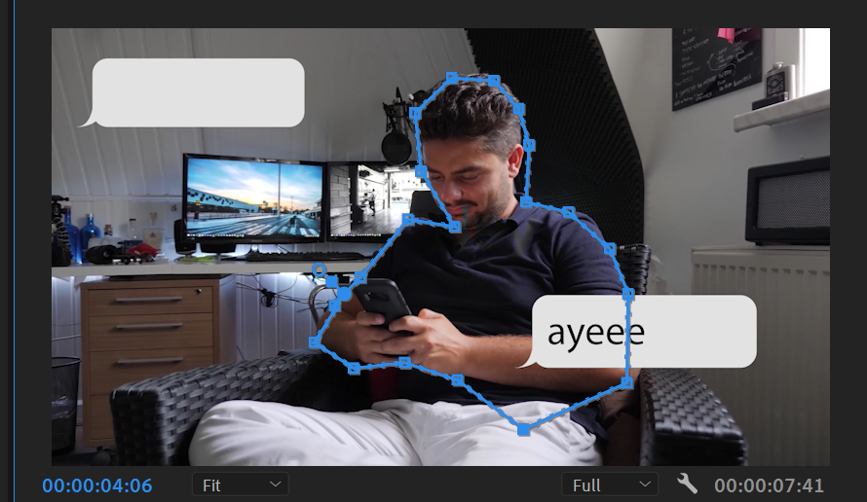
Additional points:
You can also add points to your mask by using the pen tool to click on the line. This allows you to create a new point that you can also manipulate.

Slide 12
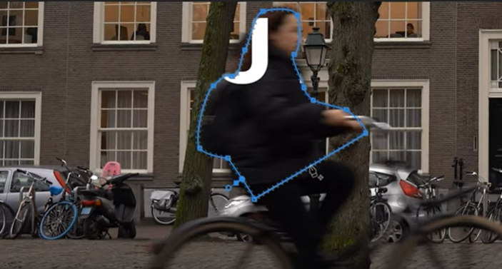
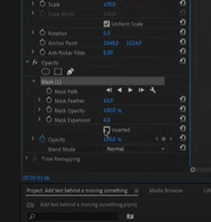
Invert:
With a completed mask, you should see text inside the mask ONLY
To fix this so the text “reveals” itself from behind the object, you:
  Go to Effect Controls
  Find Mask 1
  Click on Inverted

Slide 13
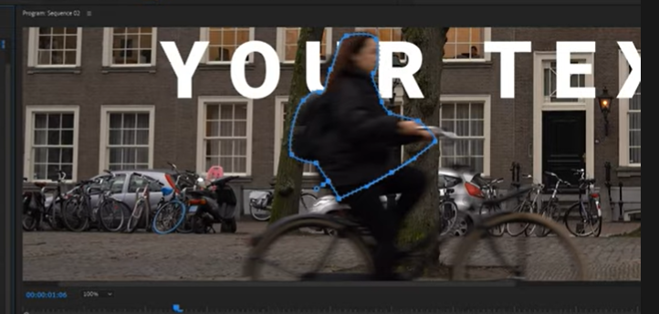
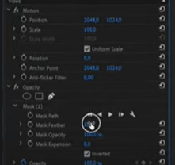
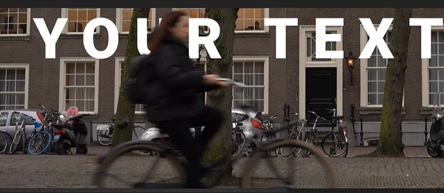
Inverted Settings:
Your text should now appear around the mask instead of inside the mask
Next, change settings to create soft edges:
  Go to Mask Feather
  Default should be 10
  Scale up and down to make it look professional
Too much feathering is bad, it makes it look like you used a mask
Too little feathering is bad, it makes your mask look choppy.

Slide 14
04
Add animation
Click on the stopwatch (Toggle animation) in front of mask path. This will add a keyframe.

Slide 15
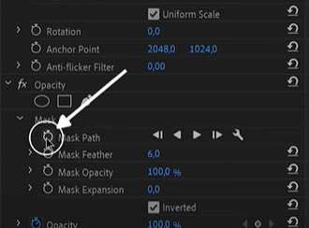

Mask Path:
Click on the stopwatch in front of “Mask Path”
This creates a keyframe that tells Premiere Pro the mask is going to change positions and move throughout the video
This allows the mask to follow the movement of the object in front of the text you’ve added
Use keyframes a checkpoints throughout the video to ensure your animation is on track

Slide 16
05
Add keyframes
Skip 3-5 frames forward using the 1-step forward command and then select the mask in effect controls.

Slide 17
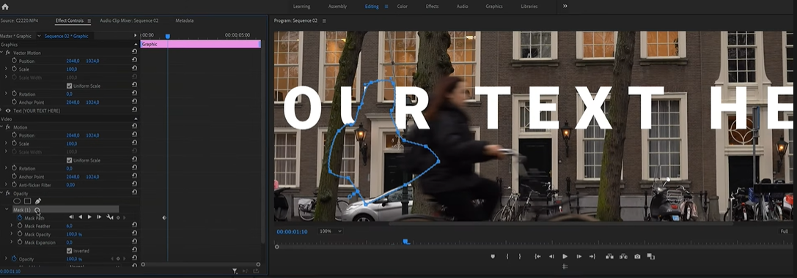

Slide 18
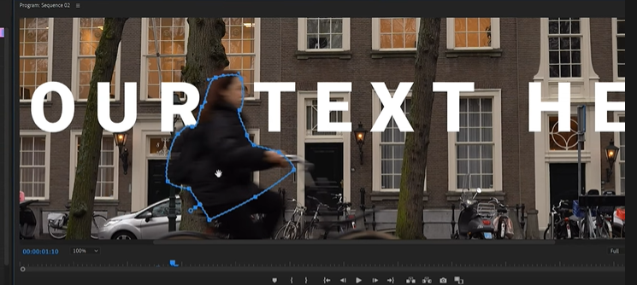
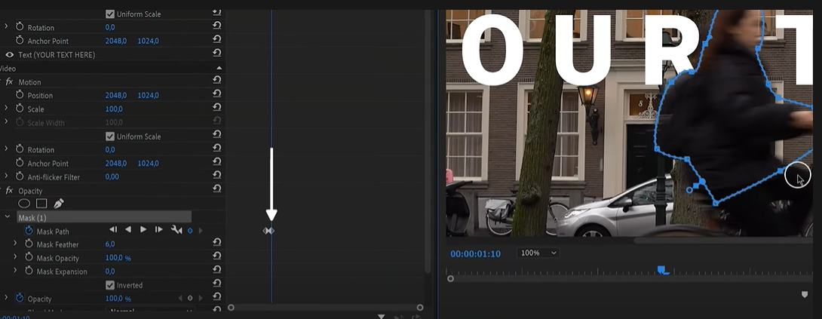
Add Keyframes!
Create a new keyframe by moving the mask forward to outline the object you initially masked.
The new keyframe pops up beside the old keyframe. This tells Premiere to animate the object seamlessly throughout frames.

Slide 19
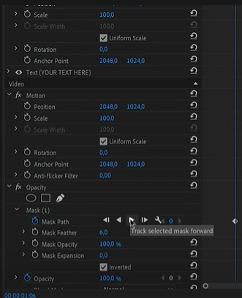
BUT...
You can also use the “track selected mask forward” button to let Premiere automatically animate this for you.
This means you don’t have to keyframe
However, you lose control over the process, which is why many do it manually

Slide 20
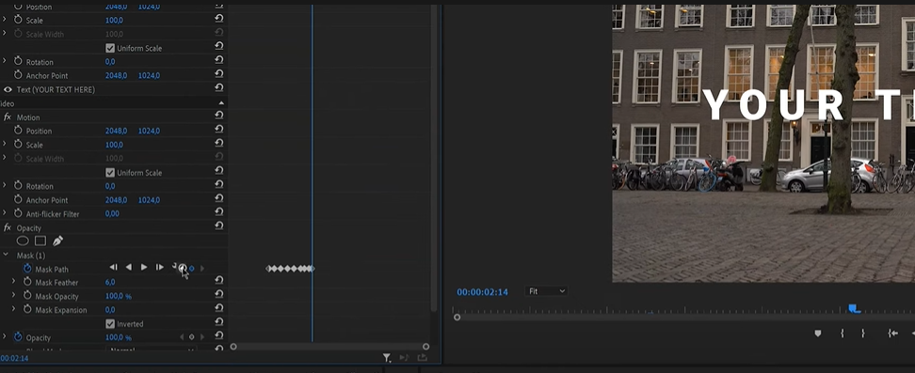
Not Tracking Properly?
If your tracking looks abnormal in either manual or automatic mode, go back to the keyframe and change its position!

Slide 21
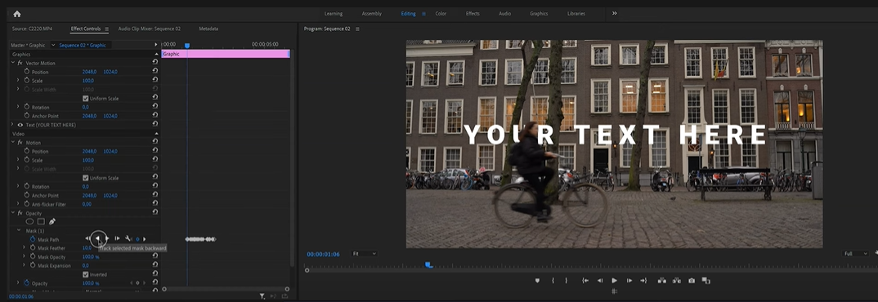
The Beginning.
Now go back to your first keyframe and work backwards
You can also do this automatically with “track selected mask backward”

