Slide 1
Commercials & PSAs
Objective:

Slide 2
Commericals

Slide 3
Before we get started
Think about your favorite commercial you have seen recently. Could be an ad on TV or an ad on a social media site.
What product or service is your favorite commercial trying to sell? What happens in your favorite commercial? Why is this your favorite commercial?

Slide 4
Commercials are short, stylistic, and impactful videos used to sell products, goods, services, and even political campaigns.

Slide 5
Since the very first television commercial ran — for $9 — more than 75 years ago, television advertising has grown into a $75 billion/year industry.
CBS sold 30-second Super Bowl 2019 commercial spots to the tune of $5.1 to $5.3 million.
Political Ads spent around $6.3 billion in the 2016 election.

Slide 6
The first commercial was a $9 commercial $4 in air charges and $5 in station charges

Slide 7
Target Audience
 | Definition | Examples to help you remember
 | The main group of people that the commercial is trying to reach and convince. A target audience can be people of a certain age group, gender, marital status, etc. | White women in their 30s Single and divorced males Senior citizens

Slide 8
Message
 | Definition | Examples to help you remember
 | The central idea that the creators of a commercial want the target audience to believe. | “This face cream will make you look younger and feel more attractive” “If you shop at our supermarket you will save a lot of money”
Notes:
Change panel

Slide 9
Word | Definition | Examples to help you remember
Logo | A mark or symbol that represents a company or product. Logos can include visuals or letters or both.
Slogan | Short and memorable phrase used to promote a product. | “Just do it” “You are worth it” “Better ingredients, better pizza”

Slide 10
Let’s play a game. See if you can name the commercial by the Jingle before the countdown ends
Jingle is a short slogan, verse, or tune designed to be easily remembered, especially as used in advertising.

Slide 11
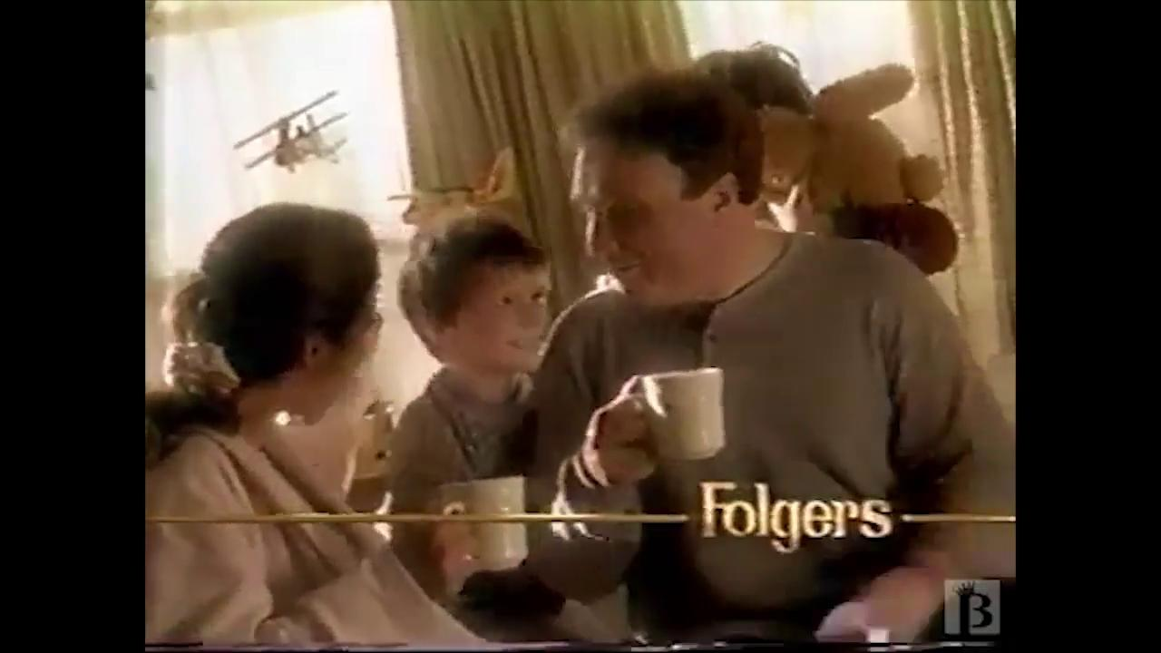

Slide 12
Word | Definition | Examples to help you remember
Celebrity endorsement | When a famous person talks about the good qualities of a product to promote it. | Michael Jordan talking about how he loves to wear Hanes T-shirt because they are soft.
Testimonials | When a private citizen (regular person) talks about the good qualities of a product to promote it. | A real consumer who talks about how much money he is saving with his new car insurance.

Slide 13
Persuasion
 | Definition | Examples to help you remember
 | Is also called Rhetoric, which is the art of using words a certain way to influence or appeal to, evoke emotions, opinions, attitudes, and behaviors | White women in their 30s Single and divorced males Senior citizens

Slide 14
Persuasive techniques used in advertising
Word | Definition | Examples to help you remember
Pathos | Appeals to our emotions or feelings | -You trust the advice of a doctor because of who he/she is. -You buy something advertised by certain celebrities whom you trust/respect
Logos | Uses logo or reasoning | Can include humor, shock value, or appeal to physical sensations like taste.
Ethos | Uses credibility to appeal | You make a good point, or you provide research-based evidence.

Slide 15
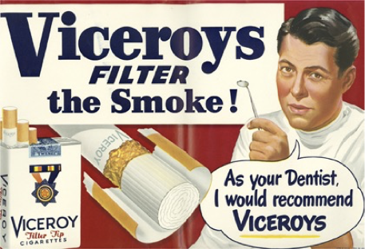
What type of Persuasion is this ad using?
Pathos?
Logos?
Ethos?

Slide 16
What type of Persuasion is this ad using?
Pathos?
Logos?
Ethos?

Slide 17
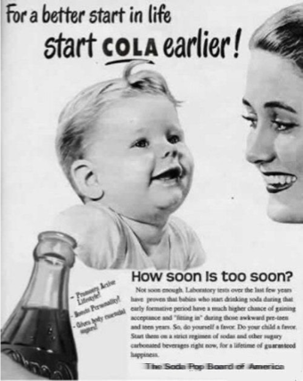
What type of Persuasion is this ad using?
Pathos?
Logos?
Ethos?

Slide 18
PUBLIC SERVICE ANNOUNCEMENT
PSA

Slide 19
Commercials vs. PSA’s
Unlike traditional commercials, public service announcements (PSAs) are primarily designed to inform and educate rather than sell a product or service

Slide 20
Target audience or Target group
 | Definition | Examples to help you remember
 | The main group of people that the PSA/commercial is trying to reach and convince. A target audience can be people of a certain age group, gender, marital status, etc. | Parents looking to adopt People that text and drive Senior citizens Teens that smoke

Slide 21
Message
 | Definition | Examples to help you remember
 | The central idea that the creators of a PSA/ commercial want the target audience to believe. | “This face cream will make you look younger and feel more attractive” “Texting while driving causes a 400 percent increase in time spent with eyes off the road.”

Slide 22
What is the point of a PSA?
They are made to change public opinion and raise awareness on important issues while presenting information quickly and efficiently.
Examples of PSA ads include drinking and driving, texting and driving, drug addiction, and bullying prevention.

Slide 23
It may be hard to make an important point entertaining in a PSA
It can be done!
PSAs don’t have to be only serious, and they don’t have to just rely on fear.
In fact, getting viewers to notice a good cause may actually work best with a lighter touch

Slide 24
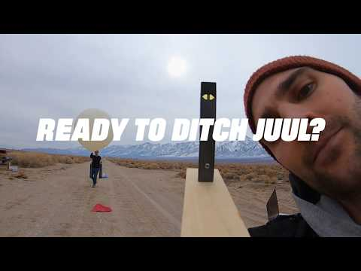

Slide 25
Think back to that PSA
What was the hook?
Hook (just like in english class) is how we grab the viewer’s attention.
Who is the target audience? Is it adults or teenagers?
What is the message in the video?
How do they get their point across?

Slide 26
PSAs are often used to highlight a community issue and persuade individuals to take action. They can convey information, create awareness, offer assistance or encourage a change in behavior.

Slide 28
Discuss
Who is the target audience?
What is the message in this video?
What is the hook?
What did it do: convey information, create awareness, offer assistance or encourage a change in behavior?

Slide 29
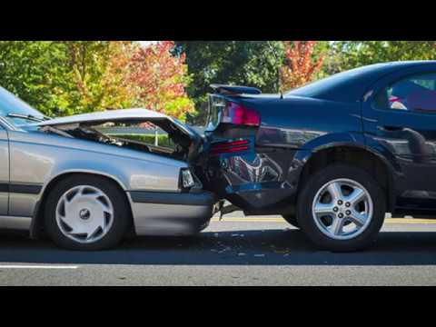

Slide 30
Discuss
Who is the target audience?
What is the message in this video?
What was the hook?
What did it do: convey information, create awareness, offer assistance or encourage a change in behavior?

