Slide 1
News and Inteviews

Slide 2
What makes a good interview?
Think about talk shows, documentaries, or even news shows you’ve seen.

Slide 3
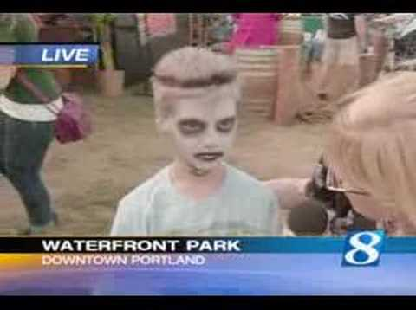

Slide 4
News History Highlights
Broadcast News came from Radio News
Original broadcast shows were weekly 10 minute programs
In the 60s, news shows upped to 30-minute broadcasts, and then have progressed into our 24/7 news information we have today!

Slide 5
Typical Newscast show rundown:
Anchors introducing or talking about topics
News packages created by reporters that tell us about an event or issue that are important to the viewers
Ends with a Fluff piece - meaning a feel good story that ends the show on a positive note to make the viewers think that there might still be some good in the world.

Slide 6
What do documentary videos and news shows have in common?

Slide 7
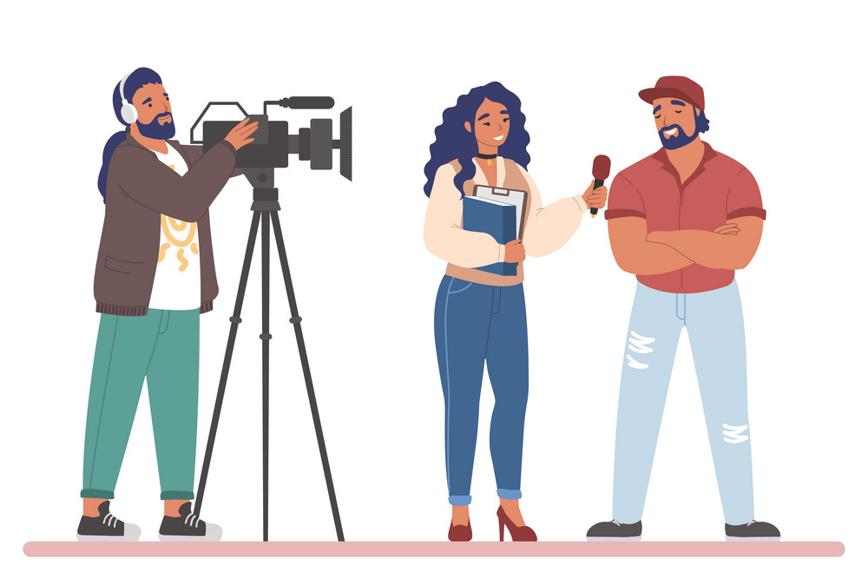
The Interview

Slide 8
Tips for Interviewing
Ask your interviewee to include your question in their answer.
When they are done with the answer, have them pause for 3 seconds and look at the camera before they turn away.
As the interviewer, avoid speaking or saying mhmm, or talking overtop your interviewee. (Unless you’re planning to include your voice in the A roll and want it to be more conversational.) That is a valid style choice, but make that choice deliberately.
Don’t share your interview questions ahead of time unless you think it will set your interviewee at ease. You want things to look authentic on-camera and not scripted. You might give them a brief outline of general ideas you will be covering, but they should not rehearse ahead of time.

Slide 9
The key elements of a video story:
People: Let’s hear from real people, either affected by an issue or event or why their opinions matter
Get people to share their personal anecdotes, expertise, and perspectives. This is where you also want to grab BROLL to show us who they are, what they do and even their daily routines.
Data: A good story should always provide relevant data that helps explain what our people are dealing with.
We can have Scientific data, Public data, or even corporate/business data.
Context: Data should be relevant, CREDIBLE, and help viewers understand. Help the audience connect to the people speaking or the story being told.
Conclusion: We need a clear ending with strong audio and video. BROLL shots usually go with the narration and maybe we have a short soundbite from the key source. The end should make us want to continue thinking/caring about the issue or characters.

Slide 10
How can we ask questions that will lead to interesting anecdotes, stories or conversations?
Two types of questions:
Effective Questions
&
Leading Questions

Slide 11
Questions
Effective questions are known as open ended questions. They are designed to help move a conversation between the interviewer and the subject. They encourage a conversations about experiences, emotions, attitudes or opinions. Effective questions are not closed-ended questions. Closed ended questions are yes or no type questions.
Leading Questions are questions that prompts or encourages a desired answer.

Slide 12
Example:
◦Effective Question – Where were you on March 13th?
◦Leading Question – On March 13th, is it true that you were in school and hung out with your friends?

Slide 14
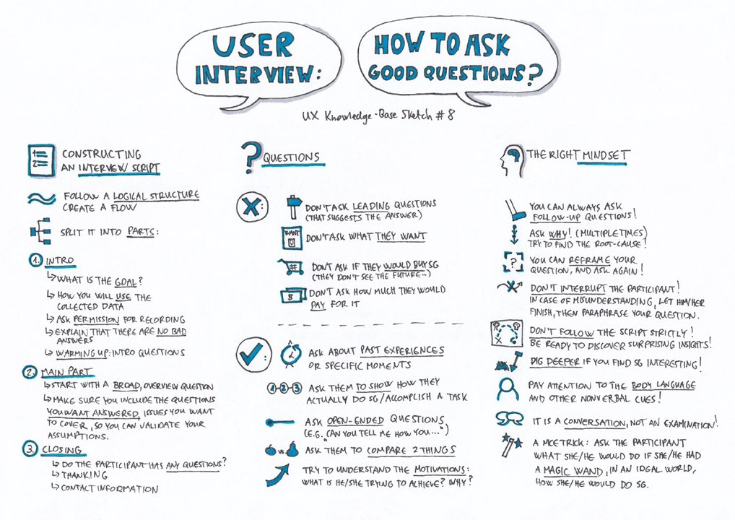

Slide 15
Group Work
Look at Open-ended questions, open-ended phrases, and leading questions.
You and your group will first pick a topic, then you each will write:
2 Open Ended questions
2 Closed questions
Then as a group you will work together to determine if it is an ineffective questions and it if is a leading question, closed question or closed and leading
You will then have to change the questions into effective questions used for interviewing.

Slide 16
News Package
A self-contained taped report put together by a reporter or anchor. Includes all the elements of a report (sound, video, etc.) in a complete “package.”
Can be used in combination with a live report, introduced by the reporter from the news desk, or as a stand-alone story.

Slide 17
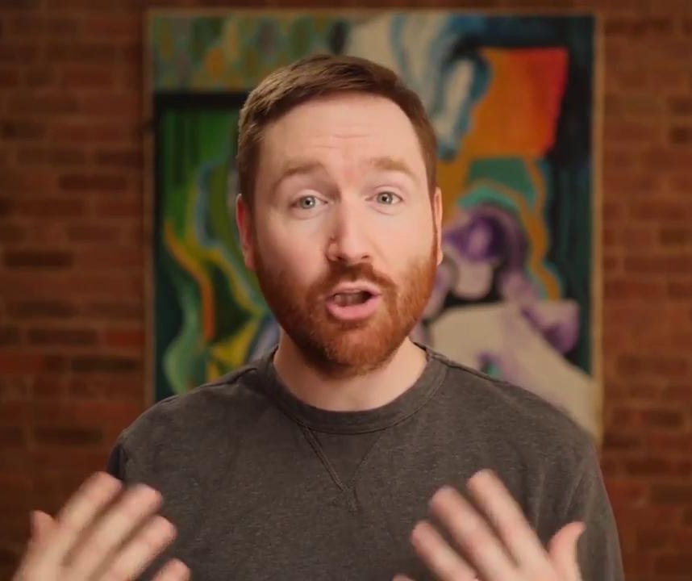
The Interview
Use the interview to lay down the narration of your documentary.
String out your story from interview to interview with narration and broll thrown in to help it flow smoothly.
Usually, you want to use a medium shot of your subject, where you are standing off screen near the camera and they are talking to you.

Slide 18
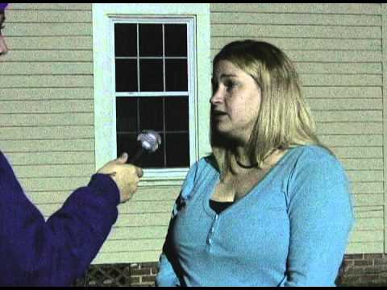

Slide 19
Creating a New Package
Write a script of what you are going to say
Record VO and Sound Bites
Record a Stand up
Obtain B Roll
Record Interviews using Effective Questions

Slide 20
Have you heard of the 5 W’s & H?
Who
What
Where
When
Why
How

Slide 21
News Story Script Outline
Introduction/summary (who)
Establish the scene (where, what)
Discuss the topic (why)
Solutions (how)
Follow-up (what's next)

Slide 23
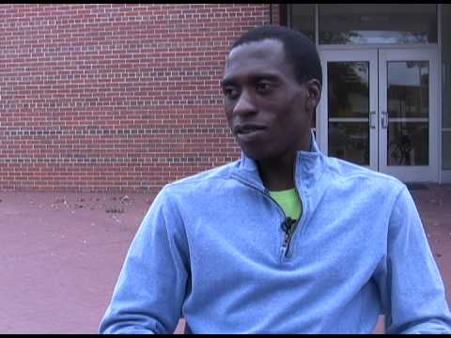

Slide 24
video

Slide 25
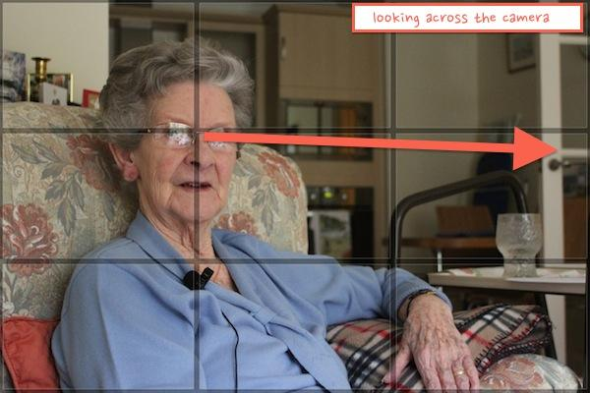
When framing for an interview think about our Framing Techniques: Rule of Thirds, Head room, and Nose Room

Slide 26
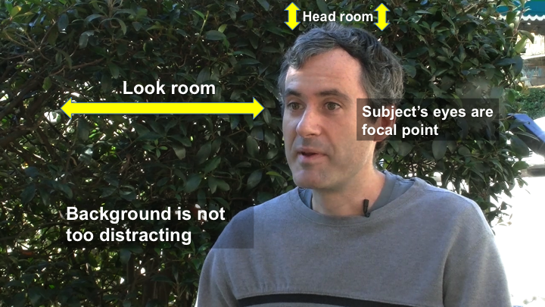

Slide 27
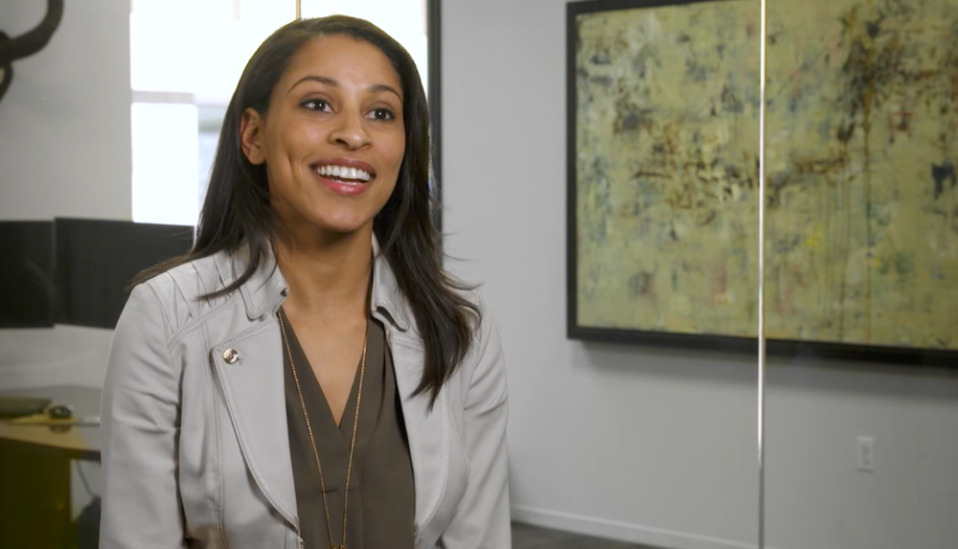
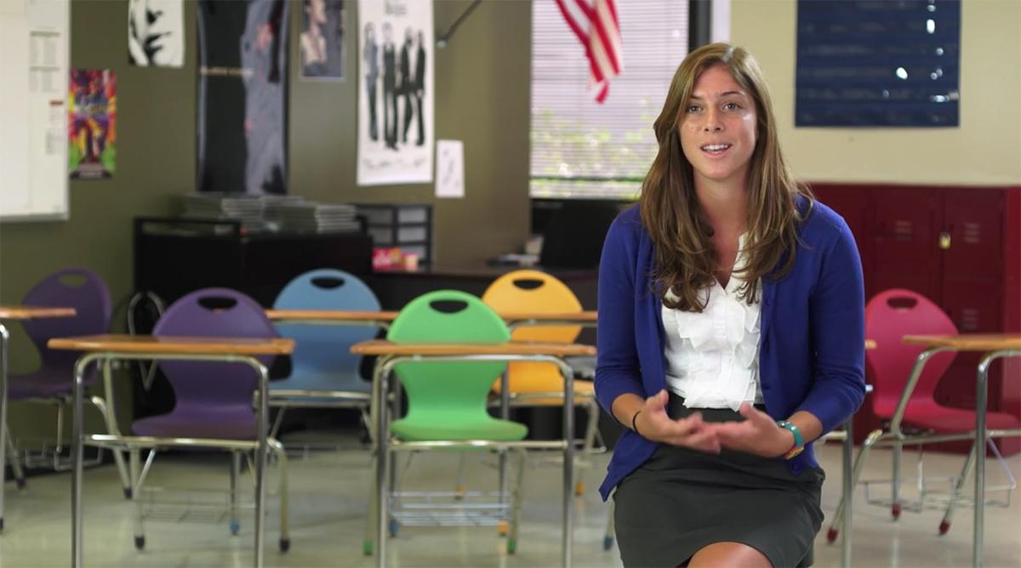
Framing an Interview
You want to portray your subject in the best way, so shooting from the mid-chest or from the waist up if they are standing are the best positions to use.

Slide 28
Sometimes it is ok to shoot from the waist up, usually in circumstances of a two shot.

Slide 29
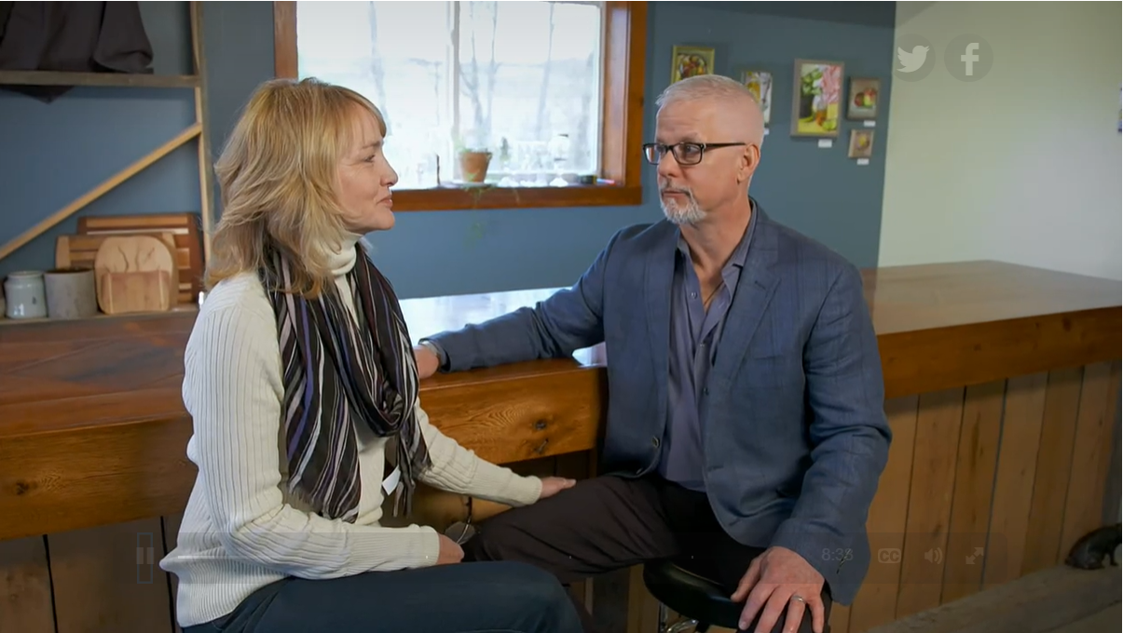
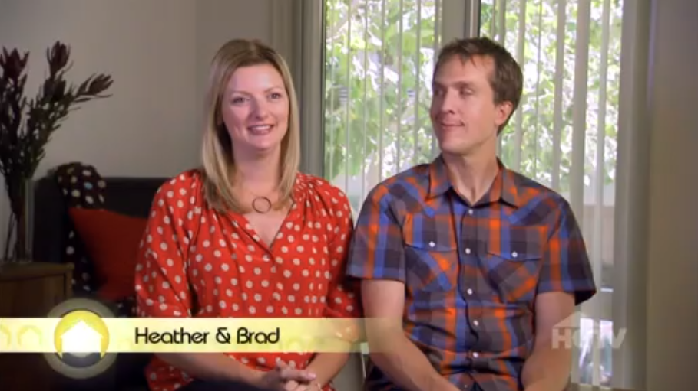
Try to avoid placing subjects in front of windows because that can make it harder for the camera to pick up the natural color. Both of these images are from House Hunters and they have been color corrected by an Online Editor.

Slide 30
Filming & Editing Elements that make up a News Package
Also used in Documentary Videos

Slide 31
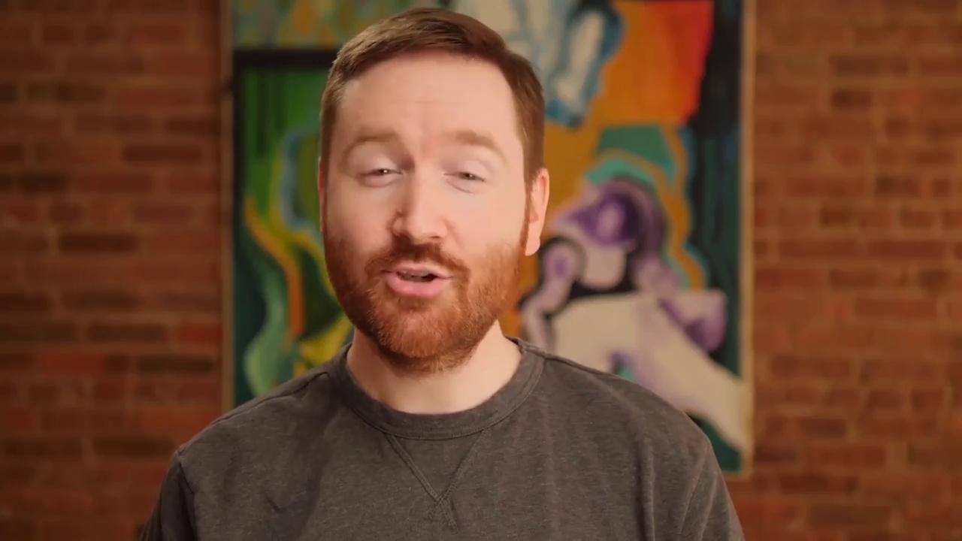
B Roll
Overshooting is key!
Make sure to get enough Broll, even if you think you have enough, GET MORE. You never know what you’ll need or like until you start editing and that extra shot might be the best for your video.

Slide 32
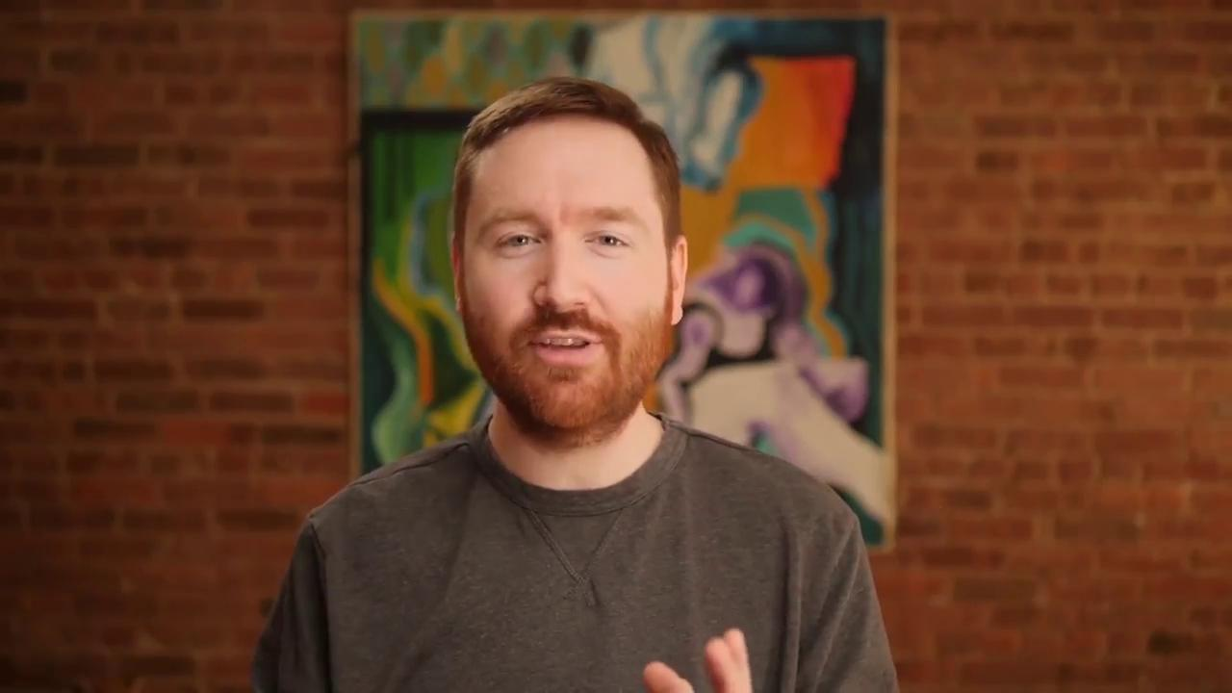

Slide 33
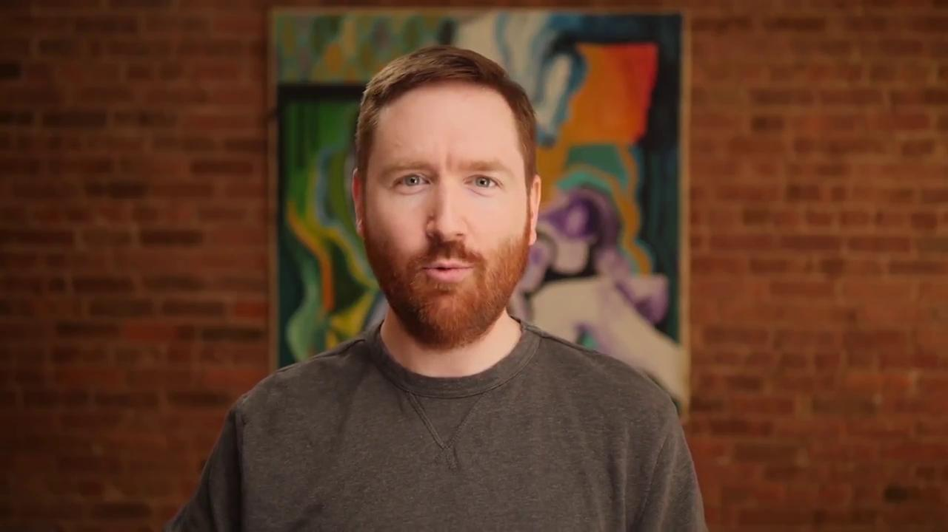
Narration – Voice Over
Your voiceover should only be used to give information that wasn’t provided in interviews.
VO’s should help bridge the gap to smoothly flow from one interview to the next interview.
VO’s can also be used to open and close your documentary

Slide 34
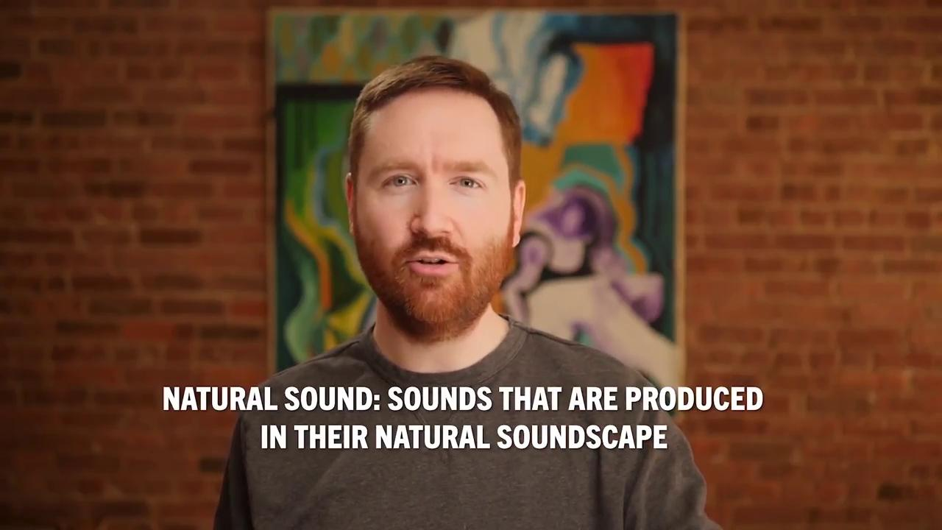
Audio – Music and Nat Sound
Throwing in Natural Sound (nat sound) will help give authenticity to your video. You can use it in your broll to give a break or breath in a thought or idea.
Your music should also help your video flow from scene to scene.

Slide 35
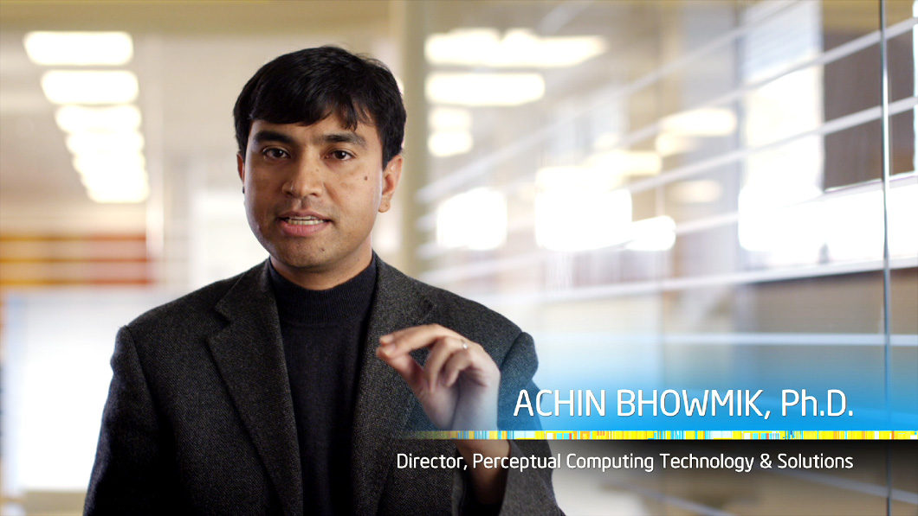
Using Lower Thirds
Your subject should have a graphic introducing them the first time you see them in your video.
In long documentaries, it is good to reshow the lower third later in the movie again to help viewers recall who is speaking

