Slide 1
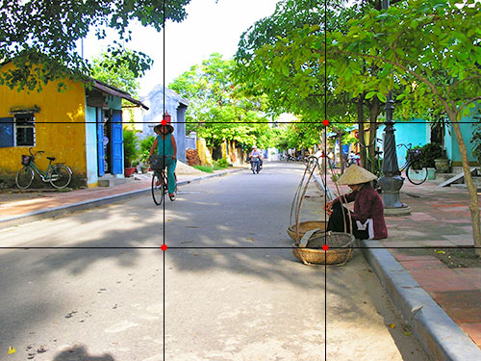
Circle the areas our eyes are drawn to first
Notes:
🍐 This is a Pear Deck Drawing Slide
🍐 To edit the type of question, go back to the "Ask Students a Question" in the Pear Deck sidebar.

Slide 2
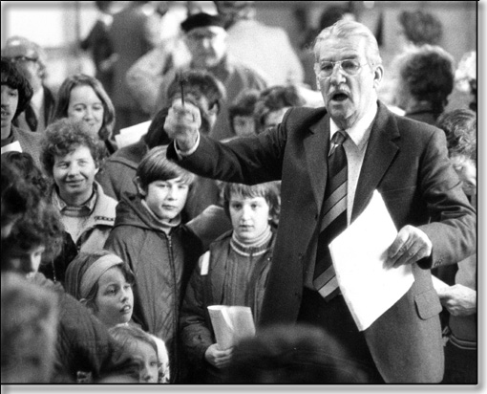
Where are our eyes drawn to on this image?
Notes:
🍐 This is a Pear Deck Draggable™ Slide.
🍐 To edit the type of question, go back to the "Ask Students a Question" in the Pear Deck sidebar.

Slide 3

Notes:
🍐 This is a Pear Deck Drawing Slide
🍐 To edit the type of question, go back to the "Ask Students a Question" in the Pear Deck sidebar.

Slide 4

Notes:
🍐 This is a Pear Deck Drawing Slide
🍐 To edit the type of question, go back to the "Ask Students a Question" in the Pear Deck sidebar.

Slide 5

Lack of nose room
Notes:
🍐 This is a Pear Deck Text Slide
🍐 To edit the type of question, go back to the "Ask Students a Question" in the Pear Deck sidebar.

Slide 6
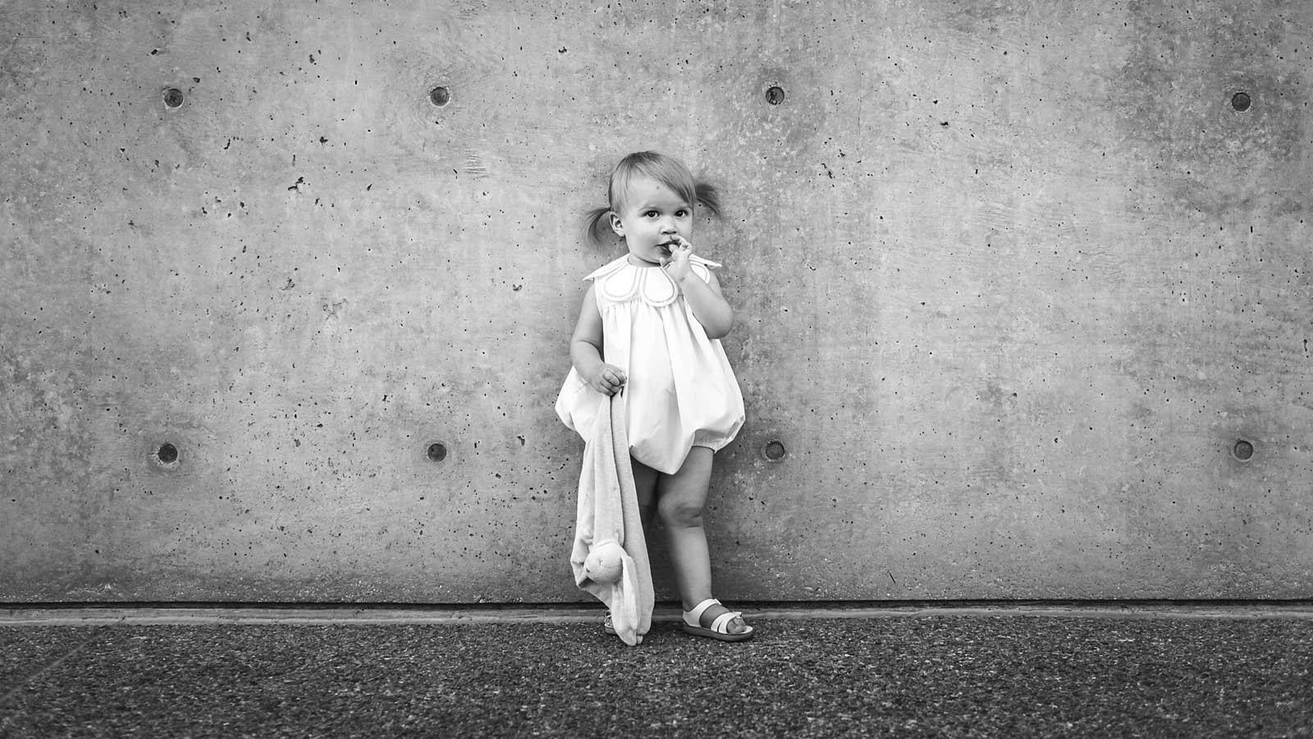
Not following the rule of thirds
But does have Symmetry
Notes:
🍐 This is a Pear Deck Text Slide
🍐 To edit the type of question, go back to the "Ask Students a Question" in the Pear Deck sidebar.

Slide 7

Leading Lines
Notes:
🍐 This is a Pear Deck Text Slide
🍐 To edit the type of question, go back to the "Ask Students a Question" in the Pear Deck sidebar.

Slide 8
Depth of Field
Notes:
🍐 This is a Pear Deck Text Slide
🍐 To edit the type of question, go back to the "Ask Students a Question" in the Pear Deck sidebar.

Slide 9

This follows Rule of Thirds
Notes:
🍐 This is a Pear Deck Text Slide
🍐 To edit the type of question, go back to the "Ask Students a Question" in the Pear Deck sidebar.

Slide 10

Too much Noseroom or look space.
Person is cut off
Notes:
🍐 This is a Pear Deck Text Slide
🍐 To edit the type of question, go back to the "Ask Students a Question" in the Pear Deck sidebar.

