Slide 1
Camera Movements
Objective 2.01
Understand key terminology related to digital video.

Slide 2
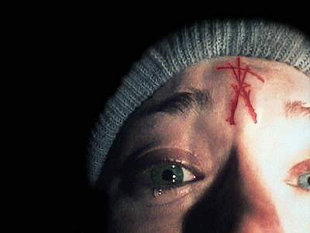
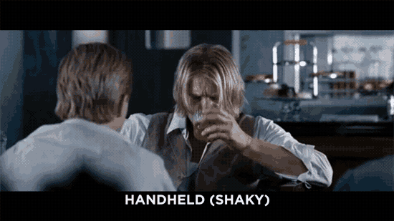
Handheld shots
The camera is not mounted on a stable surface, but is instead held by a person.
These are used to produce a bumpy and jerky look, and were made popular after ‘The Blair Witch Project’
It is often used to give a sense of reality or as POV shots

Slide 3
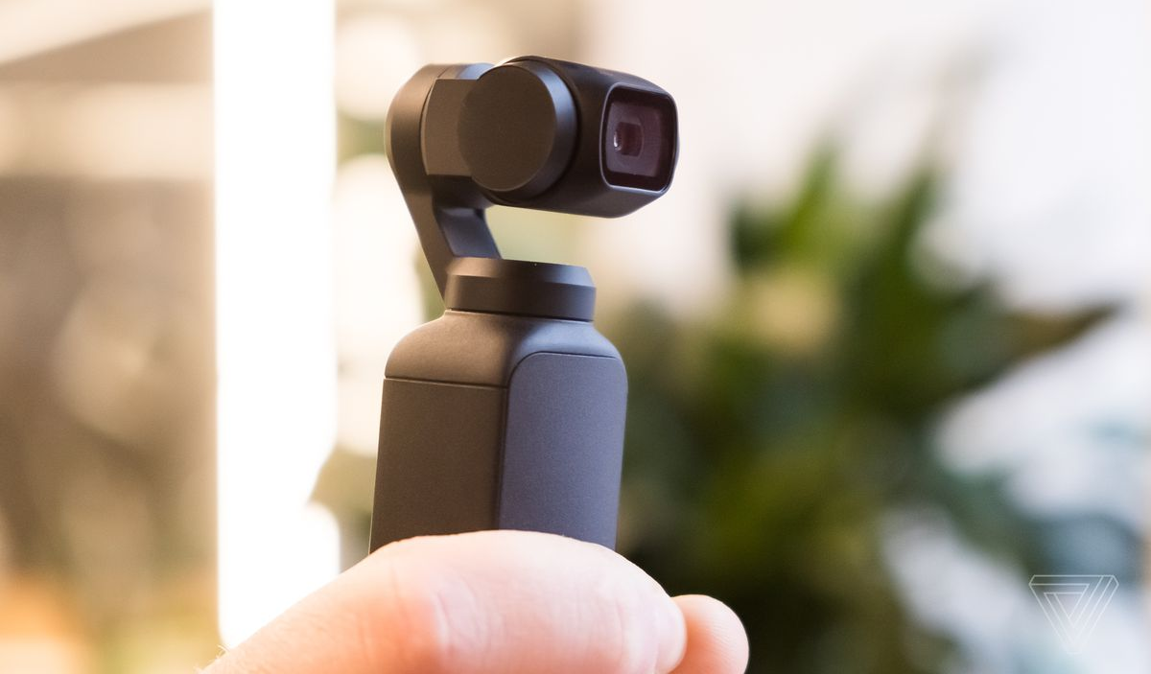
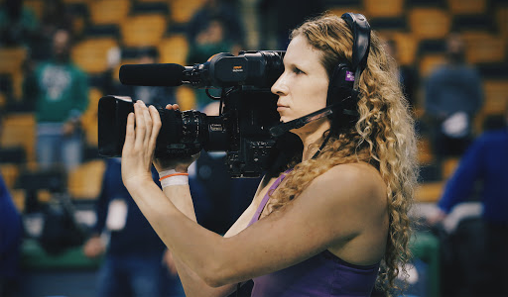
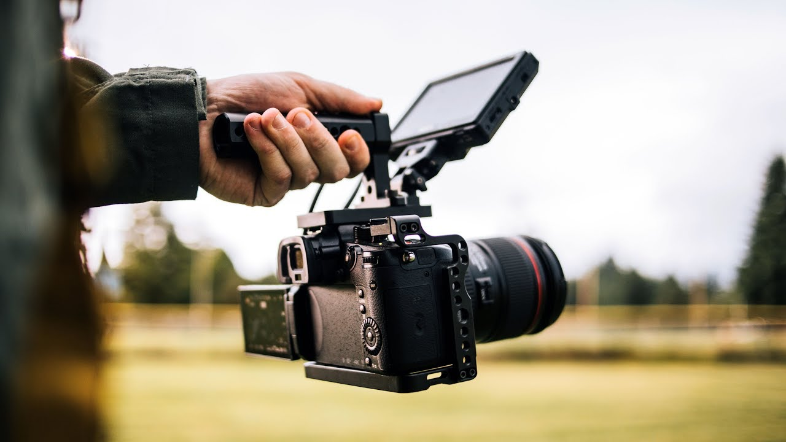
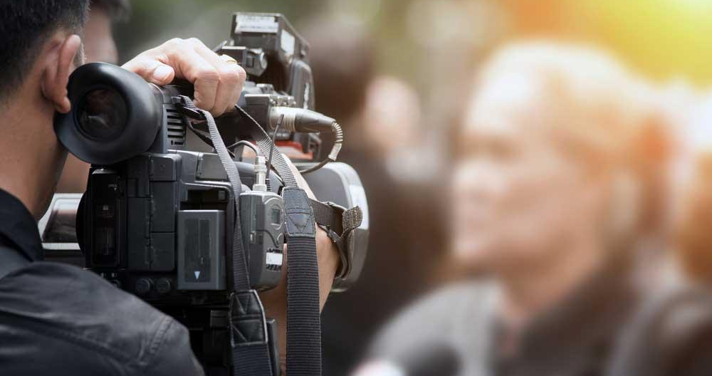

Slide 4
There are 5 ways to achieve camera/shot movement
Tripod
Hand held
Camera Lens
Dolly
Steadicam

Slide 5
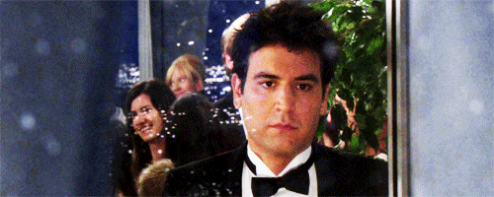
Zoom Shot
Camera does NOT physically move
Lens movement
Altering the focal length of the lens to give the illusion of moving closer to or further away from the action.

Slide 6
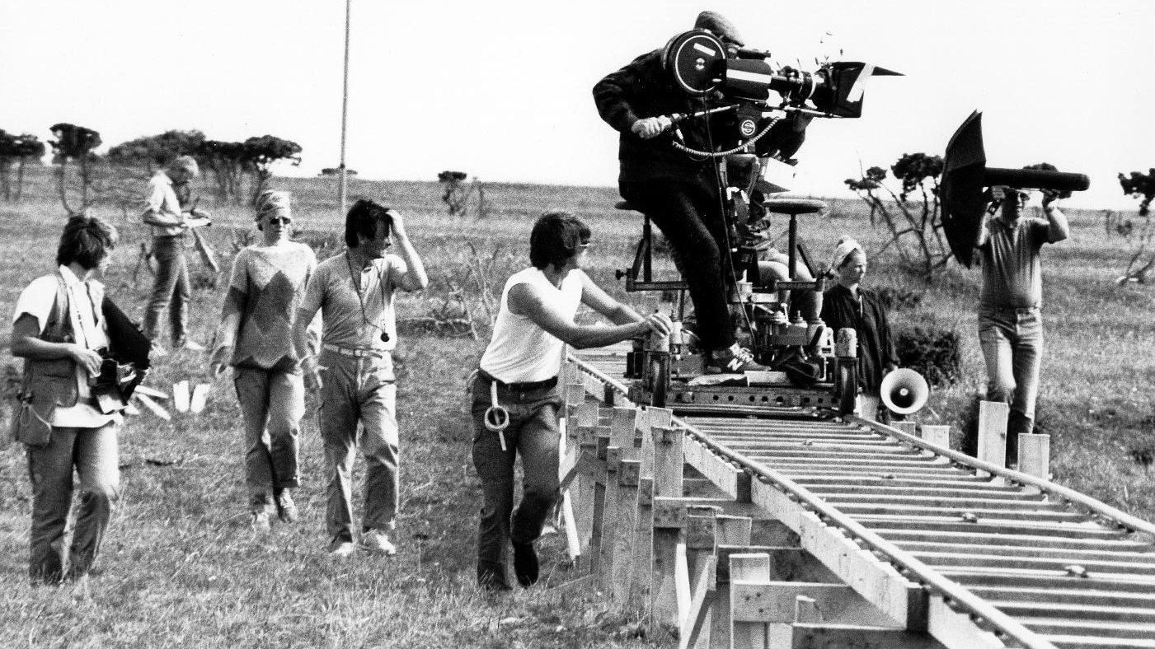
Tracking Shot
In a tracking shot, the entire camera moves.
This refers to following the subject; forward, backward, side to side.

Slide 7
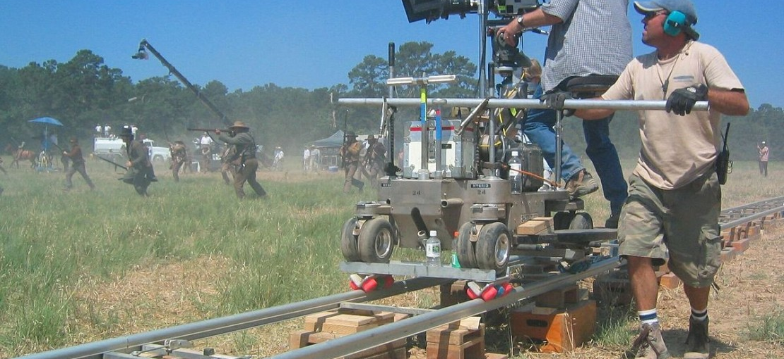
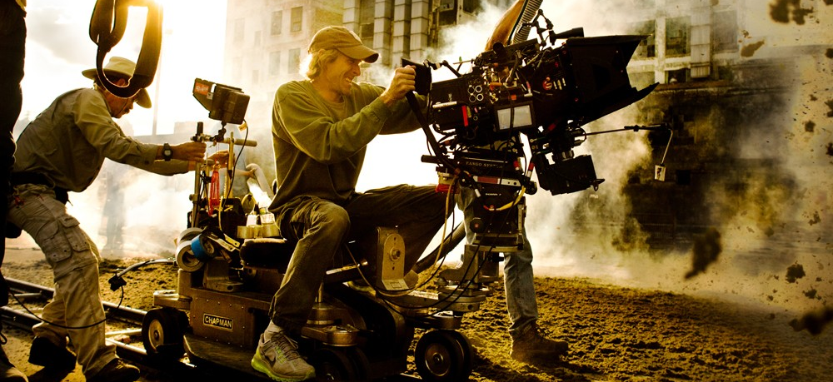
Dolly Shots
Grip
A dolly shot is a specific kind of tracking shot where we follow a subject on an apparatus called a dolly.
You can dolly in and dolly out, which is different than zooming in and out on a subject.

Slide 8
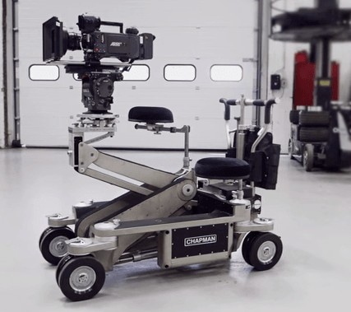
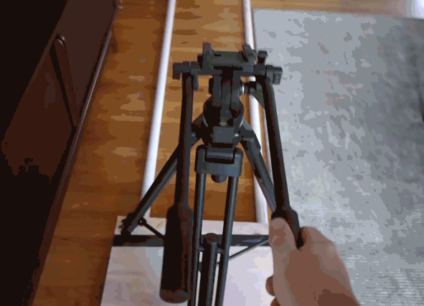
Dolly (Equipment)
Many forms of dolly equipment. Dolly just means to have a smooth movement.

Slide 9
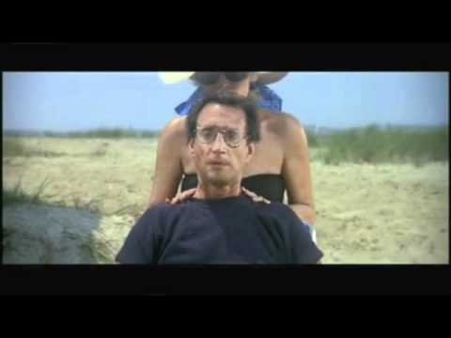
DOLLY ZOOM
Also known as the Vertigo shot (based off the movie Vertigo)
Camera is dollied either forward or backward while the zoom on the lens is pulled in the opposite direction
The effect has the characters in the frame remain the same size while the foreground and background become compressed or de-compressed

Slide 10
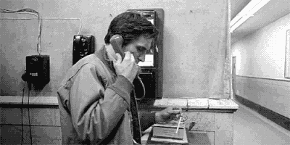
Truck Shot
Trucking is the same as dollying, only you are moving the camera from left to right instead of in and out. Another type of tracking shot.

Slide 11
Truck (movement parallel to action)

Slide 12
Pan Shot
A Pan shot moves horizontally from a still camera, like standing still and turning your head from side to side.

Slide 14
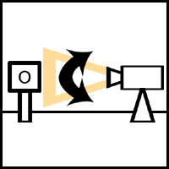
Tilt Shot
The camera moves vertically.
Tilts are used to move between low and high angles.

Slide 16
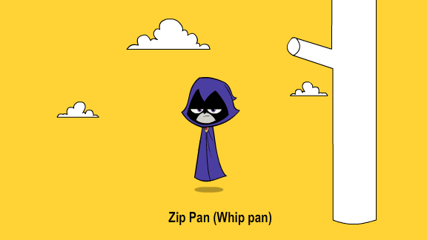
Zip Pan
This is the quick movement of the pan left and right without seeing what is in between your two object.

Slide 17
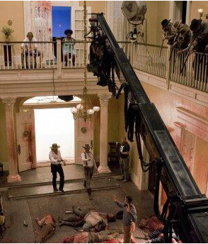
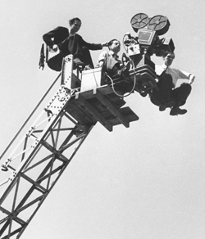
Crane Shots
The camera is mounted on a crane, or mechanical arm that can lift it above the ground.
Can be used for Bird’s Eye angle
Crane shots may not be very high but have great flexibility for shots.
They can be used dramatically to simulate flying or swooping through a scene.

Slide 18
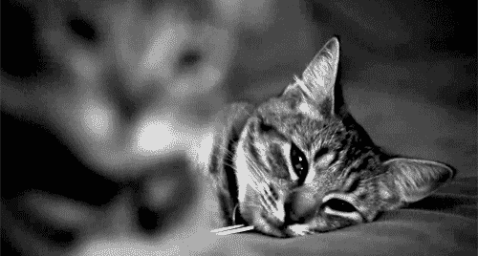
Rack Focus
Is the practice of changing the focus of the lens during a shot.
The term can refer to small or large changes of focus.

Slide 19
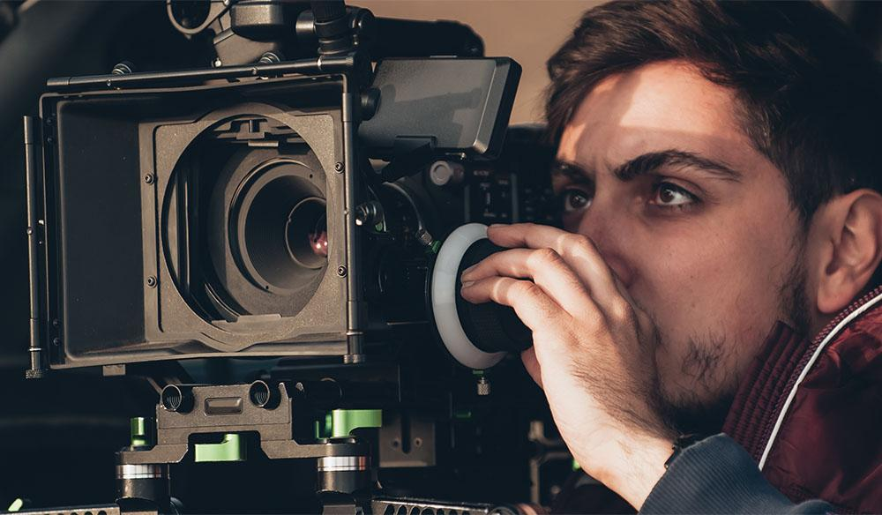
On movie sets, cameras have a specific dial to use for rack focus

Slide 20
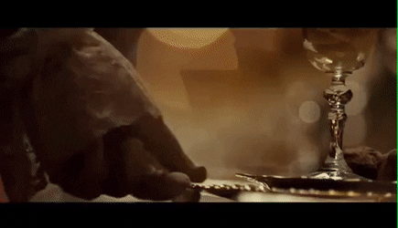

Slide 21
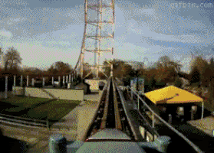
Repetitive fast movement should be avoided
The standard shot rule is stationary - motion - stationary.
Having rapid movement and repeated zooms can make your audience feel sick.
If you edit or cut away in the middle of movement, you may make your view disoriented.

Slide 22
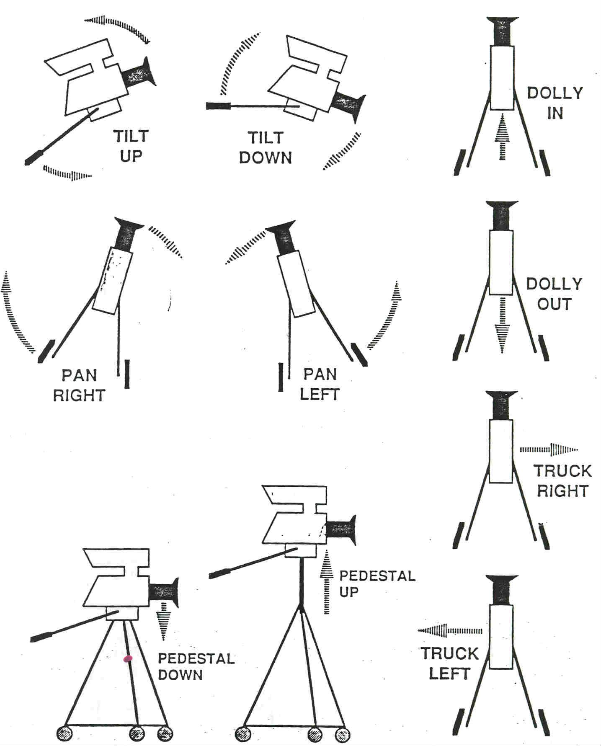
To Review:

Slide 23
Your activity for today
Download the Analyze Camera Movements worksheet.
Choose a video to watch (see instructions on worksheet). Must be school appropriate!
You will look for 5 camera movements and analyze the impact of that movement on the scene and story.

