Slide 1
A Roll vs B Roll
Objective: 2.02
Demonstrate knowledge of basic principles and best practices employed in the digital video industry

Slide 2
What is A-roll?
A-roll is interview footage.
It’s the video or audio that tells the story, and that acts as the backbone of your videos.
In other words, it’s the main narrative driver.

Slide 3
When to use A-roll
A-roll can/should be used:
To establish who a speaker is. This gives viewers the opportunity to attach a voice to a face.
To serve as a segway between location changes. This can help prevent confusion caused from directly jumping from one place to another.

Slide 5
What is B-roll?
B-roll is the footage that supplements and supports the A-roll.
It is the video that you use to visually illustrate your story and to demonstrate what your interview subject is talking about.

Slide 6
When to use B-roll
B-roll can/should be used:
To break up long segments of A-roll.
To cover up jump cuts or edit points.
To visually show the story that’s being told.
To serve as a transition between different interview subjects. This helps the footage breathe a bit.

Slide 9
B-roll Challenge Assignment

Slide 10
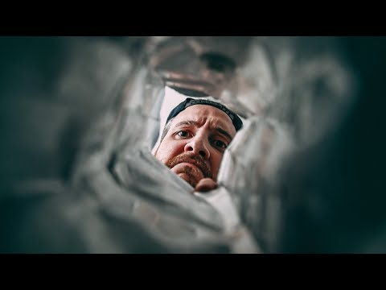

Slide 11
Additional items to get:
Static Shot
Handheld Shot
Dolly shot (push in or pull out)
Tracking shot
Trucking shot
Zoom shot
Pan
Tilt

