Slide 1
Movie Genres
Objective: 2.01
Understand key terminology related to digital video.

Slide 2
Genre is…
the “term for any category of literature or other forms of art or entertainment”
For filmmakers, it is usually the simplest, most practical way to categorize different styles of stories and content.

Slide 3
What elements make up our favorite genres?

Slide 4
Action
High energy, stunts and chases, adventurous, 'good-guy' heroes or heroines battling 'bad guys' - all designed for pure audience escapism.

Slide 5
Action Film
One of the earliest film genres in existence and one of the most popular with cinema audiences.
You can have sub-genres that would include:
War and Military action
Spy and espionage action
Martial arts action
Western Shoot ‘Em up action

Slide 6
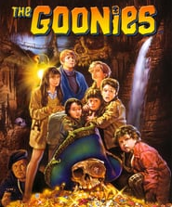
Adventure
exciting stories, with new experiences or exotic locales, very similar to or often paired with the action film genre.

Slide 7
Comedy
Light-hearted plots designed to amuse and provoke laughter

Slide 8
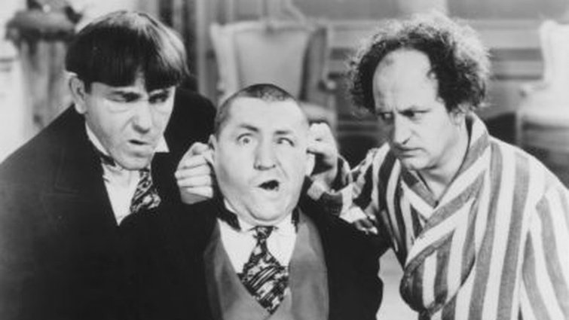
Comedies
The comedy genre has been one of the most flexible genres, as its roots have made their way into the very fabric of cinema and many other genres contained within.
Some sub-genres include:
Slapstick comedy
Screwball comedy
Parody comedy

Slide 9
Drama
Serious, portraying realistic stories involving intense character development and interaction.

Slide 10
Film Noir
A style or genre of cinematographic film marked by a mood of pessimism, fatalism, and menace. The term was applied to American thriller or detective films made in the period 1944-54.

Slide 11
Horror
Designed to frighten and to invoke our hidden worst fears.
It can be crossed with other genres like sci-fi

Slide 12
Musical
A musical or dance performance integrated as part of the film narrative, or they are films that are centered on combinations of music, dance, song or choreography.

Slide 13
Science Fiction: (Sci-fi): semi-scientific, visionary and imaginative

Slide 14
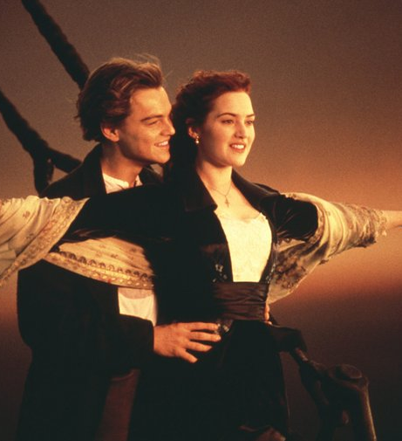
Romance
Romantic films often explore the essential themes of love at first sight, unrequited romantic love, forbidden love/romance and tragic love.
Some of the main sub-genres include:
Historical Romance
Romantic Drama
Romantic Comedy
Chick Flick
Paranormal Romance

Slide 15
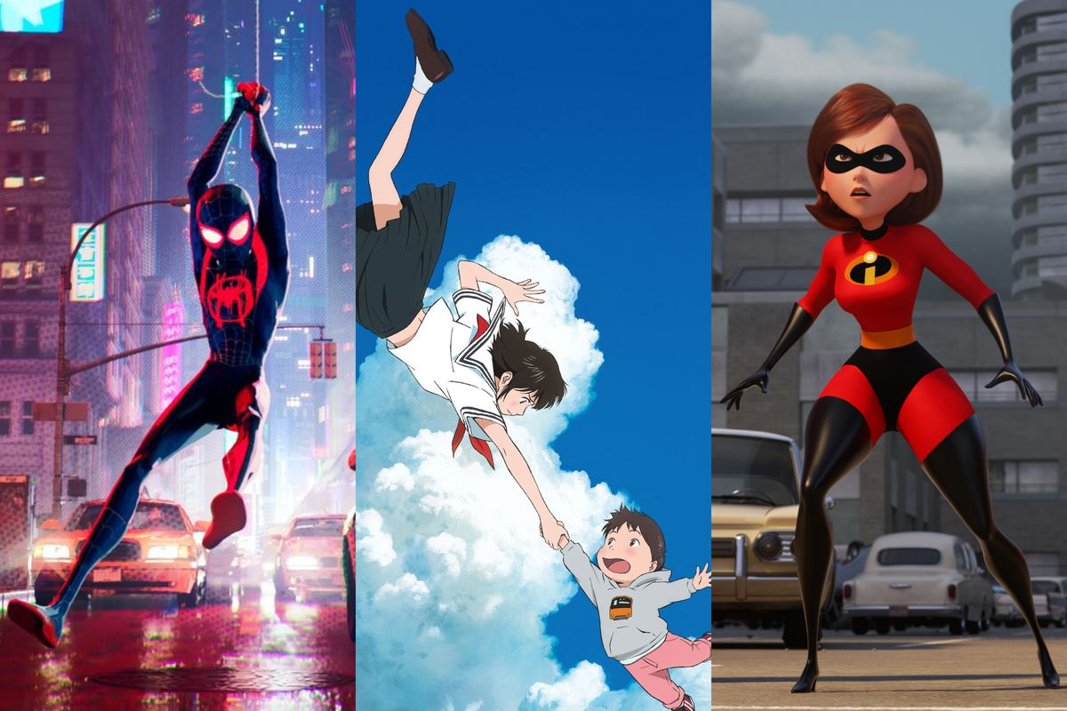
Animation
Creating the illusion of movement through the rapid display of still images.

Slide 16
News & Documentary
a nonfictional motion picture intended to document some aspect of reality
primarily for the purposes of instruction, education, or maintaining a historical record.

Slide 17
Commericals
PSA:
COMMERCIAL:
A message to promote an ideal or raise awareness of a particular issue.
An advertisement intended to sell a product.

