Slide 1
Graphic Design Layouts
Objective 1.02

Slide 2
Business Card
Contains contact information
Used to remember you or your business
Typically includes
The contact’s name
Company
Logo
Address
Telephone, cell & fax numbers
Email address
Website

Slide 3
Letterhead
Company stationery containing a printed heading
Usually includes
The name and logo of the company
Address
Phone and fax numbers
Email address & website

Slide 4
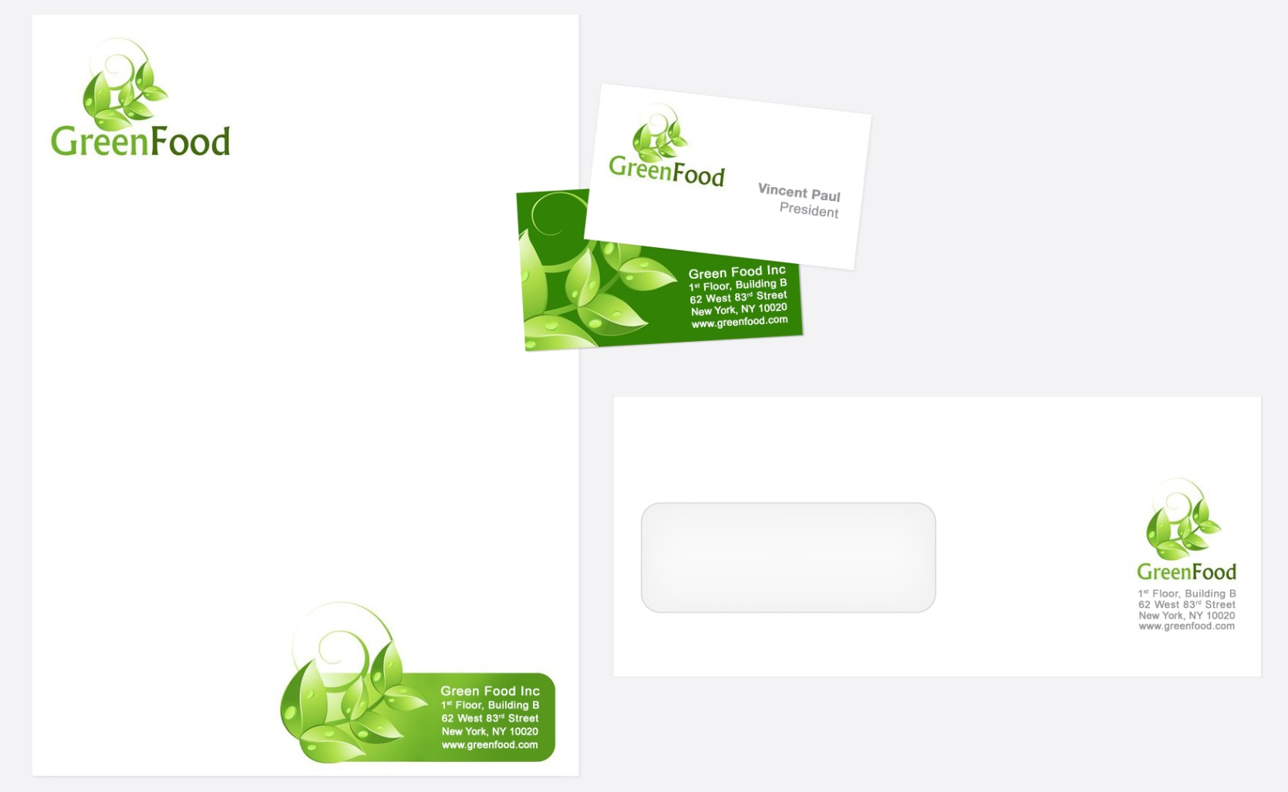
Remember Consistency?
The color scheme and graphics of the business card and letterhead should match

Slide 5
Flyer
One-page document
Used to inform or advertise a one-time event

Slide 6
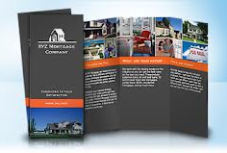
Brochure
Used to advertise or provide information more long-term than a flyer
Printed on higher grade paper
May be printed front and back, bi-fold or tri-fold

Slide 7
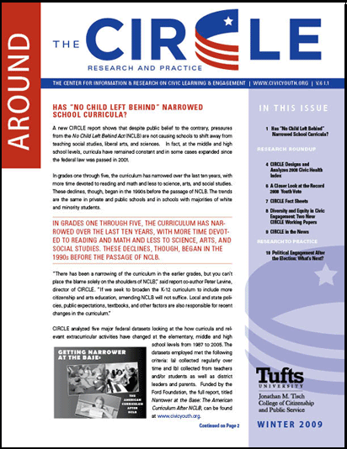
Newsletter
Distributed weekly, monthly, or quarterly
Formatted in columns with side headings, graphics, and text boxes
Keeps organization, club, agency, or business members updated on news and current events

Slide 8
Advertisement
A notice or announcement in a public medium promoting a product, service, or event
Notes:
Note to teacher: Have students take a moment to find an Advertisement example in a magazine or on the web.

Slide 9
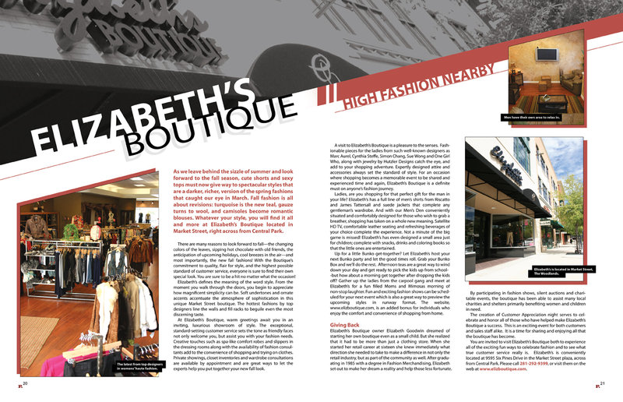
Magazine Layouts
The arrangement of graphics and copy in a magazine

Slide 10
Infographics
Graphical representation of data or information intended to present complex information quickly and clearly
Notes:
For more examples of infographics, visit dailyinfographic.com.

Slide 11
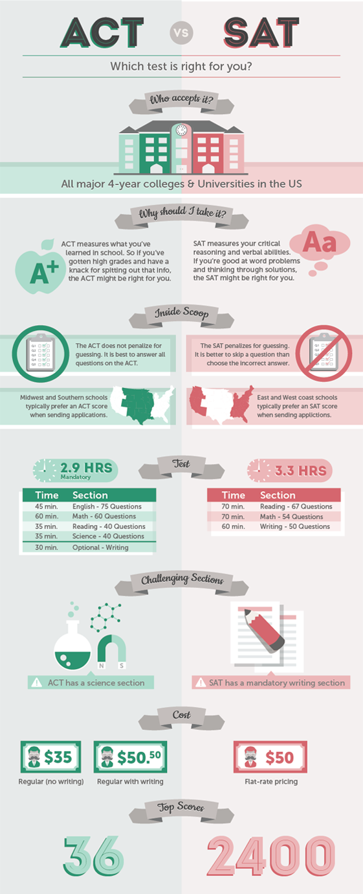
Notes:
Infographic comparing the ACT vs. SAT

